Slide 1
PowerTank
Power Solution on Earth

Slide 2
Team: BU_Precursors
Barisal, Bangladesh

Slide 3
From the head
Ripon Chandra das
Mehedi Hasan
Shakil Islam
Imran Talukder
Sohel Mahamud
Sumaiya Jahan Shammi
Ripon Chandra das
Mehedi Hasan
Shakil Islam
Imran Talukder
Yeasir Arafat Rakib
Sumaiya Jahan Shammi
Sagor Saha

Slide 4
Rotation of Turbine
Due to force of falling water rotate the turbine and produce charge that stored in Battery.

Slide 5
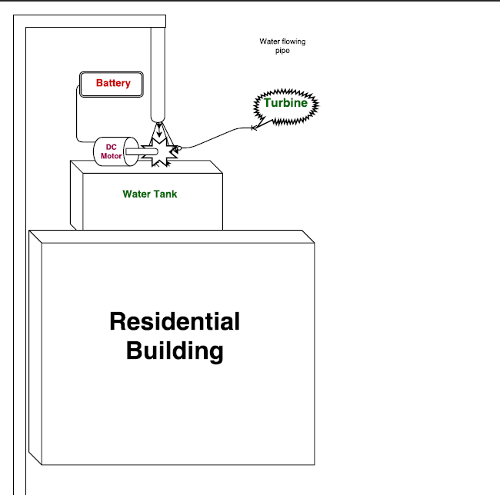

Slide 6
Thank you
For Patient watching

