Slide 1
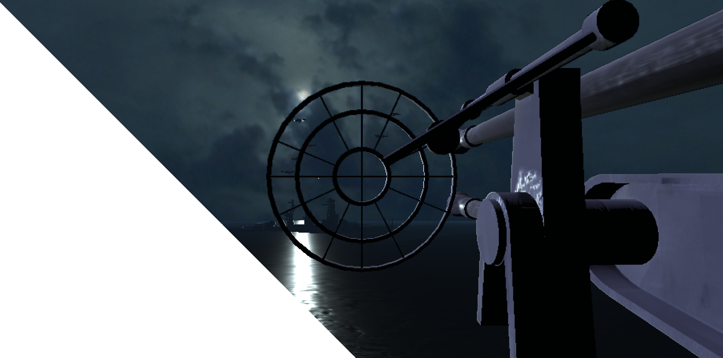
AirCraft
By Ronn Quijada and Sean Stevens

Slide 2
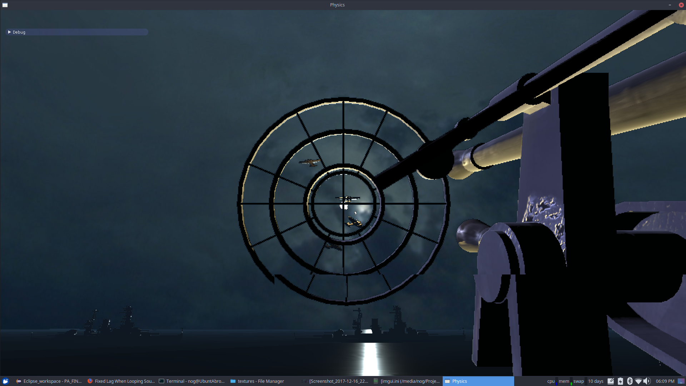
Premise
You are an anti-air gunner protecting your fleet from incoming bombers
Is an arcade style infinite level game where the player must fight through each wave
Each wave gets harder, with tougher and faster planes
Taking too long to shoot down planes will result in a plane escaping
The plane will bomb your ship, and it’s game over.

Slide 3
Features
Skybox
Sound Engine
(basic) Animation Engine
“Pathfinding and AI”
Physics Raycasting
Ocean Waves
(proper) Normal Mapping
Physically Based Rendering
Conservation of Energy, Stronger reflections at grazing angles (Fresnel)
Includes texture defined roughness/metallic-dielectric materials
Follows metalness workflow implementing Cook-Torrance BRDF

Slide 4
Optimizations
Deferred Rendering
Primitive models used to “mask” which pixels are affected by each light
Greatly reduces amount of fragments processed for each light
MipMapping
Instanced Models/Textures
Independent resolution scaling
World can be rendered at a different resolution from the skybox/GUI

Slide 5
Demo

Slide 6
Questions?
By Ronn Quijada and Sean Stevens
Email: ripostory@gmail.com
Steam: The Planiprism

