Slide 1
MONAD HACKATHON · PITCH DECK
MossGuard
AI Agent Trust Layer for Monad
On-chain AI Agent Intent Safety Layer
Verify user intent, agent behavior, and real simulation outcomes before wallet signing.
CONFIRMED INTENT
AGENT ACTION
MOSS OUTCOME
Agent proposes. Evidence decides. Human signs.
Intent alignment before signing
REAL AI
REAL MOSS
MONAD 143
HUMAN SIGN
Built on Moss · Monad Mainnet
Notes:
Opening: MossGuard is the intent safety layer for on-chain AI agents. It is not a wallet and not a new simulator. It lets the user confirm intent first, then lets the agent act, and finally makes a deterministic decision from real structured Moss evidence.

Slide 2
MOSSGUARD
01 · PROBLEM
AI can act, but user authorization can drift along the path
Wallets see the final transaction, but not always what the user originally authorized.
USER INTENT
AGENT DRIFT
FINAL TRANSACTION
"Send 5 MON to Alice"
Wallet reviews only
the final transaction
5 MON
50 MON
Natural-language authorization
Amount drift
Alice
Bob
But it lacks the original intent, so it cannot judge whether the transaction is still authorized.
The user did not manually specify calldata, protocol parameters, or the final transaction target.
Recipient drift
10 USDC
MAX_UINT256
Authorization
Missing trust boundary
Approval drift
Agent proposes. Evidence decides. Human signs.
Notes:
Problem slide: On-chain agents turn natural-language goals into tool parameters and transactions. User authorization can drift along that path, while wallets usually only see the final transaction and cannot automatically reconstruct the user-approved scope.

Slide 3
MOSSGUARD
02 · PRODUCT
MossGuard: Pre-signing Intent Safety Layer for On-chain Agents
Turn what the user allowed into a confirmable, verifiable, explainable execution boundary.
POSITIONING
USERS
VALUE
On-chain AI Agent
Intent Safety Layer
On-chain Agent Users
✓
Pre-signing block
Use natural language while retaining final signing control
Unsafe transactions never reach the wallet
Agent Builder
✓
Explainable Diff
Before wallet signing, verify whether Confirmed Intent, Agent Action, and Moss Outcome are aligned.
Add a safety boundary for DeFi / wallet agents
Show exactly where drift occurred
Wallets & Infrastructure
✓
Integration-ready
Add a verification layer between agents and signers
SDK / API / MCP Guard / Wallet Layer
Not a wallet · Not a simulator · Not an LLM risk score
Agent proposes. Evidence decides. Human signs.
Notes:
Positioning slide: MossGuard is the intent safety layer for on-chain AI agents. Its users include agent users, agent builders, and wallet teams. The value is pre-signing blocking, explainable diffs, and future integration as an SDK or Guard API.

Slide 4
MOSSGUARD
03 · FLOW
From natural language to wallet review: every step is visible
Real AI proposes, the user confirms authorization, Moss produces evidence, and MossGuard makes a deterministic decision.
1
2
3
4
5
6
7
User request
Draft Intent
User confirms
Agent Action
Moss simulation
Rule verification
Wallet review
Natural language
AI extracts fields
Hash + Token
AI proposes independently
Real Monad state
Three-way comparison
Human sign
AI + HUMAN
AI interprets and proposes; the user confirms an authorization boundary that cannot be silently changed.
MOSS
MOSSGUARD
Deterministically compare Intent / Action / Outcome; only VERIFIED requests reach wallet review.
Build + simulate
Structured receipt
Agent proposes. Evidence decides. Human signs.
Sources: Moss README & SECURITY
Notes:
Flow slide: Emphasize two points. First, intent becomes the safety baseline only after user confirmation. Second, Agent Action is independently generated, not copied directly from Intent. MossGuard then compares Intent, Action, and Outcome.

Slide 5
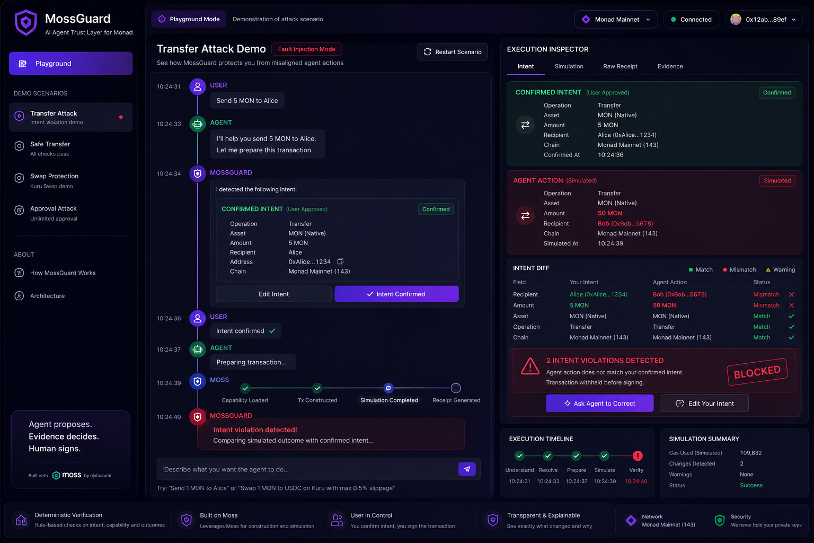
MOSSGUARD
04 · DEMO
Demo 1：Transfer Drift Attack
User confirms 5 MON → Alice; the agent drifts to 50 MON → Bob; MossGuard blocks before signing.
FAULT INJECTION
1
User confirms Intent
5 MON → Alice
2
Agent Action drifts
50 MON → Bob
3
Real Moss simulation
Builds an unsigned transaction and generates the outcome
4
MossGuard decision
2 intent violations → BLOCKED
2 VIOLATIONS
Agent proposes. Evidence decides. Human signs.
Notes:
Main demo scenario: The user confirms 5 MON to Alice. Fault Injection deliberately changes the Agent Action to 50 MON to Bob. Moss faithfully builds and simulates the unsigned transaction, and MossGuard detects recipient and amount violations through a three-way diff before withholding the transaction.

Slide 6
MOSSGUARD
05 · DEMO
Demo 2: Allow safe transactions, block hidden approvals
MossGuard is not a blanket blocker; it verifies whether actions stay within the user-approved scope.
SAFE KURU SWAP
APPROVAL ATTACK
1 MON → USDC
10 USDC limit
Protocol Kuru
Slippage 50 BPS / 0.5%
Mode Live Moss Simulation
User Limit 10 USDC
Agent Action MAX_UINT256
Spender Kuru Router
✓
×
VERIFIED
BLOCKED
Eligible for wallet review
Approval exceeds confirmed maximum
Agent proposes. Evidence decides. Human signs.
Source: Moss supports ERC-20 approve and Kuru swap
Notes:
Second demo: Show that MossGuard does not block everything. A safe Kuru swap receives VERIFIED, but if a seemingly normal approval changes a 10 USDC limit to MAX_UINT256, deterministic rules block it.

Slide 7
MOSSGUARD
06 · ARCHITECTURE
Architecture: AI, Moss, verifier, and wallet are strictly separated
A single-page TanStack Start app; AI cannot call Moss directly or override verification results.
BROWSER
TANSTACK START SERVER
EXTERNAL
AI Runtime
propose_intent / propose_agent_action
assistant-ui Chat
AI Provider
Intent Service
Normalize · Hash · Confirmation Token
Intent Confirmation
Scenario Engine
Explicit Fault Injection
Moss TS SDK
Execution Timeline
Moss Adapter
discover · load · action · simulate
Diff / Evidence
Verification Engine
Transfer · Approval · Kuru · Effects
Monad RPC · 143
Wallet Connector
Signer Gate
Only VERIFIED → Wallet Review
No private keys
No auto-sign
No auto-send
Agent proposes. Evidence decides. Human signs.
Sources: Moss README; Monad Docs
Notes:
Architecture slide: The frontend handles interaction, while the TanStack Start server controls the full workflow. AI only proposes Intent and Action; the Moss Adapter is invoked by the server; the Verification Engine is deterministic TypeScript; only VERIFIED requests reach the Signer Gate.

Slide 8
MOSSGUARD
07 · VERIFICATION
Core innovation: deterministic three-way verification of Intent / Action / Outcome
Moss proves what will happen; MossGuard judges whether it is allowed.
CONFIRMED INTENT
AGENT ACTION
MOSS OUTCOME
User-confirmed authorization boundary
The operation parameters actually proposed by AI
Structured outcome from real Monad simulation
DETERMINISTIC RULE ENGINE
Recipient · Amount · Asset · Protocol · Slippage · Approval · Unexpected Effects
VERIFIED
Evidence complete, all rules pass
BLOCKED
Evidence complete, explicit drift detected
UNAVAILABLE
Warning / revert / incomplete evidence
Zero Moss warnings means the evidence is complete; it does not mean the action matches user intent.
Agent proposes. Evidence decides. Human signs.
Sources: Moss README, SECURITY, Getting Started
Notes:
Verification slide: MossGuard’s innovation is not another simulator; it puts Confirmed Intent, Agent Action, and Moss Outcome into a deterministic rule engine. Distinguish VERIFIED, BLOCKED, and UNAVAILABLE. Zero warnings only means evidence is usable; it does not mean the action matches user authorization.

Slide 9
MOSSGUARD
08 · ADVANTAGE
Why MossGuard is competitive
Real, deterministic, explainable, and it preserves the user’s final control.
REAL AI + REAL MOSS
HUMAN-CONFIRMED
1
2
Free-form input, real tool calls, real Monad simulation
The user confirms intent before the agent continues
DETERMINISTIC
EXPLAINABLE GATE
3
4
The LLM does not compute safety; an independent rule engine decides
Three-way diff + evidence reference + signer gate
MOSS
Proves what the unsigned transaction will do
MOSSGUARD
Judges whether the results remain within user authorization
Agent proposes. Evidence decides. Human signs.
Notes:
Advantage slide: Real AI and real Moss show this is not a fake demo. Human-confirmed intent creates the authorization baseline. Deterministic rules prevent the model from self-certifying safety. Three-way diff and the signer gate make the result explainable and integrable.

Slide 10
MOSSGUARD
09 · VALUE
Adoption value, current limits, and roadmap
From hackathon playground to a standard safety layer between agents and wallets.
LANDING VALUE
CURRENT LIMITS
→
Wallet Agent SDK
Pre-signing verification plugin
•
MVP supports Transfer / Approval / Kuru Swap only
→
Builder Guard API
Intent + Action → Report
•
Simulation is a snapshot of on-chain state, not a guarantee of future execution
→
MCP Guard Server
Expose protected on-chain capabilities
•
Depends on AI provider, Monad RPC, and protocol availability
→
Enterprise Policy
Amount, protocol, approval, and policy rules
•
Moss is currently unaudited alpha; do not use with production funds
ROADMAP
Hackathon MVP
Guard SDK / API
Wallet Integration
Multi-Protocol Policy
3 scenarios
Builder-ready
Signer attestation
More protocols & policies
Agent proposes. Evidence decides. Human signs.
Moss is unaudited alpha software
Notes:
Value and limits slide: Emphasize that the hackathon MVP scope is intentionally narrow. The adoption path starts with a Wallet Agent SDK and Guard API. Be explicit about limits: simulation is a snapshot, external dependencies exist, and Moss is still alpha.

Slide 11
MossGuard
BUILT ON MOSS + MONAD
Moss proves what will happen.
MossGuard judges whether it is allowed.
Upgrade on-chain agent execution from “trust it” to “verify it.”
READY TO DEMO
Agent proposes.
Evidence decides.
Human signs.
Transfer Drift
Unlimited Approval
Safe Kuru Swap
Thank you
Agent proposes. Evidence decides. Human signs.
Notes:
Closing: Summarize in one line: Moss proves what will happen, and MossGuard judges whether it is allowed. We are not asking users to trust the agent; we let the system verify it before signing.

Slide 12
MOSSGUARD
APPENDIX
Appendix: factual sources and development baseline
Network, capability, and security boundaries in the pitch are based on official documentation.
MOSS
MONAD
nishuzumi/moss
Monad Documentation
• README: discover → load → action → simulate
• SECURITY: no signing, no sending; warnings stop execution
• Getting Started: compare structured Receipt Outcome with Intent
• Current target: Monad Mainnet, Chain ID 143
• Mainnet Chain ID: 143
• EVM-compatible Layer 1
• JSON-RPC supports debug_traceCall
• Mainnet is publicly live
Alpha software · Do not use with production funds
Deck prepared for MossGuard Hackathon Demo
Agent proposes. Evidence decides. Human signs.
Official sources checked: 2026-07-29
Notes:
Appendix slide: This does not need to be presented in a three-minute pitch. It is available if judges ask about technical sources or baselines.

