Slide 1



01
Vulneraptor
A Lightweight Web Vulnerability Scanner
Team Members:
Under the supervision of:
Khaled Ahmed
Abdelrahman Ahmed
Salma Mahmoud
Sama Mostafa
Eng.Zeinab Mouhamed

Slide 2




02
The Problem
Web applications can contain multiple security weaknesses that are difficult and time-consuming to identify manually.
🔍 Manual reconnaissance is time-consuming
🧩 Security checks are often performed
using multiple tools
⚠️ Common vulnerabilities and misconfigurations
can be overlooked
→ VulCheck aims to simplify and automate the initial security assessment.

Slide 3



03
Project Objectives
⚙️
Discover open ports,
services, and web endpoints.
Identify common
web security issues such
as XSS and SQL Injection.
Check security headers,
cookies, and exposed information.
Collect findings from different
checks in one tool.
Keep the system easy to extend
with new security modules.

Slide 4
04
TARGET INPUT
IP / Domain / URL
│
▼
RECON MODULE
│
▼
WEB TARGETS FOUND?
/ \
YES NO
│ │
▼ ▼
XSS SCANNER Web Checks
│ Skipped
▼
SQL INJECTION
SCANNER
│
▼
SECURITY CONFIGURATION
│
┌─────────┼──────────┐
│ │ │
Headers HTTPS/Cookies Exposed
Services
└─────────┼──────────┘
▼
RESULTS AGGREGATOR
│
▼
FINAL REPORT
System
Architecture

Slide 5

05
Reconnaissance Module
Target
IP / Domain
↓
Nmap Port Scan
Open Ports
↓
Service Detection
Services + Versions
↓
HTTP Recon
Headers + Server Info
↓
Endpoint Crawling
Discovered URLs
↓
OS Clues
Discovered URLs
↓
Recon Results
OS Clues

Slide 6




06
Vulnerability Detection
🌐 Web Vulnerabilities
Security Configuration
Security Headers
XSS Detection
Tests user-controlled inputs
Identifies potential script injection points
Checks important HTTP
security headers
Identifies missing
protections
Recon Data
↓
Input / Response Analysis
↓
Vulnerability Checks
↓
Findings + Severity
Database Security
SQL Injection Detection
Session Security
Cookie Analysis
Tests parameters for SQL
injection indicators
Analyzes application
responses
Reviews cookie security attributes
Detects missing security flags

Slide 7
07
Security Configuration & HTTP Analysis
🌐 HTTP Reconnaissance
🛡️ Security Headers
Cookie Security
HTTP Status Code
Server Information
X-Powered-By
Content-Type
HTTP Headers
Content-Security-Policy
X-Frame-Options
X-Content-Type-Options
Strict-Transport-Security
Secure
HttpOnly
SameSite
HTTP Response
↓
Headers + Cookies
↓
Security Analysis
↓
Missing / Weak Configuration
↓
Finding + Severity

Slide 8
08
Scan Workflow
1. Target Validation
2. Reconnaissance
3. Web Analysis
The user provides an IP address or domain, and VulCheck validates the target before starting the assessment.
Nmap is used to
discover open ports,
running services,
and available service
information.
Detected web services are analyzed through HTTP reconnaissance and endpoint crawling to understand the application's structure.
4. Security Checks
5. Findings Analysis
6. Results
The collected information
is passed to security
modules
that test for selected
vulnerabilities and
security
misconfigurations.
The scanner organizes detected issues and evaluates their
potential security
impact and severity.
All scan information
and findings are collected
into structured results
that can be used for
further analysis and
.reporting.

Slide 9
09
Findings & Severity
🔴 High Severity
🟠 Medium Severity
Security weaknesses that could increase the application's attack surface or facilitate attacks.
Examples:
Missing security headers
Weak cookie configuration
Potential XSS
Critical security issues that may allow significant unauthorized access or data exposure.
Examples:
SQL Injection
Severe authentication/security weaknesses
🟢 Low Severity
Informational or lower-impact issues that should still be reviewed.
Examples:
Information disclosure
Technology/version exposure
Minor configuration issues

Slide 10
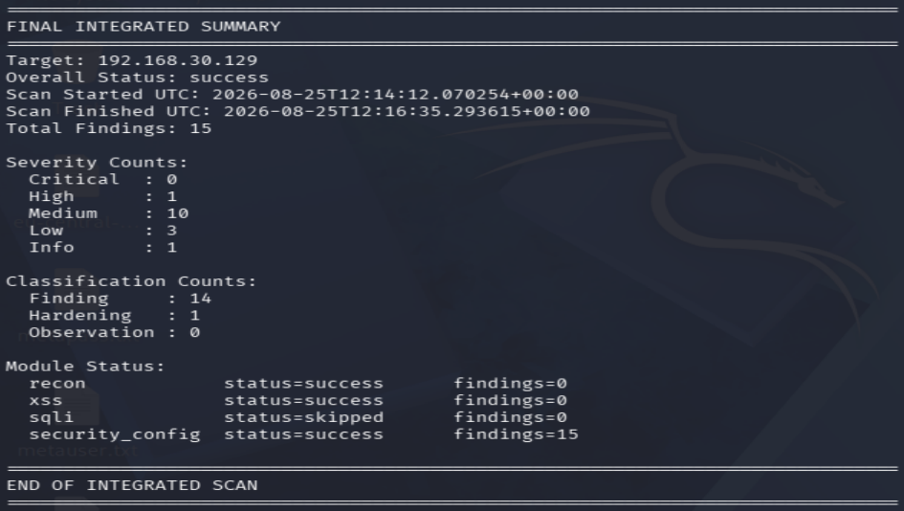

10
Live Demo
Target Assessment
1.Reconnaissance
Open ports identified
Running services detected
Service banners collected
2.Web Analysis
HTTP service detected
Server information collected
Web endpoints discovered
3.Security Analysis
Vulnerability checks performed
Configuration issues analyzed
Findings categorized by severity
VulCheck transforms raw scan data into structured security findings.

Slide 11

11
Technologies & Tools Used
Python
🔎 Nmap
🌐 Requests
Core Development Language
Used to implement the scanning logic, modules, and security checks
HTTP Analysis
Used to send HTTP requests and analyze web responses
Network & Service Discovery
Used for port scanning, service detection, and reconnaissance.
🕷️ HTML Parsing
📦 Modular Architecture
🐙 Git & GitHub
Endpoint Discovery
Used to parse web pages and identify available links/endpoints.
Extensible Design
Security functionality is separated into independent modules.
Version Control & Collaboration
Used to manage the source code and collaborate on the project.

Slide 12
12
Conclusion & Future Improvements
🚀 Future Improvements
✅ What We Achieved
More Vulnerability Checks
Expand coverage to additional OWASP vulnerabilities.
Improved Reporting
Generate detailed HTML/PDF reports with severity and recommendations.
Better Detection Accuracy
Reduce false positives through more advanced response analysis.
Authentication Support
Add scanning for authenticated web applications.
Enhanced Automation
Allow multiple targets and scheduled assessments
Automated Reconnaissance
Discover open ports, services, and web endpoints.
Web Security Analysis
Analyze HTTP responses and application information.
Vulnerability Detection
Perform automated checks for selected common vulnerabilities.
Security Configuration Analysis
Identify potential weaknesses in headers, cookies, and configurations.
Modular Architecture
Provide a flexible structure that can be extended with new security modules.
VulCheck provides a lightweight and extensible foundation for automated security assessment.

Slide 13
13
Thank You for Your Attention
Vulneraptor
Lightweight Automated Security Assessment

