Slide 1
AGRO-AMIGOS The Future Of Innovation is NOW……..

Slide 2
Concept
Early detection of plant diseases by using Deep Learning Techniques.
Furthermore we provide cure for each disease.
Even suppliers of pesticides/bio-fertilizers can sell their products on Android App.

Slide 3
Usability & Design:
End Users :
1. Farmers
2. Supplier
Simple & easily accessible user interface
1. Web App
2. Android App

Slide 4
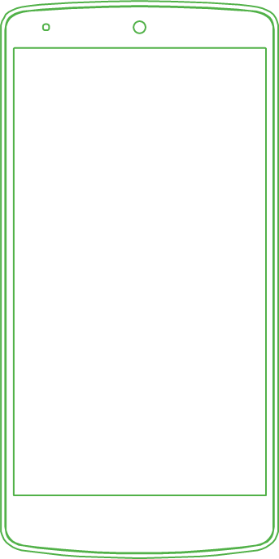
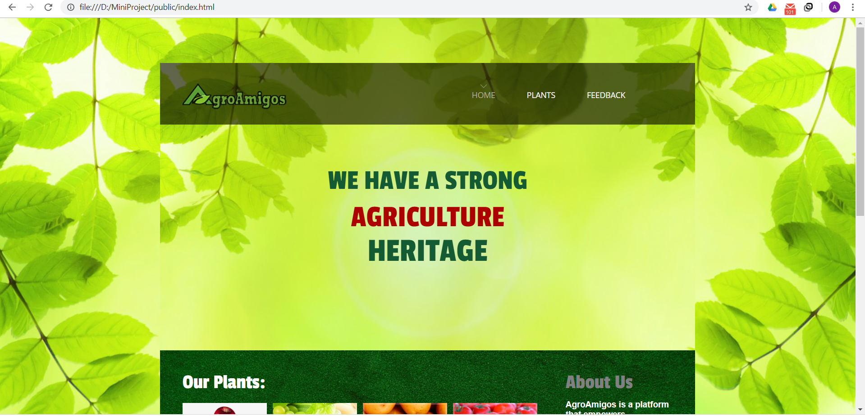
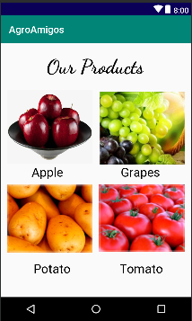
HAVE A LOOK AT OUR USER INTERFACE
Place your screenshot here

Slide 5
Our process is easy
Get result and suggested pesticides/ bio-fertilizers
Click picture of diseased crop leaf
03
01
02
Upload an image on website or app

Slide 6
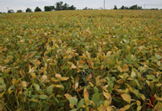
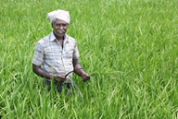
Implementation
User Input
Image Pre-Processing
Image Segmentation
Disease Name and Solution
Classification
Feature Extraction by using Deep Learning

Slide 7
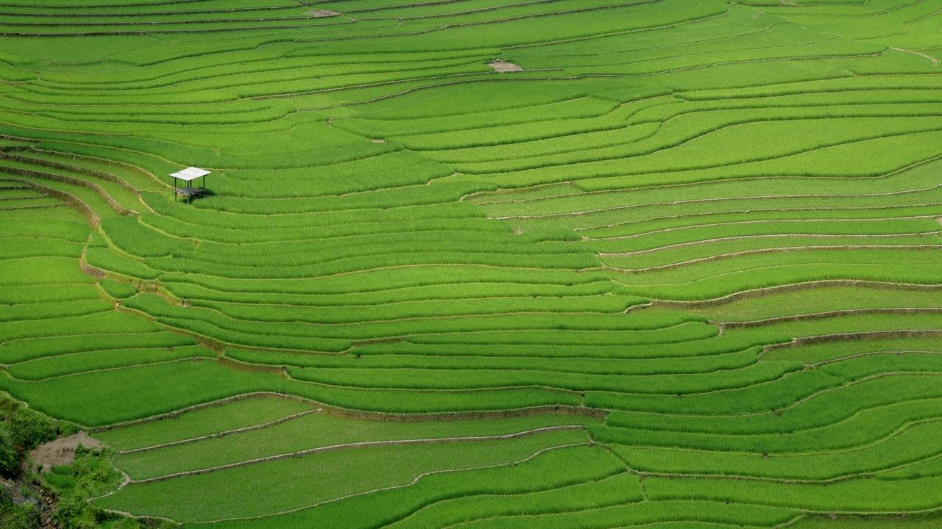
Business Relevance
Commission through fertilizer suppliers.
Revenue generated from play store.
Extra Revenue through Google ads.

Slide 8
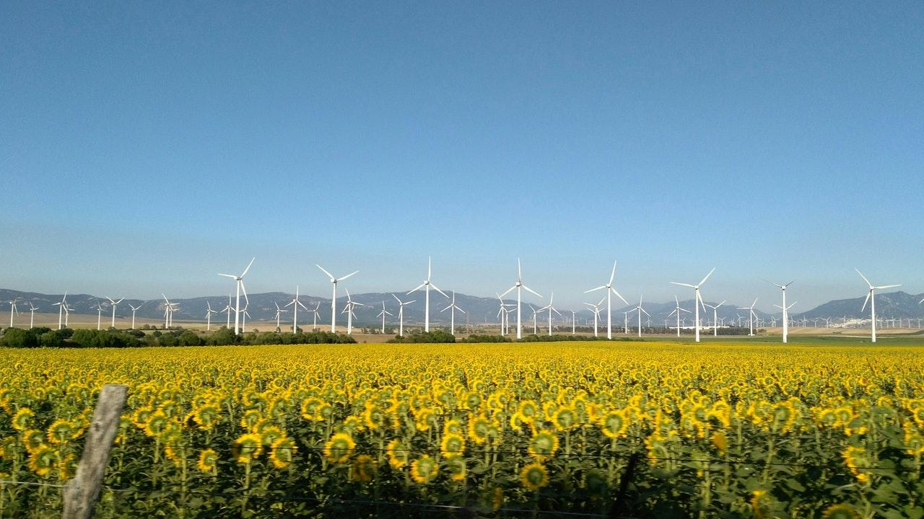
Marketing Strategies
Promotion through Government schemes .
Approach committee of fertilizer suppliers.
Spreading awareness in rural areas through schools.

Slide 9
Thankyou

