Slide 1

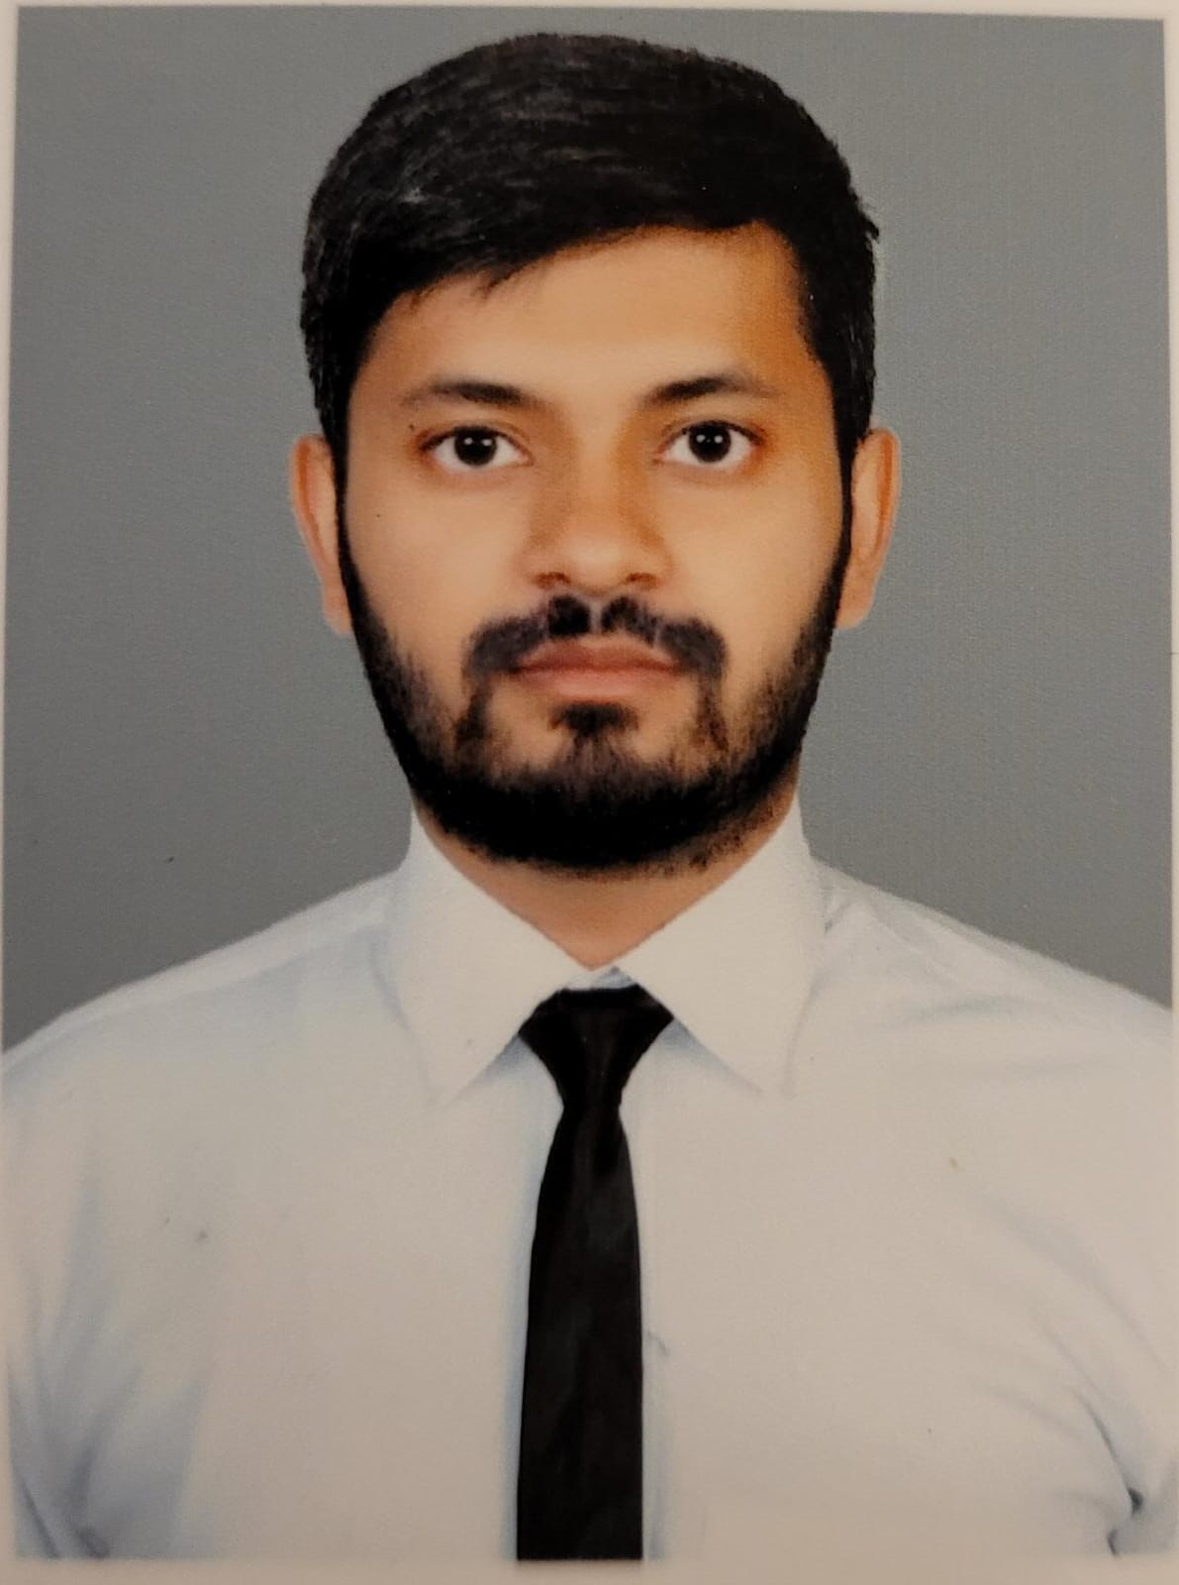
Ripudaman
301221570
Software Engg
-AI Fast Track(3422)
Assignment 1 Express Portfolio Site

Slide 2
About Me
From India
Completed Bachelor of technology in computer science(2019).
Data Analyst – 2 years experience working for clients like “PayPal”, “Bayer”, and “SAP”.
Wanted to upgrade my knowledge and role from an Analyst to a Data Scientist.
Course matched my future goals.

Slide 3
Projects & Interests
Currently working on a Store sale prediction project.
Planning to start an AI Vision project.
I take part in Kaggle competitions as well.
Interested in Data Science and all data-related products.
Love to read about using data to predict growth, stock, and Fintech.

Slide 4
The Future
After completing the course will go for the Data Scientist role in a good organization.
Would like to start my own project/business.

