Slide 1

JSS COLLEGE OF ARTS, COMMERCE & SCIENCE
MULTIPLE DISEASE PREDICTION
SUBMITTED BY:
SUBMITTED TO:
RIPUNJAY RAJ
MEGHA S
Assistant Professor
Department of Computer Science
JSS COLLEGE OF ARTS,COMMERCE AND SCIENCE

Slide 2
introduction
The increasing prevalence of chronic diseases such as heart disease, diabetes, breast cancer, Parkinson's disease, and chronic kidney disease poses a significant challenge to global health systems. According to the World Health Organization (WHO), non-communicable diseases (NCDs) account for approximately 71% of all deaths worldwide, highlighting the urgent need for effective early detection and intervention strategies. Early diagnosis is critical, as it can lead to timely treatment, improved patient outcomes, and reduced healthcare costs. However, traditional diagnostic methods often rely on subjective assessments and can be time consuming, leading to delays in care.
In recent years, advancements in machine learning and artificial intelligence have opened new avenues for enhancing disease prediction and diagnosis. These technologies can analyze vast amounts of health data, identifying patterns and correlations that may not be immediately apparent to healthcare professionals. By leveraging patient demographics, medical history, lifestyle factors, and laboratory results, machine learning algorithms can generate predictive insights that facilitate early intervention.

Slide 3
ABSTRACT
The Multiple Disease Prediction System is designed to assist healthcare professionals and individuals in identifying the risk of five major diseases: heart disease, diabetes, breast cancer, Parkinson's disease, and chronic kidney disease. By utilizing advanced machine learning techniques and a robust backend developed in Python, the system will analyze various health parameters and provide predictive insights. The frontend, developed using Stream lit, will ensure an intuitive user experience, allowing users to input data and receive predictions seamlessly. This project aims to enhance early diagnosis and promote preventive healthcare measures. This health assistant not only empowers users with immediate insights into their health status but also serves as a valuable educational tool, raising awareness about the symptoms and risk factors associated with these diseases. The integration of machine learning into healthcare applications exemplifies the potential for technology to enhance patient outcomes and promote proactive health management.

Slide 4
AIM
The primary aim of the Multiple Disease Prediction System is to develop an advanced, user-friendly platform that leverages machine learning algorithms to accurately predict the risk of five significant chronic diseases: heart disease, diabetes, breast cancer, Parkinson's disease, and chronic kidney disease. By integrating a robust backend developed in Python with an intuitive frontend built using Stream lit, the system seeks to provide healthcare professionals and individuals with a powerful tool for early detection and risk assessment. The project aims to facilitate timely medical interventions by enabling users to input their health data and receive real-time predictions regarding their risk levels for these diseases. Additionally, the system aspires to promote proactive health management by offering personalized insights and recommendations based on the prediction results. Ultimately, the goal is to enhance the quality of healthcare delivery, improve patient outcomes, and contribute to a more informed and health-conscious society, thereby addressing the growing burden of chronic diseases effectively.

Slide 5
EXISTING SYSTEM
Current healthcare systems primarily rely on traditional diagnostic methods and manual assessments for identifying chronic diseases such as heart disease, diabetes, breast cancer, Parkinson's disease, and chronic kidney disease.
DISADVANTAGES:
Limited scope
Subjectivity
Time-consuming
Accessibility issues
Data integration challenges

Slide 6
PROPOSED SYSTEM
The proposed Multiple Disease Prediction System aims to revolutionize chronic disease management by utilizing advanced machine learning algorithms to predict the risk of heart disease, diabetes, breast cancer, Parkinson's disease, and chronic kidney disease.
ADVANTAGES:
Comprehensive Predictions
User Friendly Interface
Data-Driven Insights
Proactive Health Management
Accessibility

Slide 7
SOFTWARE AND HARDWARE REQUIREMENTS
SOFTWARE REQUIREMENTS:
Operating System : Windows, macOS OR Linux
Python : Version 3 or above.
Libraries : Pandas, NumPy, Scikit-learn,
Matplotlib, Stream lit.
IDE : Jupyter Notebook, PyCharm or
any preferred Python.
HARDWARE REQUIREMENTS:
Processor : Intel i5 or equivalent.
RAM : Minimum 8 GB
Storage : Minimum 100 GB free disk
Internet Connection : Required for accessing the
the web application

Slide 8
MODULES
DIABETES PREDICTION: Uses a machine learning model to predict the likelihood of diabetes based on user input parameters such as glucose level, blood pressure, BMI, and age. The model is loaded from a saved file and used for real-time prediction.
HEART DISEASE PREDICTION: Predicts the presence of heart disease using clinical parameters like age, chest pain type, cholesterol level, and exercise-induced angina. The model is pre-trained and loaded for inference.
PARKINSON'S DISEASE PREDICTION:Utilizes voice measurement features to predict parkinson's disease. The model is trained on relevant datasets and integrated into the app for user input-based prediction.
BREAST CANCER PREDICTION:Uses features extracted from breast cancer datasets to classify tumors as malignant or benign. The model is loaded and used to provide predictions based on user inputs.

Slide 9
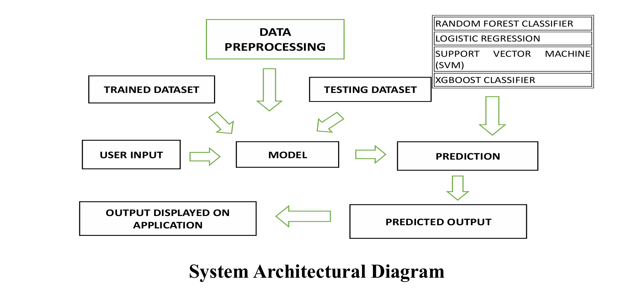
SYSTEM ARCHITECTURAL DIAGRAM

Slide 10
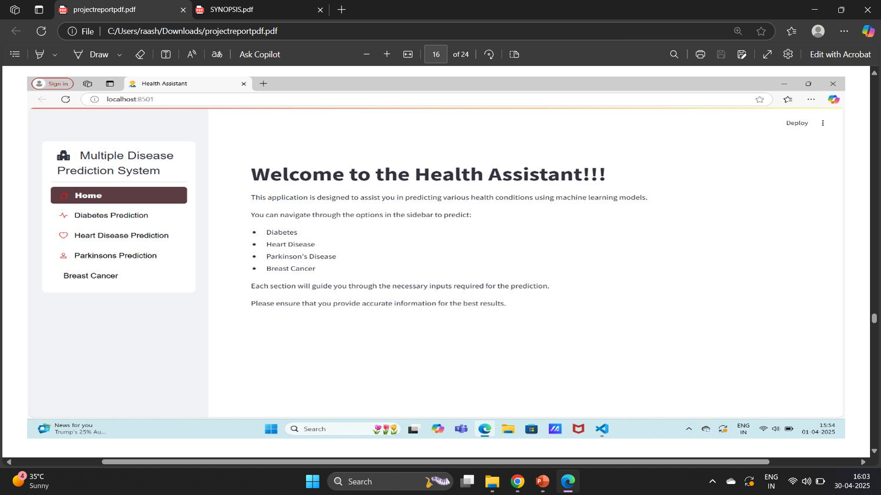
SNAPSHOTS
Homepage

Slide 11
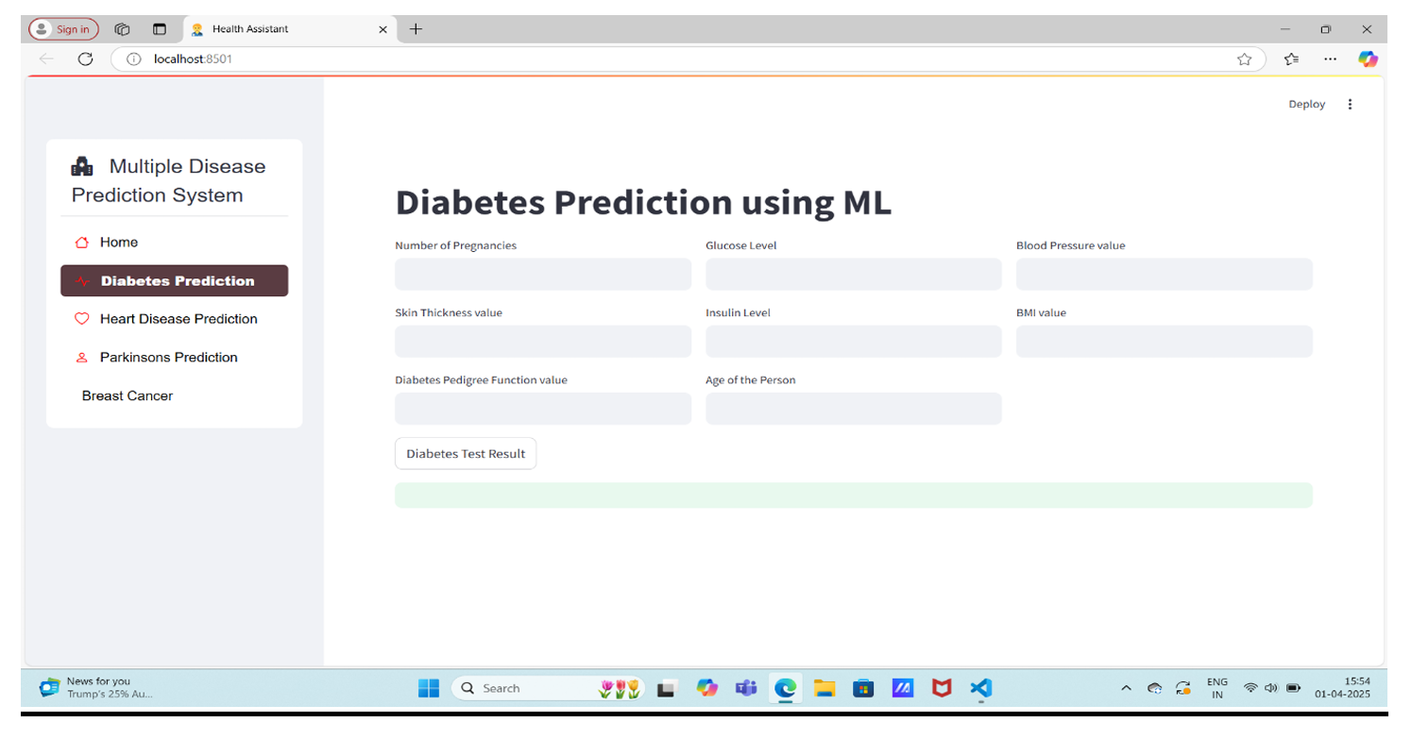
DIABETES PREDICTION

Slide 12
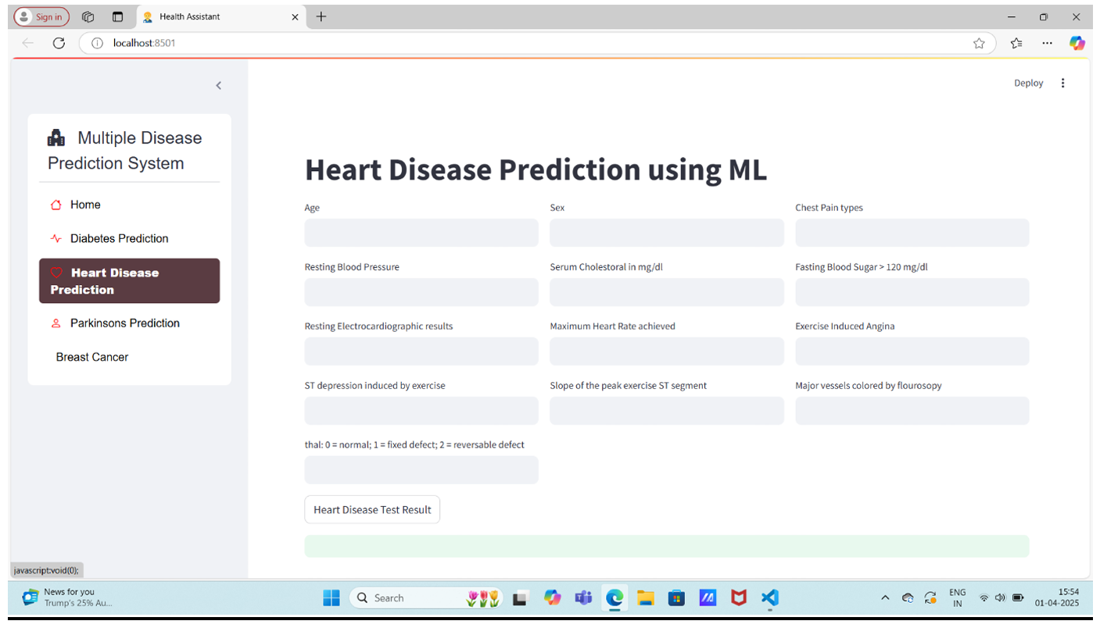
HEART DISEASE PREDICTION

Slide 13
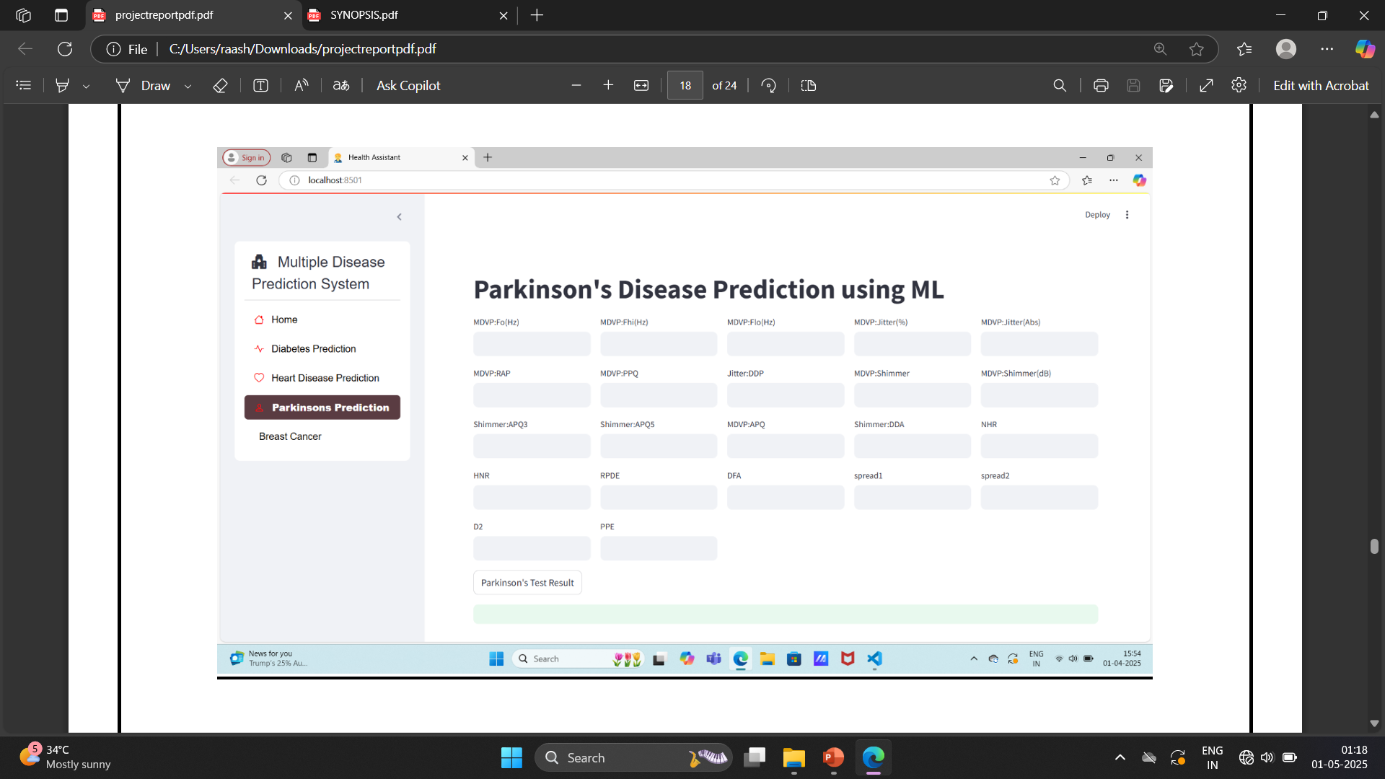
PARKINSON’S DISEASE PREDICTION

Slide 14
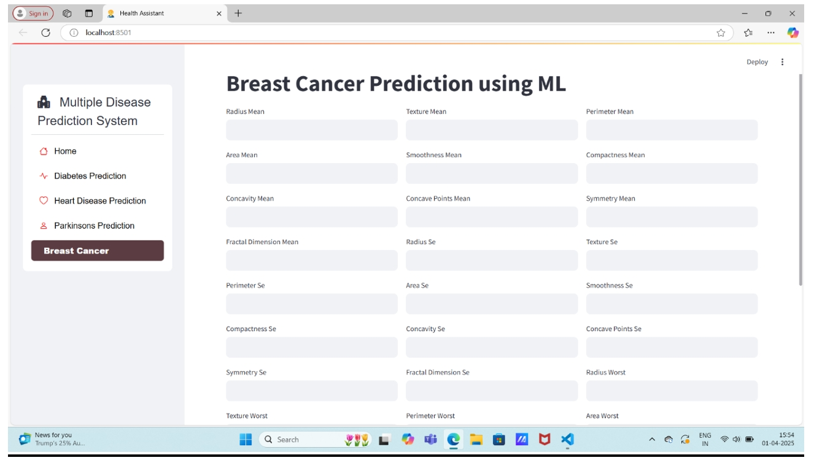
BREAST CANCER PREDICTION

Slide 15
-Diabetes Prediction: Approximately 78-80% accuracy
- Heart Disease Prediction: Approximately 85% accuracy
- Parkinson's Disease Prediction: Approximately 85-90% accuracy
- Breast Cancer Prediction: Approximately 92-95% accuracy

Slide 16
CONCLUSION
The “Health Assistant" application is a robust, stream lit-based machine learning tool designed for multiple disease predictions, including diabetes, heart disease, Parkinson’s and breast cancer. By leveraging pre-trained models stored in the saved model directory, the app ensures quick and efficient predictions based on user inputs. The application follows a well-structured flow: users select a disease category from the sidebar, input relevant medical data, and receive a diagnosis after processing. Each disease prediction is powered by a corresponding machine learning model loaded using pickle. The models analyze user inputs, classify the likelihood of disease presence, and display results instantly through the stream lit interface .This system enhances accessibility to preliminary health assessments without requiring in-depth medical knowledge. However, it is not a replacement for professional medical advice. Instead, it serves as an initial screening tool to encourage users to seek proper medical consultation if necessary.

Slide 17
FUTURE ENHANCEMENT
To further improve the functionality and usability of the Multiple Disease Prediction System, the following enhancements are proposed:
Improved Model Accuracy
User Authentication and Data Security
Real-Time Data Processing
Integration with Wearable Devices
Multi-Language Support
Doctor Consultation Feature
AI-Based Recommendations

Slide 18
THANK YOU

