Slide 1
Visualization of COVID-19 related data in Slovakia
Richard Kaštiak, 506538
Marko Ondrejička, 506543

Slide 2
Motivation
01
02
03
Make information more readable
Our goal is to make available pandemic data more readable for ordinary people
Increase knowledge
We want to increase knowledge about current pandemic situation
Easy to use and personalized
Key features of our service are simplicity and customizability of the data output

Slide 3
Data
NCZI (National Center for Health Information)
REST API (https://data.korona.gov.sk/)
open-source project (link)
Endpoints:
/api/ag-tests/by-district
/api/hospital-beds/by-district
/api/hospital-patients/by-district

Slide 4




Service implementation
Kubernetes cluster
169.51.203.137:30335
169.51.203.137:32295
web-app-service
cors-service
web-app-pod
cors-pod

Slide 5
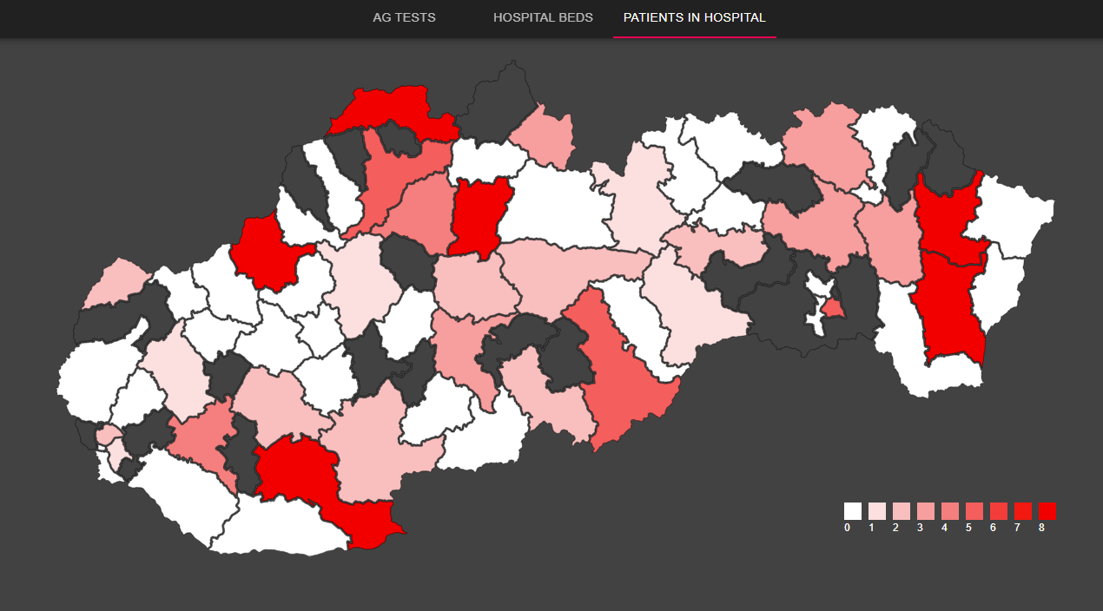
DEMO
(link)

Slide 6
FUTURE WORKS
Vaccines
Intervals
Mobile friendly
Show information about current COVID-19 vaccination situation
Include graph showing evolution of pandemic situation in selected time interval
Make our service mobile friendly and more responsive

Slide 7
Q&A

