Slide 1
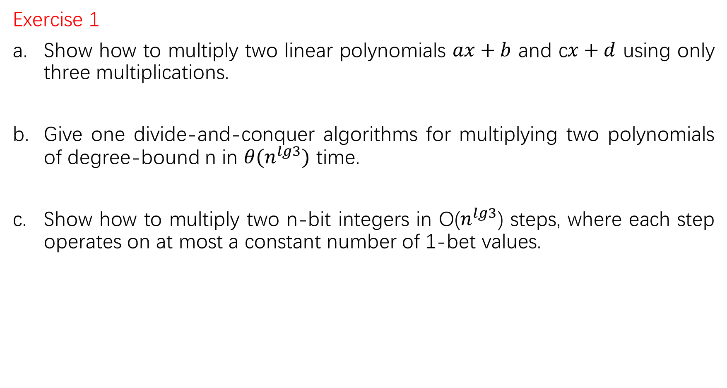
Exercise 1
Show how to multiply two linear polynomials $ax+b$ and c$x+d$ using only three multiplications.
Give one divide-and-conquer algorithms for multiplying two polynomials of degree-bound n in $θ(n^{lg3})$ time.
Show how to multiply two n-bit integers in O($n^{lg3}$) steps, where each step operates on at most a constant number of 1-bet values.

Slide 2

a.
(a+b)(c+d)=ac+bc+ad+bd
So, we compute that product, we also compute ac and bd. This gets us the product of the two polynomials is
$acx^{2}+\left(\left(a+b\right)\left(c+d\right)−ac−bd\right)x+bd$

Slide 3
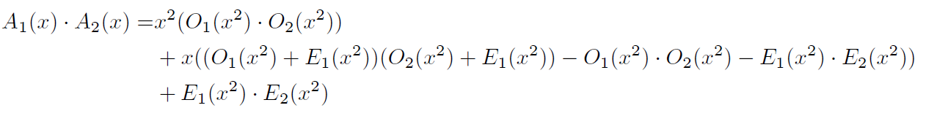

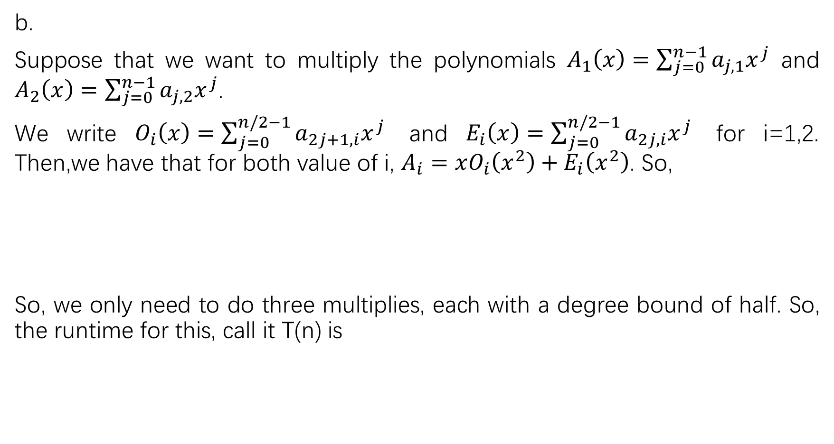
b.
Suppose that we want to multiply the polynomials $A_{1}\left(x\right)=\sum_{j=0}^{n−1}{a_{j,1}x^{j}}$ and $A_{2}\left(x\right)=\sum_{j=0}^{n−1}{a_{j,2}x^{j}}$.
We write $O_{i}\left(x\right)=\sum_{j=0}^{n/2−1}{a_{2j+1,i}x^{j}}$ and $E_{i}\left(x\right)=\sum_{j=0}^{n/2−1}{a_{2j,i}x^{j}}$ for i=1,2. Then,we have that for both value of i, $A_{i}=xO_{i}\left(x^{2}\right)+E_{i}\left(x^{2}\right)$. So,
So, we only need to do three multiplies, each with a degree bound of half. So, the runtime for this, call it T(n) is

Slide 4

c.
Treat a n-bit integer $b_{n−1},b_{n−2}$,…, $b_{0}$ as an n-degree polynomial of the form $b_{n−1}x^{n−1}+b_{n−2}x^{n−2}$+…+ $b_{1}x+b_{0}$. Then simply use the multiplication procedure of part(b) to multiply two n-bit integers represented as polynomials in O($n^{lg3}$) time.

