Slide 1
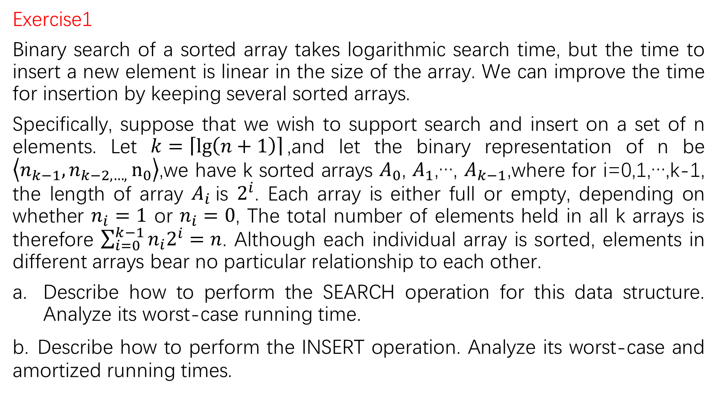
Exercise1
Binary search of a sorted array takes logarithmic search time, but the time to insert a new element is linear in the size of the array. We can improve the time for insertion by keeping several sorted arrays.
Specifically, suppose that we wish to support search and insert on a set of n elements. Let $k=\left\lceil \lg\left(n+1\right)\right\rceil$,and let the binary representation of n be $\left\langle n_{k−1},n_{k−2,…, }n_{0}\right\rangle$,we have k sorted arrays $A_{0}$, $A_{1}$,…, $A_{k−1}$,where for i=0,1,…,k-1, the length of array $A_{i}$is $2^{i}$. Each array is either full or empty, depending on whether $n_{i}=1$ or $n_{i}=0$, The total number of elements held in all k arrays is therefore $\sum_{i=0}^{k−1}{n_{i}2^{i}}=n$. Although each individual array is sorted, elements in different arrays bear no particular relationship to each other.
Describe how to perform the SEARCH operation for this data structure. Analyze its worst-case running time.
b. Describe how to perform the INSERT operation. Analyze its worst-case and amortized running times.

Slide 2

i=0
i=1
i=2
……
……
i=k-1

Slide 3




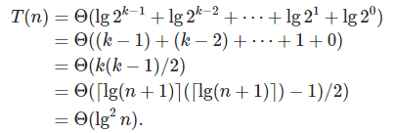

a. The SEARCHSEARCH operation can be performed by searching each of the individually sorted arrays. Since all the individual arrays are sorted, searching one of them using a binary search algorithm takes time, where m is the size of the array. In an unsuccessful search, the time is .In the worst case, we may assume that all the arrays are full, ,and we perform an unsuccessful search. The total time taken is
Thus, the worst-case running time is

Slide 4


b.We create a new sorted array of size 1 containing the new element to be inserted. If array (which has size 1)is empty. Then we replace with the new sorted array. Otherwise, we merge sort the two arrays into another sorted array of size 2. If is empty, then we replace with the new array; otherwise we merge sort the arrays as before and continue. Since array is of size ,if we merge sort two arrays of size each, we obtain one of size ,which is the size of . Thus, this method will result in another list of arrays in the same structure that we had before.

Slide 5
Insert 3, 1, 8, 2, 6, 7 ,5 12, 10, 11, 13

Slide 6
Insert 3, 1, 8, 2, 6, 7 ,5 12, 10, 11, 13
3

Slide 7
Insert 3, 1, 8, 2, 6, 7 ,5 12, 10, 11, 13
1 | 3

Slide 8
Insert 3, 1, 8, 2, 6, 7 ,5 12, 10, 11, 13
8
1 | 3

Slide 9
Insert 3, 1, 8, 2, 6, 7 ,5 12, 10, 11, 13
1 | 2 | 3 | 8

Slide 10
Insert 3, 1, 8, 2, 6, 7 ,5 12, 10, 11, 13
6
1 | 2 | 3 | 8

Slide 11
Insert 3, 1, 8, 2, 6, 7 ,5 12, 10, 11, 13
6 | 7
1 | 2 | 3 | 8

Slide 12
Insert 3, 1, 8, 2, 6, 7 ,5 12, 10, 11, 13
5
6 | 7
1 | 2 | 3 | 8

Slide 13
Insert 3, 1, 8, 2, 6, 7 ,5 12, 10, 11, 13
1 | 2 | 3 | 5 | 6 | 7 | 8 | 12

Slide 14
Insert 3, 1, 8, 2, 6, 7 ,5 12, 10, 11, 13
10
1 | 2 | 3 | 5 | 6 | 7 | 8 | 12

Slide 15
Insert 3, 1, 8, 2, 6, 7 ,5 12, 10, 11, 13
10 | 11
1 | 2 | 3 | 5 | 6 | 7 | 8 | 12

Slide 16
Insert 3, 1, 8, 2, 6, 7 ,5 12, 10, 11, 13
13
10 | 11
1 | 2 | 3 | 5 | 6 | 7 | 8 | 12

Slide 17



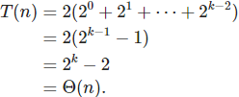

Let us analyze its worst-case running time. We will assume that merge sort takes 2m time to merge two sorted lists of size m each. If all the arrays ,
…, ,are full, then the running time to fill array , would be
Therefore, the worst-case time to insert an element into this data structure is

Slide 18





However, let us now analyze the amortized running time. Using the aggregate method, we compute the total cost of a sequence of n inserts, starting with the empty data structure. Let r be the position of the rightmost 0 in the binary representation of n, so that ,for j=0, 1, …,r-1. The cost of an insertion when n items have already been inserted is
Furthermore, There are at most insertions for each value of r. The total cost of the n operations is therefore bounded by
The amortized cost per insert operation, therefore is
$$\left\langle n_{k−1},n_{k−2,…, }n_{0}\right\rangle$$

Slide 19

0000
0001 $2^{0}$
0010 $2^{1}$
0011 $2^{0}$
0100 $2^{1}+2^{2}$
0101 $2^{0}$
0110 $2^{1}$
0111 $2^{0}$
1000 $2^{1}+2^{2}+2^{3}$
1001 $2^{0}$
1010 $2^{1}$
1011 $2^{0}$

Slide 20
Exercise2
Consider an ordinary binary search tree augmented by adding to each node x the attribute x.size giving the number of keys stored in the subtree rooted at x. Let be a constant in the range .We say that a given node x is
if and . The tree as a whole is if every node in the tree is .
a. A 1/2-balanced tree is, in a sense, as balanced as it can be. Given a node x in an arbitrary binary search tree, show how to rebuild the subtree rooted at x so that it becomes 1/2-balanced. Your algorithm should run in time , and it can use O(x.size) auxiliary storage.

Slide 21
Since we have O(x.size) auxiliary space, we will take the tree rooted at x and write down an inorder traversal of the tree into the extra space. This will only take linear time to do because it will visit each node thrice, once when passing to its left child, once when the nodes value is output and passing to the right child, and once when passing to the parent. Then, once the inorder traversal is written down, we can convert it back to a binary tree by selecting the median of the list to be the root, and recursing on the two halves of the list that remain on both sides. Since we can index into the middle element of a list in constant time, we will have the recurrence

Slide 22
8
7
9
6
3
1
4

Slide 23
Inorder
1
3
4
6
7
8
9

Slide 24
Inorder
1
3
4
7
8
9
6

Slide 25
Inorder
1
4
7
9
6
3
8

Slide 26
Inorder
6
3
8
1
4
7
9

Slide 27

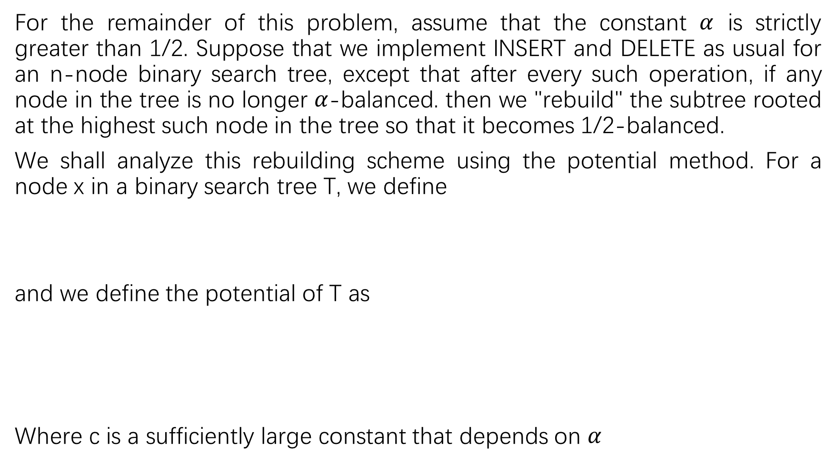
For the remainder of this problem, assume that the constant $α$ is strictly greater than 1/2. Suppose that we implement INSERT and DELETE as usual for an n-node binary search tree, except that after every such operation, if any node in the tree is no longer $α$-balanced. then we "rebuild" the subtree rooted at the highest such node in the tree so that it becomes 1/2-balanced.
We shall analyze this rebuilding scheme using the potential method. For a node x in a binary search tree T, we define
and we define the potential of T as
Where c is a sufficiently large constant that depends on $α$

Slide 28

b. Argue that any binary search tree has nonnegative potential and that a 1/2-balanced tree has potential 0.
c. Suppose that m units of potential can pay for rebuilding an m-node subtree. How large must c be in terms of $α$ in order for it to take O(1) amortized time to rebuild a subtree that is not $α$-balanced.

Slide 29
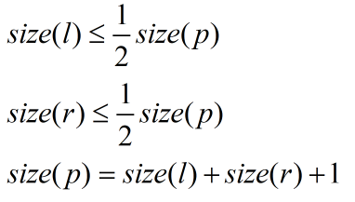

b.
Note $∆(x)$ is nonnegative according to its definition. Since c is also nonnegative constant, for any binary search tree $Φ(T)$ is nonnegative.
Let p be the parent, node l and r be its left and right children respectively. By the definition of 1/2-balanced tree, the following conditions are satisfied:
(1)
(2)
(3)

Slide 30




Equation 3 implies that:
Combined with equation 1, we can conclude that
Together with equation 2, the following inequalities hold
Similarly, this relation holds for the left child
(4)
(5)
(6)

Slide 31
Therefore for 1/2-balanced tree
Combined with
Its potential is 0.

Slide 32




c.
First, if a tree is not $α$-balanced, it is satisfied:
Therefore
Secondly, after rebuilding the tree to 1/2-balanced tree, the potential
$φ\left(D_{i}\right)=0$.
This equation implies

Slide 33




From the above equation, we can conclude that

