Slide 1
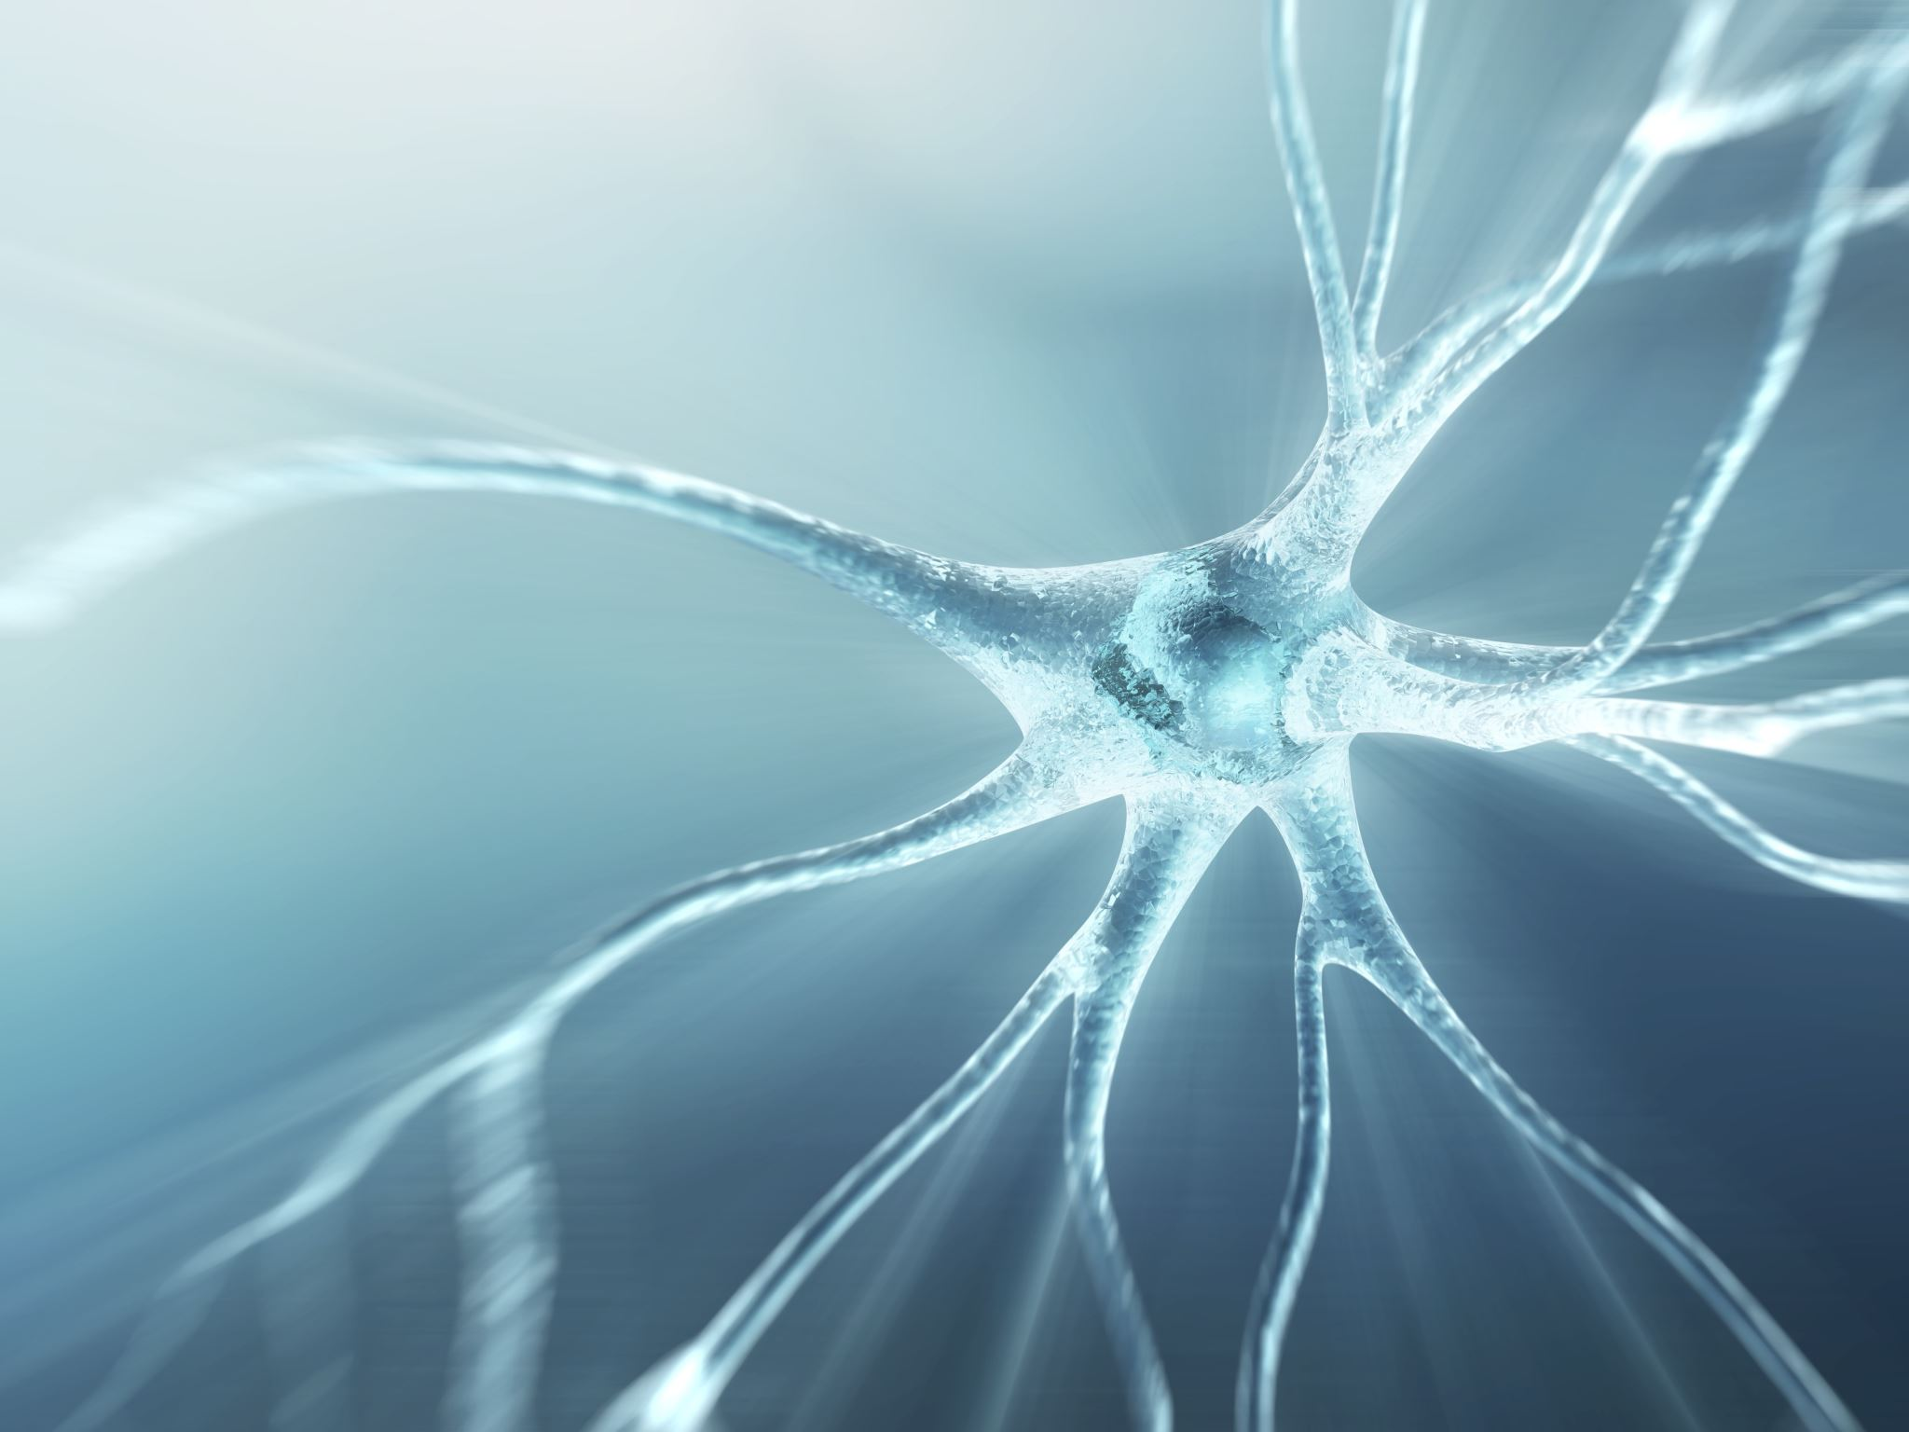
Constructing neural networks using Dendritic Neuron Model
理工学教育部 - 数理・ヒューマンシステム科学専攻
名前：李 加一
学籍番号: 32372010
2023.6.29

Slide 2
CONTENTS
DNM: Dendritic Neuron Model
RDNN: DNM-based temporal prediction model
ADNS: DNM-based multilayer neural network
I
II
III

Slide 3
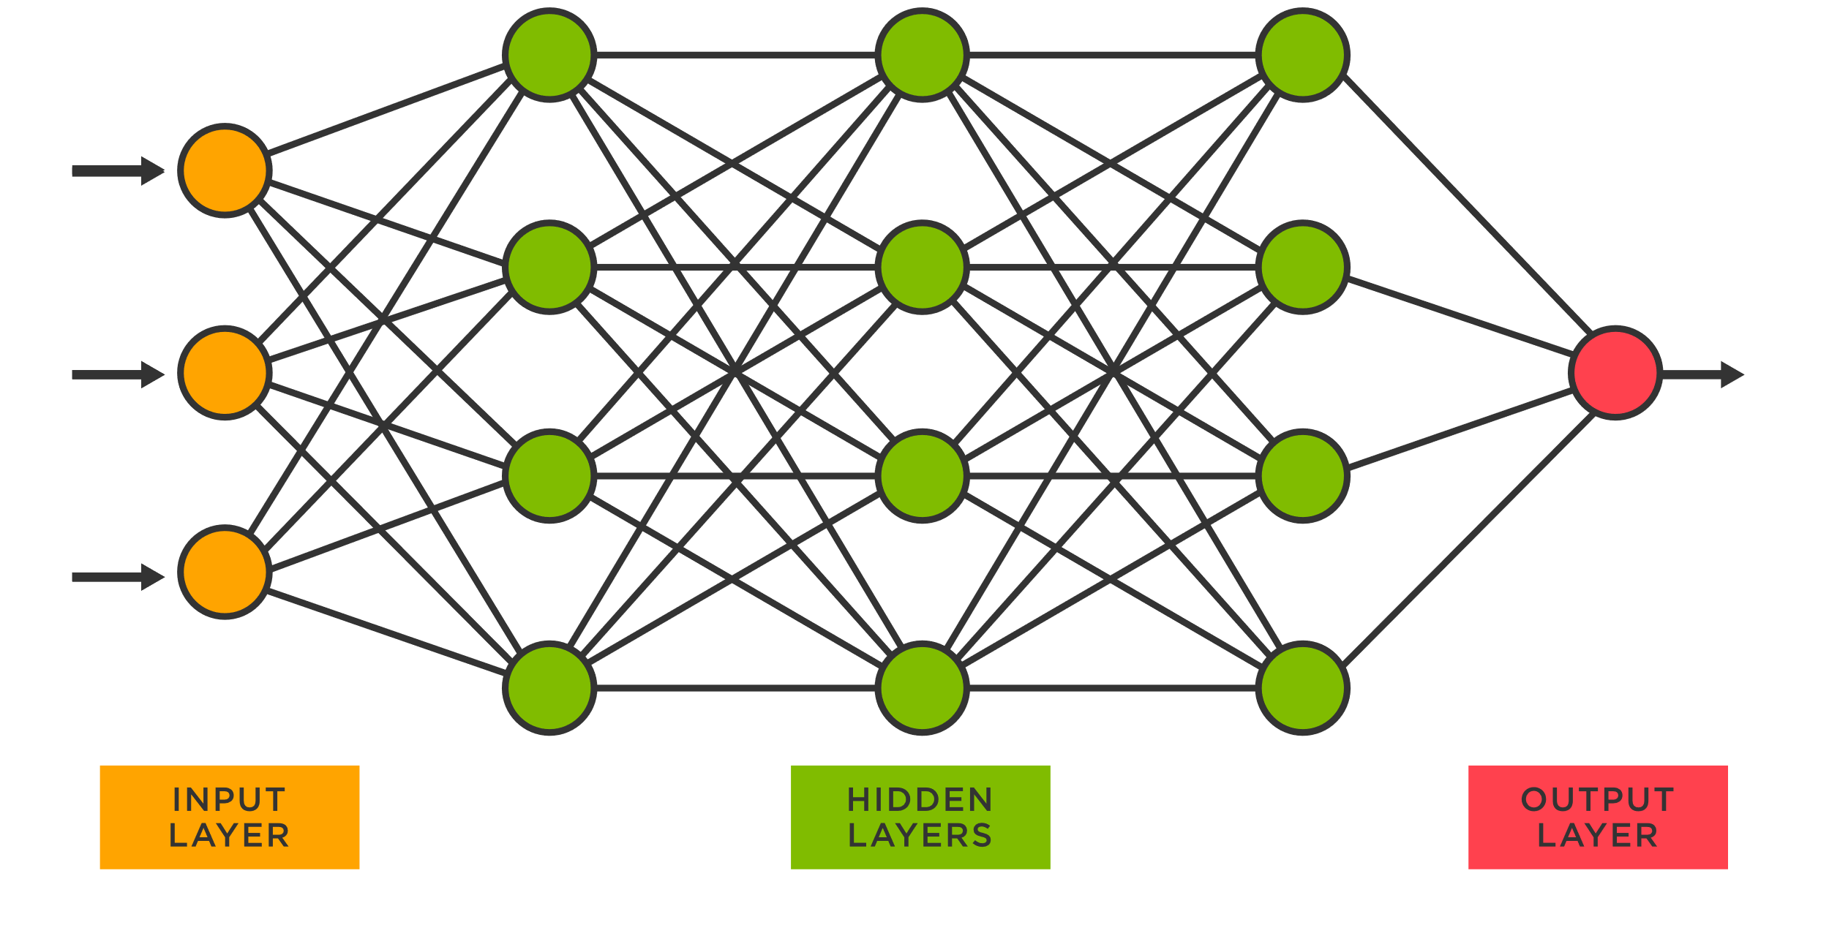
1
DNM: Dendritic Neuron Model
The basic unit for building deep learning models is the McCulloch-Pitts (MP) neuron.
Deep
Learning
Model
？？
Despite their widespread use, MP neurons have certain limitations, such as their inability to handle noise and uncertainty in input data, as well as their limited adaptability to varying data distributions.
Black Box
Notes:
Despite their widespread use, traditional neural models have certain limitations, such as their inability to handle noise and uncertainty in input data, as well as their limited adaptability to varying data distributions

Slide 4
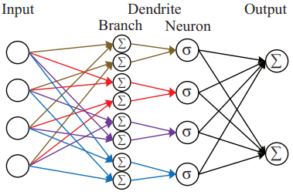
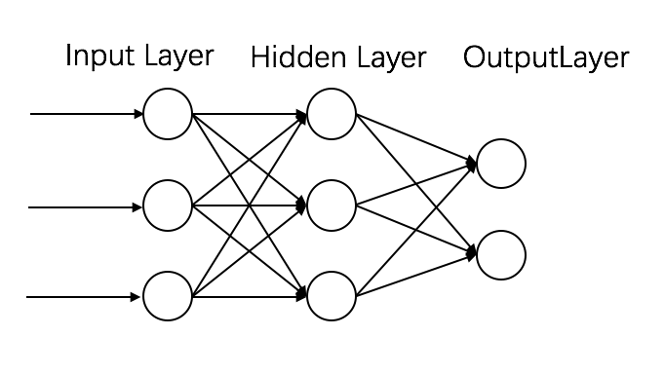
1
DNM: Dendritic Neuron Model
improve
How to improve MP neurons has become a popular research topic. Many researchers have made improvements to MP neurons but have not been widely disseminated.

Slide 5
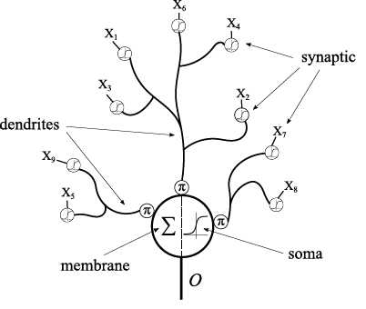
1
DNM: Dendritic Neuron Model
Recently, Dendritic Neuron Model (DNM) has been widely studied. In many practical problems, DNM can achieve good results.
wind power forecasting
house price forecasting
exchange rate forecasting
prediction
…
Solve
classification
Diagnosis of breast cancer
…

Slide 6
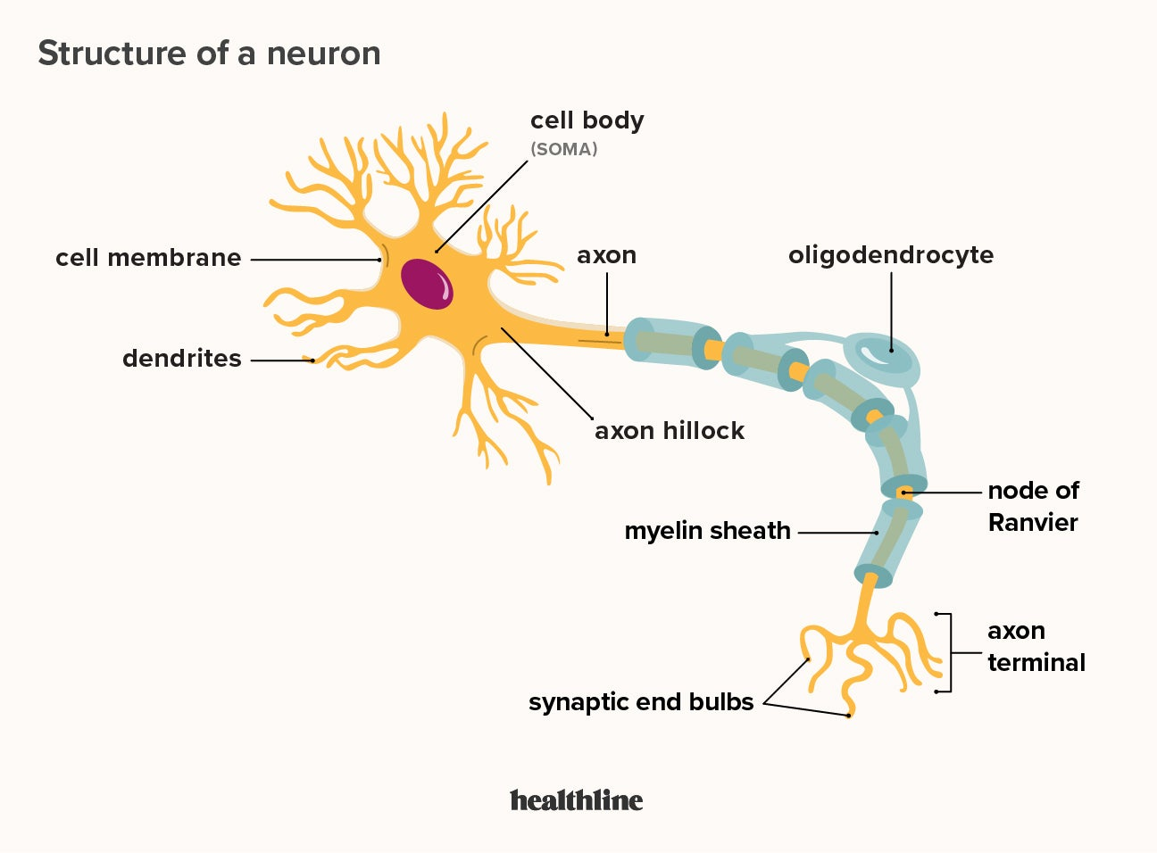
1
DNM: Dendritic Neuron Model

Slide 7

1
DNM: Dendritic Neuron Model
However, DNM still has some issues, such as:
In most cases, DNM need to be trained using evolutionary algorithms (EA) to achieve the best results. EA limits the increase of DNM parameters.
The computational power of a single DNM is limited and it is currently impossible to form complex network with multiple DNMs.

Slide 8
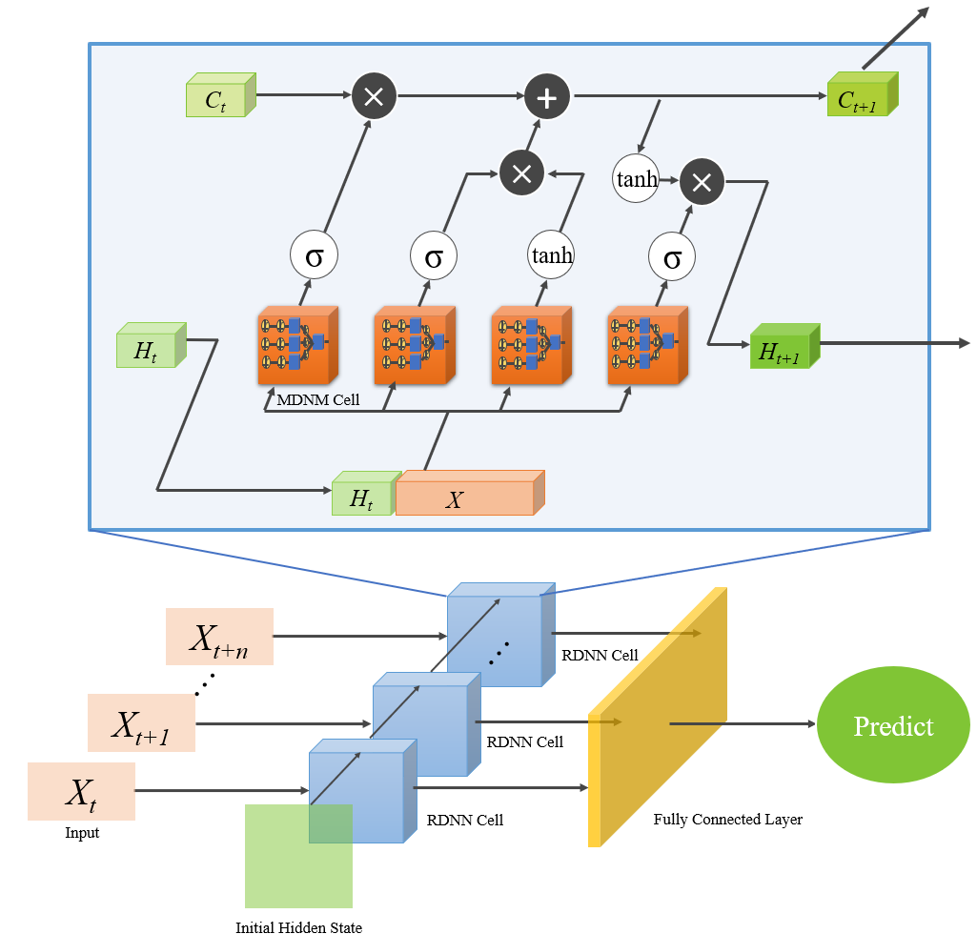
2
RDNN: DNM-based temporal prediction model
In this section, we propose a new recurrent neural network using DNM-M as the base unit, which we call recurrent dendritic neural network (RDNN).
The inputs at different moments are processed by the RDNN cell and passed to the fully connected layer to get the final output.

Slide 9
2
RDNN: DNM-based temporal prediction model
In this section, we propose a new recurrent neural network using DNM-M as the base unit, which we call recurrent dendritic neural network (RDNN).
The inputs at different moments are processed by the RDNN cell and passed to the fully connected layer to get the final output.

Slide 10
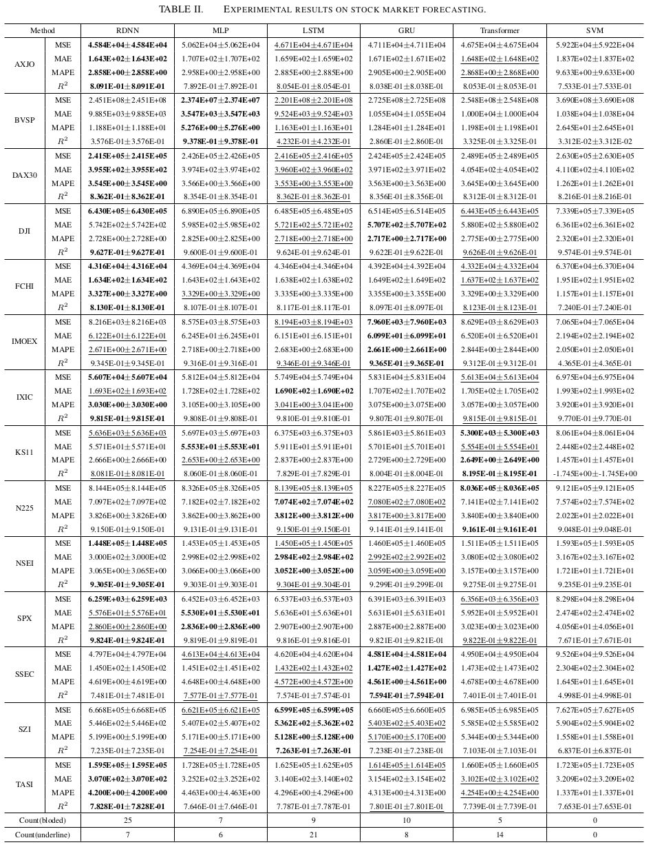

Slide 12
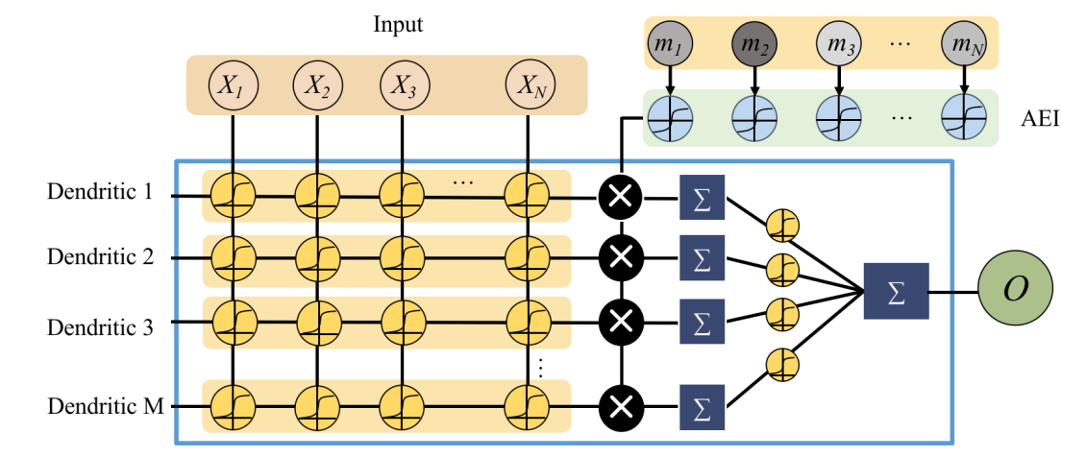
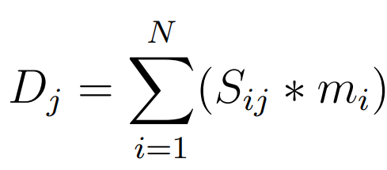
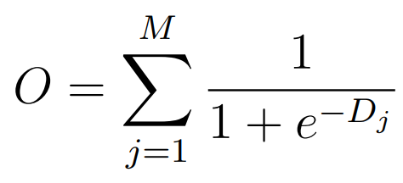
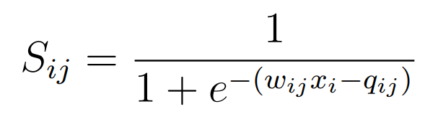
2
RDNN: DNM-based temporal prediction model

