Slide 1
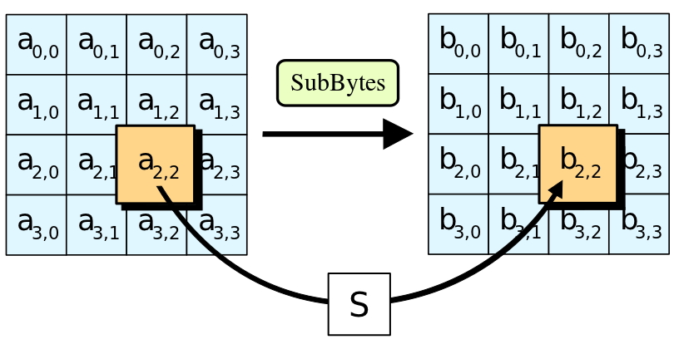
An FPGA Implementation of AES

Slide 2
Outline
Background
Goals
Basic theory
Tools
Current state of project
Demonstration
Improvements

Slide 3
Background
AES aslköjdnas

Slide 4
Goals
To be able to encrypt a standard set of data using 128, 192, or 256 bit AES encryption
To be able to decrypt a standard set of data using 128, 192, or 256 bit AES encryption
To be able to send arbitrary data to FPGA board for encryption
To be able to receive encrypted data from FPGA board after encryption

Slide 5
Basic Theory
Rijndael AES flash animation

Slide 6
Tools
Altera DE2
Quartus II
VirtualBox
Git and GitHub

Slide 7
Current state of project
All sub-components done and working
Key expansion done and working
Encryption process in development
Component for serial communication done, but not used

Slide 8
Demonstration

Slide 9
Possible improvements
Finnish the encryption process component
Use the serial component to send and receive arbitrary data
Reverse the encryption process (decryption)

