Slide 1
ChoreTracker.com
Chris Lipscomb
Michael Morrison
Carolyn Zhang

Slide 2

Overview
Project Description and Areas of Focus
UI Design and Wireframe Mockups
Backend Development and Demo
Future Plans

Slide 3
Problem statement
Roommates of shared households often have trouble keeping track of chores that need to be completed.
Roommates don’t do the chores that they are supposed to do.

Slide 4
Description
Choretracker.com is a website in which users can create groups or households to help track chores.

Slide 5




features
Create household groups
Add chores to the household
Commend or Reprimand members
Track member scores

Slide 6
Audience
The audience or users of this website are roommates or household sharing members. It is aimed for people who share a household to track and reward or reprimand residences for maintaining the living area.

Slide 7


Areas of Focus
MySQL Database PULL/PUSH
Read and write information regarding roommates, chores, as well as keeping track of session information.
HTML/CSS
design and layout of the website

Slide 8

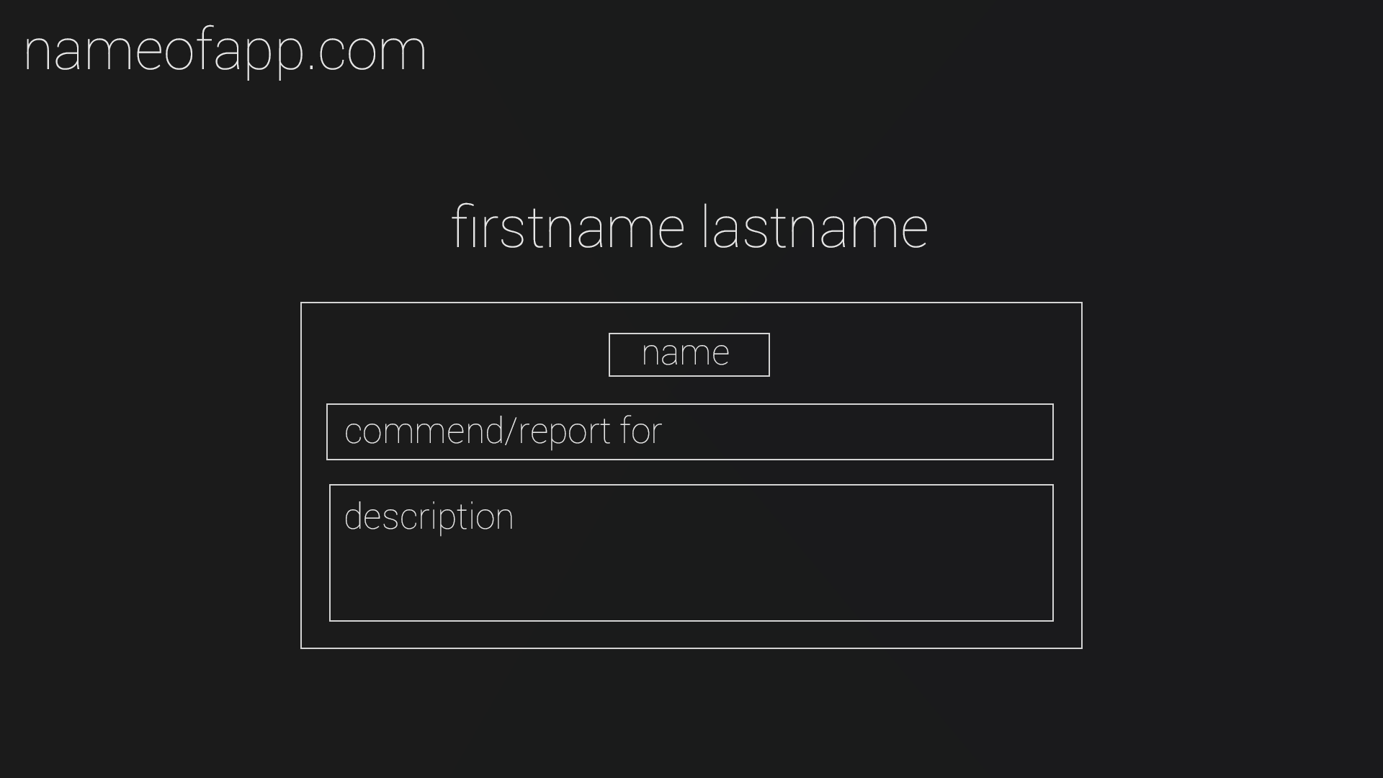
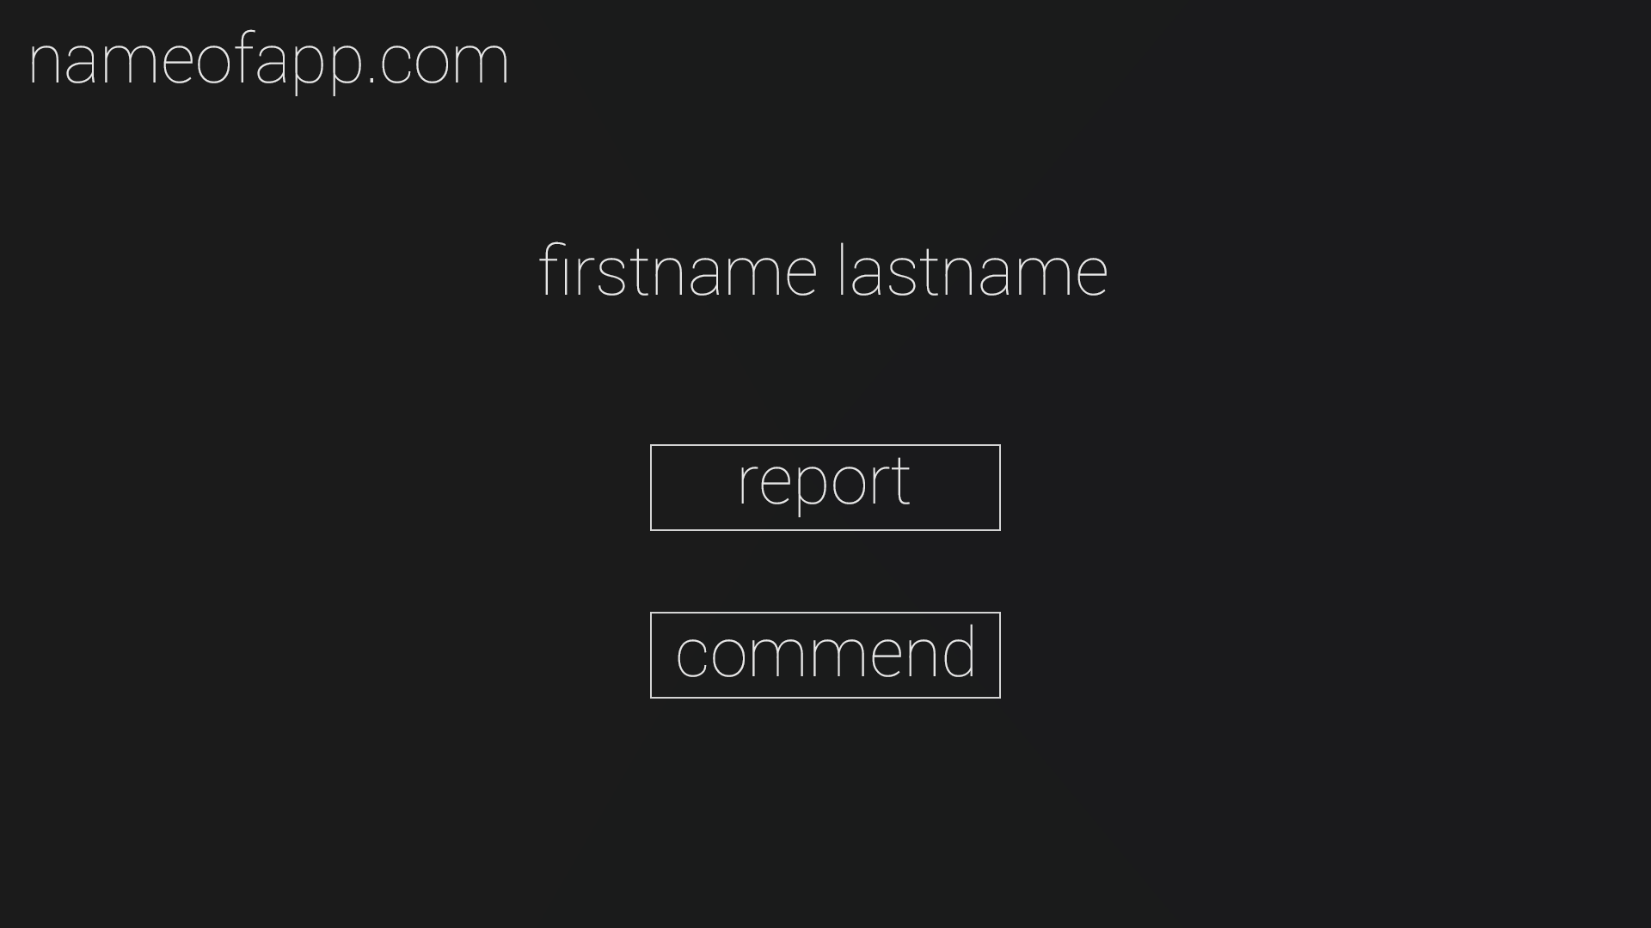
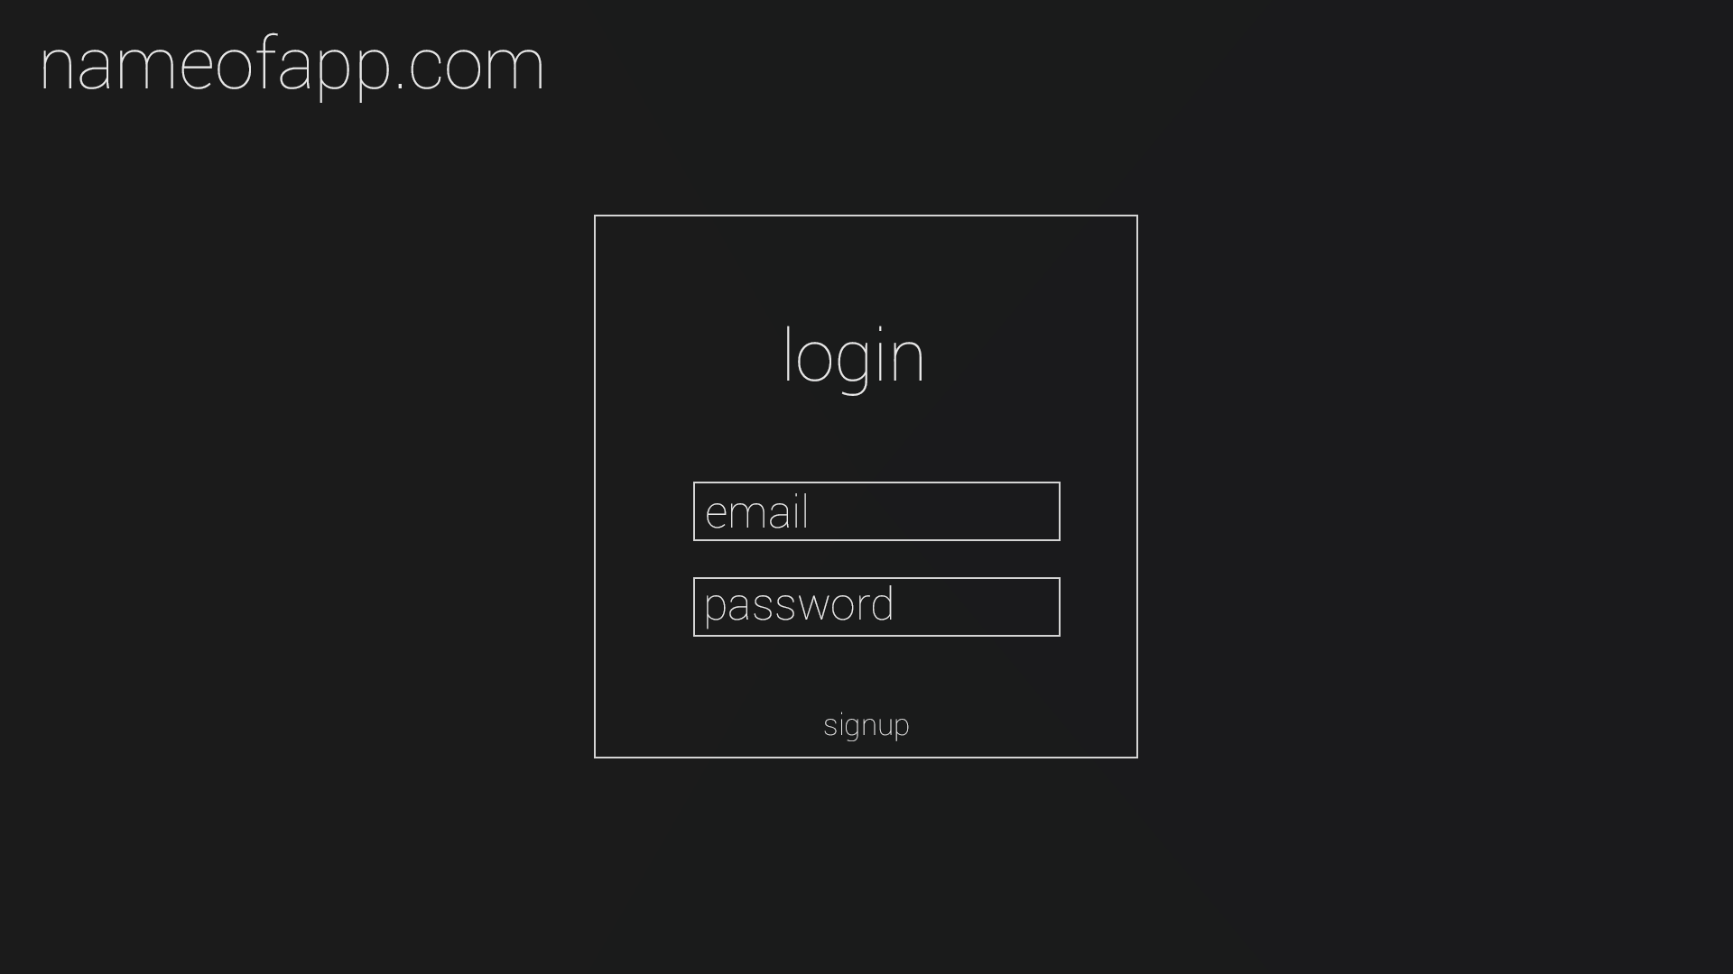
Initial Design ideas

Slide 9
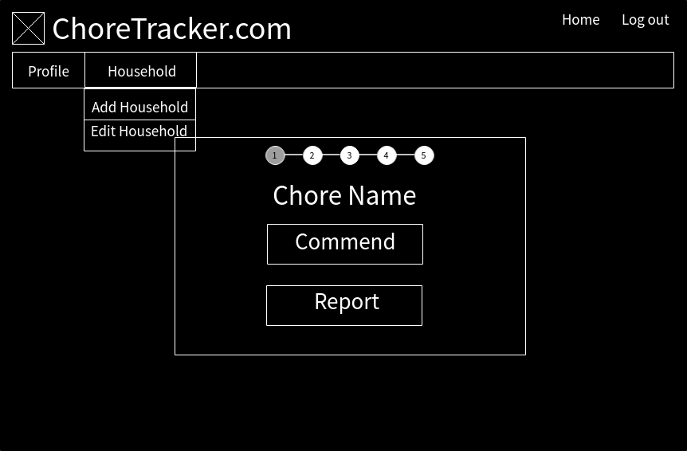
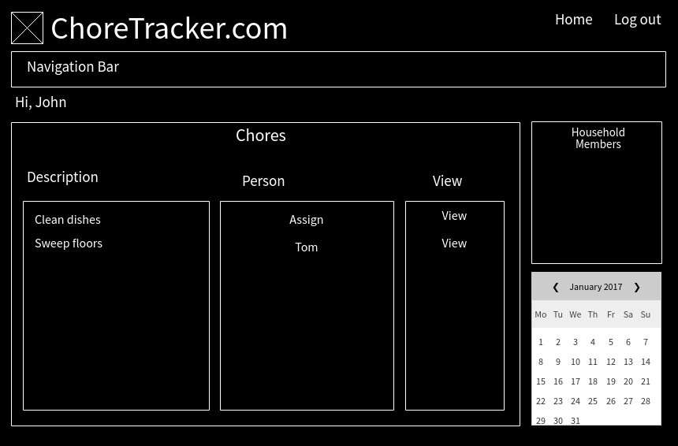
More Functionality

Slide 10
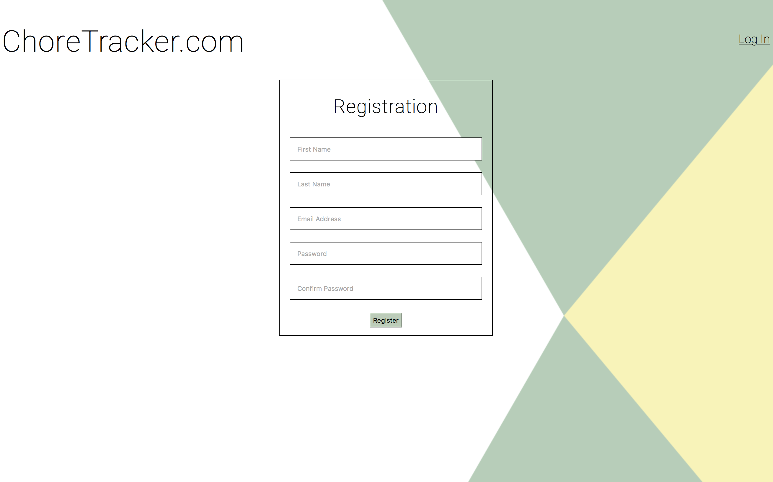
Later Design

Slide 11
Database Schema
Events
eventID
reporterUserID
groupID
choreID
reportedUserID
Users
userID
username
password
salt
email
firstName
lastName
Group_users
groupID
userID
score
Groups
groupID
groupName
groupCode
Chorevalues
choreID
groupID
choreValue
Chores
choreID
choreName
posNeg

Slide 12
PHP Scripts
Connect with the database to add information to the database and potentially edit the information later
Help keep form the database safe from SQL injections
Keep information that appeared on multiple pages in separate documents
Store session information to allow user login.

Slide 13
Demo
http://localhost:8080/IIT-Project/index.php

Slide 14
Future plans
Select dates when events occurred
Allow other users to confirm events
Vote on value of certain chores
Rent payment feature
Set rewards for having a high score
ie. Decreasing rent
Set punishments for having low scores
ie. Increasing rent
Incorporate website onto college campuses

Slide 15
questions?

