Slide 1
ChoreTracker.com
Chris Lipscomb
Michael Morrison
Carolyn Zhang

Slide 2

Overview
Project Description and Areas of Focus
UI Design and Wireframe Mockups
Backend Development and Demo
Future Plans

Slide 3
Problem statement
Roommates of shared households often have trouble keeping track of chores that need to be completed.
Roommates don’t do the chores that they are supposed to do.

Slide 4
Description
Choretracker.com is a website in which users can create groups or households to help track chores.

Slide 5




features
Create household groups
Add chores to the household
Commend or Reprimand members
Track member scores

Slide 6
Audience
The audience or users of this website are roommates or household sharing members. It is aimed for people who share a household to track and reward or reprimand residences for maintaining the living area.

Slide 7


Areas of Focus
MySQL Database PULL/PUSH
Read and write information regarding roommates, chores, as well as keeping track of session information.
HTML/CSS
design and layout of the website

Slide 8

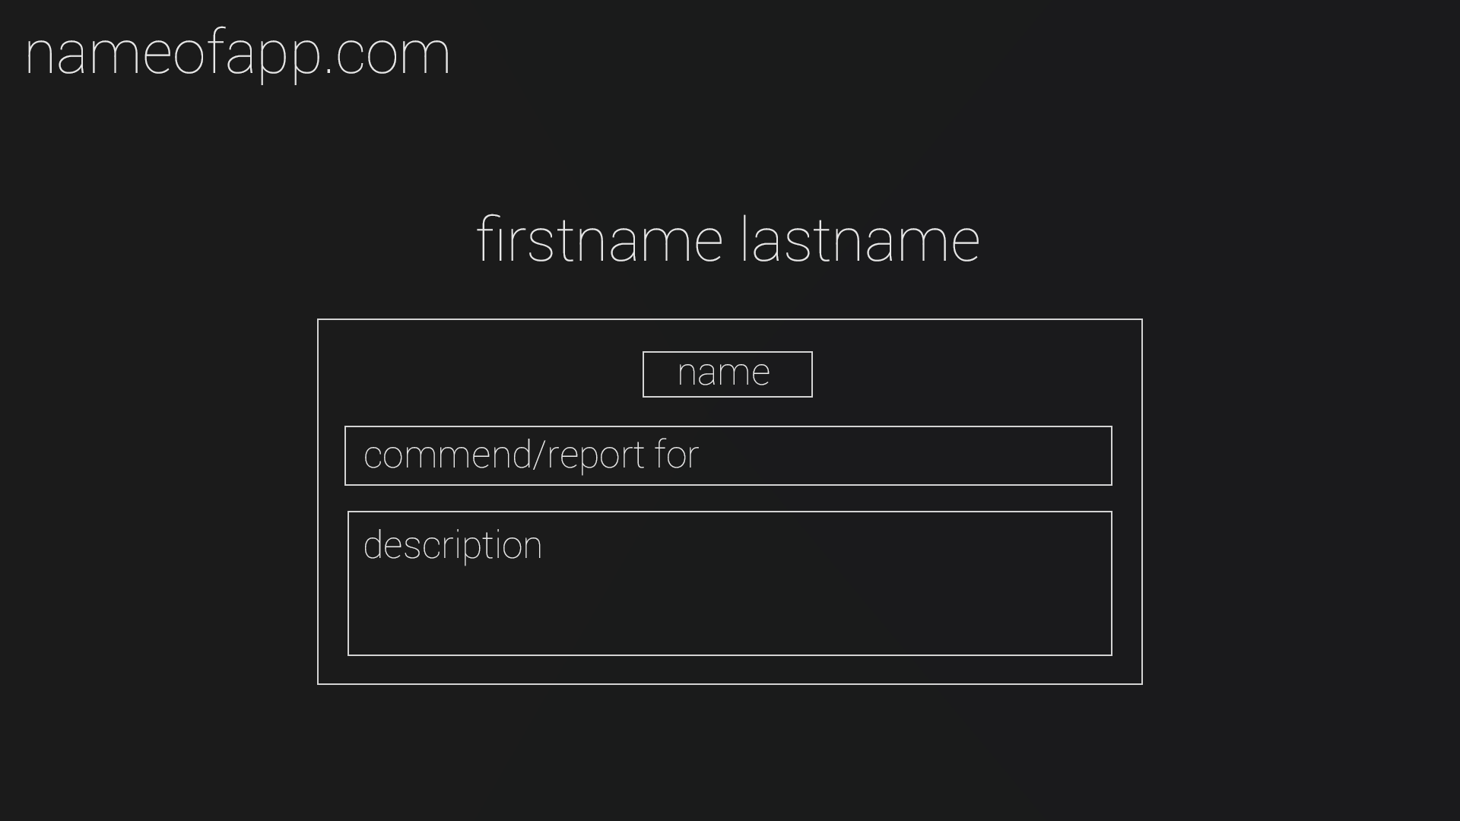
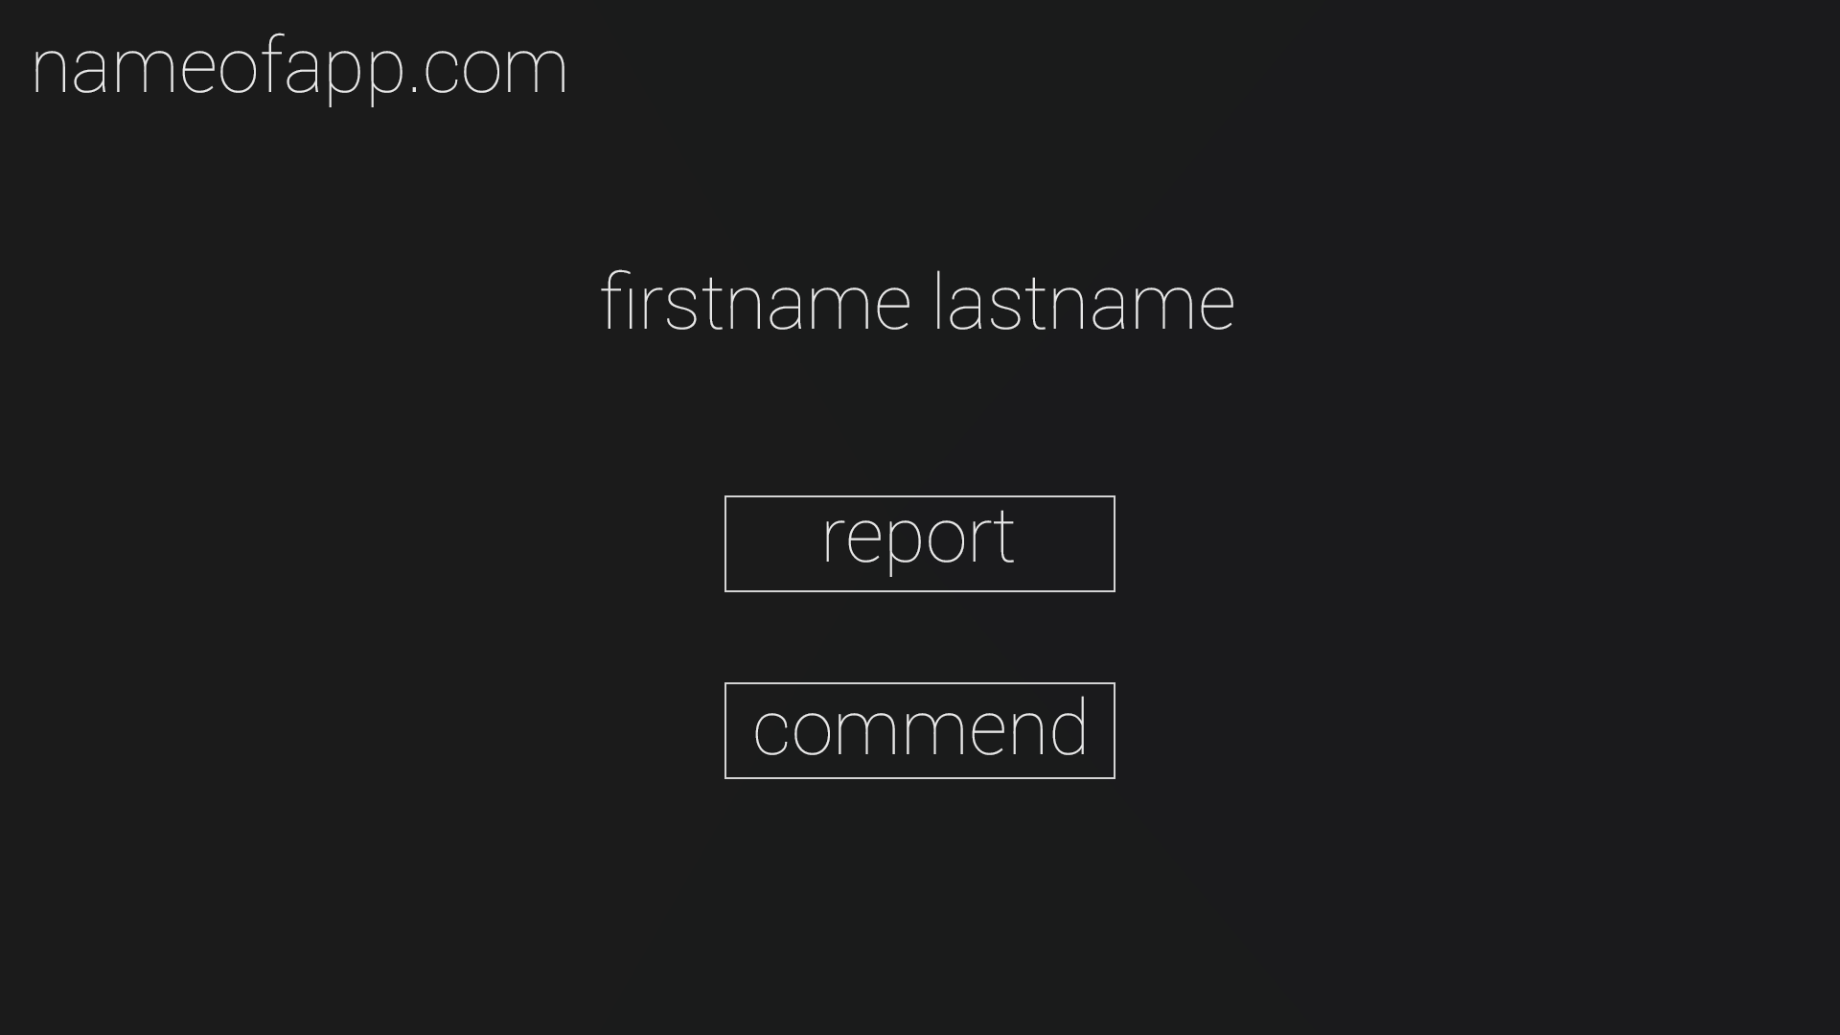
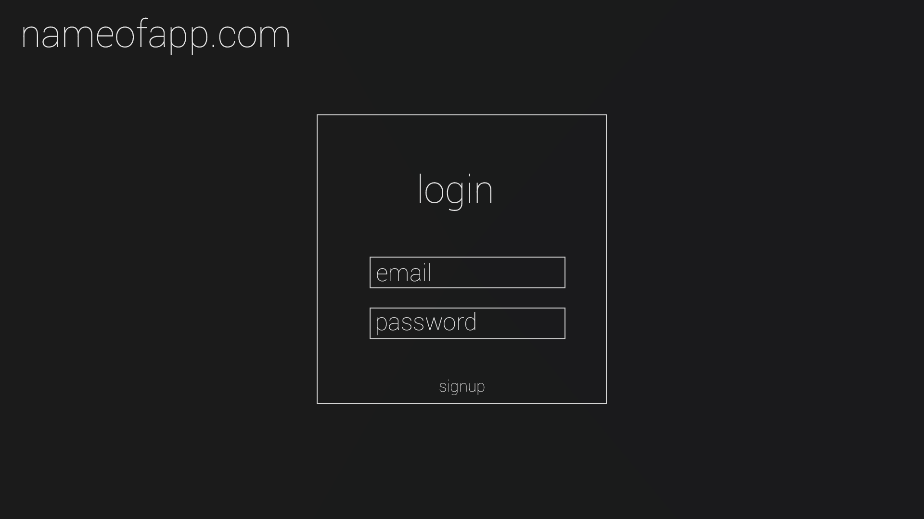
Initial Design ideas

Slide 9
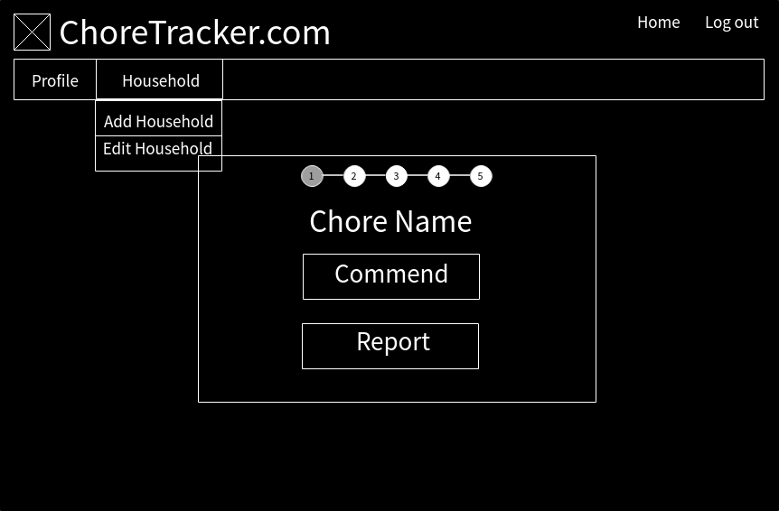
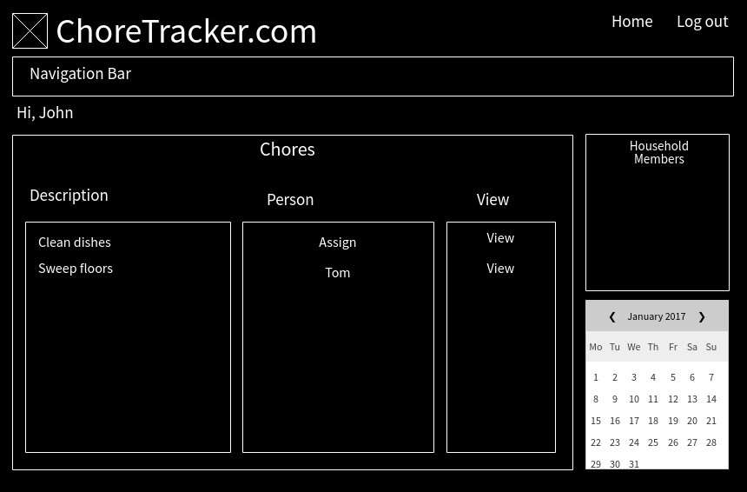
More Functionality

Slide 10
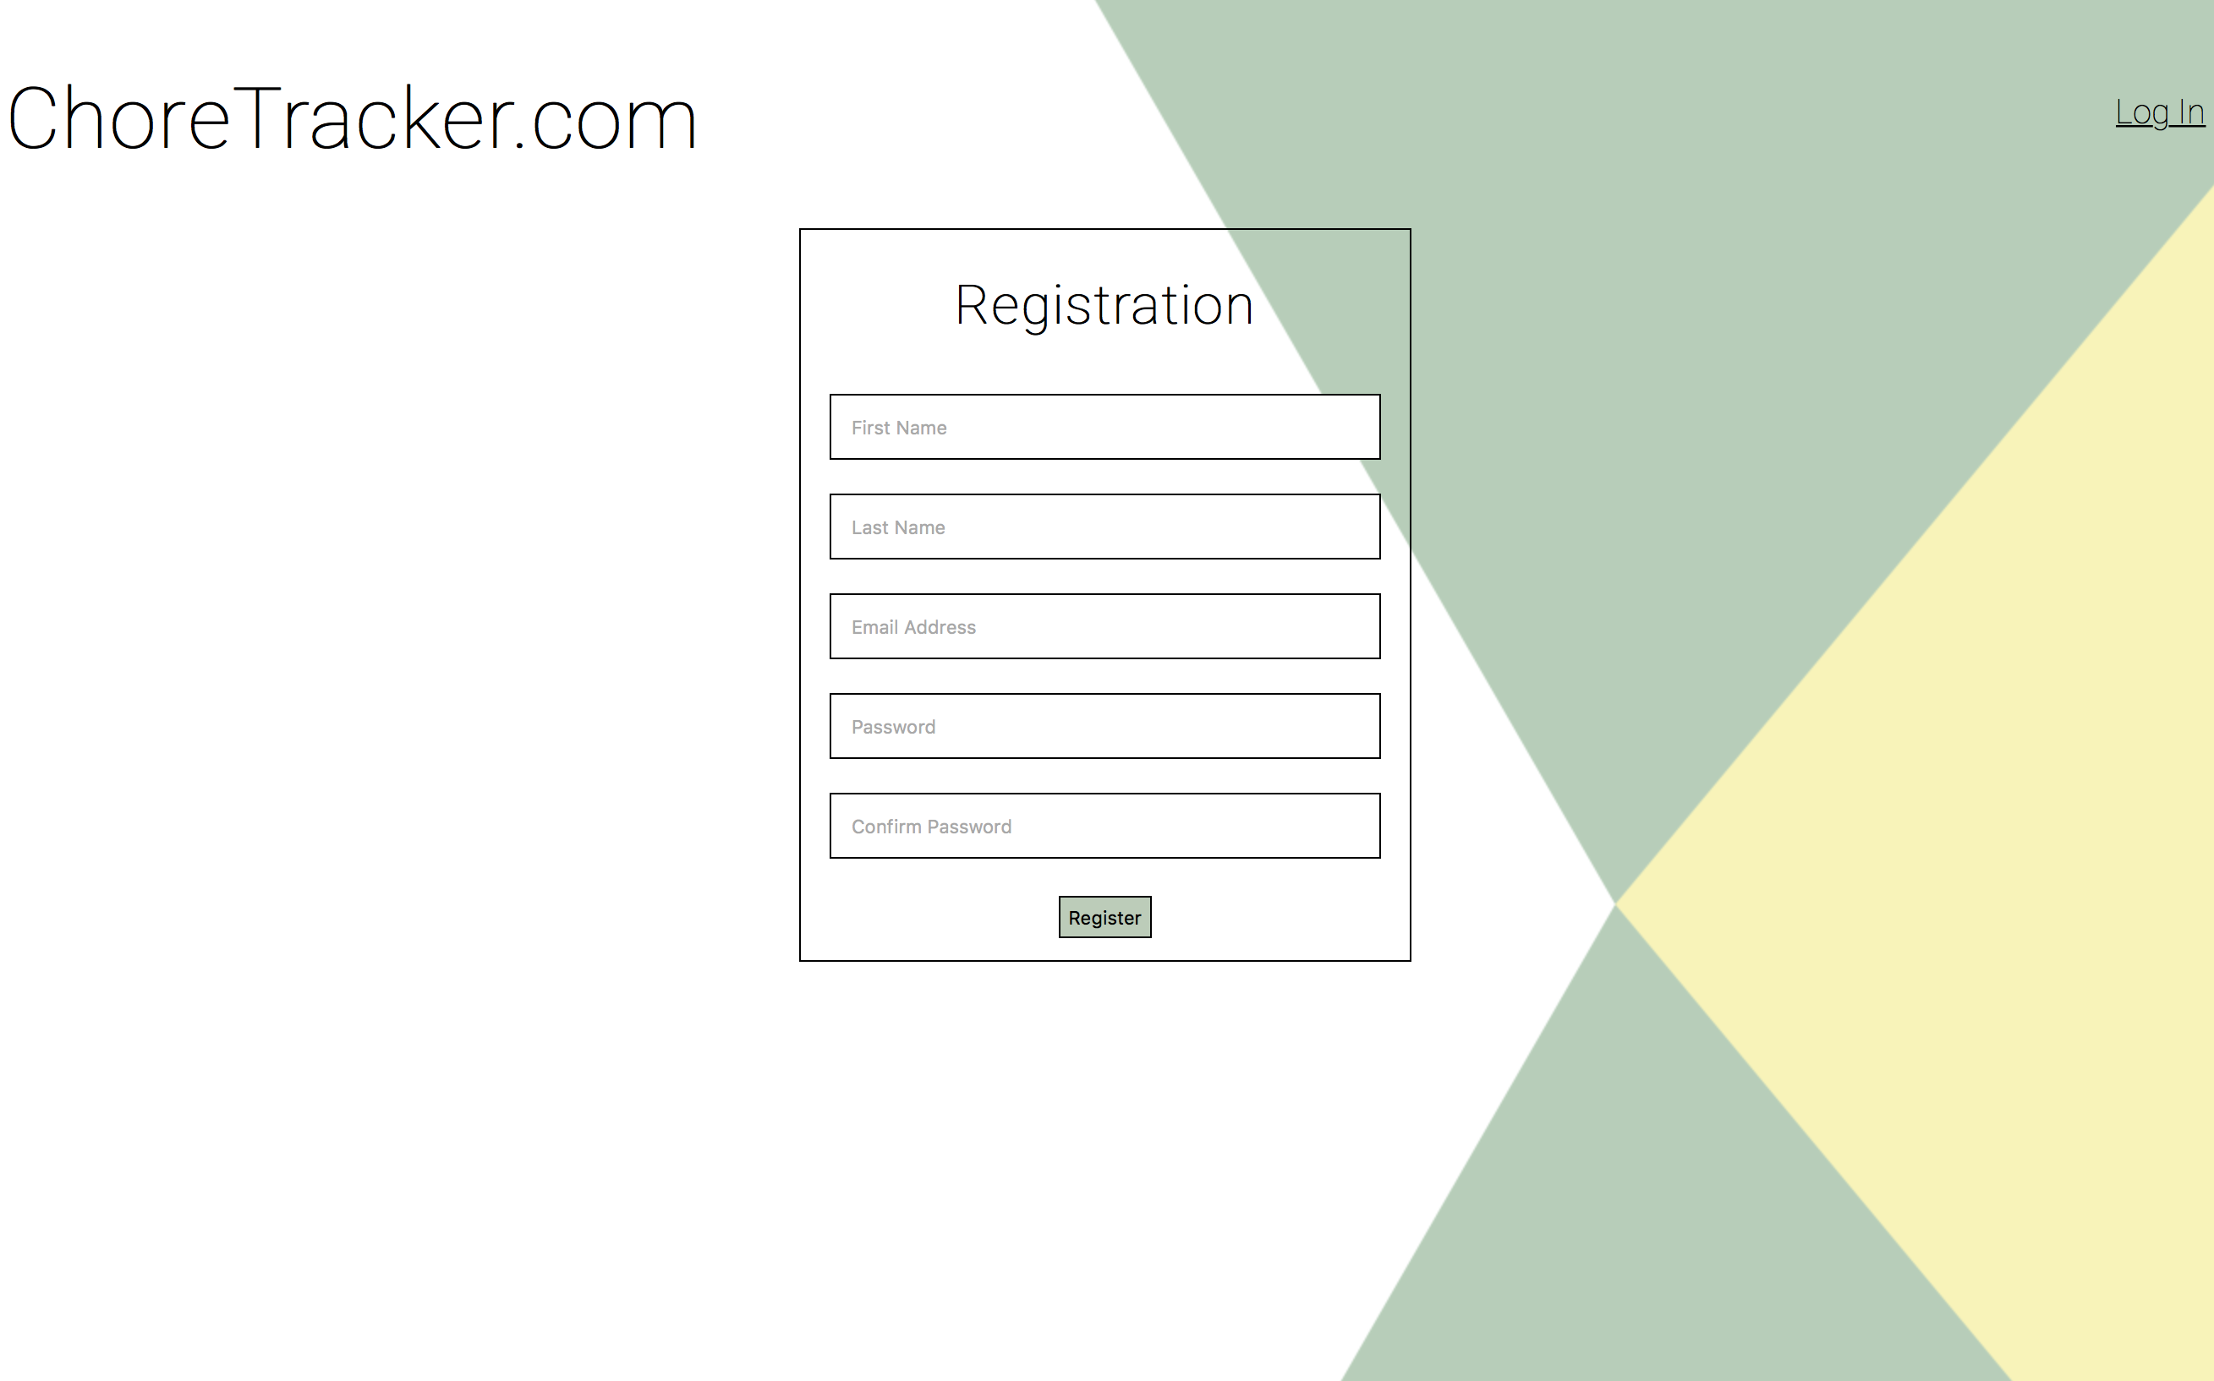
Later Design

Slide 11
Database Schema
Events
eventID
reporterUserID
groupID
choreID
reportedUserID
Users
userID
username
password
salt
email
firstName
lastName
Group_users
groupID
userID
score
Groups
groupID
groupName
groupCode
Chorevalues
choreID
groupID
choreValue
Chores
choreID
choreName
posNeg
Utilized php scripts to access database

Slide 12
Demo
http://localhost:8080/IIT-Project/index.php

Slide 13
Future plans
Rent payment feature
Set rewards for having a high score
ie. Decreasing rent
Set punishments for having low scores
ie. Increasing rent
Incorporate website onto college campuses

Slide 14
questions

