Slide 1
Walmart sct hackathon round 2 team name: risdorn by Rishabh indoria

Slide 2
Predicting hard drive failure
The goal of this project is to develop a model that can predict when a hard drive is likely to fail.
This will help in maintenance, replacement, prevent data loss, cost savings and could also lead to better resource planning.
Similar problems exist in the Healthcare industry, where instead of hard drives we will be predicting failure for medical devices.

Slide 3
Data processing
SMART (Self-Monitoring, Analysis, and Reporting Technology) attributes are diagnostic data points collected by hard drives to monitor their health and predict potential failures.
There are a total of 255 SMART attributes, but any drive reports only 20-40 values.
Initially SMART attributes which correspond to critical state. However, using just these attributes leads to a very poor R2 score.
Instead we try to use all the SMART attributes and reduce them based on number of values available.

Slide 4
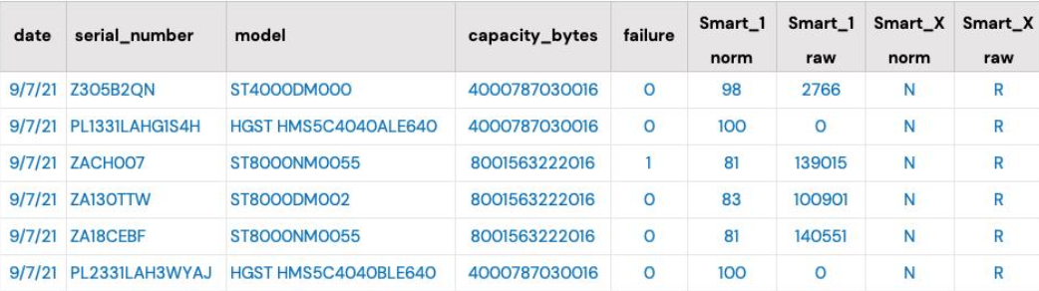

Slide 5
Model building
Linear Regression: Simple and interpretable, assumes linear relationship between features and target variable.
Lasso Regression: Adds penalty to the absolute size of coefficients, promoting sparsity and feature selection.
Decision Tree Regression: Non-linear model that splits data into hierarchical structures, easily interpretable but prone to overfitting.
Random Forest regression: Ensemble learning method combining multiple decision trees to improve predictive performance and reduce overfitting. Offers robustness, and scalability making it suitable for our predictive modeling task.

Slide 6
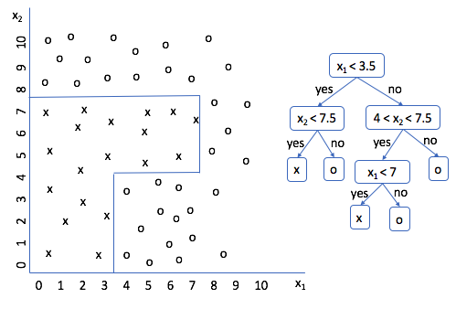
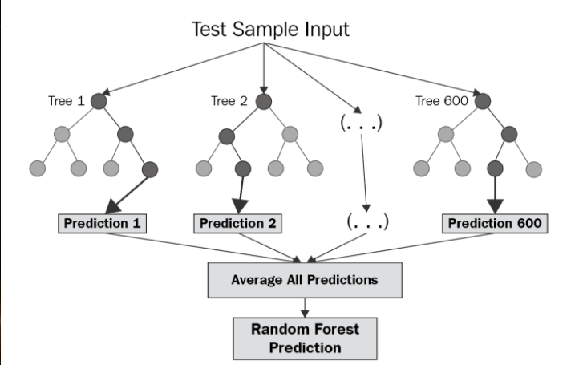

Slide 7
Model evaluation
R2 Score measures the proportion of the variance in the dependent variable (target) that is predictable from the independent variables (features).
Achieved an impressive R2 score of 0.988, indicating high predictive performance on the training dataset.
Obtained a score of 0.386, suggesting that the model's performance on unseen data is less satisfactory compared to the training dataset.

Slide 8
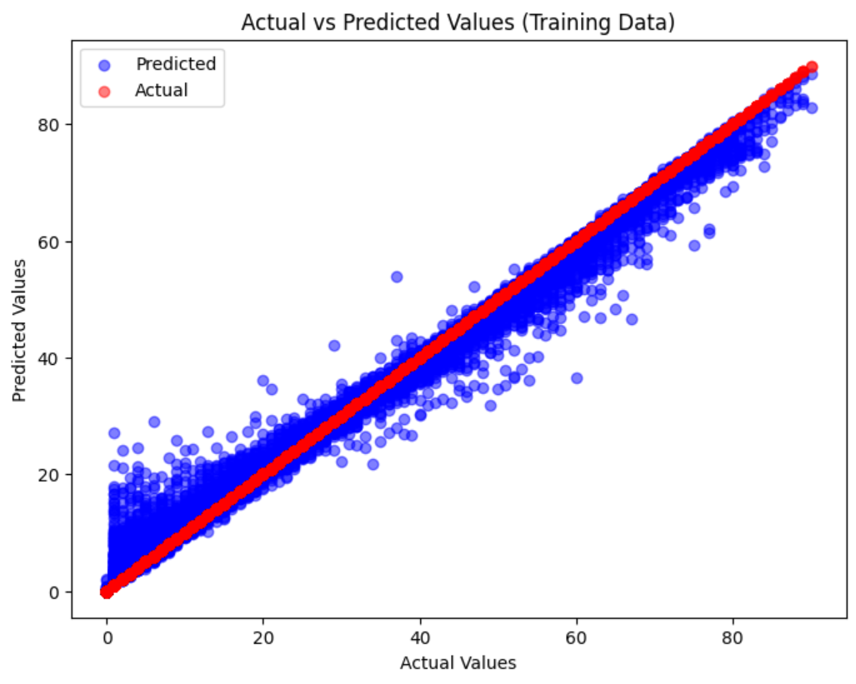
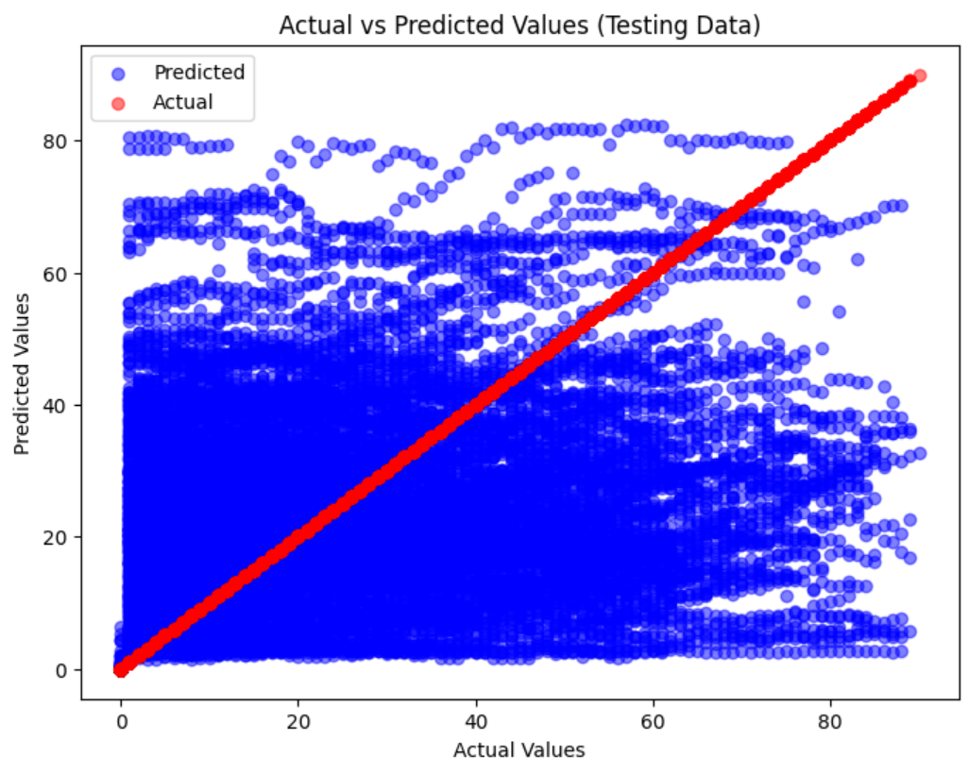

Slide 9
conclusion
In conclusion, our project to predict hard drive failure using machine learning models has shown promising results, but also highlighted key considerations for future improvement.
Adaptability to Changing Data, and Continuous Learning are a few considerations
While our model achieved high accuracy on the training dataset, the drop in performance on the test dataset implies the importance of addressing challenges such as overfitting, and feature engineering.

Slide 10
THANK YOU
Rishabh Indoria
2020A3PS0500P

