Slide 1
TIMELINE MURAL · WORKING PROOF
Beaumont, in one long wall
The mural we can print today — production-grade stand-ins for Kelly's vision — laid end to end with the images still to be sourced shown in place, so the whole story arc is visible and the gaps are honest.
12
ready to print now
9
to re-acquire from source
1800–1988
years spanned

Slide 2
How to read this deck
Each slide is one frame of the mural, in chronological order — walk them front to back and you walk Beaumont from before the town to today.
READY frames are production-grade images we can print now, chosen to match Kelly's curated set. They appear in full colour with their print size.
TO SOURCE frames are Kelly's picks that survive only as low-resolution scans. They appear in grayscale, flagged with where to re-acquire a better original: Track A online, Track B Malki Museum + Morongo Tribe, Track C Library storage.
The caption under each image is written for a visitor to the finished wall. The case for why the image belongs in the timeline is in each slide's speaker notes — your talking points, not the audience's. Captions are draft until facts and rights are confirmed.

Slide 3
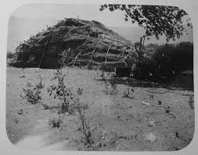
1800
FRAME 1 OF 21
Ceremonial Big House Morongo
A ceremonial Big House on what is today the Morongo Reservation. Long before the town of Beaumont existed, the San Gorgonio Pass was — and remains — the homeland of the Cahuilla and Serrano peoples, with the Big House at the center of ceremonial and community life.
Credit: Unknown
TO SOURCE
TRACK B
Malki Museum / Morongo Band (cultural consent required)
Notes:
WHY THIS IMAGE IS ON THE WALL
The Ceremonial Big House opens the timeline before the town existed — the Pass as Native homeland, the story's necessary first word.
Sourcing status: TO RE-ACQUIRE — no printable version exists. Track B · Malki Museum + Morongo Tribe consult. Source lead: Malki Museum / Morongo Band (cultural consent required).
(Caption is draft visitor-facing text; confirm facts and rights before public use.)

Slide 4
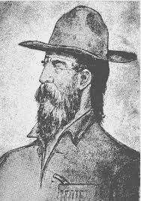
c. 1850s-1860s (Pauline Weaver, d.1867)
FRAME 2 OF 21
Weaver
Pauline Weaver — scout, trapper, and one of the earliest non-Native figures to move through the San Gorgonio Pass. His presence bridges the era of Native homeland and the arrival of American settlers.
Credit: Unknown
TO SOURCE
TRACK A
Calisphere / published portrait
Notes:
WHY THIS IMAGE IS ON THE WALL
Pauline Weaver, frontier scout and namesake presence in the Pass — the human bridge between the Native era and Anglo settlement.
Sourcing status: TO RE-ACQUIRE — no printable version exists. Track A · online (Calisphere / OAC). Source lead: Calisphere / published portrait.
(Caption is draft visitor-facing text; confirm facts and rights before public use.)

Slide 5
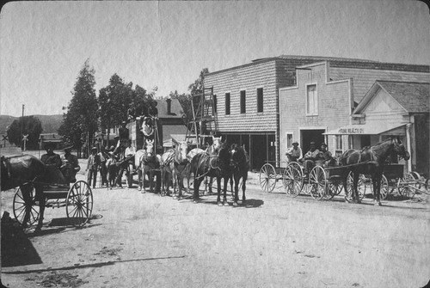
1860
FRAME 3 OF 21
1860S Stagecoach Downtown Beaumont
A stagecoach on Beaumont's dirt main street, around 1860. Before the railroad, the Pass was a stop on the long road west, and the stagecoach was its lifeline to the wider world.
Credit: Unknown
TO SOURCE
TRACK A
Calisphere coll. 1828 / SGPHS
Notes:
WHY THIS IMAGE IS ON THE WALL
A stagecoach on the dirt main street — Beaumont as a stop on the road west, before the railroad changed everything.
Sourcing status: TO RE-ACQUIRE — no printable version exists. Track A · online (Calisphere / OAC). Source lead: Calisphere coll. 1828 / SGPHS.
(Caption is draft visitor-facing text; confirm facts and rights before public use.)

Slide 6
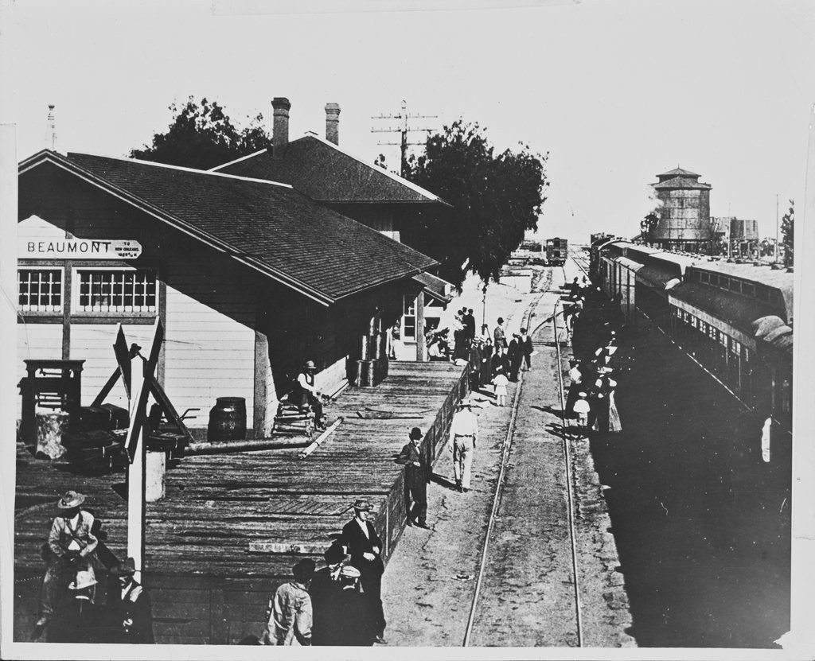
1875
FRAME 4 OF 21
Beaumont Train Depot Calisphere
The Beaumont train depot, 1875. The arrival of the Southern Pacific railroad is the hinge of the whole story — the moment a stretch of ranchland became a townsite with a future.
Credit: Beaumont Library District Local History Collection, via Calisphere
TO SOURCE
TRACK A
Calisphere coll. 1828 (has CBAN/ARK — quick win)
Notes:
WHY THIS IMAGE IS ON THE WALL
The 1875 depot is the hinge of the whole story: the moment the railroad arrived and the townsite was born. Non-negotiable on the wall.
Sourcing status: TO RE-ACQUIRE — no printable version exists. Track A · online (Calisphere / OAC). Source lead: Calisphere coll. 1828 (has CBAN/ARK — quick win).
(Caption is draft visitor-facing text; confirm facts and rights before public use.)

Slide 7
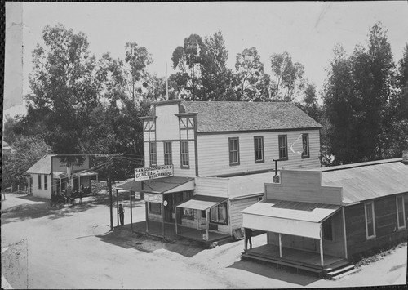
Undated
FRAME 5 OF 21
Post Office
One of Beaumont's earliest post offices. In a young town the post office was among the first institutions of civic life — proof that a scattering of settlers had become a community with a name and an address.
Credit: Beaumont Library District
TO SOURCE
TRACK A
Beaumont Library District
Notes:
WHY THIS IMAGE IS ON THE WALL
The earliest Post Office view — the founding-era civic seed that the c.1910 stand-in later grew from.
Sourcing status: TO RE-ACQUIRE — no printable version exists. Track A · online (Calisphere / OAC). Source lead: Beaumont Library District.
(Caption is draft visitor-facing text; confirm facts and rights before public use.)

Slide 8
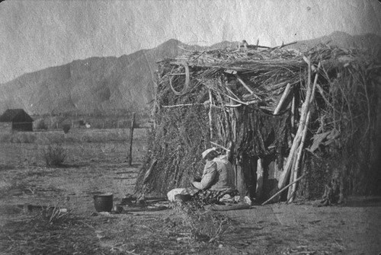
1900
FRAME 6 OF 21
Traditional House On Morongo Reservation
A traditional dwelling on the Morongo Reservation, around 1900. As the new town grew nearby, Native life in the Pass continued — a reminder that Beaumont grew up alongside, not in place of, the people who were here first.
Credit: Unknown
TO SOURCE
TRACK B
Malki Museum / NAA (cultural consent required)
Notes:
WHY THIS IMAGE IS ON THE WALL
A traditional house on the Morongo Reservation, c.1900 — Native life continuing alongside the new town, not erased by it.
Sourcing status: TO RE-ACQUIRE — no printable version exists. Track B · Malki Museum + Morongo Tribe consult. Source lead: Malki Museum / NAA (cultural consent required).
(Caption is draft visitor-facing text; confirm facts and rights before public use.)

Slide 9
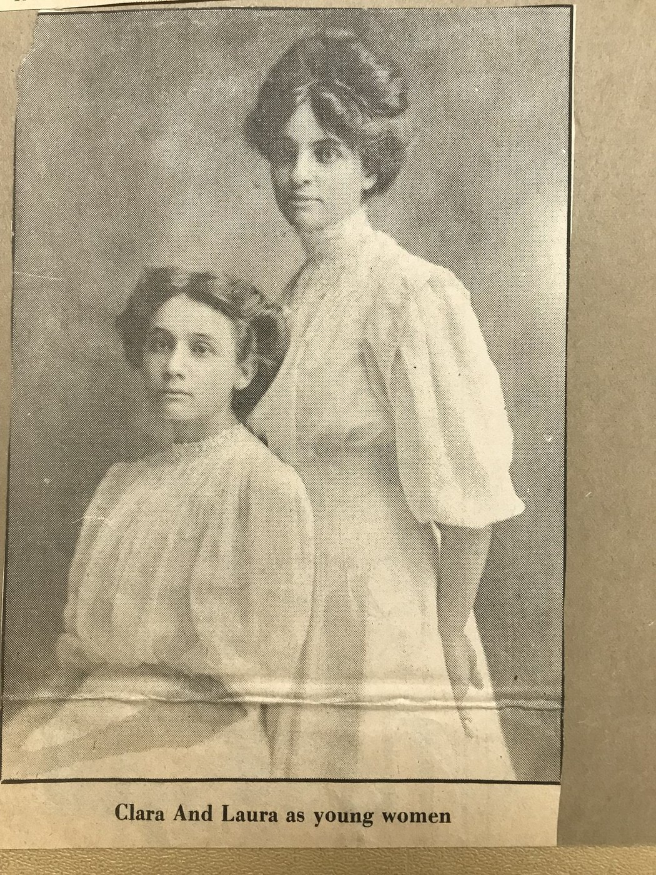
c. 1908-1918
FRAME 7 OF 21
Clara Stewart Left And Laura May Stewart Right
Clara and Laura May Stewart on the family ranch, around 1908. The Stewarts were among the pioneer families who worked the land in Beaumont's early years — and this rare frame keeps the women of the ranch in the picture.
Credit: Unknown
READY · 24.2" @150 PPI
Notes:
WHY THIS IMAGE IS ON THE WALL
Ranch women in the saddle — the Stewart daughters put Beaumont's pioneer founding families on the wall, and a rare frame of frontier women who ran the land.
Production status: ready to print — 24.2" long edge at 150 PPI (3024×4032 px). Taste-matched stand-in for Kelly's curated vision.
(Caption is draft visitor-facing text; confirm facts and rights before public use.)

Slide 10
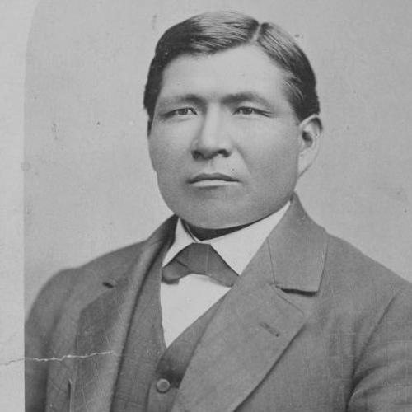
1908
FRAME 8 OF 21
Morongo Band Of Mission Indians
Members of the Morongo Band of Mission Indians, 1908. A portrait of the Pass's original community as a living people — central to any honest telling of Beaumont's timeline.
Credit: Unknown
TO SOURCE
TRACK B
Malki Museum / USC / NAA (cultural consent required)
Notes:
WHY THIS IMAGE IS ON THE WALL
The Morongo Band of Mission Indians, 1908 — a portrait of the Pass's original community as a living people, central to an honest timeline.
Sourcing status: TO RE-ACQUIRE — no printable version exists. Track B · Malki Museum + Morongo Tribe consult. Source lead: Malki Museum / USC / NAA (cultural consent required).
(Caption is draft visitor-facing text; confirm facts and rights before public use.)

Slide 11
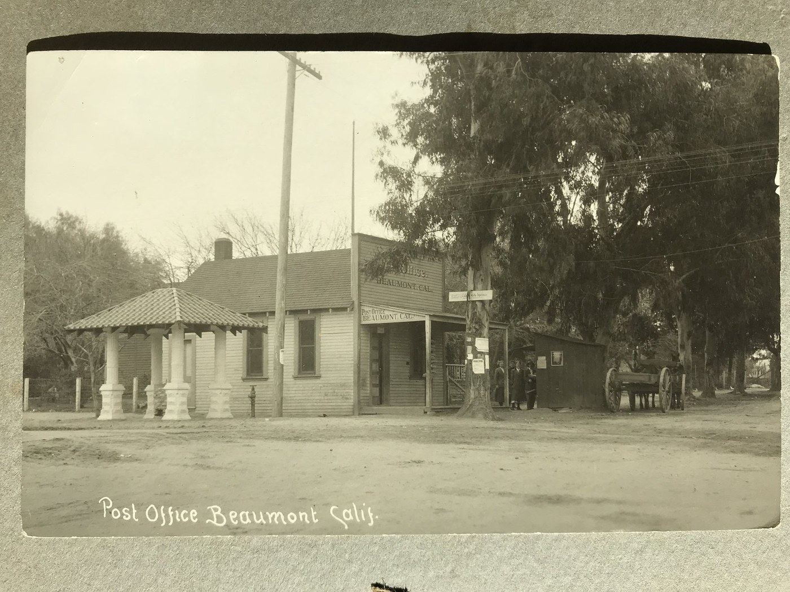
c. 1910-1915
FRAME 9 OF 21
Beaumont Post Office Ne Corner Fifth St And Egan Ave
The Beaumont Post Office at Fifth Street and Egan Avenue, about 1910. For decades this corner was the heart of the young town's public life — where residents collected mail, traded news, and crossed paths downtown.
Credit: Unknown
READY · 24.2" @150 PPI
Notes:
WHY THIS IMAGE IS ON THE WALL
The Post Office at Fifth & Egan anchors the young town's civic core — the corner that was, for decades, the center of Beaumont's public life.
Production status: ready to print — 24.2" long edge at 150 PPI (4032×3024 px). Taste-matched stand-in for Kelly's curated vision.
(Caption is draft visitor-facing text; confirm facts and rights before public use.)

Slide 12
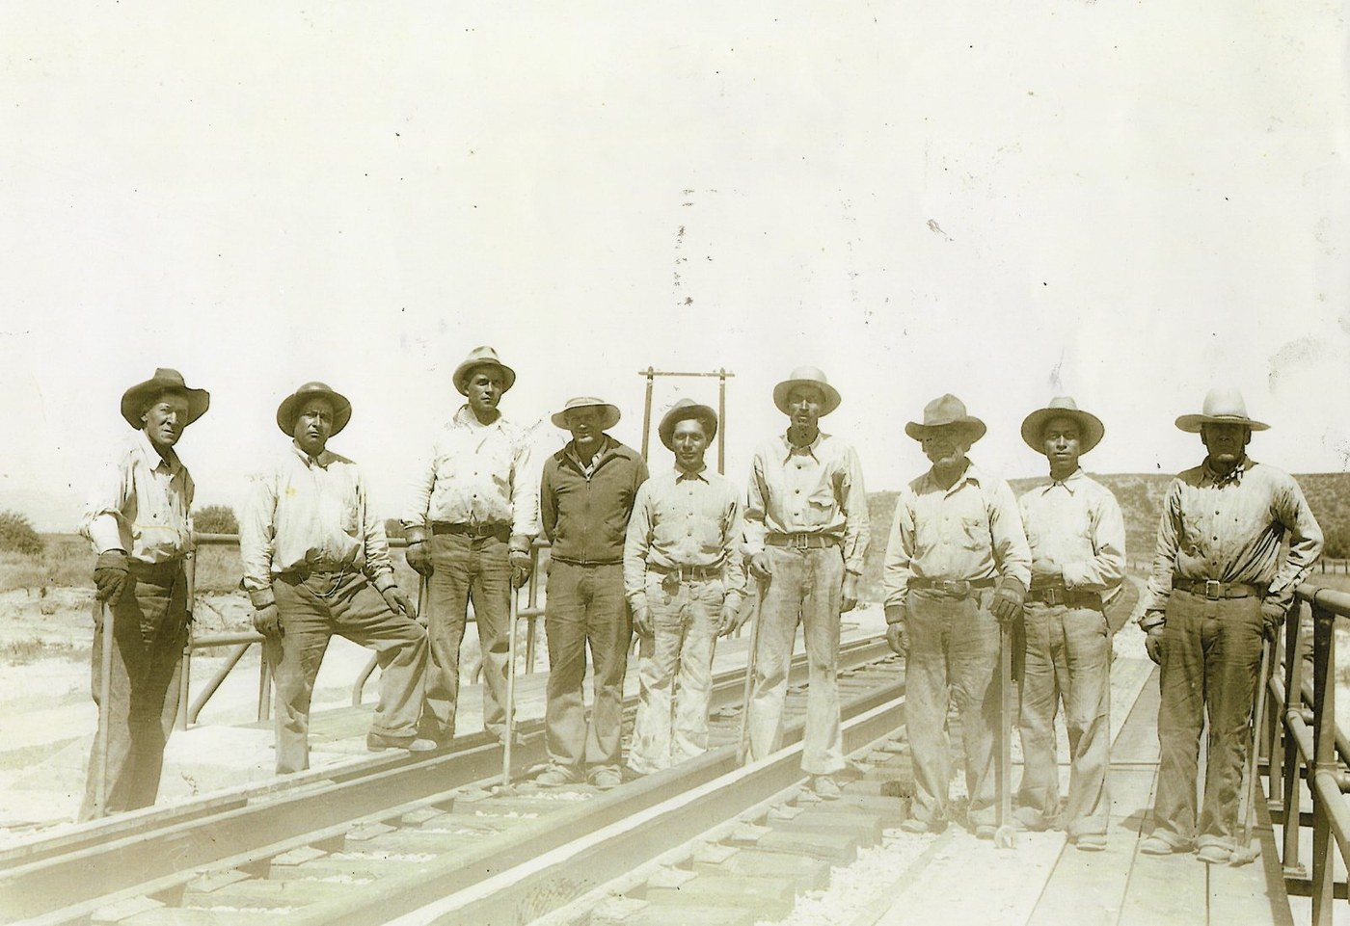
c. 1910-1935
FRAME 10 OF 21
Railroad Workers Luis Estrada Fourth From Right
A Southern Pacific railroad crew around 1910, Luis Estrada fourth from the right. The railroad made Beaumont possible, and the Latino laborers who built and kept the line were central to the town's growth.
Credit: Estrada family collection
READY · 35.7" @150 PPI
Notes:
WHY THIS IMAGE IS ON THE WALL
Railroad crew with Luis Estrada — the Southern Pacific line built Beaumont, and this frame credits the Latino labor that laid and kept the track.
Production status: ready to print — 35.7" long edge at 150 PPI (5954×4085 px). Taste-matched stand-in for Kelly's curated vision.
(Caption is draft visitor-facing text; confirm facts and rights before public use.)

Slide 13
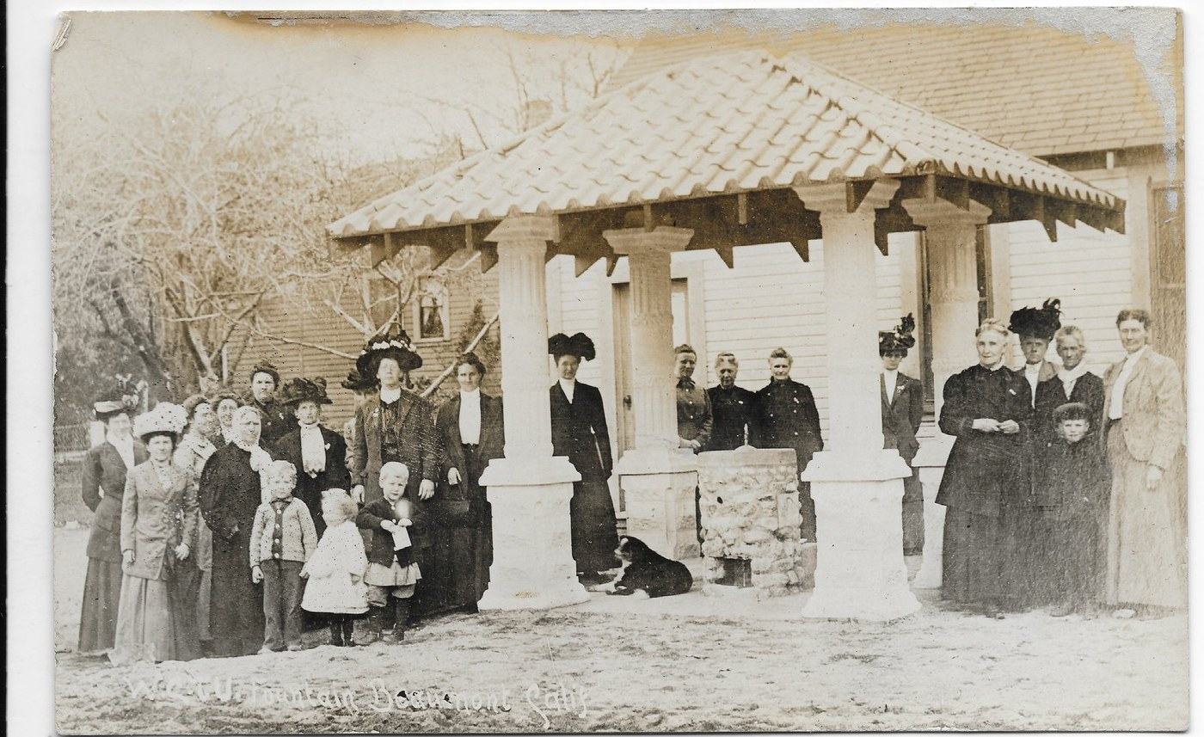
1910
FRAME 11 OF 21
Wctu Fountain
The Woman's Christian Temperance Union fountain, 1910. It offered clean water to people and horses alike, and stood as a very public sign that the era's great reform movements reached even a small Pass town.
Credit: Leslie A. Rios III Postcard Collection
READY · 41.6" @150 PPI
Notes:
WHY THIS IMAGE IS ON THE WALL
The WCTU fountain is Beaumont's monument to the temperance movement — proof that national social currents ran straight through a small Pass town.
Production status: ready to print — 41.6" long edge at 150 PPI (6926×4236 px). Taste-matched stand-in for Kelly's curated vision.
(Caption is draft visitor-facing text; confirm facts and rights before public use.)

Slide 14
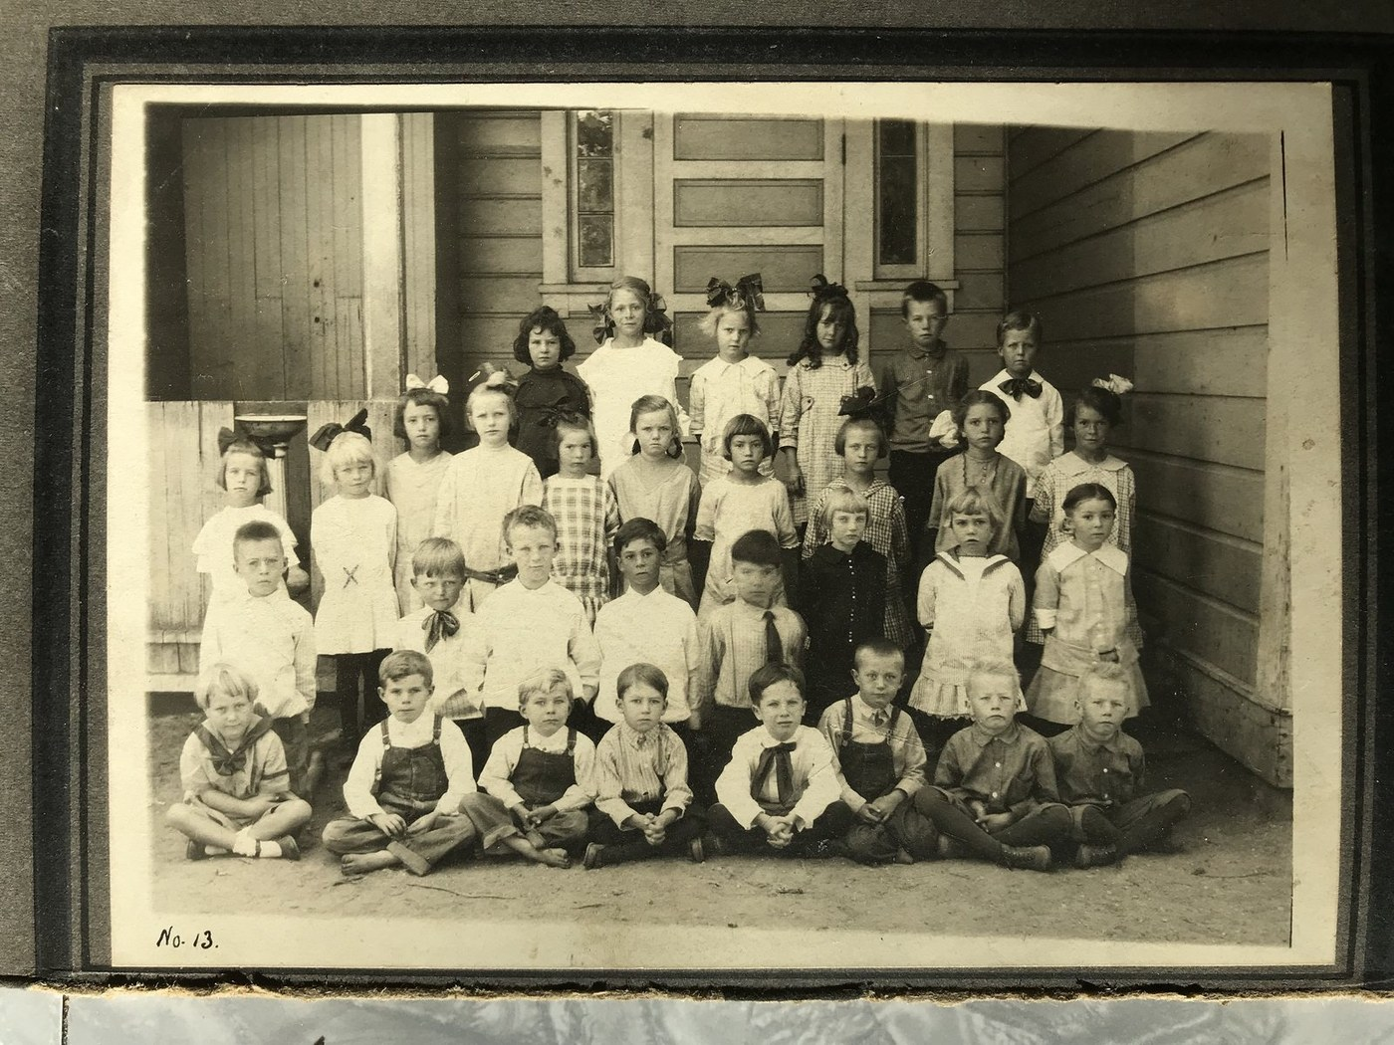
1916
FRAME 12 OF 21
Wellwood School
Wellwood School, 1916. As Beaumont grew from scattered ranches into a community, it built schools to raise its own — the mark of families putting down roots.
Credit: Beaumont Library District
READY · 24.2" @150 PPI
Notes:
WHY THIS IMAGE IS ON THE WALL
Wellwood School — the arrival of formal education marks the town's shift from settlement to community raising its own.
Production status: ready to print — 24.2" long edge at 150 PPI (4032×3024 px). Taste-matched stand-in for Kelly's curated vision.
(Caption is draft visitor-facing text; confirm facts and rights before public use.)

Slide 15
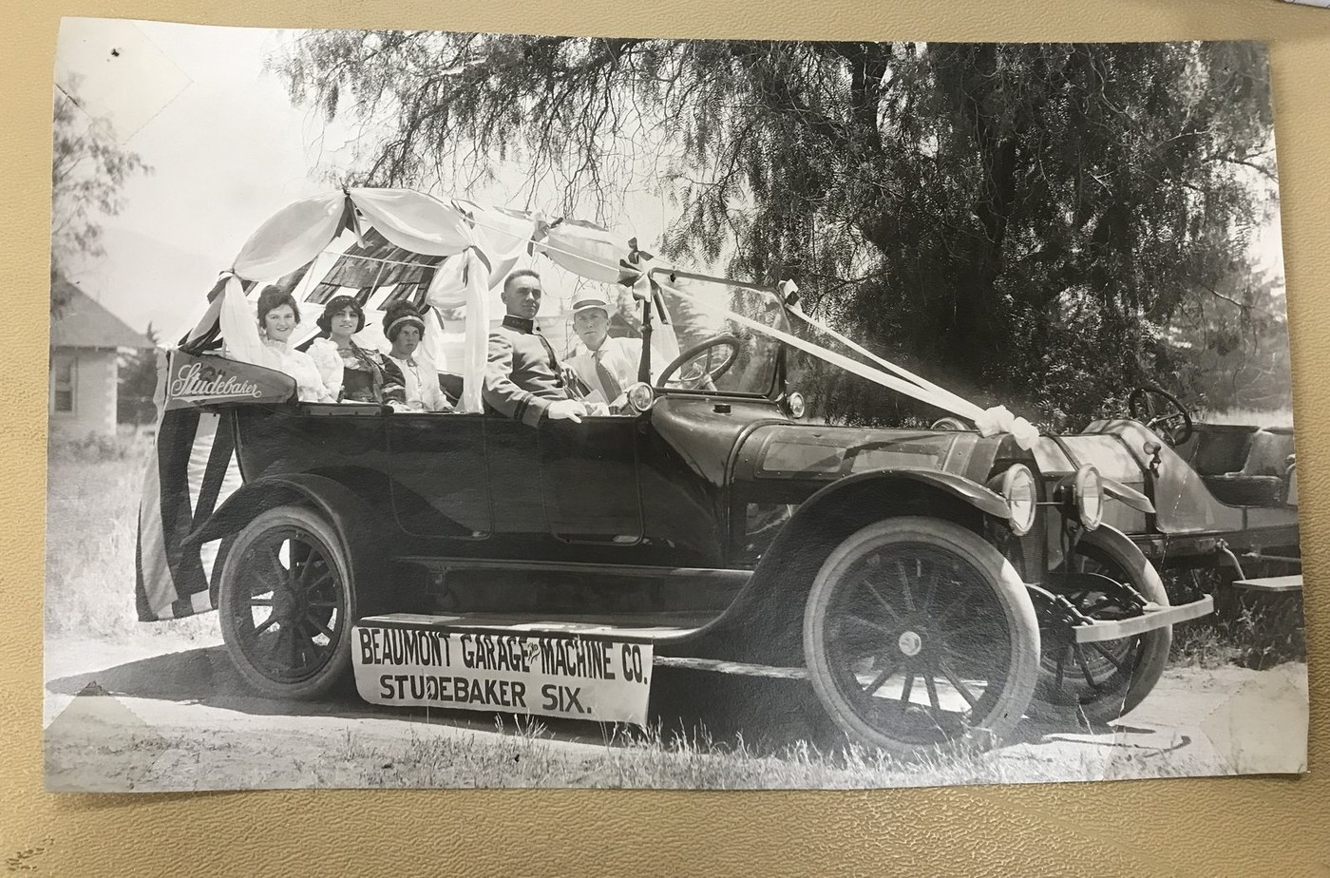
1919
FRAME 13 OF 21
Cherry Festival Queen
The Cherry Festival Queen, 1919. Beaumont's orchards made it cherry country, and the annual festival turned the harvest into the town's signature celebration — a tradition that still shapes local identity.
Credit: San Gorgonio Pass Historical Society
READY · 24.2" @150 PPI
Notes:
WHY THIS IMAGE IS ON THE WALL
The Cherry Festival Queen crowns Beaumont's identity as cherry country — the orchards were both the economy and the civic celebration.
Production status: ready to print — 24.2" long edge at 150 PPI (4032×2661 px). Taste-matched stand-in for Kelly's curated vision.
(Caption is draft visitor-facing text; confirm facts and rights before public use.)

Slide 16
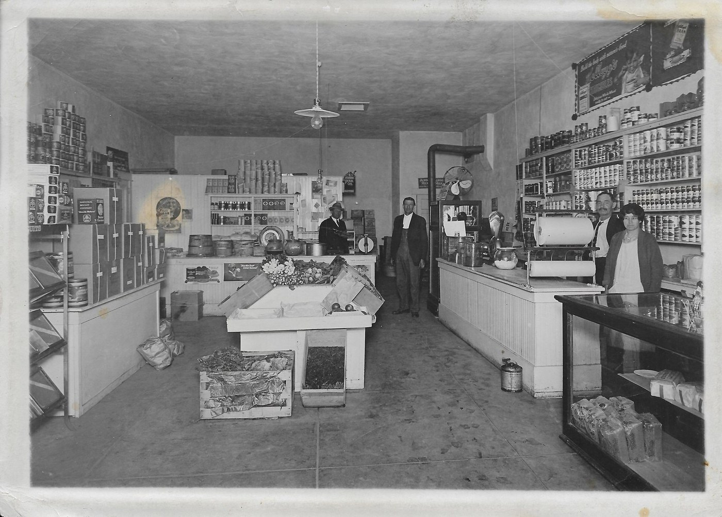
c. 1920s
FRAME 14 OF 21
George Sumner S And S Store On Fifth Street Interior
Inside George Sumner's S&S Store on Fifth Street in the 1920s. Beyond the civic buildings lay the everyday downtown — the counters where residents actually spent their days and their dollars.
Credit: Unknown
READY · 24.8" @150 PPI
Notes:
WHY THIS IMAGE IS ON THE WALL
Inside the S&S Store on Fifth Street — Main Street commerce, the daily downtown that a wall of civic buildings alone would miss.
Production status: ready to print — 24.8" long edge at 150 PPI (4133×2965 px). Taste-matched stand-in for Kelly's curated vision.
(Caption is draft visitor-facing text; confirm facts and rights before public use.)

Slide 17
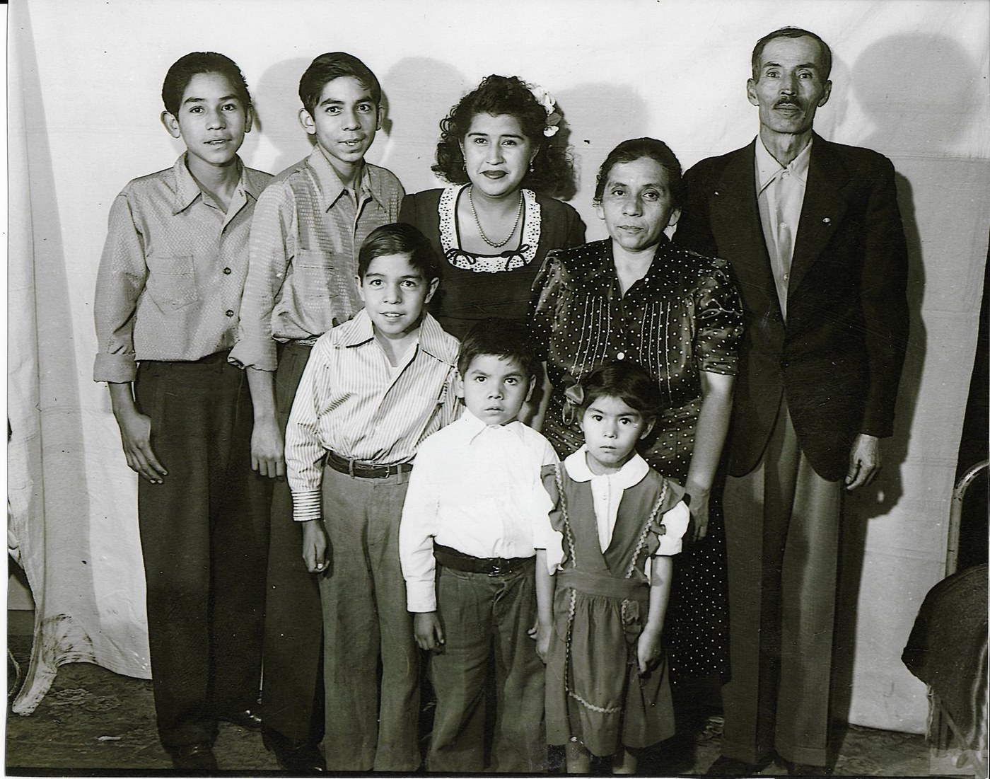
c. 1940s
FRAME 15 OF 21
Luis Estrada Family In Their Southern Pacific Railroad Section House Leslie Collection
The Estrada family beside their Southern Pacific home in the 1940s. A generation on from the railroad crews, the image shows a family rooted in Beaumont — the human story behind the town's founding industry.
Credit: Estrada family collection
READY · 36.4" @150 PPI
Notes:
WHY THIS IMAGE IS ON THE WALL
The Estrada family beside their Southern Pacific home — the railroad story carried forward a generation, from labor to a rooted Beaumont family.
Production status: ready to print — 36.4" long edge at 150 PPI (6068×4770 px). Taste-matched stand-in for Kelly's curated vision.
(Caption is draft visitor-facing text; confirm facts and rights before public use.)

Slide 18
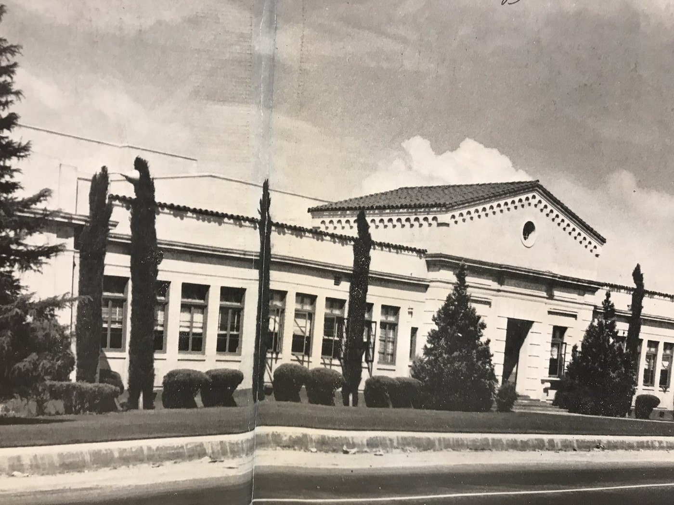
1942
FRAME 16 OF 21
Beaumont High School
Beaumont High School, 1942. By mid-century the town's schools had come of age, and generation after generation of residents passed through these halls.
Credit: donated by Leslie Rios
READY · 24.2" @150 PPI
Notes:
WHY THIS IMAGE IS ON THE WALL
Beaumont High School — education come of age, the institution that a whole mid-century generation of residents passed through.
Production status: ready to print — 24.2" long edge at 150 PPI (4032×3024 px). Taste-matched stand-in for Kelly's curated vision.
(Caption is draft visitor-facing text; confirm facts and rights before public use.)

Slide 19
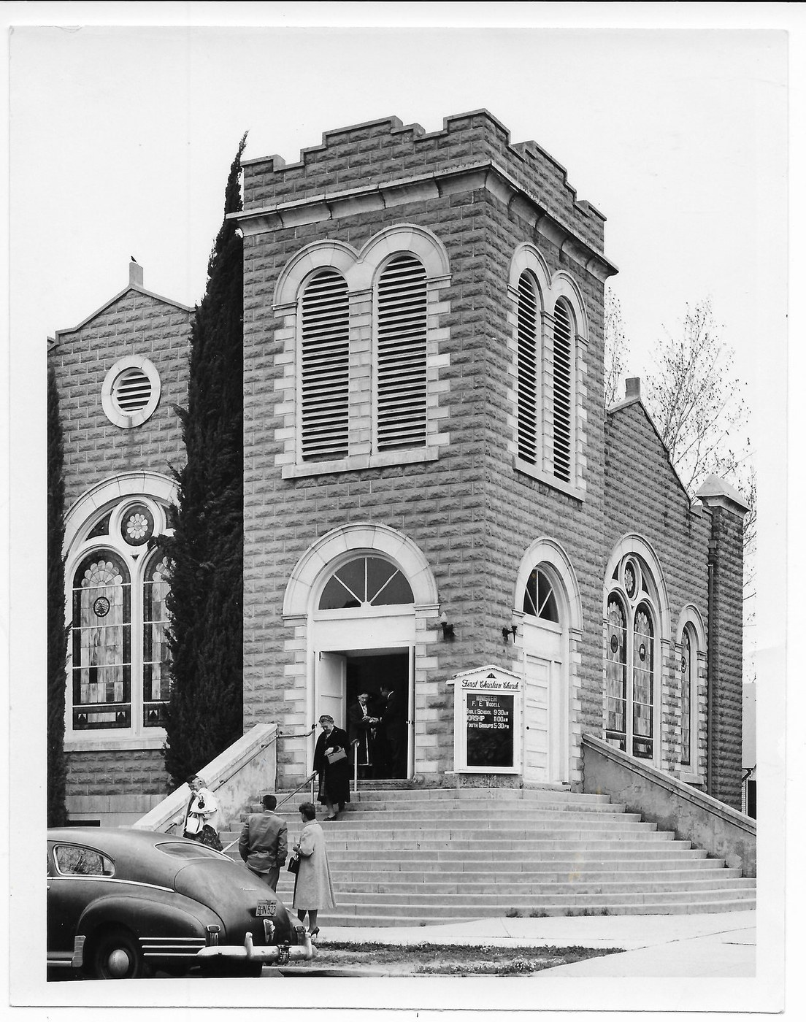
1950
FRAME 17 OF 21
First Christian Church Egan Ave Probably Late 1950S A
First Christian Church on Egan Avenue, about 1950. A mainline congregation at the town's civic center — shown alongside Sacred Heart to reflect a Beaumont of many communities worshiping side by side.
Credit: Unknown
READY · 24.0" @150 PPI
Notes:
WHY THIS IMAGE IS ON THE WALL
First Christian Church on Egan — the mainline civic congregation, paired with Sacred Heart to show a town of two communities worshiping side by side.
Production status: ready to print — 24.0" long edge at 150 PPI (3152×3997 px). Taste-matched stand-in for Kelly's curated vision.
(Caption is draft visitor-facing text; confirm facts and rights before public use.)

Slide 20
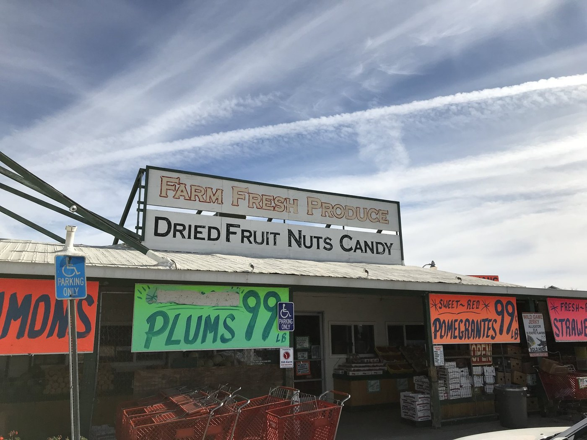
c. 1950s-1960s
FRAME 18 OF 21
Dowling Orchard Fruit Fresh Produce And Dried Fruit Nuts Candy Signs
The Dowling orchard and packing store in the 1950s. At the fruit industry's height, Beaumont's fresh and dried produce carried the Pass's name far beyond the valley.
Credit: Unknown
READY · 24.2" @150 PPI
Notes:
WHY THIS IMAGE IS ON THE WALL
The Dowling orchard and packing store at the industry's peak — dried fruit and fresh produce that shipped the Pass's name outward.
Production status: ready to print — 24.2" long edge at 150 PPI (4032×3024 px). Taste-matched stand-in for Kelly's curated vision.
(Caption is draft visitor-facing text; confirm facts and rights before public use.)

Slide 21
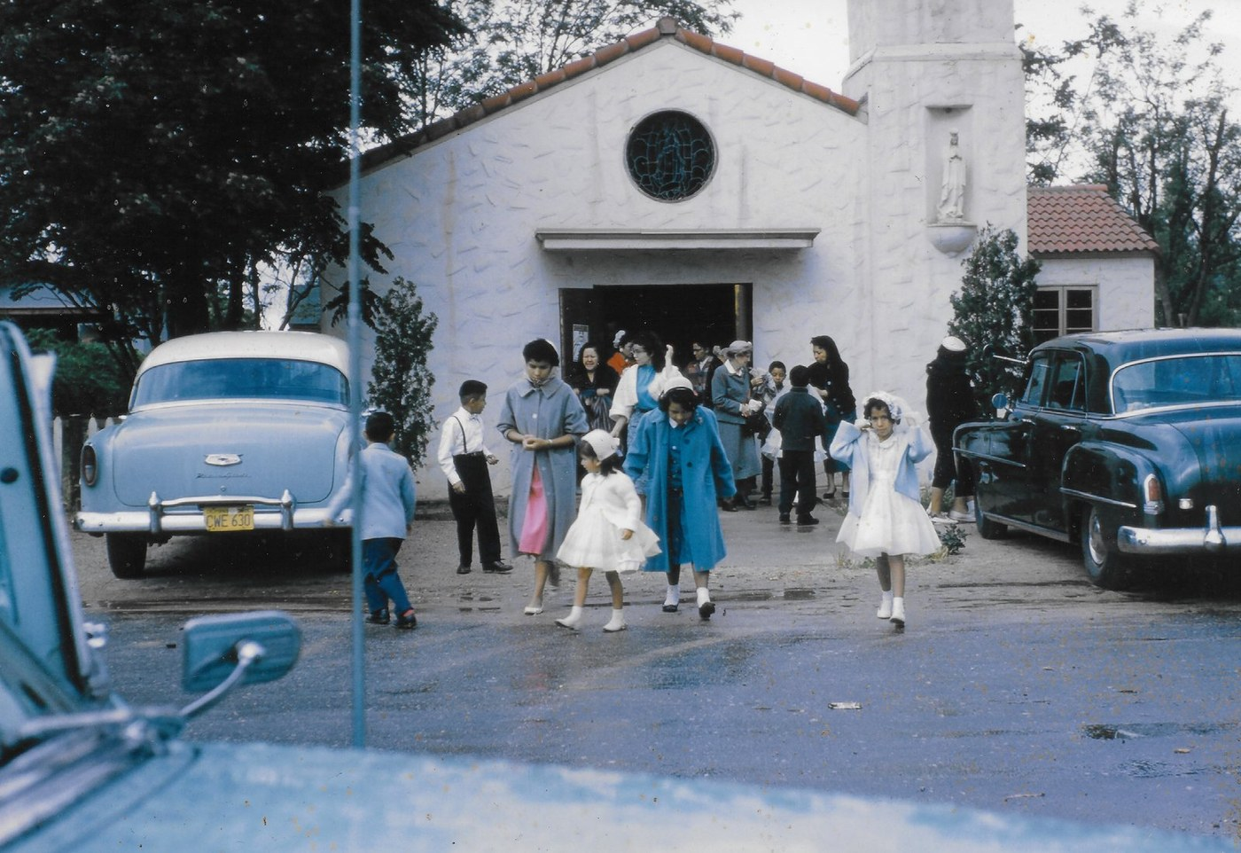
c. late 1950s
FRAME 19 OF 21
Sacred Heart Barrio Church From Leslie Rios
Sacred Heart church in the barrio, late 1940s. A center of faith and gathering for Beaumont's Mexican-American community, it anchored a neighborhood essential to the full story of the town.
Credit: Leslie A. Rios III Postcard Collection
READY · 49.5" @150 PPI
Notes:
WHY THIS IMAGE IS ON THE WALL
Sacred Heart barrio church — the faith and gathering place of Beaumont's Mexican-American community, and one of the few large-format survivors.
Production status: ready to print — 49.5" long edge at 150 PPI (8258×5670 px). Taste-matched stand-in for Kelly's curated vision.
(Caption is draft visitor-facing text; confirm facts and rights before public use.)

Slide 22
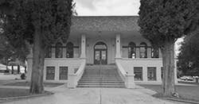
1965
FRAME 20 OF 21
Expansion Mansard Roof
A new mansard-roofed building marks Beaumont's postwar expansion, 1965. As the mid-century town modernized, it began to outgrow its founding footprint.
Credit: Unknown
TO SOURCE
TRACK C
Library storage / Record Gazette
Notes:
WHY THIS IMAGE IS ON THE WALL
The 1960s mansard-roof expansion — postwar Beaumont modernizing, the town outgrowing its founding footprint.
Sourcing status: TO RE-ACQUIRE — no printable version exists. Track C · Library storage / newspaper morgue. Source lead: Library storage / Record Gazette.
(Caption is draft visitor-facing text; confirm facts and rights before public use.)

Slide 23
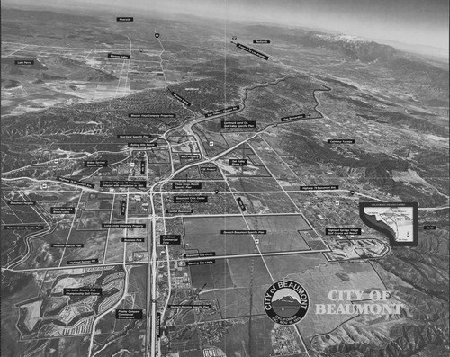
1988
FRAME 21 OF 21
Beaumont Developments
New development on the edge of Beaumont, 1988. Near the end of the timeline, the town starts its turn toward the growing commuter community it is today.
Credit: Unknown
TO SOURCE
TRACK C
Library storage / Record Gazette
Notes:
WHY THIS IMAGE IS ON THE WALL
Late-century development — the timeline's near end, Beaumont becoming the commuter town it is today.
Sourcing status: TO RE-ACQUIRE — no printable version exists. Track C · Library storage / newspaper morgue. Source lead: Library storage / Record Gazette.
(Caption is draft visitor-facing text; confirm facts and rights before public use.)

Slide 24
What we need to finish the wall
Track A · Online (4)
Calisphere coll. 1828/1582, OAC, Record Gazette. Start with the 1875 Depot — it's already online with an ARK.
Weaver · 1860S Stagecoach Downtown Beaumont · Beaumont Train Depot Calisphere · Post Office
Track B · Malki + Tribe (3)
Malki Museum sourcing AND Morongo Tribe cultural consent before any public use of the Native-heritage images.
Ceremonial Big House Morongo · Traditional House On Morongo Reser · Morongo Band Of Mission Indians
Track C · Storage (2)
The unindexed Library storage. Bring the printed pull-list; triage on the first visit.
Expansion Mansard Roof · Beaumont Developments

