Slide 1
Where NV electromagnetically induced transparency lives,
and where it inverts
Risei Abe
Department of Electrical and Electronic Engineering
Institute of Science Tokyo
Group seminar / progress report

Slide 2
Outline
1. Introduction
What EIT is, why NV, and what we ask
2. Method
The criterion, how each point is judged, and the check against the literature
3. Results
The island, room temperature, the sign reversal, the field
4. Discussion
What to measure, and why room temperature fails
5. Summary
Operating window fixed; experiment this year

Slide 3
I. Introduction

Slide 4
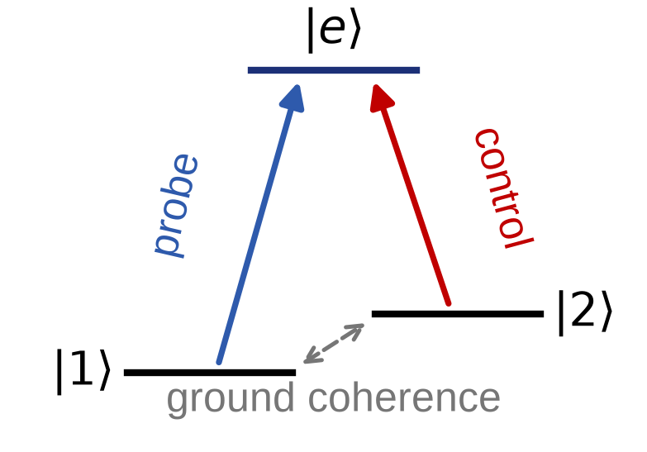
A control laser makes two excitation paths interfere, turning an absorber transparent.
Introduction 1: What EIT is
• Two ground states, one excited state: the Λ system.
• The two absorption paths cancel at two-photon resonance.
• Population is trapped in a dark state that the light cannot excite.
• Requires a long-lived ground coherence: it is destroyed by dephasing.
In the ideal Λ system probe absorption vanishes at two-photon resonance when the ground coherence is long-lived.
[1] M. Fleischhauer, A. Imamoğlu and J. P. Marangos, Rev. Mod. Phys. 77, 633 (2005).

Slide 5
We turned to NV because the group-IV centres that motivated us have no settled model.
Introduction 2: Why NV is the test bed
SiV / SnV — where we started
• Inversion symmetric: optical line robust against electric noise
• Orbital Λ channel, no spin-overlap obstruction
• Room-temperature EIT was the hope
• But: excited-state Hamiltonian and phonon rates not settled
NV — where we can compute
• ³E Hamiltonian measured and published
• Phonon-induced orbital hopping rate Γₓᵧ(T) measured
• Cryogenic ensemble EIT already demonstrated
• So the theory can be tested against something known
Strategy: build the criterion on NV, where every input is known, then carry the same criterion back to group-IV.
NV wins as a test bed not on material grounds but because its excited-state model and phonon rates are independently measured.
[2] L. J. Rogers et al., Phys. Rev. Lett. 113, 263602 (2014). [3] M. W. Doherty et al., Phys. Rep. 528, 1 (2013).

Slide 6
We ask whether NV EIT survives to room temperature, and if not, exactly where it stops.
Introduction 3: The question
Is room-temperature NV EIT possible?
If not — up to what temperature can it be observed at all?
• Known: NV ensemble EIT is demonstrated at cryogenic temperature.
• Missing: any microscopic account of why it disappears on warming.
• The usual answer — “dephasing grows” — predicts only a monotone fade. It predicts no lower bound, no field threshold, and no change of sign.
• All three occur.
Cryogenic NV ensemble EIT is established; no published work fixes its upper temperature limit or its collapse mechanism.
[4] V. M. Acosta et al., Phys. Rev. Lett. 110, 213605 (2013). [5] C. Santori et al., Phys. Rev. Lett. 97, 247401 (2006).

Slide 7
II. Method

Slide 8
A no-go says the targeted pathway contributes nothing — not that the total response vanishes.
Method 1: What a no-go actually claims
✗ The tempting definition
“EIT is forbidden when χ_full = 0”
✓ The correct object
δχₛ ≡ χ_full − χ_cut ≡ 0
χ_full = 0 is what perfect EIT looks like.
Ideal Λ system, worked through
cut (pathway removed) Ξ_cut = 1
full (pathway intact) Ξ_full = 0 ← response vanishes
sector correction δΞₛ = −1 ← maximally non-zero
The pathway cut is an algebraic counterfactual (B = C = 0 with the steady state held fixed), not a control-off measurement.
[6] D. Finkelstein-Shapiro et al., Phys. Rev. A 99, 053829 (2019).

Slide 9
Built from the response kernel, the criterion holds for any Markovian emitter.
Method 2: A material-independent criterion
Material
H, jump operators,
dipoles
Kernel
Kᵢⱼ = dᵢ† G(z) dⱼ
Test
δχₛ = 0
⇔ K₁₂K₂₁ = 0
Verdict
no-go / suppressed /
go
• Nothing in the test is specific to NV, to diamond, or even to optics.
• Already applied to group-IV centres (SiV, SnV) and to a non-optical witness.
• What changes between materials is only which pathway is closed and by what.
For the scalar block, δχₛ vanishes identically if and only if the product of the two Raman vertices K₁₂K₂₁ vanishes.
[7] K. Zhou et al., J. Phys. A 58, 095303 (2025). [8] X. Zhao, L.-M. Kuang and J.-Q. Liao, Phys. Rev. A 113, 013723 (2026).

Slide 10
We judge every point by three criteria at once, because a dip alone identifies nothing.
Method 3: How each operating point is judged
1. Sign
Does the pathway reduce or
increase absorption?
C > 0 transparency
C < 0 induced absorption
2. Containment
Is the feature actually inside
the scan window?
adaptive two-photon window
(widths span 3 decades)
3. Lineshape
EIT interference, or
Autler–Townes doublet?
AIC model comparison
|ΔAIC| ≥ 6
• Physics from the full 9-level Lindblad generator — no adiabatic elimination.
• 240 grid points over T = 20–115 K and B⊥ = 0–0.5 T; each point gets one of four labels.
A strong control gives an Autler–Townes doublet even with zero ground coherence, so a dip alone cannot establish EIT.
[9] P. M. Anisimov, J. P. Dowling and B. C. Sanders, Phys. Rev. Lett. 107, 163604 (2011).

Slide 11
Our response kernel returns the density matrix the EIT literature derives.
Method 4: The kernel reproduces the literature result
Ideal Λ system, weak probe
A ρₑ₁ + B ρ₂₁ = b_p and C ρₑ₁ + G_g ρ₂₁ = 0
Eliminate the optical block — G_g is never inverted: S_g = G_g − C A⁻¹B
⟹ ρₑ₁ = b_p / (A + β/G_g), β = |Ω_c|²/4
ρₑ₁ = (iΩ_p/2) / [ γ₃₁ + iδ_p + (|Ω_c|²/4) / (γ₂₁ + i(δ_p − δ_c)) ]
identical, term by term, to Fleischhauer RMP 77, 633 (2005)
N_e branches — the NV case: K₁₂ = Σⱼ d₁ⱼ* d₂ⱼ / aⱼ, a coherent sum, same Ξ.
δ_p = δ_c = 0, γ₂₁ → 0: χ_full = 0 while δΞₛ = −1 — Method 1, derived.
Textbook Λ susceptibility recovered exactly; the full Liouvillian reproduces the archived 70 K contrast to 0.25 %.
[1] M. Fleischhauer, A. Imamoğlu and J. P. Marangos, Rev. Mod. Phys. 77, 633 (2005). Multilevel form: [16] O. S. Mishina et al., Phys. Rev. A 83, 053809 (2011); group theory note §9.6–9.7.
Symbolic check (N_e = 1–4): calculations/symbolic/verify_lambda_reduction.py. Benchmark: [4].

Slide 12
III. Results

Slide 13
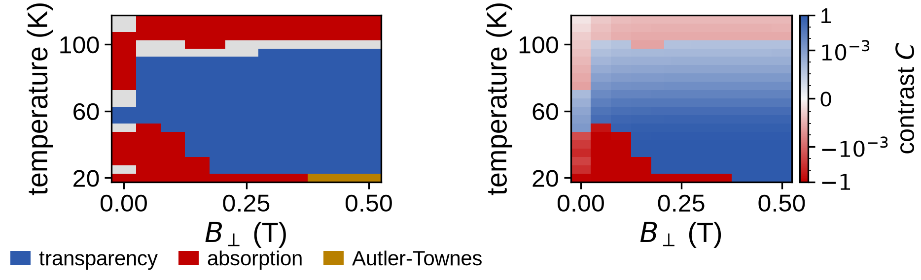
NV EIT does not simply fade — it occupies a bounded island in the temperature–field plane.
Result 1: The temperature–field island
Cold edge: 30 K at 0.15 T; above 0.3 T it is the 20 K grid floor, closed by 3 Autler–Townes points.
Transparency needs B⊥ ≳ 0.15 T: the window runs 30–90 K at that field and 20–95 K above 0.3 T.
Phonon-induced orbital hopping: [10] K.-M. C. Fu et al., Phys. Rev. Lett. 103, 256404 (2009). [11] M. L. Goldman et al., Phys. Rev. Lett. 114, 145502 (2015).

Slide 14
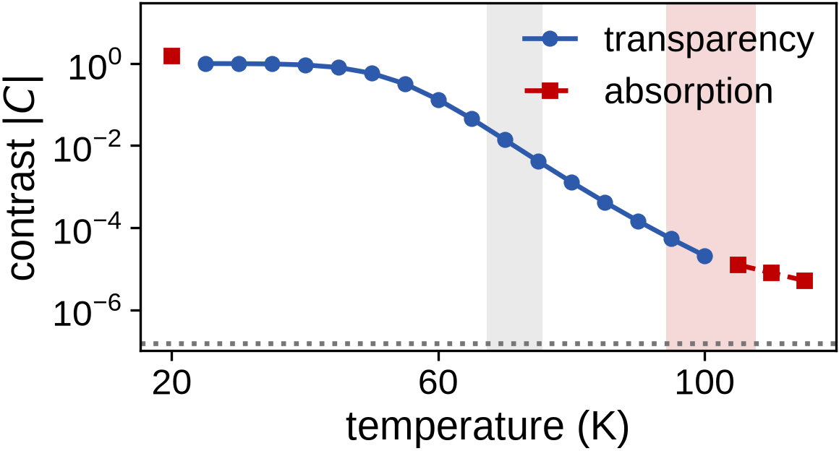
Room temperature loses nine orders of contrast and lands two orders below the detection floor.
Result 2: Room temperature
contrast → time
30 K 0.99
instant
70 K 1.4×10⁻²
1 μs
90 K 1.5×10⁻⁴
10 ms
300 K −1.1×10⁻⁹
never
At 300 K the contrast is 1.1×10⁻⁹, of the wrong sign, and 140× below the 1.5×10⁻⁷ detection floor.
³E structure: [3] M. W. Doherty et al., Phys. Rep. 528, 1 (2013). Contrasts and detection chain: this work.

Slide 15
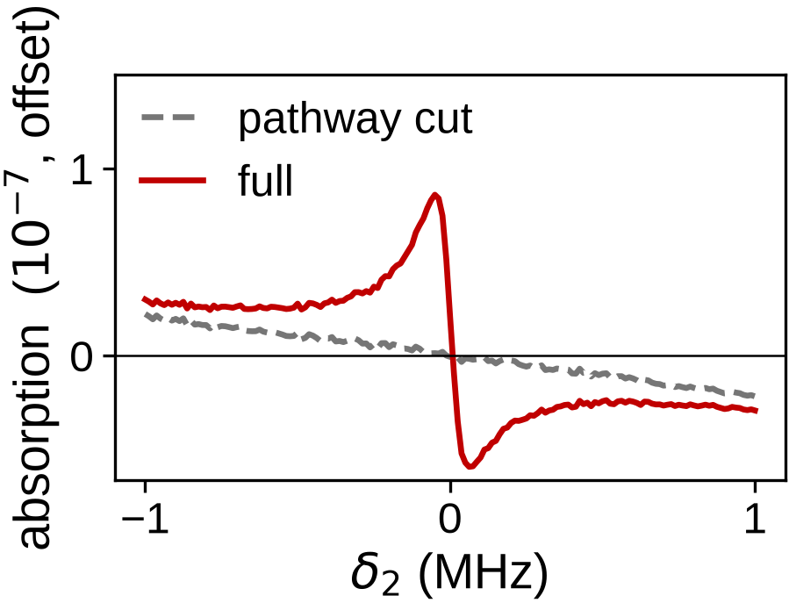
Above 103 K the control stops inducing transparency and starts inducing absorption.
Result 3: Sign reversal at 103 K
Why this matters
• No Autler–Townes mechanism gives a sign change
• So it directly tests the interference account
Where it happens
T_sign = 103 [97, 108] K
full Liouvillian, 68 % interval, 80 samples
reduced kernel not trusted above 90 K
Peak contrast turns negative between 100 and 105 K above 0.15 T; at 105 K the transmission signal is −1.2×10⁻⁵.
Induced absorption in Λ systems: [12] P. Valente, H. Failache and A. Lezama, Phys. Rev. A 67, 013806 (2003).

Slide 16
The transverse field is a switch that opens the pathway, not a dial that buys temperature.
Result 4: The role of the transverse field
B⊥ (T)
T₁% (K)
verdict
• 0 → 0.15 T
• boundary jumps by 40 K
• 0.15 → 0.50 T
• boundary moves < 2 K
0 – 0.10
27 – 33
no usable window
0.15
70.3
window opens
0.2323
71.1
—
0.50
69.7
no further gain
The field is required to have a channel at all; once open, the upper temperature is set by dissipation, not by the field.
Ground-state Zeeman structure: [3] M. W. Doherty et al., Phys. Rep. 528, 1 (2013). Boundaries: this work.

Slide 17
IV. Discussion

Slide 18
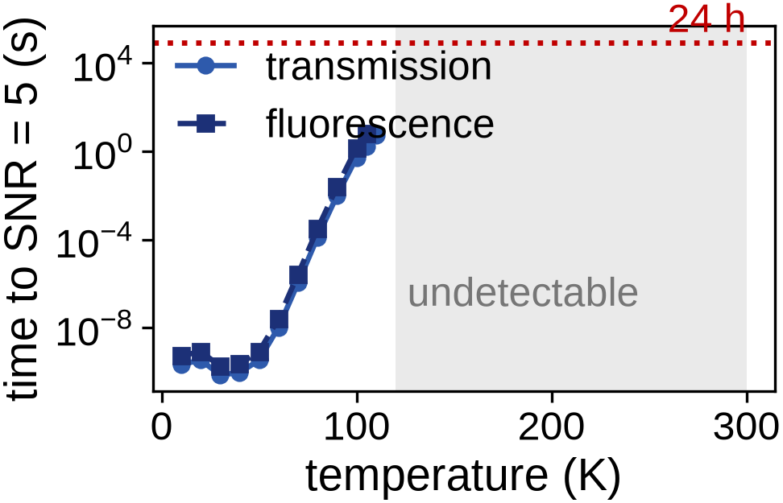
The decisive measurement is following the fringe through zero at 103 K.
Discussion 1: What to measure
Where to look
• 30–90 K at 0.15 T, 20–95 K above 0.3 T
• Transmission or fluorescence both work
The decisive measurement
• Follow the fringe through zero at 103 K
• 1.6 s at 105 K, 5.6 s at 110 K
Transmission is detectable to 110 K, fluorescence to 105 K; past 120 K technical noise blocks detection outright.
Ensemble EIT magnetometry, from which the detection chain is taken: [4] V. M. Acosta et al., Phys. Rev. Lett. 110, 213605 (2013).

Slide 19
Room temperature fails because a thermalising orbital mode destroys the Raman path.
Discussion 2: Why room temperature fails
The mechanism
A jump inside the excited manifold conserves population but acts on every optical coherence as pure loss. Phonon hopping Eₓ ↔ Eᵧ therefore decoheres the pathway while removing no population. Rate entering the coherence equation: Γₓᵧ / 4.
What NV would need
• Freeze out the orbital dynamics, or
• Push the branch splitting far above kT
• Neither is available in bulk NV at 300 K
Back to group-IV
• Orbital Λ: no spin-overlap obstruction
• But orbital coherence damped by single phonons
• Strain and spin–orbit splitting are the levers
The obstruction is a thermalising orbital degree of freedom in the excited manifold, not the spin dephasing usually blamed.
Orbital averaging and phonon coupling: [13] G. Thiering and A. Gali, Phys. Rev. B 96, 081115 (2017). [14] K. D. Jahnke et al., New J. Phys. 17, 043011 (2015).

Slide 20
We have fixed the operating window and found a falsifiable prediction to test this year.
Summary and next step
1. Bounded island
Transparency needs B⊥ ≳ 0.15 T, and runs 30–90 K at that field, 20–95 K above 0.3 T.
2. Room temperature: no
Residual contrast 1.1×10⁻⁹, wrong sign, undetectable at any integration time.
3. Sign reversal at 103 K
Control-induced absorption above 103 [97, 108] K — measurable in seconds.
Next: measure within the year and test the predicted window and the sign reversal against experiment.
PRA manuscript complete; six figures and all numerical gates recorded and reproducible from the repository.
All contrasts, boundaries and integration times: this work, full 9-level Lindblad generator.

Slide 21
S. Appendix

Slide 22
The criterion rests on a small set of theorems, each provable with first-course linear algebra.
Appendix 1: Theorems behind the criterion
Thm 1A Optical dark subspace has dimension N_g − rank Ω; basis independent.
Thm 1B Stationary iff it is an eigenvector of every jump operator and of H_eff.
Thm 2A The weak-probe response is an exact Schur complement.
Thm 2B δχₛ = 0 ⇔ K₁₂K₂₁ = 0. This, not χ_full = 0, is the no-go.
Thm 3 Under fast damping the first non-zero path moment fixes the power of 1/Γ.
Thm 4 Finitely many moments certify an all-orders exact zero (Cayley–Hamilton).
Thm 5 Sector symmetry forces an identically vanishing transfer.
Thm 6 Singular damping leaves an O(1) protected channel in ker D.
Full statements and proofs are in the group's theory note; the manuscript uses 2A, 2B and the rate map only.
Dark-state classification: [6] D. Finkelstein-Shapiro et al., Phys. Rev. A 99, 053829 (2019). Morris–Shore: [15] J. R. Morris and B. W. Shore, Phys. Rev. A 27, 906 (1983).

Slide 23
The reduced kernel reproduces boundary temperatures but not contrast magnitudes.
Appendix 2: Reduced kernel vs full Liouvillian
• Compared against the full Liouvillian on 108 grid points: 47 agree within 10 %, and 13 disagree in sign.
• Failures are structured, not random: below 40 K the reduced kernel reports transparency where the full model reports absorption; above 90 K no field agrees within 10 %.
• Threshold temperatures still agree — the bands overlap, medians shifted by ≈ 3 K.
How the manuscript uses this
• Every contrast magnitude quoted comes from the full Liouvillian
• The reduced kernel is used only for threshold locations, re-derived with the full model as a check
• Truncation (singlet, hyperfine) shifts contrast by ≤ 30 %, never the sign
Reduced-vs-full agreement is 47/108 points within 10 % with 13 sign disagreements, concentrated below 40 K and above 90 K.
Full 9-level generator built from [3] M. W. Doherty et al., Phys. Rep. 528, 1 (2013).

Slide 24
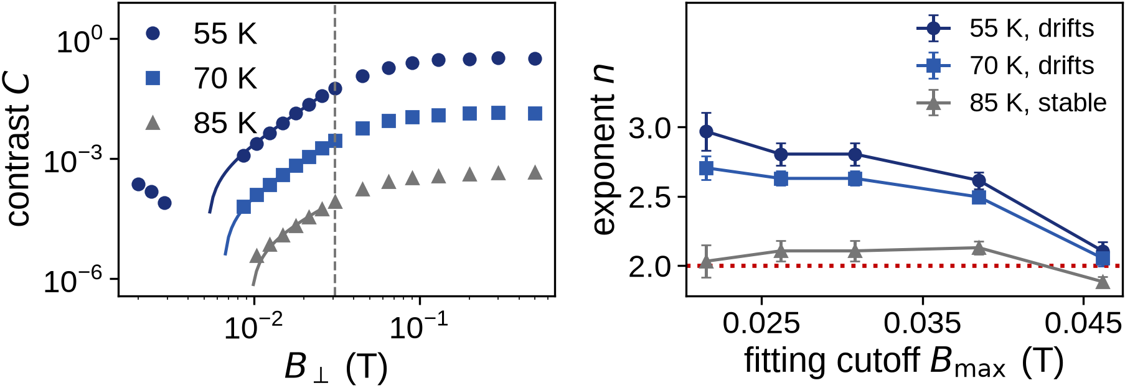
The quadratic law is confirmed at the warm end of the island, not at the cold end.
Appendix 3: Transverse-field exponent
85 K gives n = 2.11 ± 0.08, stable against the fitting cutoff; at 55 and 70 K the exponent drifts and is not determined.
Expected C = C_res + a B⊥² from one symmetry-breaking insertion per Λ leg; ground-state mixing scale γₑB = D_gs from [3].

Slide 25
We separate EIT from Autler–Townes by model comparison rather than by eye.
Appendix 4: EIT vs Autler–Townes
EIT model (interference)
A = C₊²/(γ₊²+δ²) − C₋²/(γ₋²+δ²)
a narrow window inside a broad line
ATS model (doublet)
A = C²[1/(γ²+(δ−δ₀)²) + 1/(γ²+(δ+δ₀)²)]
two dressed-state peaks, no interference
• Both fitted to the same computed spectrum, together with Lorentzian and Fano alternatives.
• Verdict from ΔAIC = IC_ATS − IC_EIT with a fixed robust gate at |ΔAIC| ≥ 6, unchanged under 60 noise bootstraps and 30 randomised fit initialisations.
Following Anisimov, Dowling and Sanders, PRL 107, 163604 (2011); the classification is stable at every temperature tested.
[9] P. M. Anisimov, J. P. Dowling and B. C. Sanders, Phys. Rev. Lett. 107, 163604 (2011).

Slide 26
One detection chain at every temperature makes the comparison measure physics, not geometry.
Appendix 5: Detection chain
• The sector cross-section grows as the optical line narrows: a fixed sample is OD ≈ 16 at 10 K and OD ≈ 0.04 at 300 K.
• Primary axis is therefore the OD-matched sample (sector OD = 1); the fixed 1 ppm / 0.5 mm sample is reported alongside.
λ 637 nm
Debye–Waller 0.030
γ_inh 30 GHz
probe power 1 μW
η detect 0.1
σ_tech 10⁻⁶
target SNR 5
ceiling 24 h
Where the archived conversions disagreed (70 K and 300 K), the conservative value was taken and the disagreement recorded.
Debye–Waller factor, inhomogeneous width and ensemble geometry: [4] V. M. Acosta et al., Phys. Rev. Lett. 110, 213605 (2013).

