Slide 1
[ TimeTable ]
ITC539 Assignment 4 App Presentation
[ Risfan Shekh ]
[ 11644125 ]

Slide 2
Introduction

Slide 3
App Overview
My app is developed for taking account of students who are busy with their routine Schedule.
This App will help such Students to easily manage studies with routine schedule.
I my self passed through such situation when I don’t know that today or tomorrow is the submission of my some Subject. And then I have to wake up full night and prepare the assignment and sometimes students don’t know and due date of assignment has already been passed.
So, I come up with a Solution to build such an app which helps us to solve this issue.

Slide 4
App Overview ( Cont..)
What is the general concept of the app
This app lets the user to add or delete the Assignments, Classes, Teacher and Exam.
User will get daily list of Assignments whose due date is today or Today’s Exam or Class which user need to attend today.
User can Delete the unnecessary assignments or classes or exams or Teachers.

Slide 5
App Overview ( Cont..)
Goals/Challenges
The biggest Challenge or we can say Goal was to make the User Interface easy for user so every Student can use it whether he or she is in School or High School or Collage/University.
If user is satisfied with your app then only the App will be successful.
Target market of app
This app is useful for all sort of students wether school, High-school or University because all students are having classes, Homework/Assignments and Exams.
So, it is useful for everybody.

Slide 6
App [Intended] Functionality
My App was designed to make the student aware of the upcoming Exam, Assignment or Class.
User can add or Delete the Class, Exam, Teacher and Assignment.
User will get the Information of today’s Class, Exam, Assignment Due on the Home Screen of App and by clicking on that information user will jump to the page of all records.
I used Card View to display data in card format.

Slide 7
Platform Used
Platform:
Android is the most Common platform which is used by almost 90% of world’s population. and most commonly all Students are using it and my app is build for ease of student.
User can Anytime just open the app on Mobile and Check whether any due or class is today or not and accordingly plan their Schedule.

Slide 8
Tools Used and Requirements
Android Studio
Android Studio is most Commonly used to Develop Android application development environment developed by Google.
General requirements needed to run this app
OS : Android Version 4 JellyBean and Latest.
API Version : Minimum API Level 24 is Required to run this app.
Device/Permissions - No Permissions are Required to use this app.

Slide 9
Techniques and Challenges
It was my First experience to developing android app so it was already challenging for me but one of the big challenge was to use RecyclerView with CardView to easily use same layout multiple times.
The Challenge was that we can’t use multiple RecycleViewAdapter to bind cardView with data. And cause my app has different data like class, Assignments, Exam and Teachers.
I come up with using multiple constructors(Fomally Called Method OverLoading Concept) to pass different arguments for all data like Class will pass Class data array with 1 extra String Argument then Assignment will pass Assignment data list with 2 extra String arguments and so on.

Slide 10
Improvements for the Future!
First of all I will add Login System and store the user data on cloud so that user can access it anytime anywhere.
In future I m going to add a Forum so that Students can chat with each other and discuss their schedules.
Then after I’ll add grading functionality with assignment module so user will come to know how much they achieved.
By accessing that data user can see a graph of their progress wether it’s good or not.

Slide 11
App Architecture
UseCase Diagram:
Add Class / Delete Class
USER
Add Assignments/ Delete Assignments
View Class,
Assignments,
Exam,
Teacher
Add Exam /
Delete Exam
Add Teacher /
Delete Teacher

Slide 12
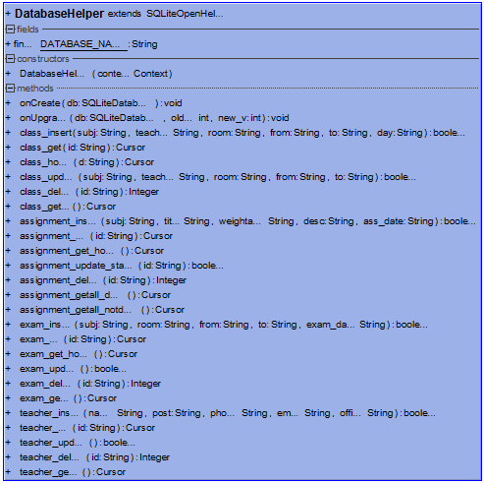
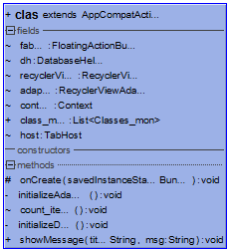
App Architecture
Class Diagram:

Slide 13
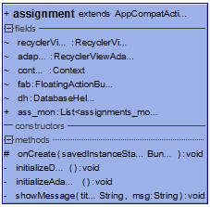
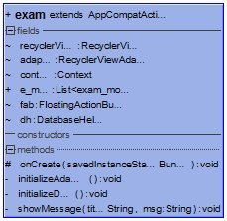
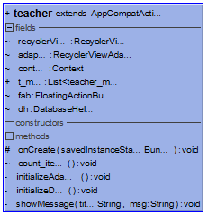
App Architecture
Class Diagram:

Slide 14
[USE CASE 1- Class]
//Use a monospaced font for code
//Courier New is good for code
TextInputEditText string_subject = (TextInputEditText) findViewById(R.id.sub) ; subject=string_subject.getText().toString();
TextInputEditText string_teacher = (TextInputEditText) findViewById(R.id.teacher); teacher=string_teacher.getText().toString();
TextInputEditText string_room = (TextInputEditText) findViewById(R.id.room); room=string_room.getText().toString();
if(dh.class_insert(subject,teacher,room,from,to,day)) {
startActivity(new Intent(getApplicationContext(), clas.class));
} else {
Toast.makeText(class_add.this,"Unsuccessful
Try Again",Toast.LENGTH_SHORT).show();
}
There are mainly 4 Use case's for Class, Assignment, Exam and Teacher.
Class
In this use case user will add a Class on Add Class Activity. Then the data will be stored in the Local Database.
After adding and storing data user will be directed to the Class page where user can see all the Classes.
On the Home Screen User can see the Classes which are scheduled today.
To display this data from database I used RecycerView and CardView.
The data will be fetched from database using Cursor and then the cursor will be passed to RecycleViewAdapter and accordingly it will print all the Classes in Card View.

Slide 15
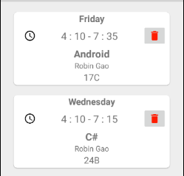
[ USE CASE 2- RecycleView and CardView]
//Use a monospaced font for code
//Courier New is good for code
holder.start_end.setText(class_mon.get(position).from_to_mon);
holder.class_no.setText(class_mon.get(position).room_mon);
holder.sub.setText(class_mon.get(position).sub_mon);
holder.teacher.setText(class_mon.get(position).tech_mon);
holder.id_c.setText(class_mon.get(position).c_id);
holder.day_cv.setText(class_mon.get(position).day_mon);
start_end = (TextView)itemView.findViewById(R.id.start_end); sub = (TextView)itemView.findViewById(R.id.sub_card); teacher = (TextView)itemView.findViewById(R.id.teacher_card);
In this Case the Data will come from Clas.java as a List and the Data will be Binded to the CardView.
RecyclerView is used when you have to reuse same layout number of times. Similar as an array of object.
So, I used RecycerView with CardView and displayed data as a Card layout.
Ex.

Slide 16
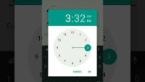
Demonstration.
Thank You….

