Slide 1
Disease Prediction System
A Machine Learning Web App using Flask, Random Forest & Data Visualization
Team Members:
Rishabh Yadav (500122500)
Kirit Somani (500123413)

Slide 2
Project Overview
A web-based Disease Prediction System using Flask.
Takes user symptoms and predicts the most likely diseases.
Includes visualizations of dataset patterns using Seaborn & Matplotlib.
Implements Random Forest Classifier with data augmentation and K-Fold CV.

Slide 3
Libraries Used
Flask - Web framework for building the app interface.
Pandas, NumPy - Data manipulation and processing.
Scikit-learn - Machine learning model and preprocessing.
Matplotlib, Seaborn - Plotting and visualization.
Joblib - Model serialization.
Warnings, IO, base64 - Utility and data handling.

Slide 4
Data Preprocessing
Encoded gender using LabelEncoder.
Converted symptoms from Yes/No to 1/0.
Ensured 'No Disease' category for symptomless cases.
Added noise to features and generated synthetic data for augmentation.

Slide 5
Model Training
Random Forest Classifier (100 trees, depth=6).
Used 5-fold cross-validation to assess accuracy.
Printed accuracy & classification report per fold.
Trained final model on entire dataset and saved with joblib.

Slide 6
Flask App Routes
'/' → Home page.
'/predict' [GET] → Shows prediction form.
'/predict' [POST] → Receives form data and predicts.
'/visualize' → Displays dataset visualizations.

Slide 7
Visualization Features
Disease distribution (bar chart).
Age distribution (histogram).
Gender distribution (pie chart).
Symptom frequency (bar chart).
Symptom correlation matrix (heatmap).

Slide 8
Frontend UI
Clean and responsive HTML with CSS.
Symptom checklist and age/gender form fields.
Visualizations embedded using base64 images.
Navigation bar links to home and visualization pages.

Slide 9
Prediction Logic
Collects user inputs from form.
Encodes gender and symptoms.
If no symptoms: Predict 'No Disease'.
Else: Predict probabilities and display top diseases with >10% chance.

Slide 10
About the website: constituent webpages

Slide 11
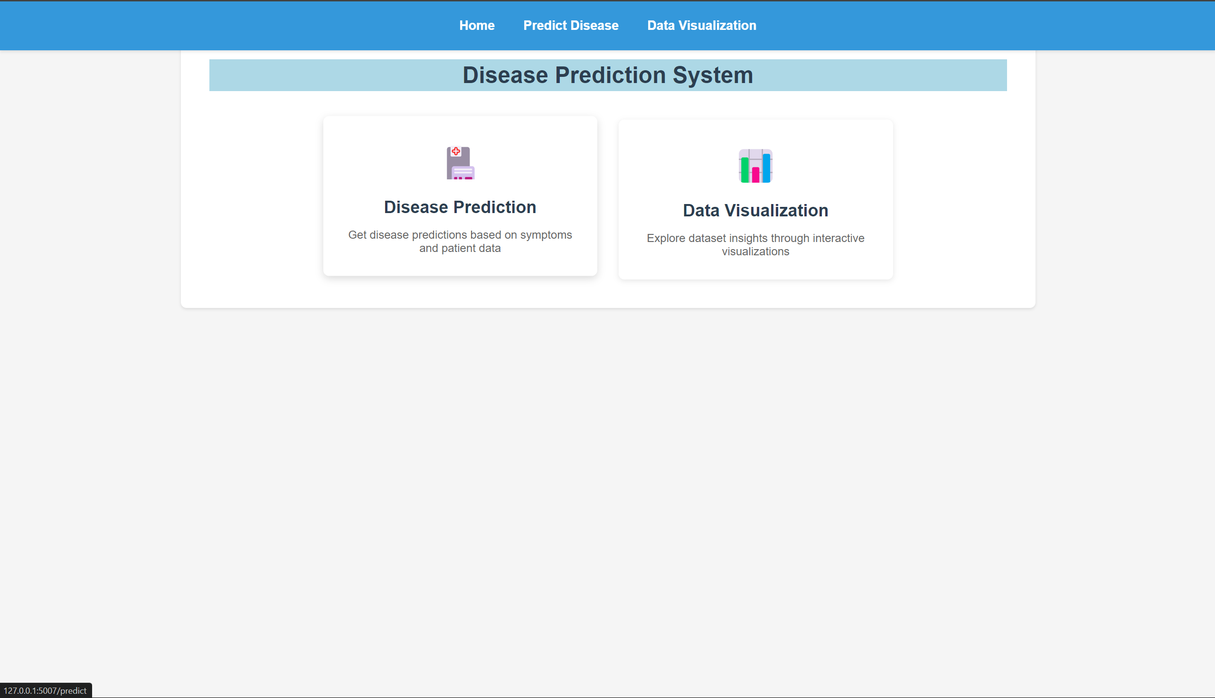
Home page

Slide 12
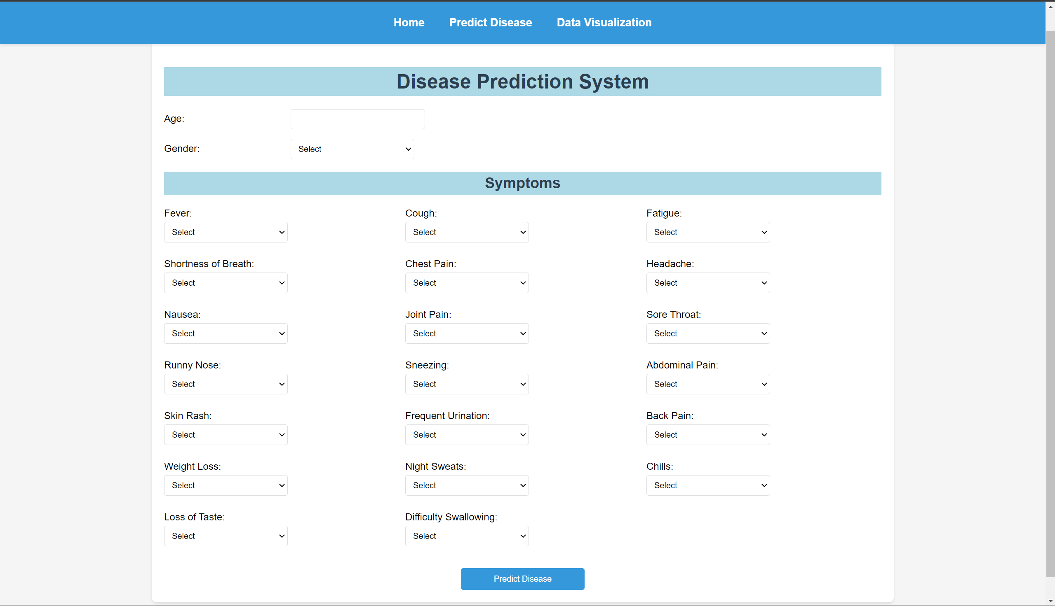
Disease prediction page (user input)

Slide 13
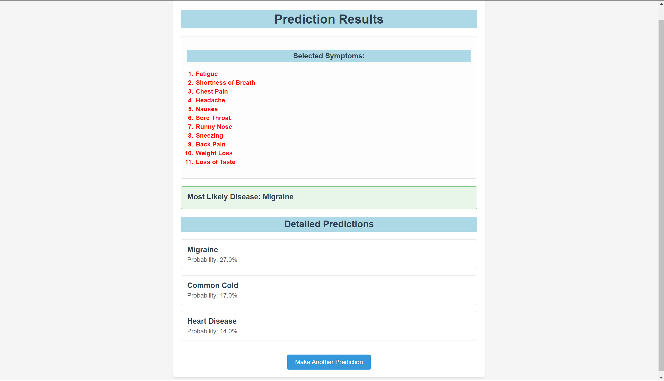
Disease prediction page (result page)

Slide 14
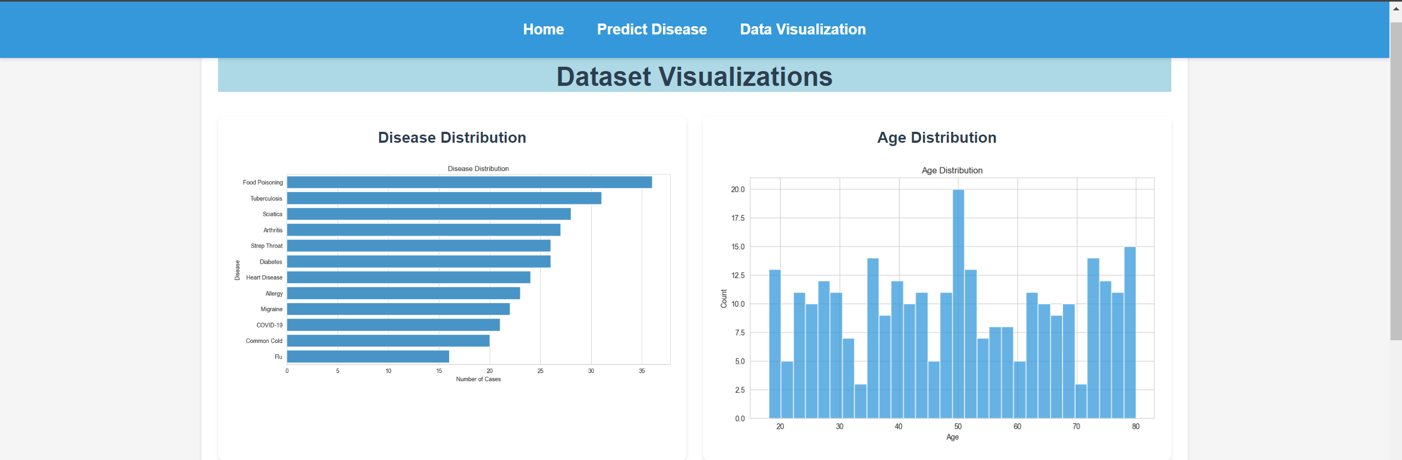
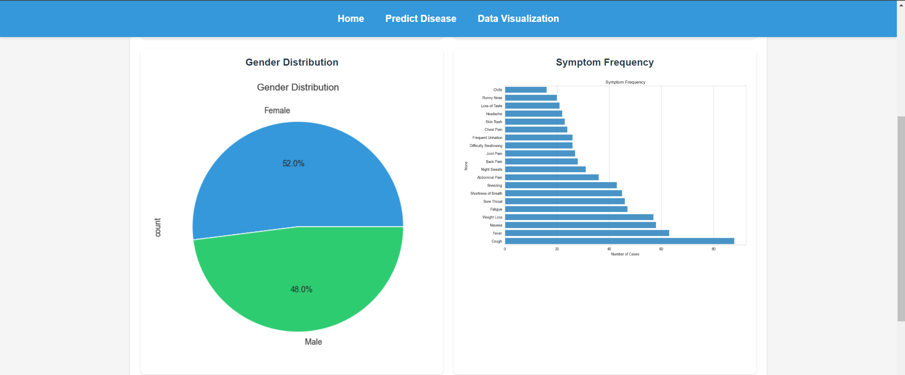
Visualization page

Slide 15
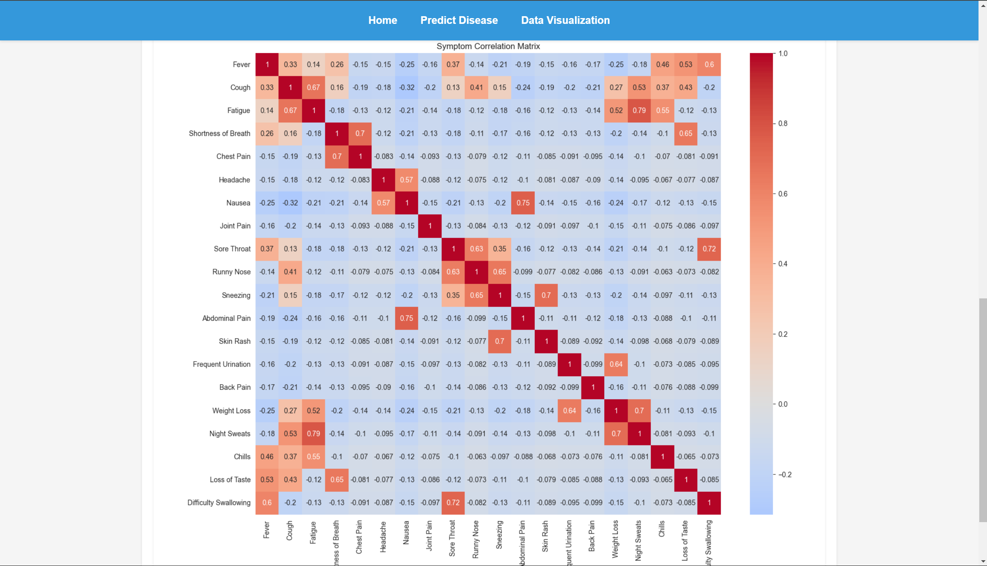
Visualization page

Slide 16
Project Summary
A complete ML-powered web system for disease prediction.
Uses real-world data and visualization for better insights.
Random Forest model provides robust prediction.
Flask enables a lightweight and interactive user experience.

