Slide 1
Jumper - AI Game

Slide 2

>Libraries used
▸ PhaserJS game framework
▸ Synaptic neural network library in javascript

Slide 3
>BACKGROUND
▸ Supervised Learning using manual input
▸ Perceptron having 1 input, 2 hidden & 1 output layer

Slide 4
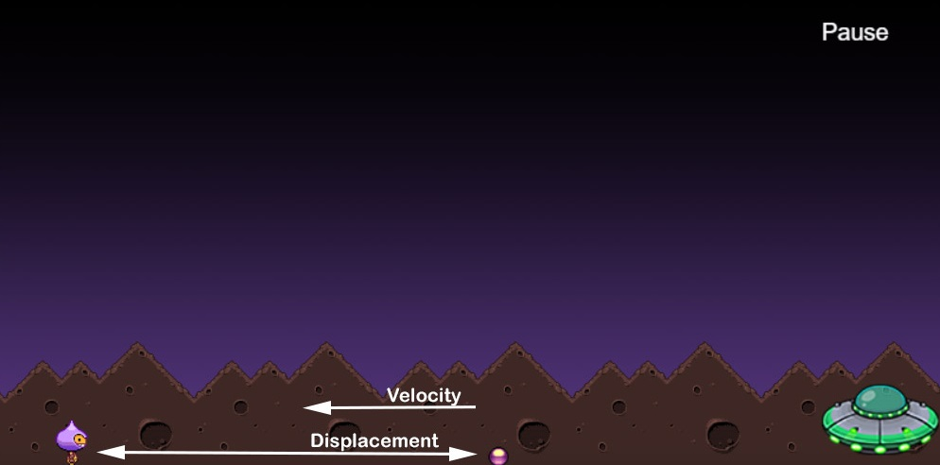
>INPUTS
▸ displacement between ball & player
▸ velocity of the ball

Slide 5
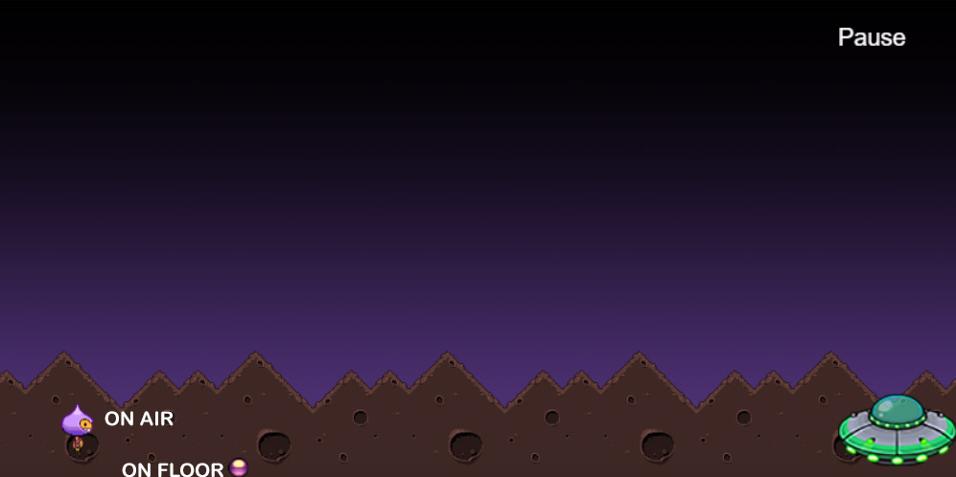
>OUTPUTS
▸ ON AIR
▸ ON FLOOR

Slide 6
HIDDEN LAYER 1
HIDDEN LAYER 2
INPUT
OUTPUT
DISPLACEMENT
ON AIR
VELOCITY
ON FLOOR

Slide 7
>SCENARIOS
▸ No user input
▸ False user input
▸ Correct user input

Slide 8
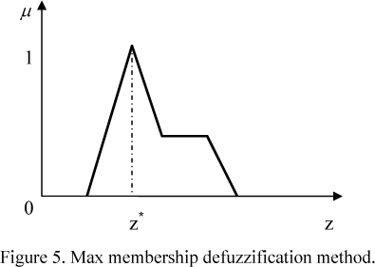
>DEFUZIFYING TECHNIQUE
Maximum membership principle

Slide 9
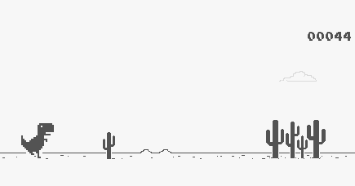
>INSPIRED FROM
▸ Chrome’s T-REX

Slide 10
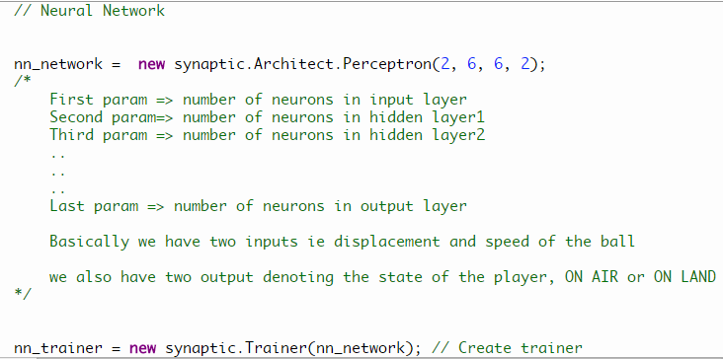
>CODE
▸ Initializing ANN

Slide 11
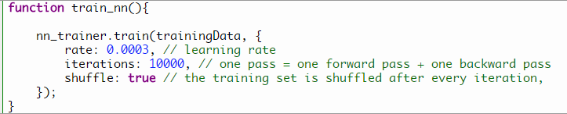
>CODE
▸ Training ANN

Slide 12
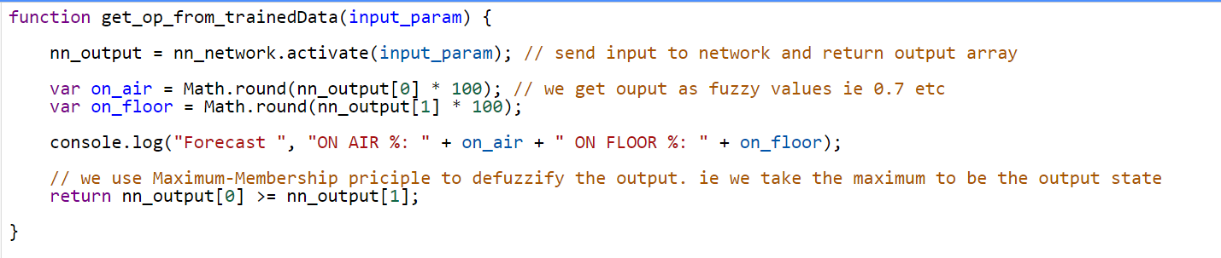
>CODE
▸ Activating ANN and getting the output

Slide 13
THANK YOU :)
>EXIT 0

