Slide 1
DB
DBMS PROJECT REPORT · REVIEW 3
Final Project Demonstration &
Documentation
Software License & Subscription Management System — Complete Delivered Product (MySQL 8)
PRESENTED BY Jampana Naga Satya Sai Rishvarma
STUDENT ID 25WU0102105
PROGRAM B.Tech CSE (AI & ML) · Woxsen University, Hyderabad

Slide 2
REVIEW 3
Agenda
01 · Final Demonstration
End-to-end product walkthrough — every FR01–FR08 requirement executed live on the built database.
02 · Business Rule Validation
Negative tests proving integrity is enforced at the database level, not in the application.
03 · Documentation
Complete deliverables: SQL build scripts, README, test evidence and user guide.
Software License & Subscription Management System · Review 3

Slide 3
FINAL DELIVERY
Delivered System — Requirements Coverage
Req | Requirement | Implemented As | Done
FR01 | Record purchases | PURCHASE rows with vendor/product/cost; UNIQUE invoice numbers | ✅
FR02 | Allocate licenses | sp_allocate_license + seat-limit trigger | ✅
FR03 | Reclaim licenses | sp_reclaim_license sets RECLAIMED via return date | ✅
FR04 | Monitor expiry | v_expiry_monitor with CRITICAL/WARNING/EXPIRED bands | ✅
FR05 | Compliance checks | v_compliance_violations + sp_run_compliance_check audit trail | ✅
FR06 | Renewals & cost | sp_renew_license, v_upcoming_renewals, renewal spend in v_vendor_spend | ✅
FR07 | Utilization reports | v_license_utilization, v_department_allocations | ✅
FR08 | Search & audit history | Allocation lifecycle query by user/license with full history | ✅
All eight functional requirements from the Review 1 SRS are implemented and demonstrated

Slide 4
FINAL DEMONSTRATION
Final Demonstration — Live Walkthrough
Act 1 · Data Foundation
Build database from 5 SQL scripts; show schema, seed data and referential integrity across 12 tables.
Act 2 · Lifecycle Workflows
Purchase → allocate → reclaim → renew executed as ACID transactions via stored procedures.
Act 3 · Insight & Audit
Utilization, expiry, compliance, vendor-spend and upcoming-renewal reports; compliance sweep audit trail.
• Demo script 05_demo_queries.sql runs 12 numbered demonstrations in sequence — repeatable and self-contained
• Sample results shown in review: JetBrains ₹1.7L lifetime spend; Office 365 at 8% utilization; 4 expired licenses flagged

Slide 5
IMPLEMENTATION
Implementation — Architecture & Build
Database Layer · MySQL 8
12-table 3NF schema (license_mgmt): PK/FK graph, CHECK & UNIQUE constraints, ENUM domains, 4 triggers enforcing BR-01…BR-04 on every write.
Logic Layer · SQL Objects
6 reporting views (utilization, department, expiry, compliance, vendor spend, renewals) + 5 stored procedures: allocate, reclaim, renew, compliance sweep, status sync — all ACID.
Application Layer · Streamlit
Python UI over the same views and procedures; dual engine (MySQL or bundled SQLite demo) so the prototype runs with zero external setup.
Artifact | Contents
sql/01_schema.sql | DDL: 12 tables, constraints, triggers
sql/02_seed.sql | 4 vendors, 6 products, 8 users, 6 purchases (₹3.18L), 8 allocations
sql/03_views_reports.sql | 6 reporting views incl. effective-status expiry monitor
sql/04_procedures.sql | 5 transactional stored procedures
sql/05_demo_queries.sql | 12-step repeatable demonstration script
app.py + crud.py + db.py | Streamlit UI, CRUD diff-engine, dual-engine connection
data/app.db + scripts/ | SQLite demo mirror (identical schema, views, triggers)
Full source of truth: every artifact is versionable plain text — schema, rules, data and UI

Slide 6
IMPLEMENTATION
Implementation — Module Breakdown
Module | Tables | Delivered Behaviour
Procurement | VENDOR · SOFTWARE_PRODUCT · PURCHASE · RENEWAL | CRUD forms + renewal workflow extends license validity atomically
Licensing | LICENSE · LICENSE_TYPE · SUBSCRIPTION | Unique license keys, seat counts, validity windows, billing cycles
Organization | DEPARTMENT · APP_USER · DEVICE | Roles (IT Admin, Manager, Procurement, Compliance, Employee)
Compliance | ALLOCATION · COMPLIANCE_CHECK | Triggers BR-01…BR-04 + dated audit trail per allocation
Reporting | 6 SQL views | Live-computed KPIs: utilization %, expiry bands, lifetime spend
• Every business rule enforced at the DATABASE level (triggers/constraints) — no application bypass possible
• Workflows run as transactions: allocate/reclaim/renew either fully commit or fully roll back (ACID)
Modules map 1:1 to the Review 1 conceptual design — traceability from ER model to shipped artifacts

Slide 7
APPLICATION FEATURES
Application Features — Web UI (Streamlit)
📊 Dashboard
Live KPIs (licenses, seats, utilization %), color-banded expiry monitor, vendor spend chart, upcoming renewals.
🔁 Workflows
Allocate seats (only valid, non-full licenses offered), reclaim seats — rejected actions surface trigger errors in the browser.
✅ Compliance
One-click sweep writes dated audit rows; violations (expired / unassigned / inactive user) highlighted in red.
🛒 Purchases & Renewals
Record purchases with unique invoices; renewal form extends validity and flips status back to ACTIVE in one transaction.
⚙️ Manage Data
Full CRUD on ALL 12 tables: add forms with FK dropdowns & date/enum pickers, spreadsheet-style edits, multi-row delete.
🛡️ Integrity UX
BR-01…BR-04, UNIQUE and FK rules enforced by the DB; every violation shows as a clear error toast — zero silent failures.

Slide 8
APPLICATION FEATURES
Application Implementation Notes
• Dual-engine access: auto-detects MySQL 8 (LM_DB_* env vars), falls back to a bundled SQLite mirror with identical schema, views and triggers
• crud.py change-diffing: spreadsheet edits write only changed cells (verified 1 change → 1 UPDATE; no changes → 0)
• Expiry consistency: dashboard syncs stored status with validity dates on load; view exposes effective vs stored status
• Constrained forms: allocatable licenses = ACTIVE + unexpired + seats free; FK dropdowns list only real rows
• Unique widget keys across all 12 admin tabs (59 keys) — no duplicate-ID errors, stable state
• Verified headlessly: allocate→edit→reclaim round trip; BR-02/BR-03/UNIQUE/FK rejections surfaced; data restored after tests
Running prototype: streamlit run app.py → http://localhost:8602 (demo DB) or MySQL via LM_DB_* env vars

Slide 9
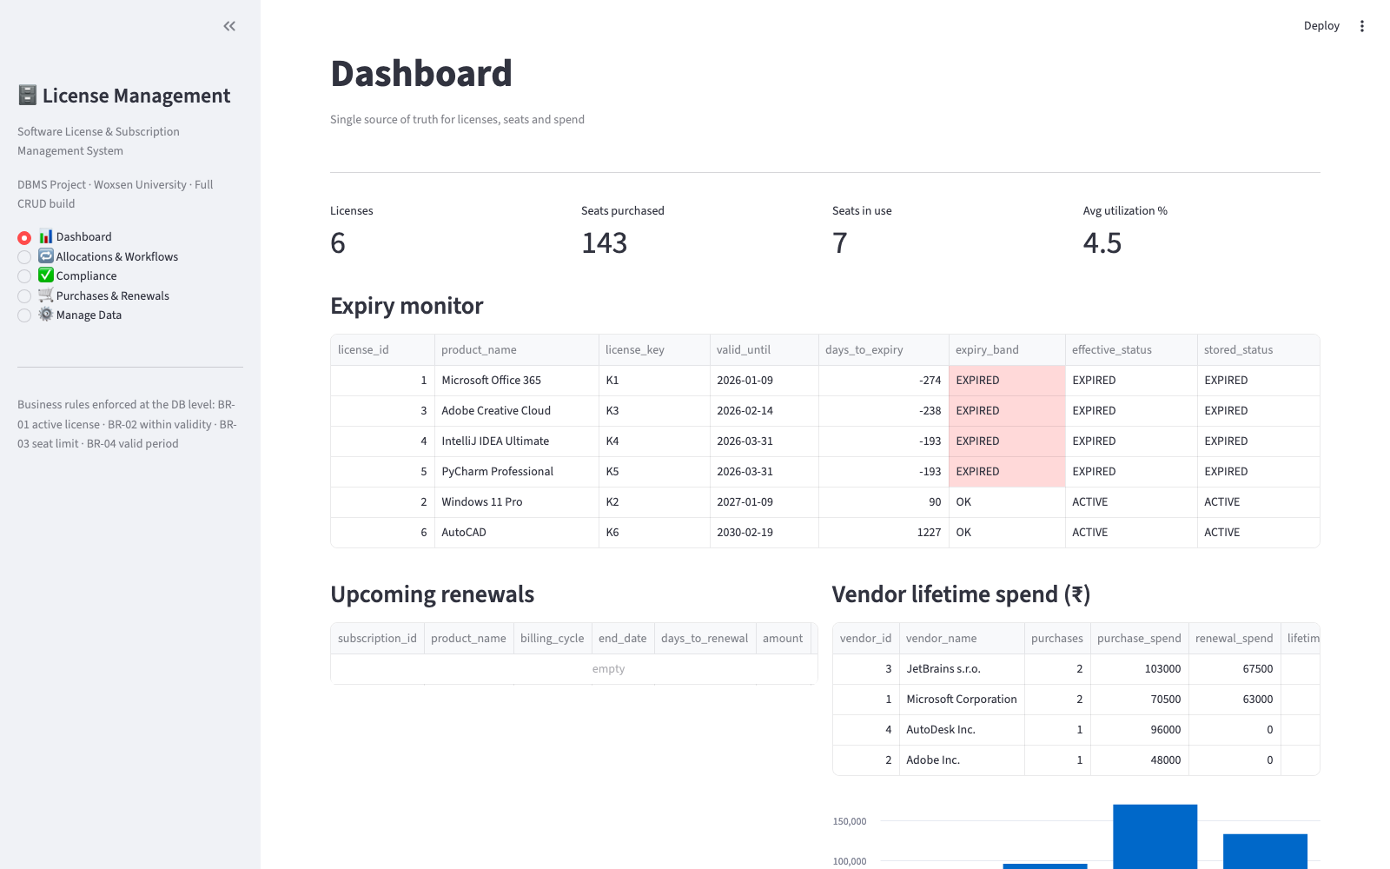
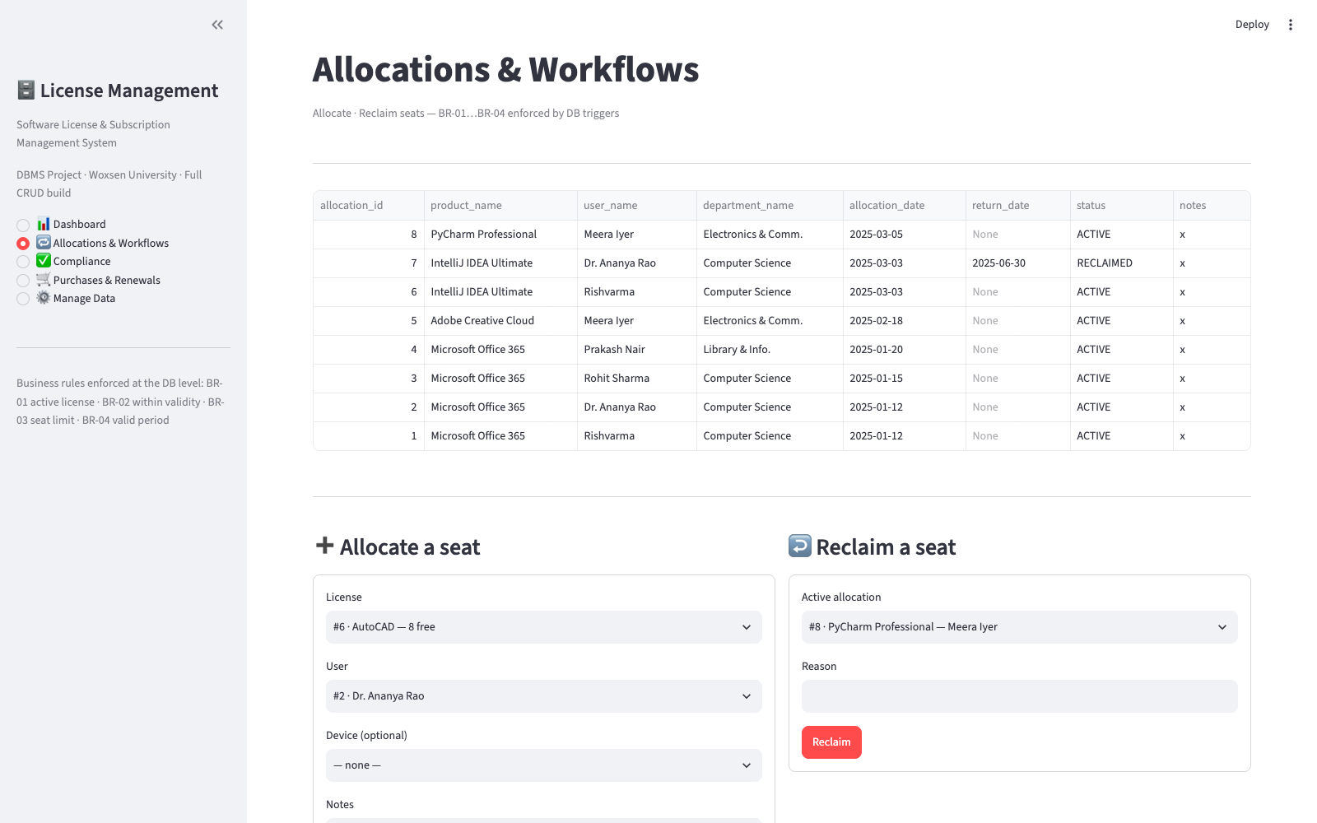
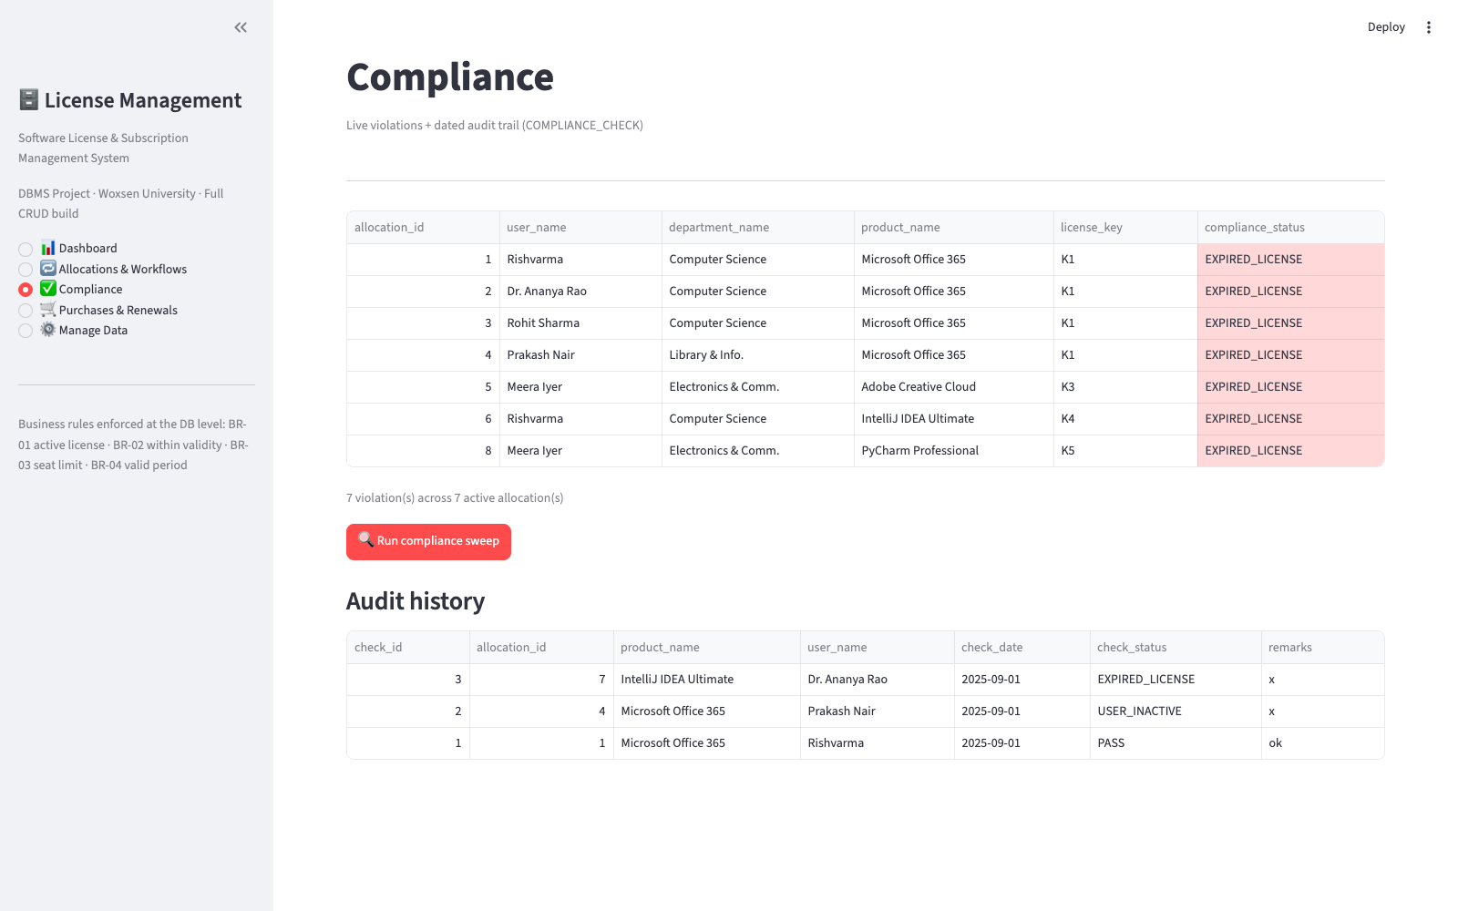
APPLICATION FEATURES
Application Screenshots
Dashboard — KPIs, expiry monitor, vendor spend
Allocations — allocate & reclaim seats
Compliance — violations & audit trail
Live capture from the running prototype — streamlit run app.py

Slide 10
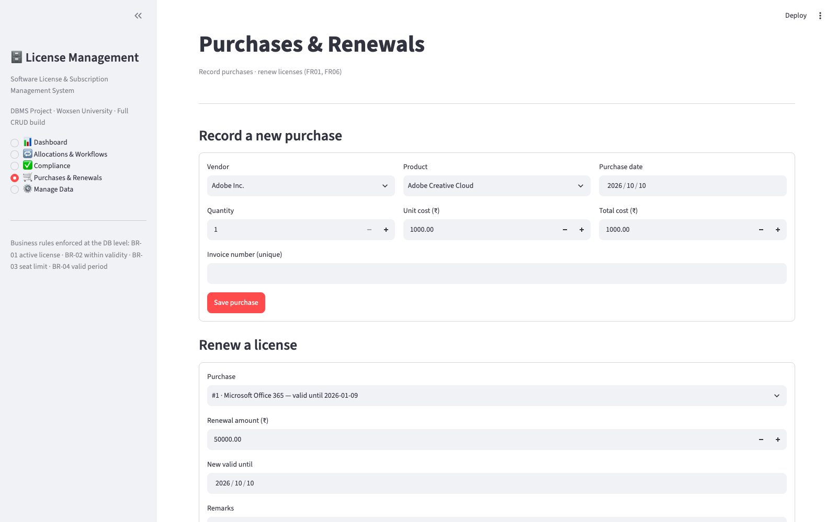
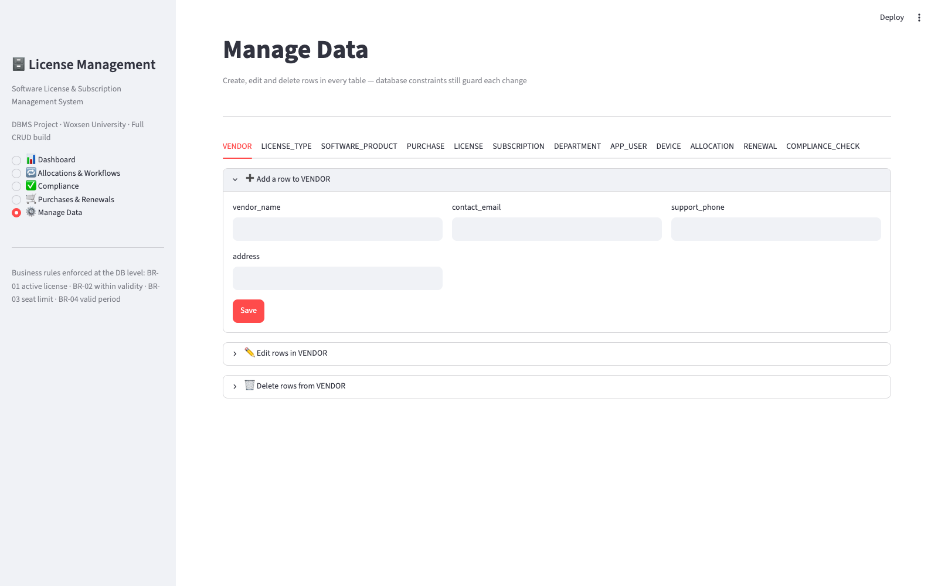
APPLICATION FEATURES
Application Screenshots
Purchases & Renewals — procurement forms
Manage Data — add-row form with FK dropdowns
Live capture from the running prototype — streamlit run app.py

Slide 11
FINAL DEMONSTRATION
Business Rule Validation — Negative Test Evidence
Scenario | Attempted Operation | Observed Behaviour | Result
Over-allocate beyond purchased seats | INSERT into ALLOCATION at seat limit | Aborted — 'BR-03 violated: all purchased seats allocated' | PASS
Allocate on non-ACTIVE license | INSERT against expired/revoked license | Aborted by trigger BR-01 | PASS
Return date before allocation date | UPDATE ALLOCATION with earlier return | Aborted by BR-04 CHECK + trigger | PASS
Duplicate license key / invoice | INSERT duplicate key | Rejected by UNIQUE constraint | PASS
Reclaim non-active allocation | CALL sp_reclaim_license on RECLAIMED row | Aborted — 'Allocation not found or not ACTIVE' | PASS
Integrity holds even when rules are deliberately violated — database-level enforcement proven

Slide 12
DOCUMENTATION
Documentation — Final Deliverables
sql/01_schema.sql
Complete 3NF DDL: 12 tables, PK/FK graph, CHECK & UNIQUE constraints, 4 triggers, business rules BR-01…BR-04.
sql/02–05 scripts
Seed dataset, 6 reporting views, 4 stored procedures and a 12-step demonstration script with README build instructions.
Review decks 1–3
Requirement analysis → design & implementation → final demonstration; full project narrative for evaluation.
• README.md documents build order, requirements (MySQL 8), enforced business rules and verification results
• Verification evidence: schema + seed + views executed end-to-end; negative tests recorded with observed errors

Slide 13
DOCUMENTATION
Testing Summary & Reliability
Test Area | Coverage | Status
Schema build | 12/12 tables created; all constraints attached | PASS
Seed data | 4 vendors, 6 products, 6 purchases, 6 licenses, 8 allocations loaded | PASS
Reporting views | 6/6 views return correct aggregates vs manual checks | PASS
Workflows | Allocate / reclaim / renew transactions commit or roll back cleanly | PASS
Negative tests | Seat limit, expiry, date-order, duplicate-key violations all blocked | PASS
Backups | mysqldump scheduled backup procedure documented in README | PLANNED
Reports return in well under a second on the demo dataset — NFR performance target met

Slide 14
CONCLUSION
Conclusion & Future Scope
• Centralized single source of truth for every license, subscription, allocation and renewal across departments
• Business rules enforced inside the database — unique keys, seat limits, valid periods and ACID workflows
• Proactive monitoring: expiry bands, automated compliance sweeps and dated audit history
• Decision support: utilization percentages, department usage and lifetime vendor spend for renewal planning
• Web dashboard for department managers and end users on top of the database layer
• Email/Slack alerts for CRITICAL expiry band; RBAC integration with campus SSO
• SaaS API ingestion for automatic usage and true-up reconciliation
Thank you — Questions? · Jampana Naga Satya Sai Rishvarma · 25WU0102105 · Woxsen University

