Slide 1
Stimulating SSH PROTOCOL

Slide 2
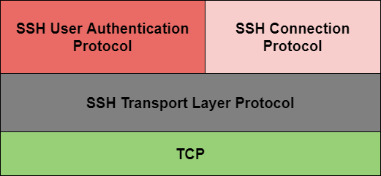

Slide 3
