Slide 1


Slide 2
AWS Simple Storage Service (S3)
-Rajdeep Das
Software Engineer
04/08/20

Slide 3

Agenda
S3 Overview
Buckets & Objects
S3 Security & Encryption
S3 Version Control
S3 Life Cycle Management
S3 Pricing
Hosting Static Website on S3 LAB
S3 Service Limits

Slide 4
S3 Overview

Slide 5

S3 Overview
What is S3?
S3 provides developers and IT teams with secure, durable, highly scalable object storage. Amazon S3 is easy to use, with a simple web services interface to store and retrieve any amount of data from anywhere on the web.

Slide 6
S3 Overview
The Basics of S3 are as follows :
S3 is object-Based i.e. allows you to upload files.
Files can be from 0 bytes to 5 TB.
There is unlimited storage.
Files are stored in Buckets.
S3 is a universal namespace i.e. names must be unique globally. - https://<bucketname>.s3.amazonaws.com (For N.Virginia) - https://<bucketbame>.<region>.amazonaws.com

Slide 7
S3 Overview
S3 – Guarantees from Amazon AWS :
Built for 99.99% availability for the S3 platform.
Amazon Guarantees 99.9% availability.
Amazon Guarantees 99.99999999999% durability for S3 information.

Slide 8
S3 Buckets & Objects

Slide 9

S3 Buckets & Objects
What is a S3 Bucket?
S3 Bucket is nothing but a naming convention of a folder, in which your objects will be stored.
What are S3 Objects?
Think Objects just as flat files. Objects consist of the followings :
Key (Name of the Object)
Value (the data & made up of a sequence of bytes).
Version ID (Unique ID for each Object).
Metadata (Data about the data you are storing).
S3 is not suitable to install an OS or DB on as it is an object based storage. Not a Block based one.

Slide 10
S3 Buckets & Objects
How does data consistency work for S3?
Read after Write consistency for PUTS of new Objects ( If you write a new file and read it immediately afterwards, you will be able to view that data ).
Eventual Consistency for overwrite PUTS & DELETES ( If you update AN EXISTING file or delete a file & read it immediately, you may get the older version, or you may not. Basically changes to objects can take a little bit time to propagate ).

Slide 11
S3 Buckets & Objects
LAB-1

Slide 12
S3 Security & Encryption

Slide 13

S3 Security & Encryption
How does S3 encrypt your data?
Encryption In Transit is achieved by SSL/TLS
Encryption At Rest (Server Side) is achieved by - S3 Managed Keys – SSE-S3 (AWS Managed) - AWS KMS Managed Keys – SSE-KMS - Server side Encryption with Customer Provided Key SSE-C
Client Side Encryption

Slide 14
S3 Security & Encryption
How does S3 secure your data?
By default, all newly created buckets are PRIVATE. You can setup access control to your bucket using :
Bucket Policies
Access Control Lists
S3 buckets can be configures to create access logs which log all requests made to the S3 bucket. This can be sent to another bucket and even another bucket in another account.

Slide 15
S3 Security & Encryption
What is a Bucket Policy?
Bucket policies provide centralized, access control to buckets and objects based on a variety of conditions, including S3 operations, requesters, resources, and aspects of the request (e.g. IP address)
You attach S3 bucket policies at the bucket level, but the permissions specified in the bucket policy apply to all the objects in the bucket or a specific object as you specify in the json policy.

Slide 16
S3 Security & Encryption
A Sample Bucket Policy
{
"Version": "2012-10-17",
"Statement": [
{
"Effect": "Allow",
"Principal": {
"AWS": ["arn:aws:iam::111122223333:user/Rajdeep",
"arn:aws:iam::111122223333:root"]
},
"Action": "s3:*",
"Resource": ["arn:aws:s3:::my_bucket",
"arn:aws:s3:::my_bucket/*"]
}
]
}

Slide 17
S3 Security & Encryption
Cross Account Bucket Policy
There are 3 ways to share S3 Buckets across accounts :
Resource-based policies and AWS Identity and Access Management (IAM) policies for programmatic-only access to S3 bucket objects.
Resource-based Access Control List (ACL) and IAM policies for programmatic-only access to S3 bucket objects.
Cross-account IAM roles for programmatic and console access to S3 bucket objects.

Slide 18
S3 Security & Encryption
Cross Account Bucket Policy
Policy JSON for Account B IAM Policy: {
"Version": "2012-10-17",
"Statement": [
{
"Effect": "Allow",
"Action": [
"s3:GetObject",
"s3:PutObject",
"s3:PutObjectAcl"
],
"Resource": "arn:aws:s3:::AccountABucketName/*"
}
]
}
Bucket Policy JSON for Account A S3 Bucket: {
"Version": "2012-10-17",
"Statement": [
{
"Effect": "Allow",
"Principal": {
"AWS": "arn:aws:iam::AccountB:user/AccountBUserName"
},
"Action": [
"s3:GetObject",
"s3:PutObject",
"s3:PutObjectAcl"
],
"Resource": [
"arn:aws:s3:::AccountABucketName/*.csv"
]
}
]
}
Account B
Account A

Slide 19
S3 Security & Encryption
LAB - 2

Slide 20
S3 Version Control

Slide 21

S3 Version Control
What is a Versioning?
Versioning is a means of keeping multiple variants of an object in the same bucket.
You can use versioning to preserve, retrieve, and restore every version of every object stored in your Amazon S3 bucket.
With versioning, you can easily recover from both unintended user actions and application failures.
Once enabled, versioning cannot be disabled, only suspended.
It integrates with Lifecycle rules.

Slide 22
S3 Version Control
How Versioning works?
If you enable versioning for a bucket, Amazon S3 automatically generates a unique version ID for the object being stored. In one bucket, for example, you can have two objects with the same key, but different version IDs, such as photo.gif (version 111111) and photo.gif (version 121212).
If you delete an object, instead of removing it permanently, Amazon S3 inserts a delete marker, which becomes the current object version. You can always restore the previous version.
If you overwrite an object, it results in a new object version in the bucket. You can always restore the previous version.

Slide 23
S3 Version Control
LAB - 3

Slide 24
S3 Life Cycle Management

Slide 25
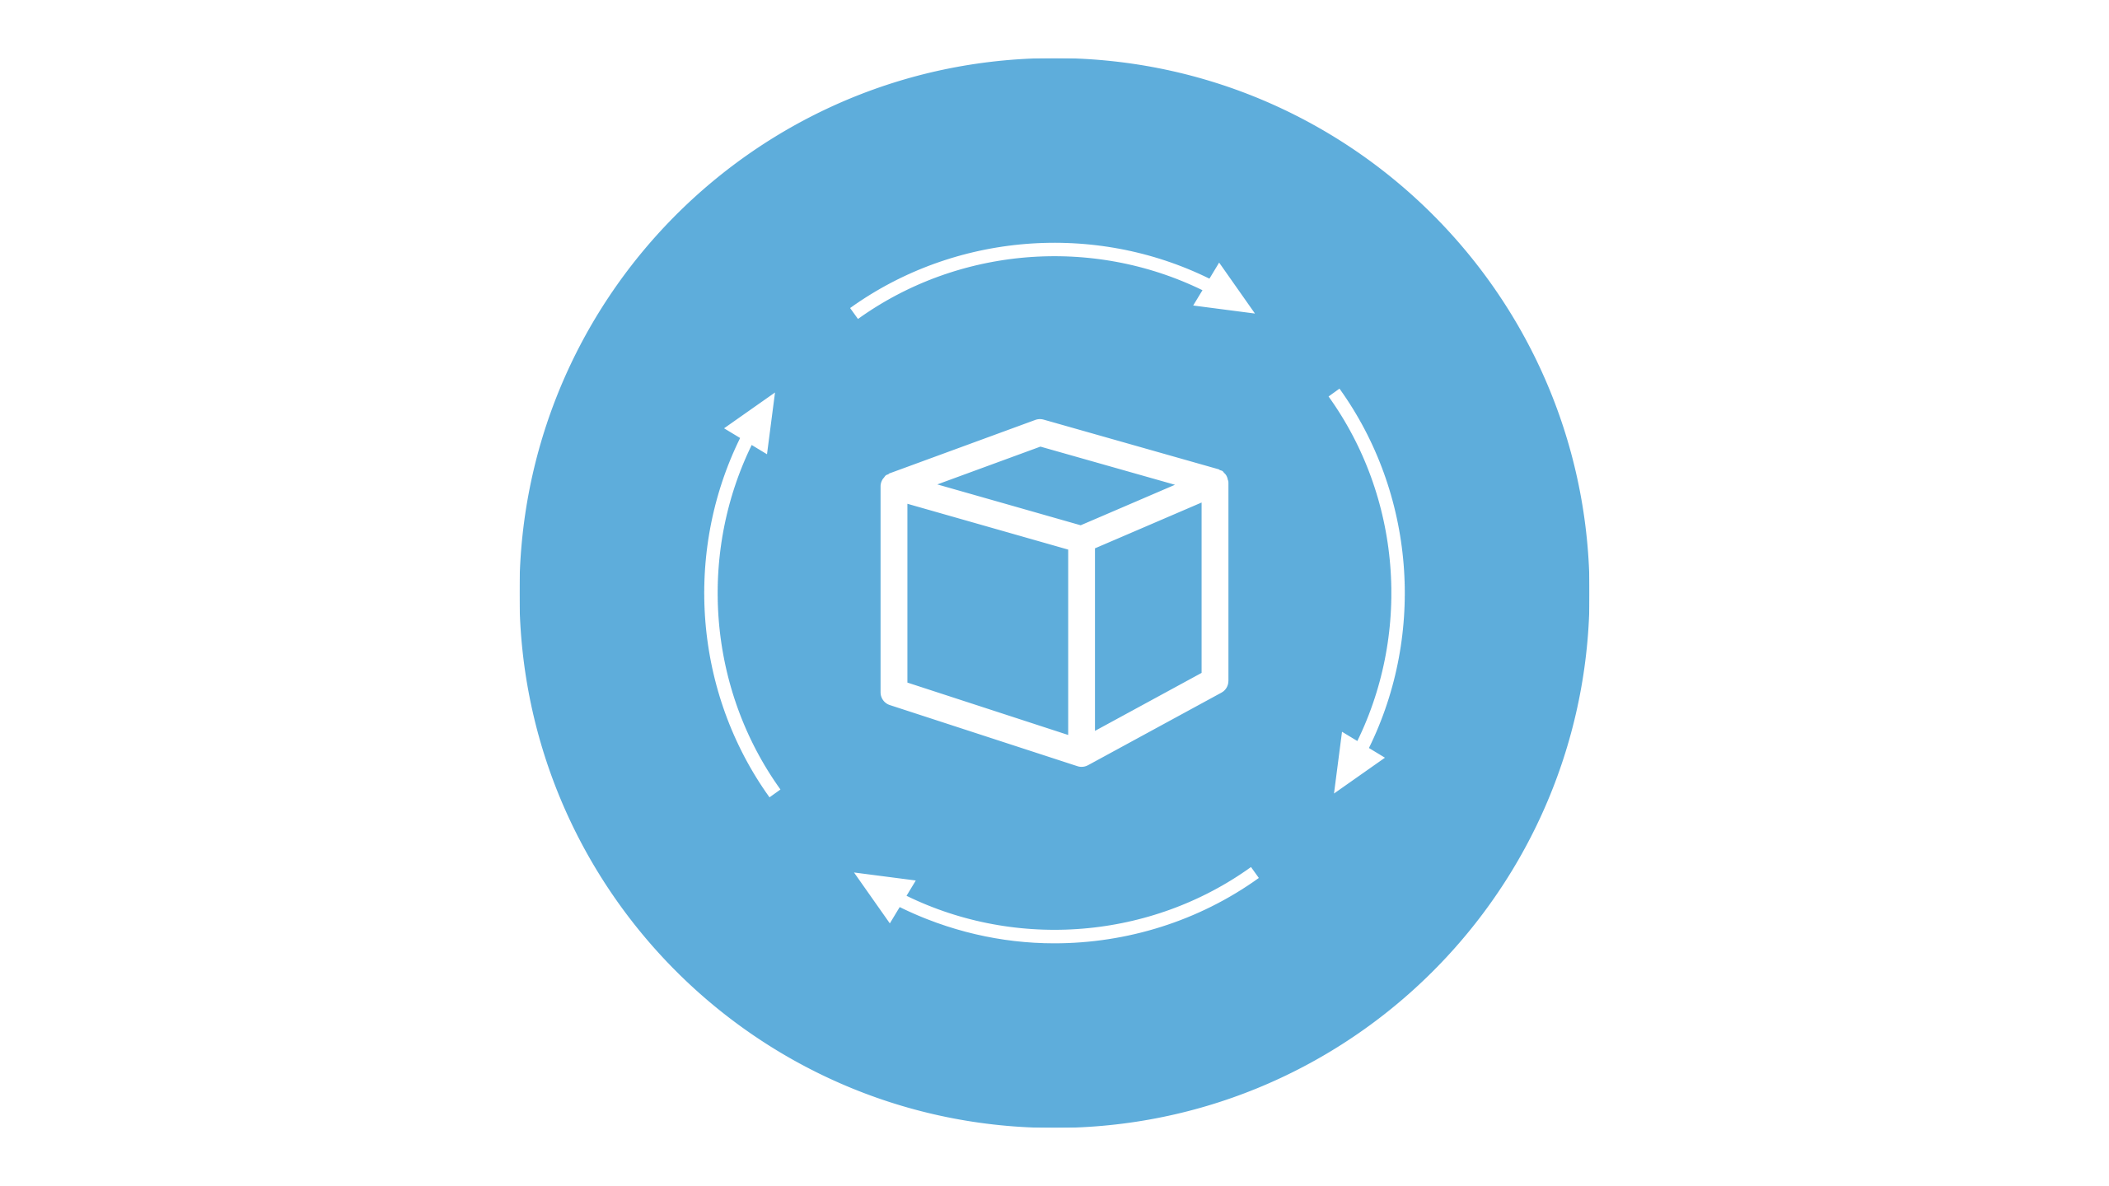
S3 Life Cycle Management
What are Storage Classes of S3?
Before understanding S3 Life cycle Rules one has to understand S3 Storage Classes.
Amazon S3 offers a range of storage classes designed for different use cases. Each storage class has different pros and cons and pricing structure.

Slide 26
S3 Life Cycle Management
1
S3 Standard
2
S3 – IA
3
S3 One Zone – IA
Highly available and durable.
Stored redundantly across multiple facilities.
Designed to sustain the loss of 2 facilities concurrently.
For data that is accessed less frequently, but requires rapid access when needed.
Lower fee than S3 Standard, but you are charged a retrieval fee.
For where you want a lower-cost option for infrequently accessed data but do not require the multiple AZ data resilience..
Lower fee than S3-IA & Standard.
4
S3 – Intelligent Tiering
5
S3 Glacier
6
S3 Glacier Deep Archive
Designed to optimize costs by automatically moving data to the most cost-effective access tier, without performance impact or operational overhead..
Based on Machine Learning of Object usage.
S3 Glacier is a secure, durable, and low-cost storage class for data archiving.
You can reliably store any amount of data at costs that are competitive with or cheaper than on-premises solutions.
Retrieval Time : Minutes to Hours.
S3 Glacier Deep Archive is S3’s lowest-cost storage class.
Retrieval Time : 12 Hours.

Slide 27
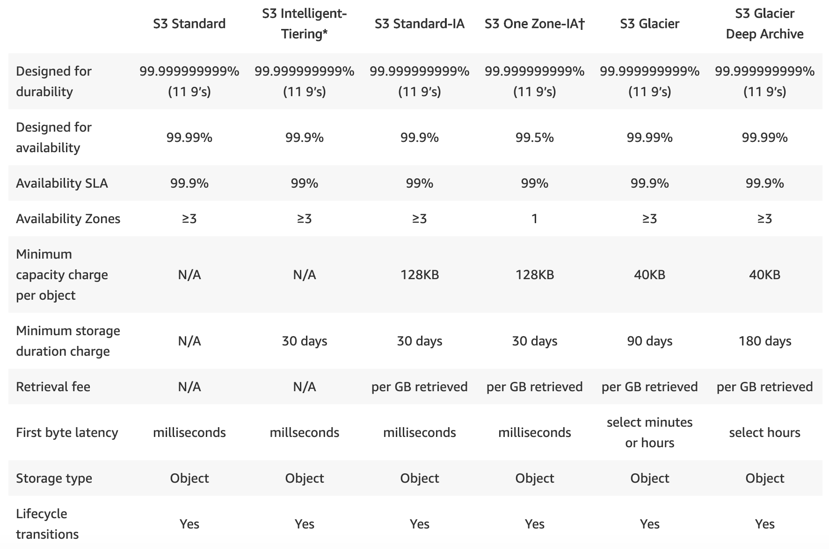
S3 Life Cycle Management
Performance across the Storage Classes

Slide 28
S3 Life Cycle Management
What is Object Lifecycle Management?
To manage your objects so that they are stored cost effectively throughout their lifecycle, Lifecycle is used.
It consists of a set of rules that define actions that S3 applies to a group of actions :
Transition Actions : Object Transition from one storage class to another after certain period of time.
Expiration Actions : Define when the objects expire. S3 deletes expired objects on your behalf.

Slide 29
S3 Life Cycle Management
LAB - 4

Slide 30
S3 Pricing

Slide 31

S3 Pricing
Amazon S3 Pricing
Pay only for what you use. There is no minimum fee. There are four cost components to consider when deciding on which S3 storage class best fits your data profile :
Storage
Requests & Data retrievals
Data Transfer
Management & Replication

Slide 32
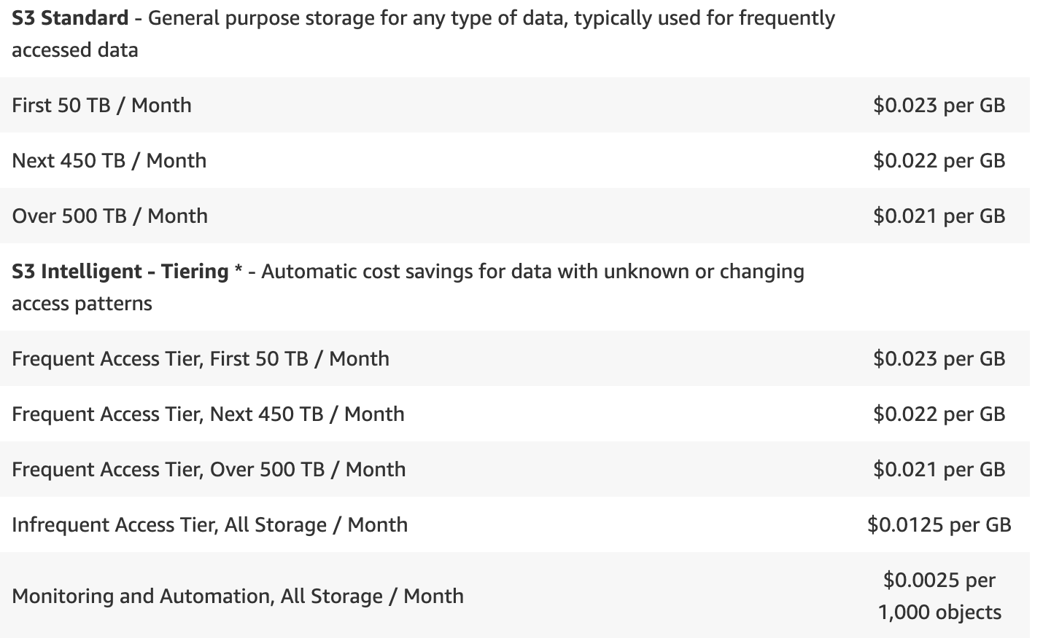
S3 Pricing
Amazon S3 Storage Pricing Example

Slide 33
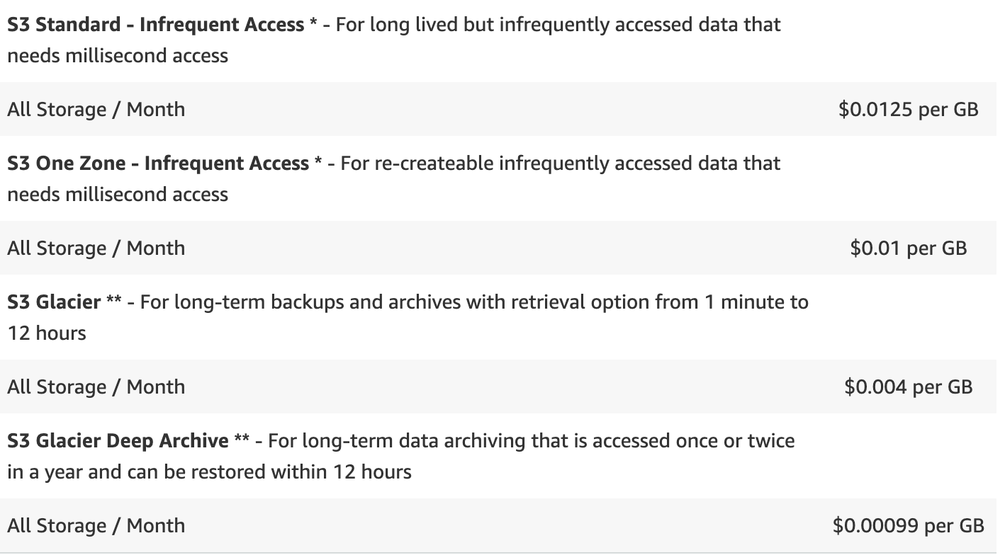
S3 Pricing
Amazon S3 Storage Pricing Example

Slide 34
S3 Pricing
Pricing High to Low
As per the pricing from different factors, here are the storage tiers listed from high to low pricing structure :
S3 Standard
S3 – IA
S3 – Intelligent Tiering
S3 One Zone – IA
S3 Glacier
S3 Glacier Deep Archive

Slide 35
S3 Pricing
Useful Link for S3 Pricing
https://aws.amazon.com/s3/pricing/

Slide 36
Hosting a Static website in S3 LAB

Slide 37
S3 Service Limits

Slide 38
S3 Service Limits
Useful Links for S3 Limitations
https://docs.aws.amazon.com/AmazonS3/latest/dev/BucketRestrictions.html

Slide 39
S3 Useful Links

Slide 40
S3 Service Limits
Useful Links for S3
https://docs.aws.amazon.com/AmazonS3/latest/dev/Welcome.html
https://aws.amazon.com/blogs/security/iam-policies-and-bucket-policies-and-acls-oh-my-controlling-access-to-s3-resources/
https://aws.amazon.com/s3/?nc=sn&loc=1
https://aws.amazon.com/s3/features/?nc=sn&loc=2
https://aws.amazon.com/s3/storage-classes/?nc=sn&loc=3
https://aws.amazon.com/s3/videos/?nc=sn&loc=6&dn=2
https://aws.amazon.com/s3/faqs/

Slide 41
Thank You!

