Slide 1
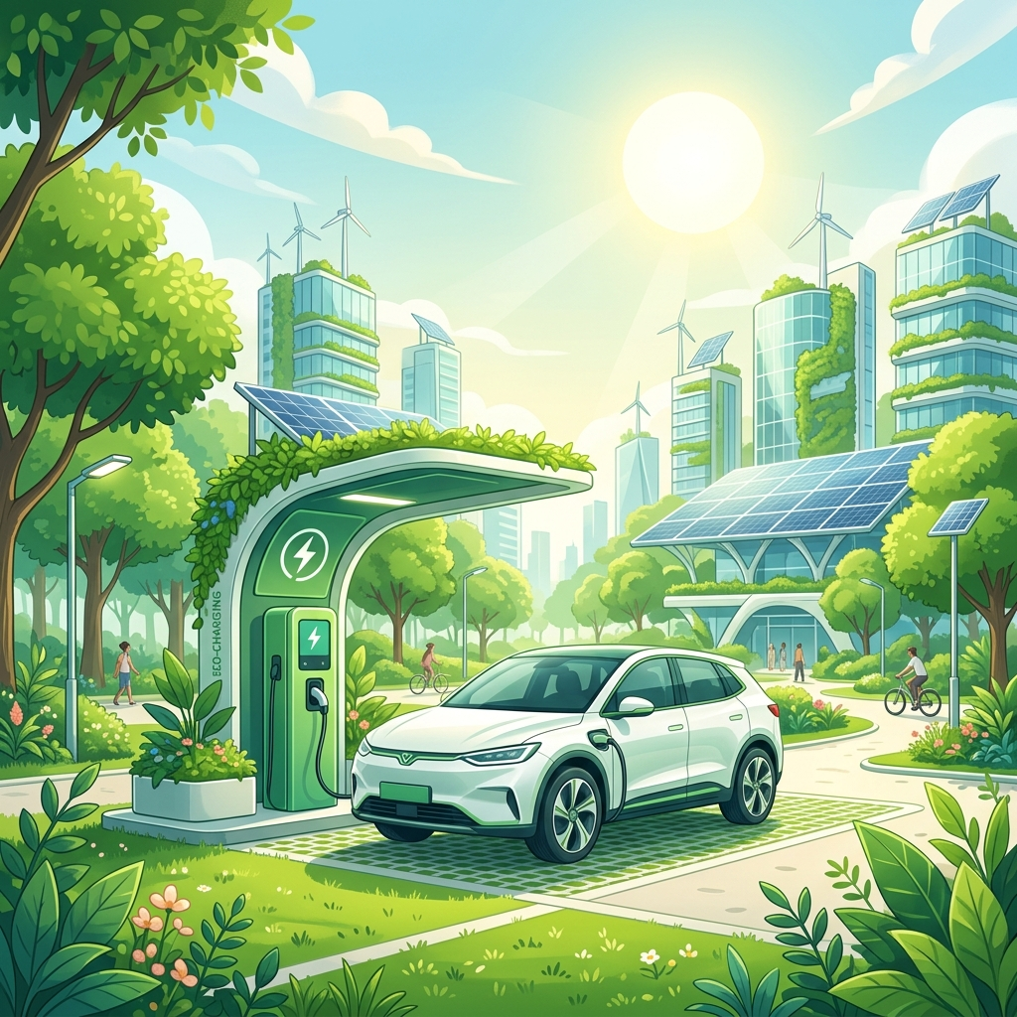
BGI HACKATHON 2026
EVgene
Theme- Smart Mobility , Evs & Logistics
Problem Statement ID – BT2P2
Problem Statement Title- EV Charging
Station Locator & Slot Booking System
Problem Statement Category- Software
Team ID- 1696
Team Name - VoltX

Slide 2
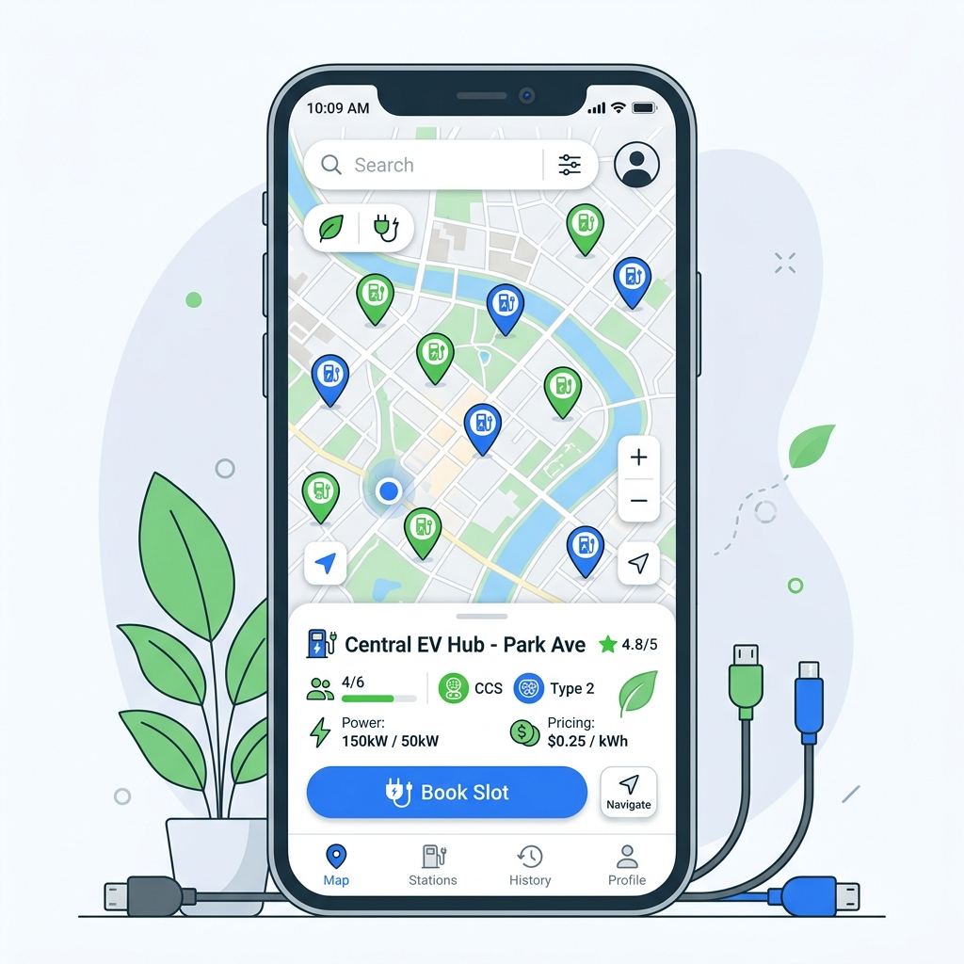
SOLUTION OVERVIEW
SOLUTION OVERVIEW
Idea >> EarthCharge
Map & Core Platform
68%
3x
100%
• Find nearby EV charging stations instantly using your phone's GPS
• See a live map showing which charging slots are free or busy right now
• Get the best route to the nearest available charger automatically
• View photos, reviews, pricing, and hours before you arrive at any station
EV owners cite range anxiety
Faster booking vs walk-in
Carbon-neutral workflow
Why EVgenee Wins
EV drivers face uncertainty before every trip.
EVgenee delivers certainty — live slot data
plus instant booking means users arrive to a
guaranteed charger, cutting idle time & emissions.
Result: faster EV adoption, greener cities.
Smart Booking System
How It Works — 4 Simple Steps
• Reserve a charging slot in advance so you never wait in a queue
• Live updates keep your booking status synced across all your devices instantly
• Book, change, or cancel your slot in one tap with instant confirmation
• Get automatic reminders and alerts so you always arrive on time
01
Open App
GPS locates nearest available EV stations
in real time
02
View Map
Live map: slot count, charger spec
& ETA to station
03
Book Slot
Reserve in one tap — free cancellation,
no penalties
04
Charge & Go
Arrive, plug in, track usage
& receive digital receipt

Slide 3

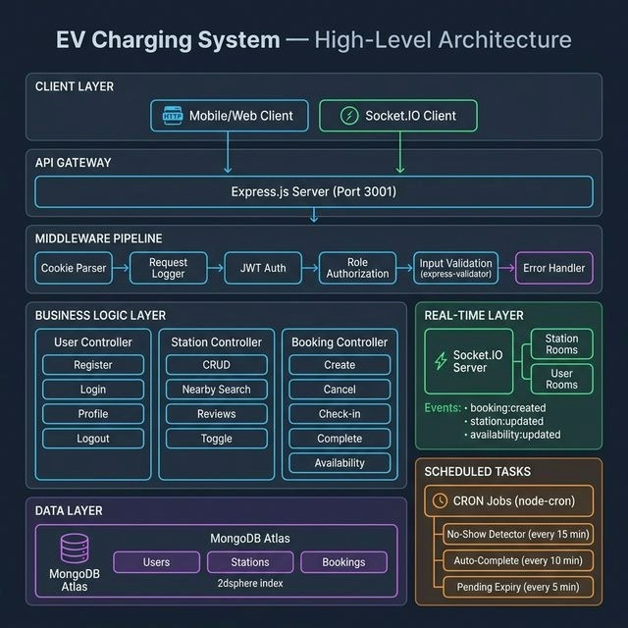
SOLUTION APPROACH
Tech Stack
Web Frontend: TypeScript, PWA, Tailwind CSS, React
Mobile App Frontend: Flutter
Backend: SpringBoot, Node.js, WebSocket
Database: MongoDB, PostgreSQL, Redis

Slide 4
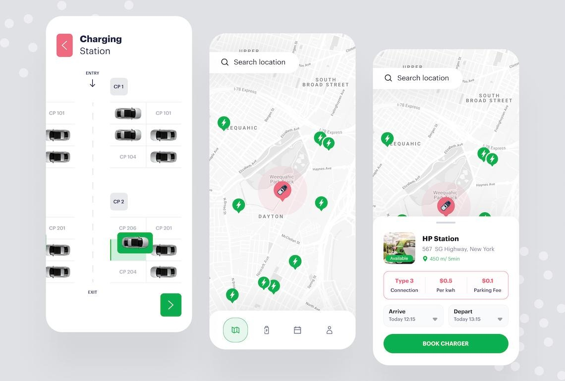
FEASIBILITY & VIABILITY
FEASIBILITY & VIABILITY
.
Technically Feasible
• Charging slot availability updates instantly with zero lag or delay
• Finds the nearest chargers to you with fast and accurate location search
• Easily expands to new cities without any major technical changes needed
Scalable Infrastructure
Low Cost Setup
• Free APIs available to test and build without any cost to start
• Uses open-source maps so no expensive licensing fees needed
• Built on reliable, widely-used technology — no special hardware required
• Entire platform built on free, open-source tools — no software license costs
• Payment system is free to use until you earn your first ₹1 lakh in revenue
• Full working app can be built for under ₹2 lakh using open-source
CHALLENGES & MITIGATIONS
Risk-Identified >> Solution-Mapped >> Deployment-Ready
VIABILITY SCORES
• Charging station data is scattered across many different operators with no single unified source
• One single connection that works with all charging networks — no separate setup needed for each operator
90%
!
>>
✓
Technical Viability
• Unstable electricity supply and weak internet in rural areas makes reliable charging difficult
• Integrate reliable Maps API with continuous data validation
85%
!
>>
✓
Market Viability
• Users may not trust or rely on the app if live charging slot data is often wrong or outdated
• Prevent overbooking using transactional APIs & live updates
92%
!
>>
✓
Operational Viability

Slide 5

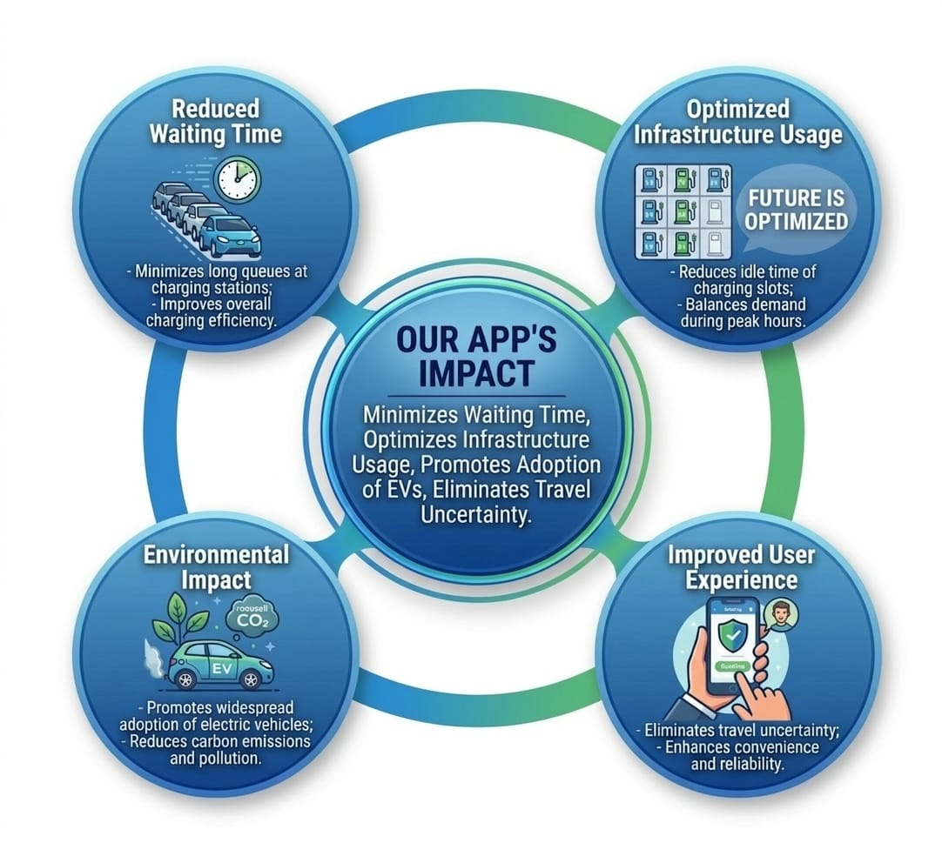
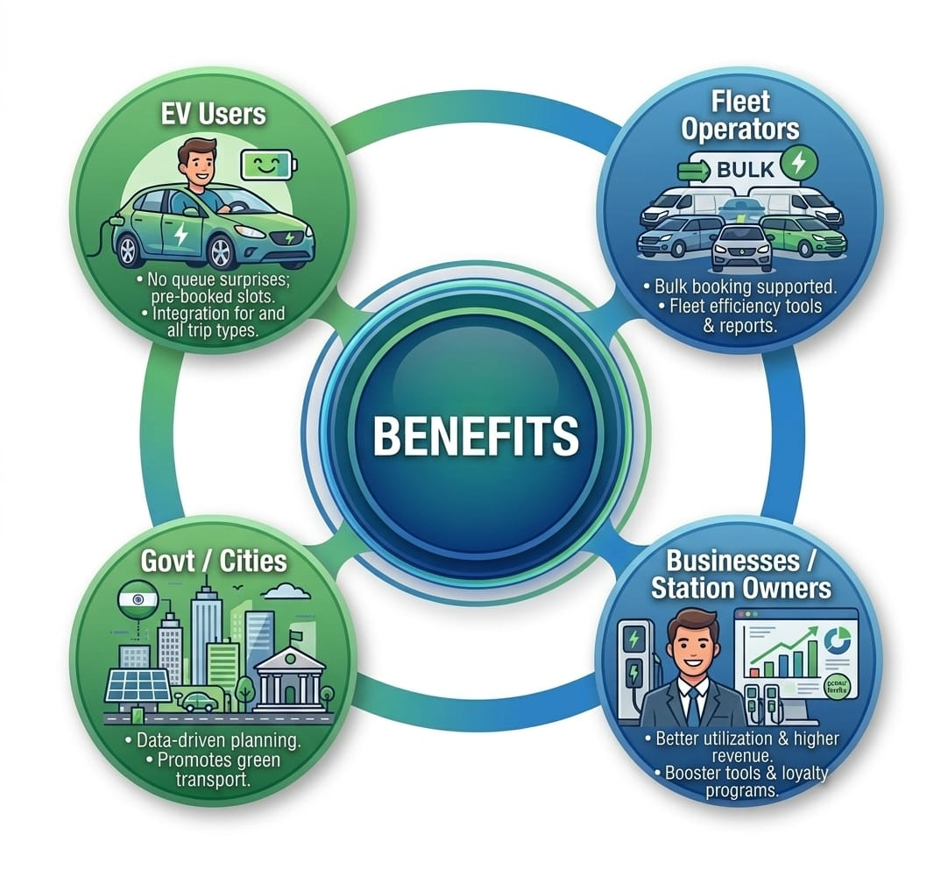
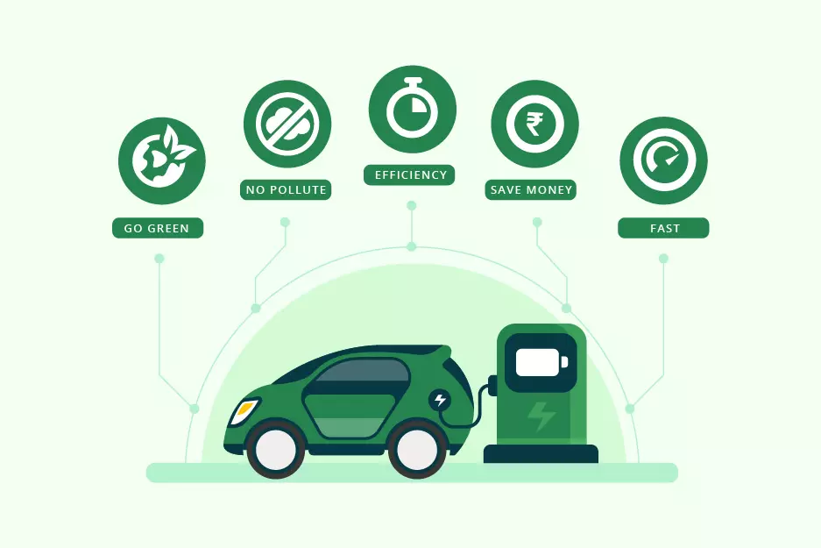
IMPACT & BENEFITS
IMPACTS:
Reduced Waiting Time
• Minimizes long queues at charging stations • Improves overall charging efficiency
Optimized Infrastructure Usage
• Reduces idle time of charging slots • Balances demand during peak hours
Environmental Impact
• Promotes adoption of electric vehicles • Reduces carbon emissions and pollution
Improved User Experience
• Eliminates uncertainty during travel • Enhances convenience and reliability
BENEFITS:
EV Users
• Zero queue surprises with pre-booked slots • Real-time navigation to the nearest available charger
Fleet Operators
• Multi-vehicle bulk booking support • Reduced downtime and better fleet utilisation
Govt / Cities
• Data-driven infrastructure planning • Promotes nationwide green transportation
Businesses / Station Owners
• Increased revenue through better utilisation • Efficient management of charging slots

Slide 6

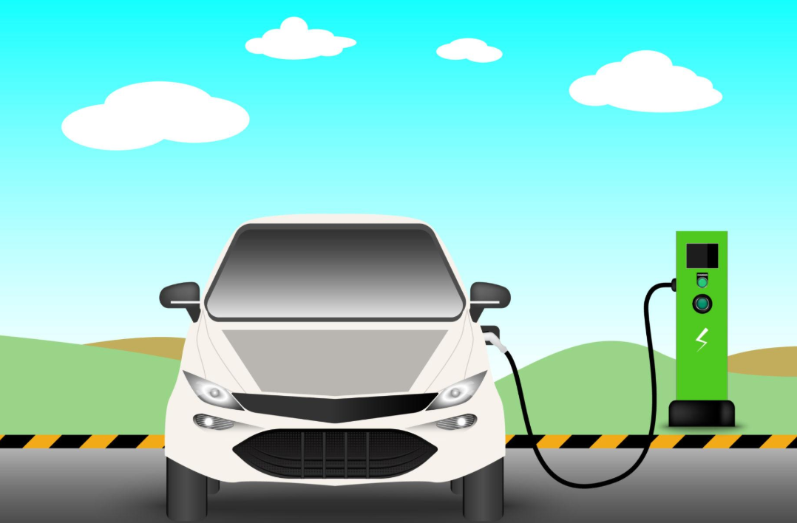

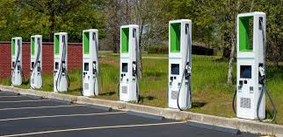
Policy & Environment
*NITI Aayog — e-Amrit EV Resource Portal (India EV ecosystem insights) • Bureau of Energy Efficiency (BEE) — EV Charging Infra Standards • PM e-DRIVE Scheme — Government initiative for EV adoption • FAME-II Policy — Incentives for EV infrastructure & growth
Market Research
• Vasudha Foundation — EV Charging Behaviour Study (India) • JMK Research — India EV Market Report 2024 • IEA Global EV Outlook — EV growth trends worldwide • Peer Paper — Smart Charging Network Optimization
Technical Resources
• Open Charge Alliance — OCPP 2.0.1 Protocol (EV charger communication) • Google Maps Platform — Geolocation, routing & navigation APIs • WebSocket — Real-time slot updates • Redis Pub/Sub — High-speed data synchronization

