Slide 1
Learning Inter-Agent Synergies in Asymmetric Multiagent Systems

Slide 2

What are asymmetric agents?
Asymmetric agents are agents that have:
Different Capabilities
Different Objectives
They can be contrasted with heterogenous agents that have different capabilities but same objectives.

Slide 3
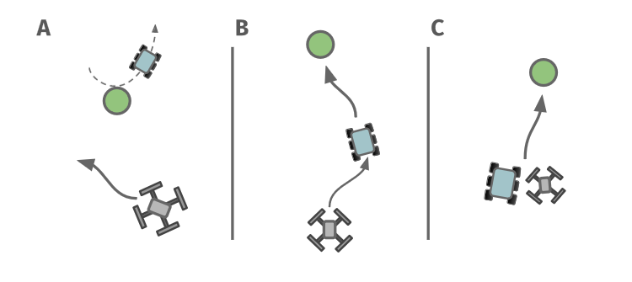
Synergy
Can be demonstrated by an example:
Rovers and drones are deployed to find excavation sites in a remote environment. A rover can mark a site that a drone must then confirm and communicate to a ground station.
[A] The drone starts its search after the rover has marked a site and left (no synergy).
[B] The drone learns to loosely follow the rover to locate and confirm a marked site (partial synergy).
[C] The rover and the drone learn to team up and navigate together leading to efficient search (full synergy).

Slide 4

Our task becomes even more difficult when we want to have a set of asymmetrical agents that perform well not only in one task but a variety of tasks that they could possibly come across.

Slide 5
Existing Strategies
Learning Individual Intrinsic rewards (LIIR)
Uses a linear combination of parameterized intrinsic reward and a team reward
To ensure alignment, intrinsic reward is updated based on gradient from team rewards, which makes it difficult to scale in case of sparse team rewards.
Multi DDPG (Deep Deterministic Policy Gradient)
Uses centralized critic to that optimizes the joint actions of all the agents.
Also relies on a dense team reward, can become intractable as the no. of agents increase.
Multi Agent Evolutionary Reinforcement Learning (MERL)
Combines gradient learning on agent-specific rewards with evolutionary algorithm that maximizes team reward; selection pressure on policies for agent-specific reward ensures alignment.
Its shared replay buffer architecture limits application to homogenous agents.

Slide 6
In This Paper

Slide 7
Quality Diversity
Two step iterative process:
Mutating a population of policies to create diversity.
Cataloging and refining the population by projecting it in behavior space.
QD offers a shift from finding a single optimal policy to several diverse policies, which offers a potential for learning complementary policies and is crucial for asymmetric settings.
In multi agent settings, exhaustively exploring the behavior space is intractable and thus we can use filtering to limit the behavior state to regions that yield good team performance.

Slide 8
Asymmetric Island Model
This is a multi-agent framework that combines agent-specific and team-wide objectives to produce teams of asymmetric agents that learn diverse agent synergies required to cooperate on a variety of tasks. It has three parts:
Islands
Mainlands
Policy Migration
While Islands handle agent-classes separately and focus on agent-specific reward and learning using QD, Mainlands take care of team tasks and utilize evolutionary algorithms to optimize team performance. Policy Migration allows us to explore and focus on policies that are similar to the ones which are already providing good performance.

Slide 9

The Habitat problem:
To test the effectiveness of training individual agent classes on islands and then migrating them to the mainland to learn team tasks, the paper considered the following collaboration problem.
We have an environment with three agent classes, : 1) Rovers with sensing equipment; 2) Excavators with digging equipment; and 3) Drones with communication infrastructure. The three classes must operate together to find resourceful dig sites, excavate regolith and communicate the number of excavated dig sites back to a ground station. Cooperation is enforced by requiring multiple excavators to work together dig up the site.
The net fitness of the team basically calculates the value of sites that are excavated and observed by a drone.

Slide 10
Broad Solution strategy:
Each policy is a feedforward neural network, with a vector of inputs representing densities of other agents and dig sites in its local environment, and 2 outputs representing an action (dx,dy).
The individual reward for each agent is 1/d, where d is the distance to the closest dig site.
These individual policies are then randomly sampled from their respective islands to form teams on the mainland following an allocation distribution mu, and teams are trained using cooperative co-evolutionary algorithm (CCEA).
High performing policies from the mainland are "migrated" back to the individual agent islands, to improve training of the individual policies.
The policy distribution mu is updated to optimize the number of agents from each island.

Slide 11
Important metrics
1) Adaptation to unseen tasks: Can agents trained in this way perform well on tasks that they didn't explicitly train for? (5 variants of the habitat game were described to test this)
2) Correlation between behaviors and tasks: Can we understand the behavioral decisions that made some teams and agents perform better than others?
The asymmetric island model performs well on both criteria.

Slide 12
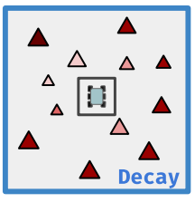
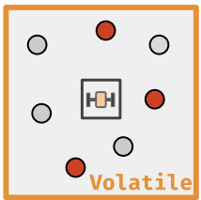
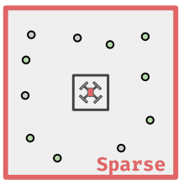
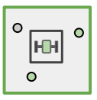
Asymmetric Coordination
Decay
Volatile
Constrained
Sparse
v(k, t+1) = v(k,t)*0.5
Marked site stays marked for 7 steps
30*30
120*120

Slide 13
Asymmetric Coordination
Scenario | Result
Decay | 80+%
Volatile | 70+%
Constrained | 100%
Sparse | 70+%
Mixed | 80+%

Slide 14
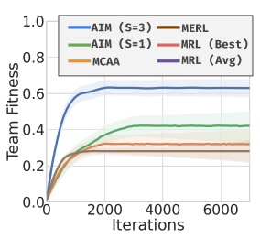
Adaptation to unseen tasks
Training:
AIM (S=1)
All 3 mainlands are assigned Decay.
AIM (S=3)
Mainlands are Decay, Constrained and Sparse
Evaluation
The evaluation is done on the "Volatile" task.
AIMS (S=3) outperforms significantly.

Slide 15
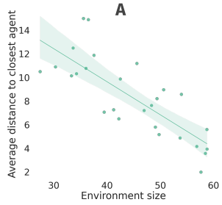
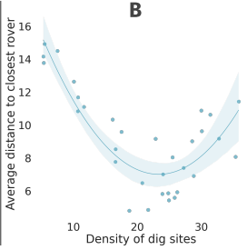
Correlations Between Behaviors and Tasks
For smaller environments , drones seem more closely linked to the task and prefer to spread in the environment (Decay) or camp around dig sites (Volatile).
The camping and spreading strategies become less effective and drones learn to follow rovers and excavators instead.
For sparser environments, the excavators seem to spread in the environment.
With the rise in density, the overall inclination to team with rovers seems to increase
This trend reverses again as the excavators seem to adopt a coverage strategy

