Slide 2
Ultrasonic Sensor
d
Tx
Ultrasonic Sensor
Rx
Obstacle
e.g., Wall, Other vehicles, etc.
(a)
(b)
Fig. 1.

Slide 3
Tiva C series TM4C123G
LaunchPad
Evaluation Kit
Ultrasonic Sensor
Tx
Peripheral
Such as PC/ OLED/
On-board LED
(TBD)
Rx
Ultrasonic Sensor
Tx
Rx

Slide 4
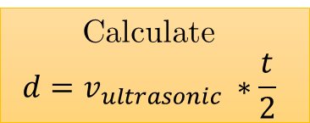
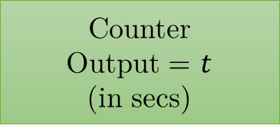

Alternate between F/R
Initialisations
Trig = 1
Wait(10$μ$s)
via interrupt
#include<..>
#include<..>
#include<..>
void fn1(..);
void fn2(..);
void main()
{
….
while(1){
……
}
}
void fn1(…)
{
}
void fn2(…){ …
Trig = 0
count > count_max
Counter
Output = $t$
(in secs)
Wait(min(echo=1), count_max)
count <= count_max
Calculate
$$d=v_{ultrasonic} ∗\frac{t}{2}$$
Output to PC

