Slide 1
Risha Nadhasha .L
au962821104075

Slide 2
Custom Summarization App using generative AI

Slide 3
Agenda
Problem statement
Project overview
End users
Solution
modelling

Slide 4
Problem statement:
In today's information-rich environment, individuals are inundated with vast amounts of textual data from various sources such as news articles, research papers, and online content. However, the challenge lies in efficiently extracting relevant information from these texts, as traditional summarization methods often fail to capture the nuances and key insights of the content accurately.

Slide 5
Project overview:
One of my favorite applications of modern Large Language Models Is to create summaries of PDFs.
More than just any summary, I want the ability to create customizable summaries that can fit any research or learning need.
This app will allow users to create custom prompts to summarize PDF files using AI-powered language models like ChatGPT and GPT-4

Slide 6
End users:
Students: Students could use the app to summarize lengthy texts, articles, or academic papers for study purposes, allowing them to grasp key concepts more efficiently.
Researchers: Researchers could utilize the app to quickly generate summaries of relevant literature for their own research projects, saving time and effort in sifting through large volumes of information
Professionals: Professionals in various fields such as journalism, law, or business could benefit from the app by summarizing documents, reports, or legal briefs, helping them to extract essential information rapidly.
Educators: Educators could employ the app to create concise summaries of educational materials for classroom use or to aid in preparing lesson plans.

Slide 7
Solution:
We develop an app called “custom summarization app” as a solution
Using AI-powered language models like chatgpt and gpt4,users will be able to construct personalized prompts for summarizing PDF files with this app.
The goal is to offer an interface through which users can create personalized summaries from any PDF files
This application should make advantage of natural language processing and machine learning algorithms to generate brief, cohensive and customized summaries that faithfully convey the main ideas of the source material

Slide 8
Modelling:
Steps:
Import dependencies
Define the helper functions
Create a responsive user interface with Streamlit.
Running the App

Slide 9
Import dependencies:
We import the required modules and libraries for implementing the app.
They include openai’s GPT models,streamlit for the user interface and some cjustom classes and functions for processing text using langchain
Define the helper functions:
setup_documents function is responsible for loading, extracting, splitting the text
custom_summary function takes the document, prompt and creates a summarization chain
color_chunks function is responsible for creating a visually appealing HTML representation of text chunks with overlaps

Slide 10
Create a responsive user interface with Streamlit.
In the main() function, we implement the user interface of the app using streamlit. We set the page configuration, create titles, and provide options for users to select the language model, chain type, chunk size, and chunk overlap values.
Based on the inputs, the app either displays the interactive text chunk visualizer when the user enables the “Debug chunk size” option or generates a custom summary from PDF file using the user-selected language model and the custom prompt

Slide 11
Running the app:
Create the conda environment:
conda env create –f environment.yml
You can also just install the required libraries using the following command:
Pip install –r requirements.txt
Open a terminal and navigate to the app directory and run the script
python ai.py
Open a web browser and navigate to http:/localhost:7850/.

Slide 12
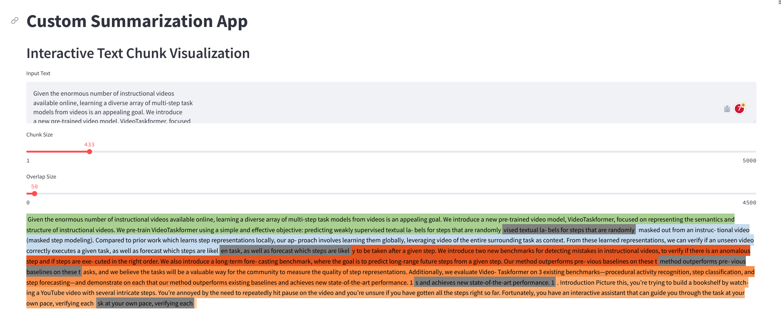

Slide 13
Thank you
Presented By: Risha Nadhasha .L
Register Number: au962821104075
Email: rishanadasha@gmail.com
College Name:University college of engineering Nagercoil

