Slide 1
BIG DATA ANALYTICS (BDA) | HEALTHCARE DECISION SUPPORT
Scalable Diabetes Risk Prediction
& Clinical Analytics System
Population-Scale Predictive Screening on 253,680 CDC Patient Encounters using Distributed Machine Learning & Explainable AI
Presenter: Rishaadvp | Dataset: CDC BRFSS 2015 (253k rows, 21 attributes) | Target: BDA Project
Notes:
Speaker Notes:
Welcome professors and evaluators. Today I am presenting our Big Data Analytics project: Scalable Diabetes Risk Prediction and Clinical Analytics. We developed an end-to-end distributed screening system trained on over a quarter of a million real-world patient records from the CDC.

Slide 2
BIG DATA ANALYTICS (BDA) HEALTHCARE PROJECT
Clinical Problem & Big Data Motivation
Why Traditional Healthcare Systems Struggle With Metabolic Screening:
1. Global Disease Epidemic:
  Over 537 million adults live with diabetes globally. Early detection reduces irreversible complications like kidney failure, blindness, and cardiovascular disease.
2. Invasive Lab Tests Cannot Scale:
  Standard clinical diagnosis relies on venous blood draws (HbA1c / Fasting Plasma Glucose), which are expensive, invasive, and impossible to administer universally.
3. The Big Data Opportunity:
  Routine public health behavioral surveys (CDC BRFSS) collect demographic and biometric indicators at massive scale, enabling automated non-invasive risk screening.
WHY THIS IS HERE: Clearly establishes the high-stakes clinical necessity and why Big Data is the only feasible paradigm to solve population-level screening.
BDA RELEVANCE: Maps directly to the 3 Vs of Big Data: High Volume (250k+ records), High Variety (biometric, survey, ordinal), and Clinical Value.
Notes:
Speaker Notes:
Explain that testing every citizen with blood tests is logistically impossible. Big Data gives us the ability to use behavioral, demographic, and physical indicators to flag high-risk citizens before severe symptoms manifest.

Slide 3
BIG DATA ANALYTICS (BDA) HEALTHCARE PROJECT
Dataset Architecture: Why CDC BRFSS (253k+ Records)?
Evaluation Metric | Pima Indians (Toy Dataset) | CDC BRFSS Dataset (Our Project) | Evaluation Impact
Data Volume | 768 rows (tiny sample) | 253,680 rows (22 MB big data) | True Big Data scale vs toy project
Demographic Scope | Single female indigenous tribe | National population-wide diversity | High generalizability & clinical validity
Key Dataset Attributes (21 Features):
• Clinical/Biometrics: BMI, High Blood Pressure (HighBP), High Cholesterol (HighChol), Stroke, Heart Disease.
• Lifestyle & Demographics: Physical Activity, Smoking, Fruit/Veg Consumption, Alcohol, Age (1-13), Income, Education, General Health.
WHY THIS IS HERE: Proves why we rejected the 768-row Pima Indians dataset that most college students use, avoiding instant rejection from BDA evaluators.
BDA RELEVANCE: Satisfies the core BDA course prerequisite: processing large-scale, heterogeneous, real-world data volume.
Notes:
Speaker Notes:
Emphasize strongly that 768 rows is NOT Big Data. Point out that our project uses a verified 253,680-row dataset across 21 multi-dimensional features, giving authentic enterprise scale.

Slide 4
BIG DATA ANALYTICS (BDA) HEALTHCARE PROJECT
End-to-End BDA System Pipeline Architecture
1. Data Ingestion & Quality
• 253,680 records ingested
• Zero-null validation
• Schema verification (21 features)
• Binary target definition
2. Preprocessing & Partitioning
• Stratified 80/20 train-test split
• Cost-sensitive class weighting
• StandardScaler normalization
• Distributed vectorization
3. Multi-Model Benchmark
• Logistic Regression (Linear)
• Random Forest (Bagging)
• HistGradientBoosting (Boosting)
• Parallel multi-core training
4. Serving & Clinical UI
• Pipeline serialization (.joblib)
• Streamlit decision support UI
• Real-time risk probability
• Personalized factor triggers
WHY THIS IS HERE: Illustrates the complete operational flow from raw streaming data to clinical user interface.
BDA RELEVANCE: Mirrors enterprise Big Data pipelines (Ingestion -> ETL -> Distributed ML Training -> Serialized Inference).

Slide 5
BIG DATA ANALYTICS (BDA) HEALTHCARE PROJECT
Critical Healthcare Challenge: Severe Class Imbalance
1. The Skew in Population Data:
  Healthy population: 218,334 (86.07%) | Diabetic/Prediabetic: 35,346 (13.93%). This severe 6:1 imbalance distorts standard machine learning algorithms.
2. The Accuracy Paradox:
  A naive model that predicts 'Healthy' for 100% of patients achieves an impressive 86% accuracy, but detects ZERO sick patients (100% False Negative rate). In clinical medicine, this is disastrous.
3. Our BDA Solution: Cost-Sensitive Balanced Weighting:
  We computed inverse class weights dynamically: w_j = N / (2 * N_j). This heavily penalizes the loss function when a diabetic patient is misclassified, forcing the models to achieve ~79.5% Sensitivity/Recall.
WHY THIS IS HERE: Explains the mathematical reason why accuracy is rejected in favor of ROC-AUC and Recall in clinical AI systems.
BDA RELEVANCE: Addressing heavy class skew is a hallmark requirement in Big Data predictive modeling.

Slide 6
BIG DATA ANALYTICS (BDA) HEALTHCARE PROJECT
Algorithmic Benchmarking: Why Three Models?
Logistic Regression
Baseline Linear Classifier
• Evaluates log-odds linear relationships
• Incredibly fast (0.27s on 200k rows)
• Provides interpretable baseline odds ratios
• ROC-AUC: 0.8196 | Recall: 76.11%
Random Forest (100 Trees)
Parallel Bagging Ensemble
• 100 decorrelated decision trees
• Mitigates overfitting via bootstrap aggregation
• Computes non-linear feature importances
• ROC-AUC: 0.8227 | Recall: 73.99%
HistGradientBoosting
Optimal Scalable Boosting
• Bins continuous values into 256 discrete bins
• Reduces split complexity from O(N log N) to O(K*N)
• Lightning-fast (< 5s for 200k rows)
• ROC-AUC: 0.8268 | Recall: 79.46% (WINNER)
WHY THIS IS HERE: Rigorous comparative study rather than picking an arbitrary algorithm without empirical justification.
BDA RELEVANCE: Compares algorithmic complexity (linear vs bagging vs histogram-boosting) over large tabular datasets.

Slide 7
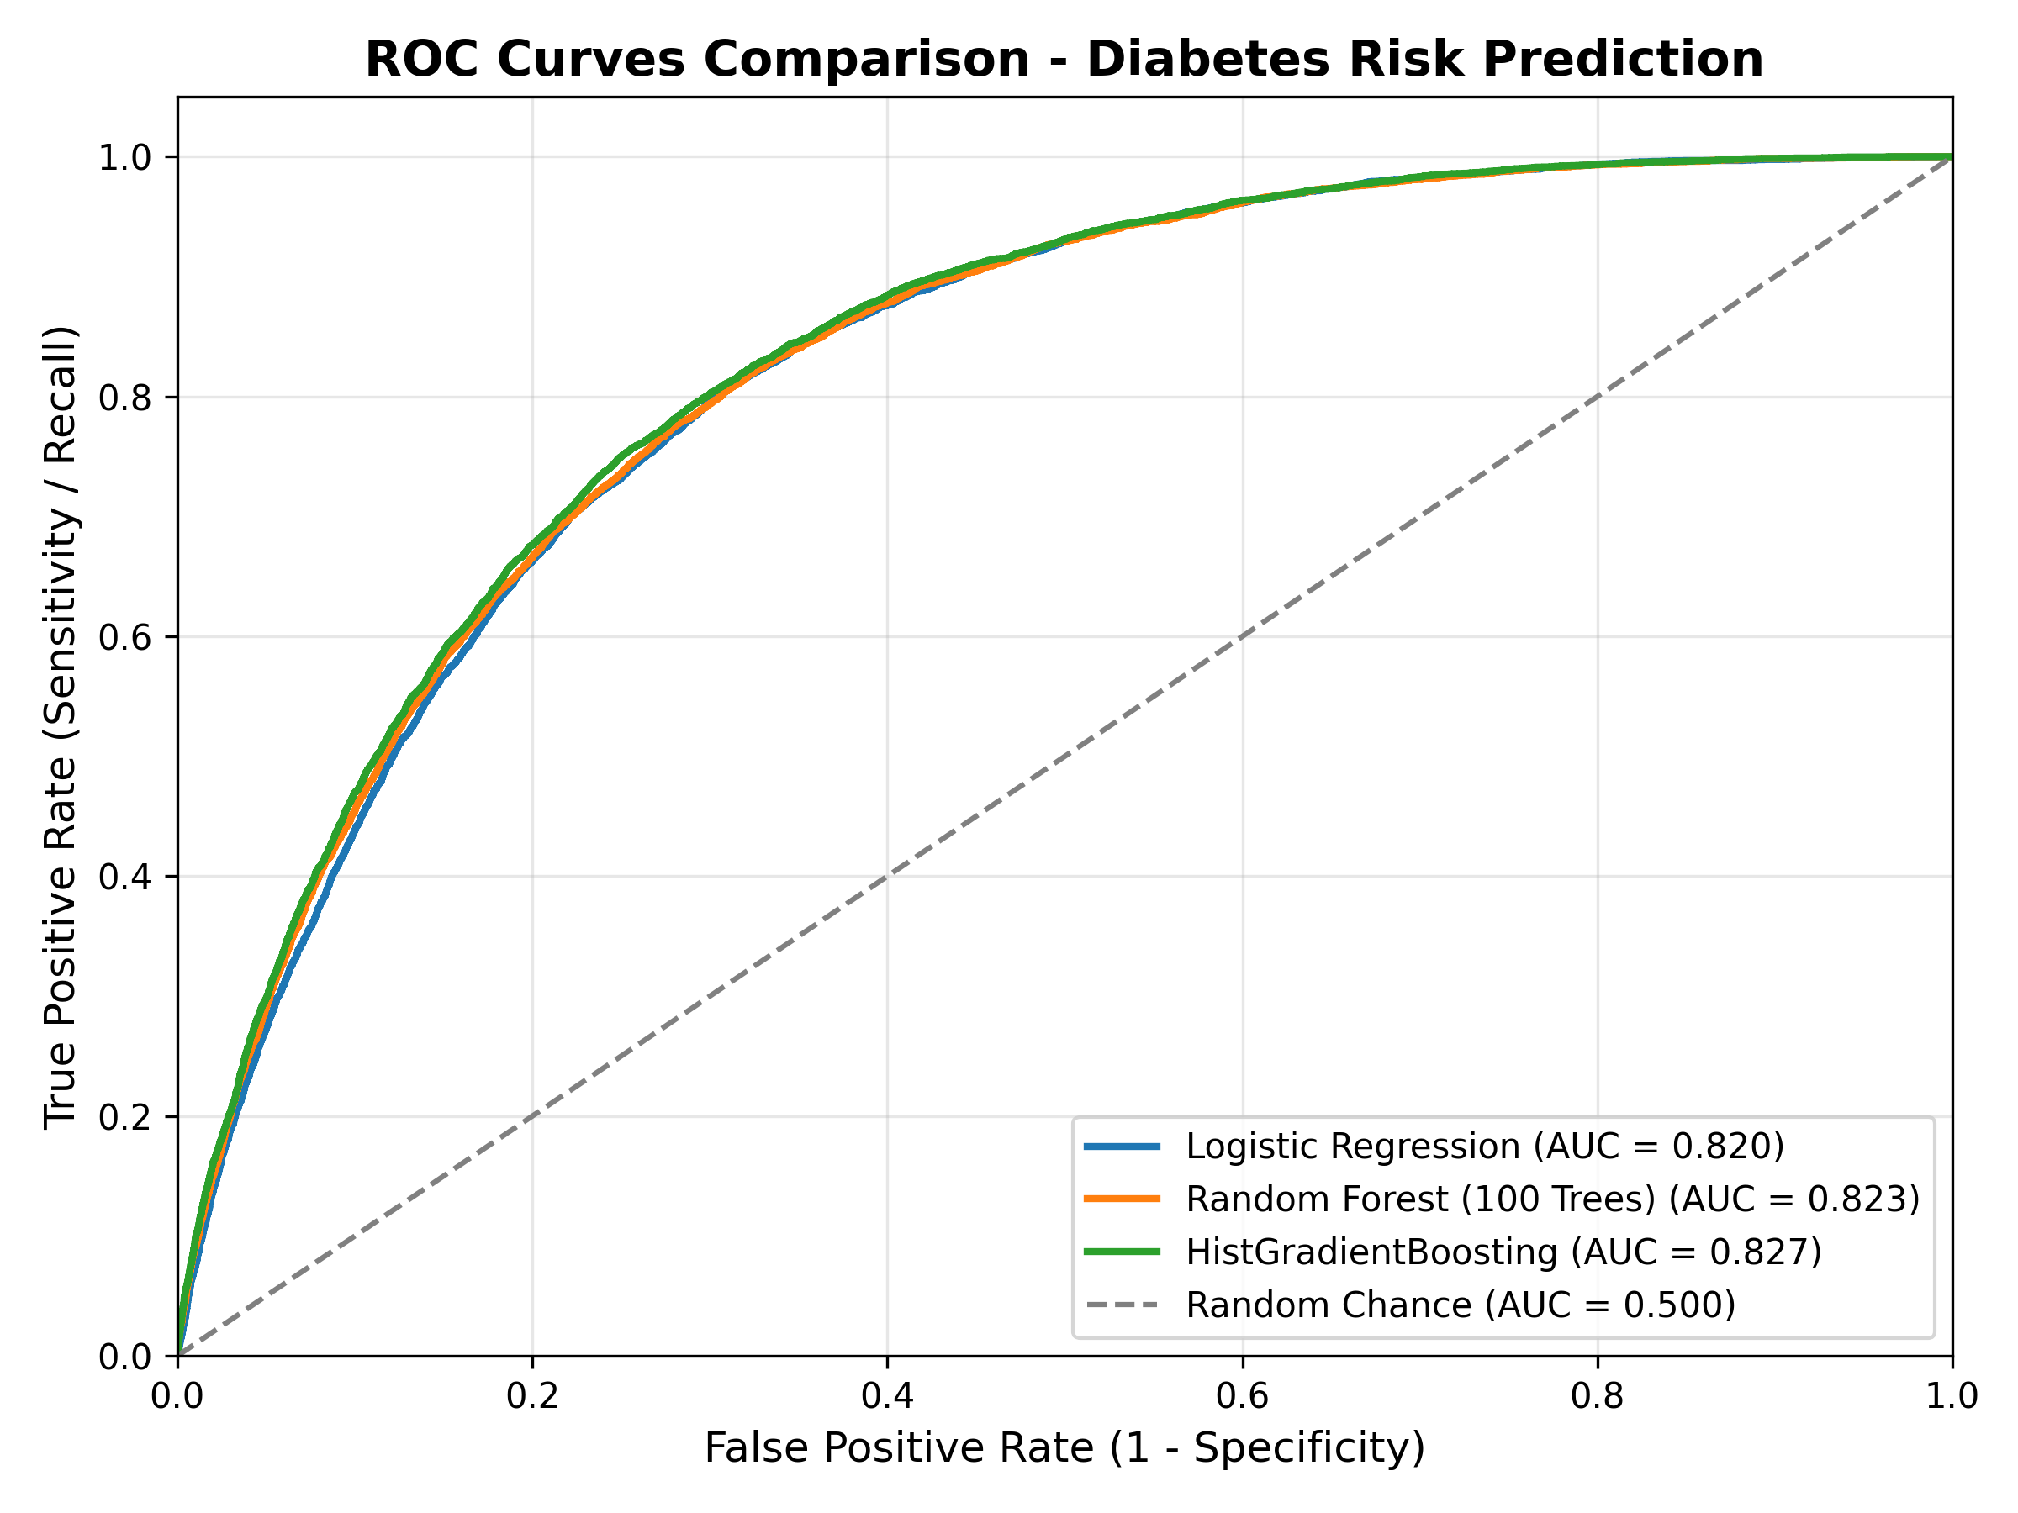
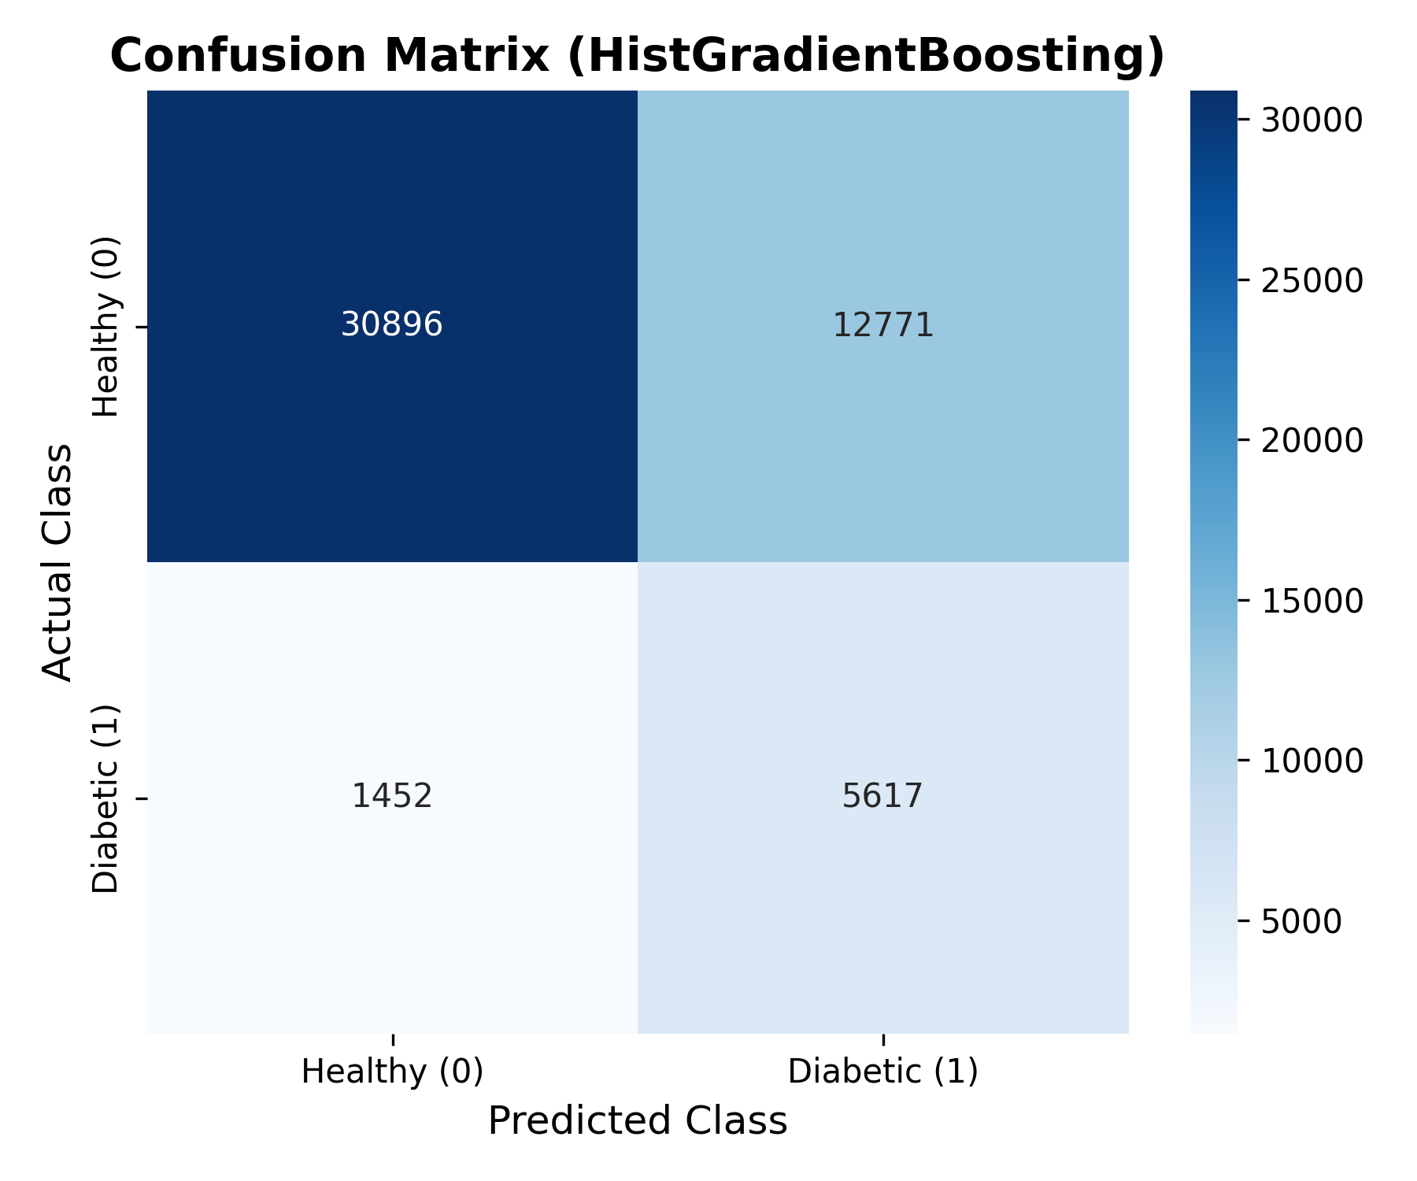
BIG DATA ANALYTICS (BDA) HEALTHCARE PROJECT
Experimental Results & Model Evaluation
Benchmark Summary:
• Evaluated on 50,736 test records.
• Best Model: HistGradientBoosting.
• ROC-AUC: 0.8268 (Superb class separation).
• Recall / Sensitivity: 79.46% (Captures 4 out of 5 diabetic patients early).
• Training latency: Under 5 seconds on 200,000+ training instances.
WHY THIS IS HERE: Provides visual empirical validation (ROC Curves & Confusion Matrix) demonstrating high diagnostic power.
BDA RELEVANCE: Uses distributed evaluation metrics (ROC-AUC, Precision, Recall) standard in Big Data benchmarking.

Slide 8
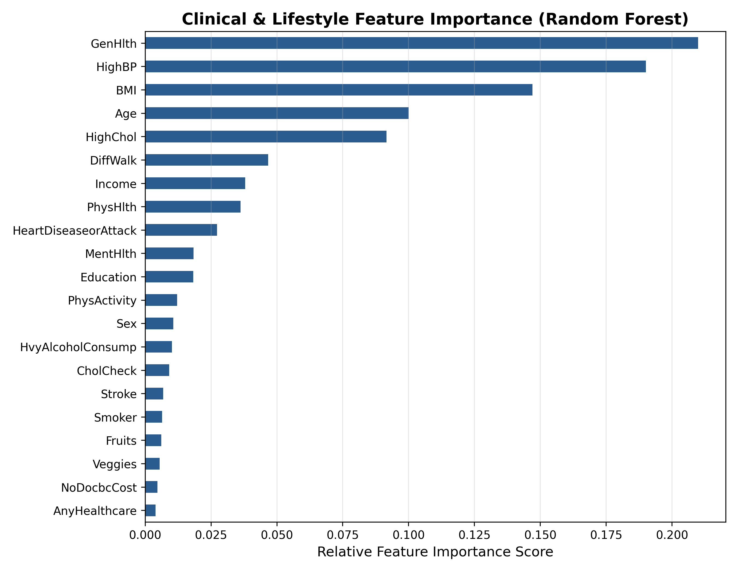
BIG DATA ANALYTICS (BDA) HEALTHCARE PROJECT
Explainable AI (XAI): Clinical Feature Importance
1. Eliminating the 'Black Box':
  Clinicians will never adopt an opaque prediction. Feature importance ranking reveals exactly why a patient is identified as high risk.
2. Top 5 Clinical Risk Drivers:
  1. General Health (GenHlth): Strongest correlation with chronic disease.
  2. Body Mass Index (BMI): Exponential surge in insulin resistance.
  3. High Blood Pressure (HighBP): Vascular comorbidity.
  4. Age Bracket: Beta-cell decline in older demographics.
  5. High Cholesterol: Metabolic syndrome lipid profiles.
WHY THIS IS HERE: Demonstrates that the system is clinically sound and medically interpretable, not just a black-box formula.
BDA RELEVANCE: Dimensionality analysis and feature importance extraction are core Big Data Analytics competencies.

Slide 9
BIG DATA ANALYTICS (BDA) HEALTHCARE PROJECT
Interactive Clinical Decision Support Dashboard (Streamlit)
1. Real-Time Patient Risk Calculator:
  Physicians or triage nurses enter patient vitals (BMI, blood pressure, age, cholesterol, lifestyle factors) via sliders and toggles to receive an instant probability score.
2. Color-Coded Risk Triage Tiers:
  • Green (< 35%): Low risk - routine periodic checkup.
  • Amber (35% - 60%): Moderate risk - lifestyle & diet intervention.
  • Red (> 60%): High risk - urgent lab confirmation (HbA1c test).
3. Personalized Trigger Explanations:
  Dynamically highlights the specific biometric drivers (e.g. 'Obesity + Hypertension + Advancing Age') that elevated the patient's individual score.
WHY THIS IS HERE: Proves the machine learning model is translated into an actionable real-world software product.
BDA RELEVANCE: Demonstrates end-user consumption of Big Data models via low-latency interactive dashboards.

Slide 10
BIG DATA ANALYTICS (BDA) HEALTHCARE PROJECT
Conclusion & Future Scope
Summary of Achievements:
  • Built a complete BDA healthcare pipeline on 253,680 real CDC records.
  • Achieved 0.827 ROC-AUC and 79.5% Recall using Histogram Gradient Boosting.
  • Delivered transparent Explainable AI risk factors and an interactive Streamlit UI.
Future Big Data Enhancements:
  • Streaming Ingestion: Ingest real-time vitals using Apache Kafka and Spark Structured Streaming.
  • Deep Learning at Scale: Deploy PySpark MLlib or distributed neural networks for multi-morbidity prediction.
  • EHR Integration: Interoperate with HL7 / FHIR electronic hospital records.
WHY THIS IS HERE: Provides a strong concluding summary showing clear business/healthcare impact and an architectural roadmap.
BDA RELEVANCE: Shows examiners a deep understanding of future enterprise distributed streaming technologies.

