Slide 1

A Major Project on
A Deep Learning-Based Approach for Inappropriate Content Detection and Classification of YouTube Videos
Under the Guidance of
Mr. T. PAVAN VINAYAK Assistant Professor
B .Tech , M .Tech
Presented By
RISHAB SAKALE 21S11A0432
BASHETTY HASINI 21S11A0416
BASHETTY AKASH 21S11A0402
KAMMARI ANJANEYULU 21S11A0404
DEPARTMENT OF ECE, MRITS

Slide 2


CONTENTS
ABSTRACT
INTRODUCTION
TOOLS REQUIRED
EXSISTING METHOD
PROPOSED METHOD
RESULTS
ADVANTAGES
APPLICATIONS
FUTURESCOPE AND CONCLUSION
REFERENCES
DEPARTMENT OF ECE, MRITS

Slide 3
ABSTRACT
YouTube has a large number of viewers, including children, as it provides entertainment on various topics like sports, religion, and movies.
Many young viewers watch cartoons, but some users misuse this by uploading unsuitable content disguised as cartoons.
Such content can have a negative effect on children, so a method is needed to detect and block it before they see it.
Some people take advantage of the platform by sharing disturbing animated videos meant for kids.
This project introduces a deep learning model that accurately finds and classifies inappropriate material in videos with 99.04% accuracy.
DEPARTMENT OF ECE, MRITS

Slide 4
INTRODUCTION
Over the past few years, social media platforms have seen a significant increase in both the production and consumption of films.
Using social media different organizations or people can exchange the information in the format of text, videos, images etc. social medias like LinkedIn, Facebook and videos uploaded information from different users.
Day by day the content is increasing and handling such huge content is going difficult as some people are uploading abusing or insulting content.
Among many social media plat forms YouTube has a greater number of users. waste content should be removed or given some restrictions to maintain company integrity.
DEPARTMENT OF ECE, MRITS

Slide 5
Download standard dataset with safe and inappropriate content
Main objective of the project is to predict youtube videos content is safe or inappropriate
In this project we introduced Bi-LSTM ,EfficientNet-SVM which are deep learning techniques
Performance metrics calculation for above algorithms
DEPARTMENT OF ECE, MRITS

Slide 6
TOOLS REQUIRED
Hardware Requirement:
Processor Type: Pentium
RAM: 512 MB RAM
Hard disk: 20 GB
Display
Software Requirement:
Operating System : Windows 10/11
Script: python 3.7.0
GUI using Tkinter
DEPARTMENT OF ECE, MRITS

Slide 7
Existing Algorithm :SVM
Old Methods for Classification – Older systems like SVM were used to check video content, but they are not very accurate for complex videos.
Limited Detection – SVM works with only two groups, so it is not good at finding different types of inappropriate content.
Basic Separation – It tries to separate content using simple rules but cannot fully understand videos like deep learning can.
Struggles with Complex Videos – SVM can handle some difficult cases, but deep learning is much better at finding hidden inappropriate content.
Existing drawbacks
Time complexity
Low accuracy
DEPARTMENT OF ECE, MRITS

Slide 8
PROPOSED METHOD
New Learning Method with Better Focus – A new advanced model is introduced to find and classify inappropriate video content, using a special attention technique to improve accuracy by focusing on key details.
Two algorithms are trained on YouTube video annotated images such as Attention based BI-LSTM and EfficientNetB7 based BI-LSTM and in both algorithms EfficientNetB7 is giving better accuracy.
On same dataset we have experiment with existing SVM algorithm but its accuracy is less than propose EfficientNetB7-BILSTM algorithm.
In propose paper author has used vulgar videos like nudity and sex so we cannot used such dataset to test above algorithms so we have used ‘Normal and Violence (fight)’ type of dataset to train above algorithms. For kids violence and fighting videos are also consider as Inappropriate Content.
DEPARTMENT OF ECE, MRITS

Slide 9
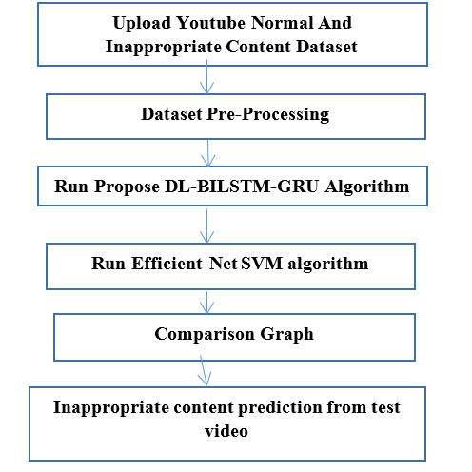
FLOW CHART OF PROPOSED SYSTEM
DEPARTMENT OF ECE, MRITS

Slide 10
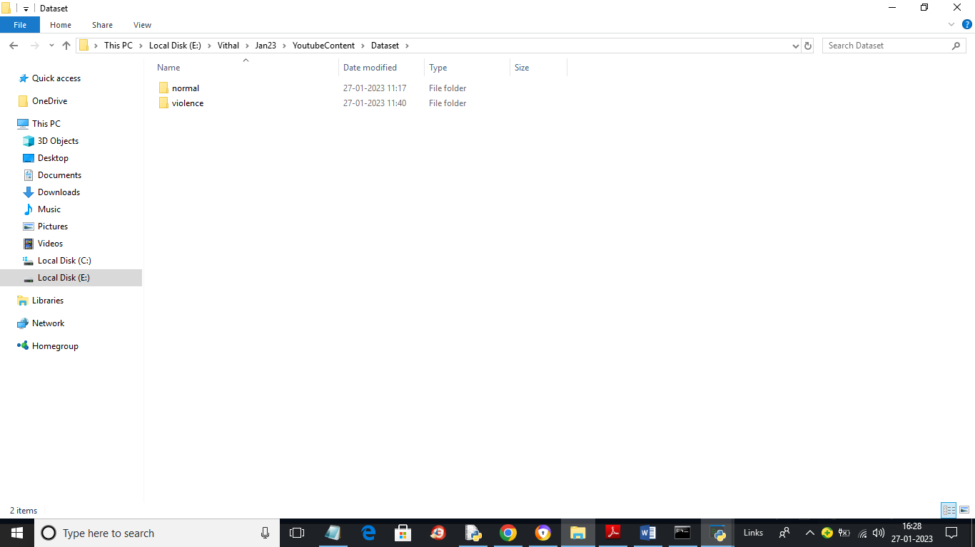
RESULTS
Dataset containing both Normal and Violence videos
DEPARTMENT OF ECE, MRITS

Slide 11
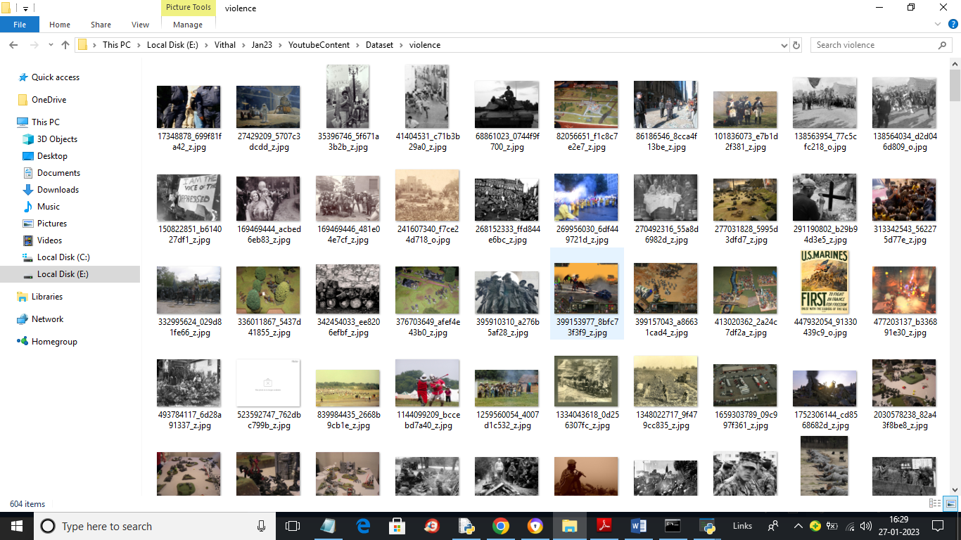
Violence Images used for Training Model
DEPARTMENT OF ECE, MRITS

Slide 12
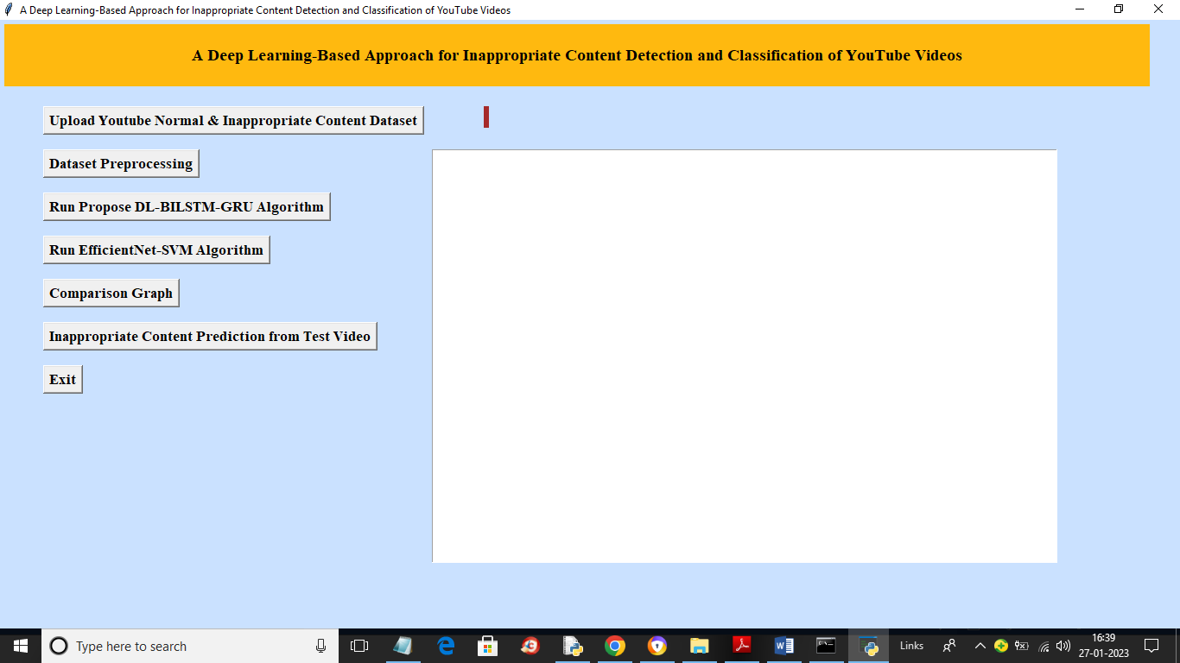
GUI prepared for proposed Model
DEPARTMENT OF ECE, MRITS

Slide 13
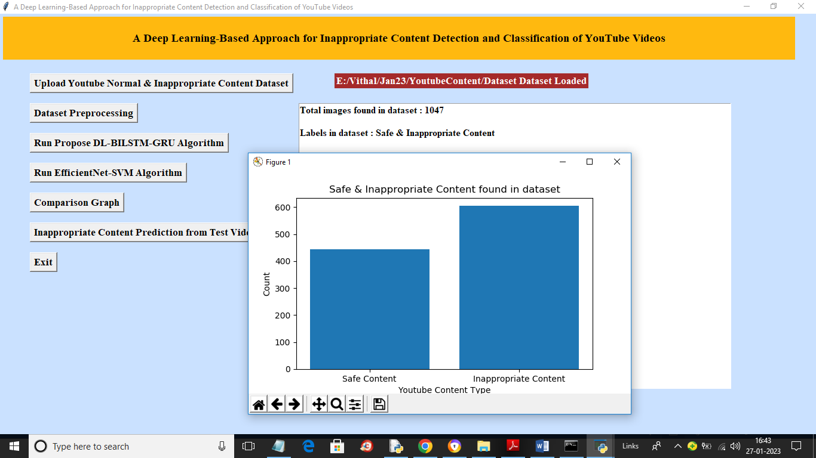
Bar Graph : Safe and Inappropriate images
DEPARTMENT OF ECE, MRITS

Slide 14
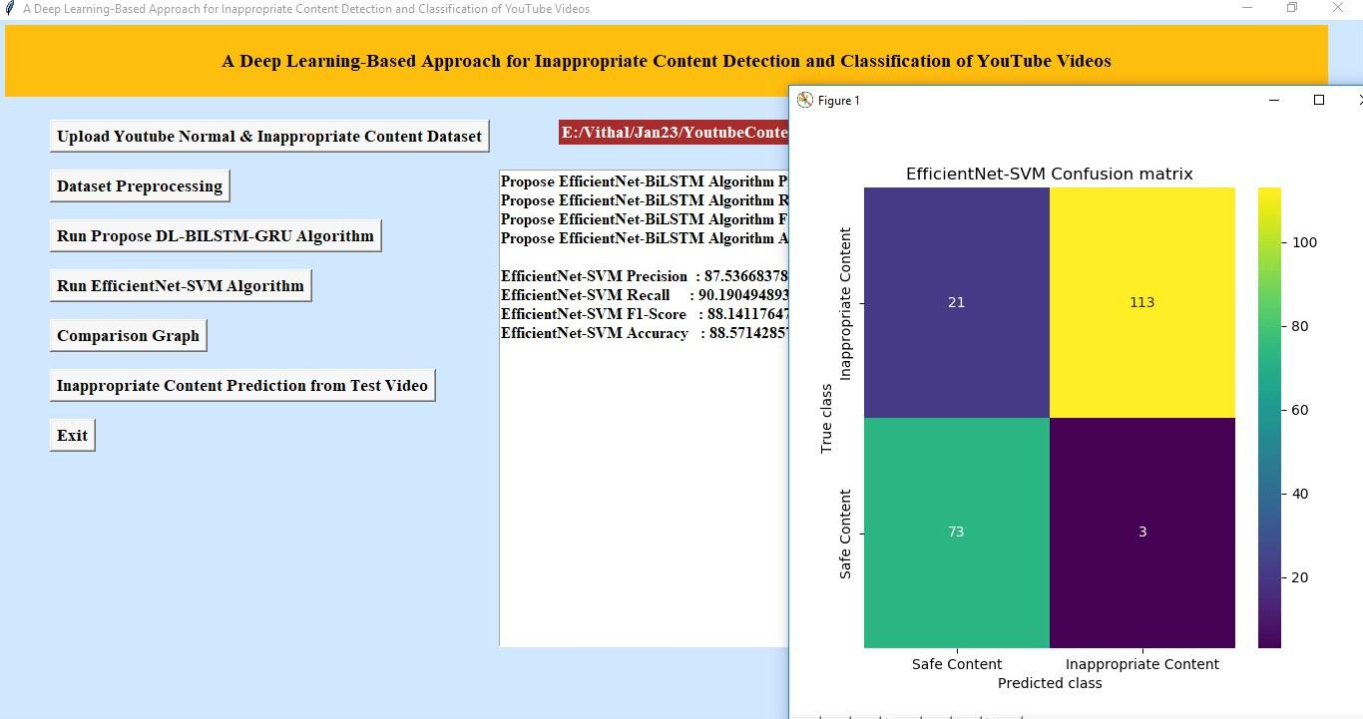
EfficientNet- SVM Confusion matrix
DEPARTMENT OF ECE, MRITS

Slide 15
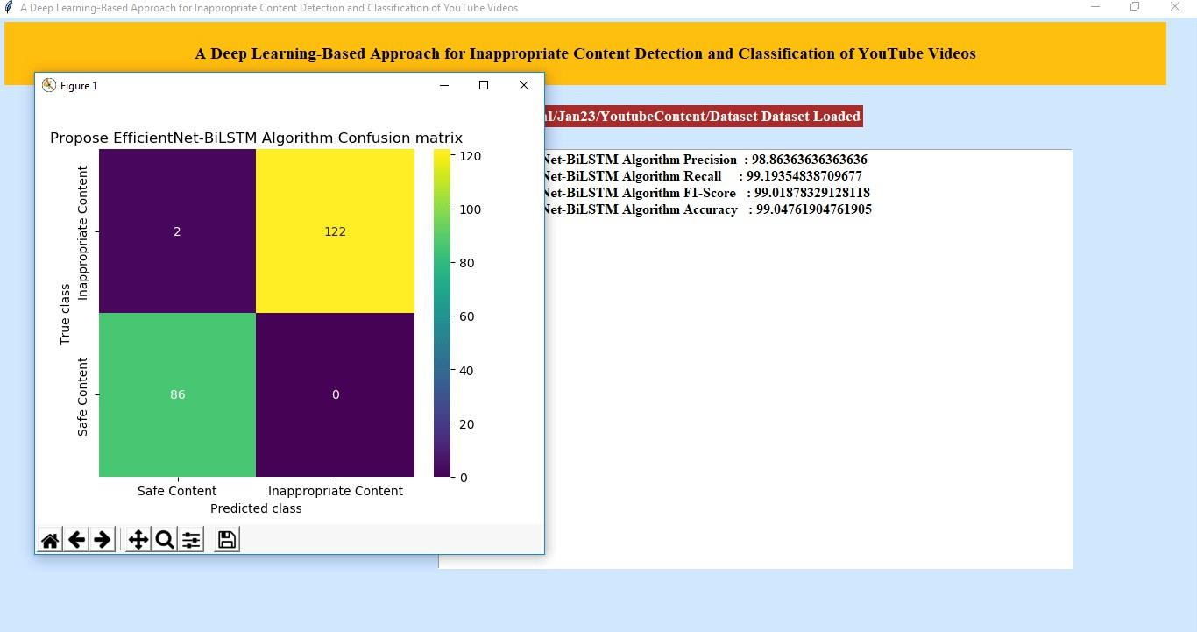
Propose EfficientNet- BiLSTM Algorithm Confusion matrix
DEPARTMENT OF ECE, MRITS

Slide 16
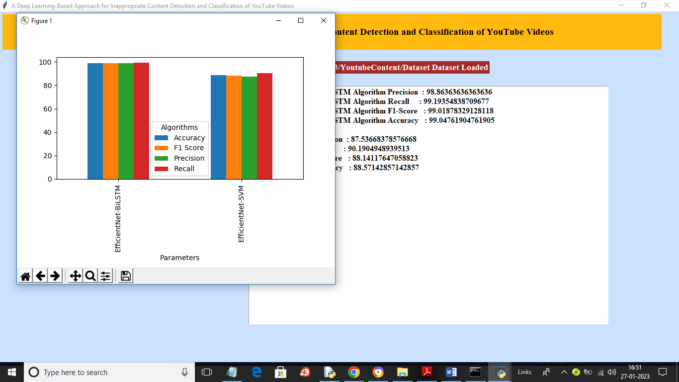
Performance analysis of Efficient Bi-LSTM and Efficient SVM algAorithms
DEPARTMENT OF ECE, MRITS

Slide 17
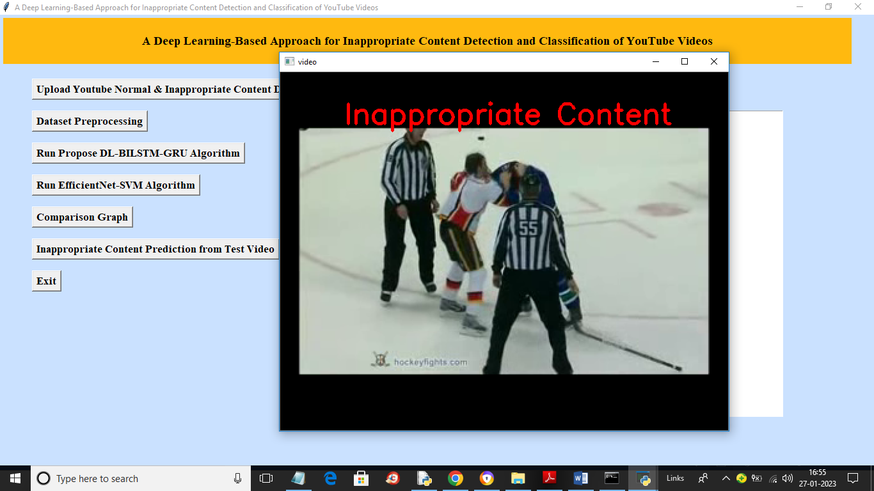
Inappropriate Content is detected
DEPARTMENT OF ECE, MRITS

Slide 18
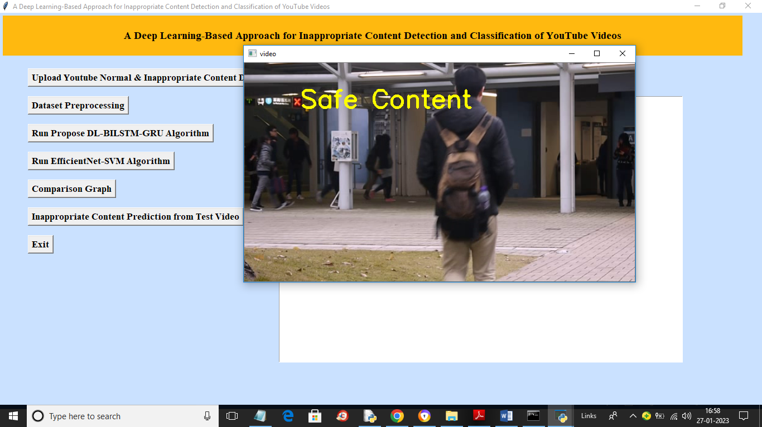
Inappropriate Content is not detected (Safe Content )
DEPARTMENT OF ECE, MRITS

Slide 19

ADVANTAGES
Better Accuracy.
Faster Processing.
Protects Children.
Works on Different Videos.
Improves Content Moderation.
DEPARTMENT OF ECE, MRITS

Slide 20


APPLICATIONS
YouTube and Social Media.
Parental Control Apps.
Educational Platforms.
Government and Law Enforcement.
Media Companies.
DEPARTMENT OF ECE, MRITS

Slide 21
CONCLUSION
While the model learns effective video representations, the BiLSTM network evaluates the recovered video features and performs multiclass video classification.
By outperforming previously used models and methods and achieving a maximum recall score of 99.2%, our BiLSTM-based system outperformed previously used models and methodologies which gives accuracy of 99.04%.
Our approach is independent of the metadata associated with YouTube videos, which malicious uploaders can alter to deceive consumers while looking for inappropriate children's content on the site.
DEPARTMENT OF ECE, MRITS

Slide 22

FUTURESCOPE
In future we can generate a separate app(android app) to understand the blocking process or removal process of videos.
Similar algorithm can be applied to other social media videos also like Instagram videos, Facebook videos.
DEPARTMENT OF ECE, MRITS

Slide 23
REFERENCES
P. Covington, J. Adams, and E. Sargin, ‘‘Deep neural networks for YouTube recommendations,’’ in Proc. 10th ACM Conf. Recommender Syst., Sep. 2016, pp. 191–198, doi: 10.1145/2959100.2959190.
M. M. Neumann and C. Herodotou, ‘‘Evaluating YouTube videos for young children,’’ Educ. Inf. Technol., vol. 25, no. 5, pp. 4459–4475, Sep. 2020, doi: 10.1007/s10639-020-10183-7.
J. Marsh, L. Law, J. Lahmar, D. Yamada-Rice, B. Parry, and F. Scott, Social Media, Television and Children. Sheffield, U.K.: Univ. Sheffield, 2019. [Online]. Available: https://www.stac-study.org/downloads/ STAC_Full_Report.pdf
M. M. Neumann and C. Herodotou, ‘‘Young children and YouTube: A global phenomenon,’’ Childhood Educ., vol. 96, no. 4, pp. 72–77,
DEPARTMENT OF ECE, MRITS

Slide 24
THANK YOU
DEPARTMENT OF ECE, MRITS

