Slide 1

How SGD Selects the Global Minima in Over-parameterized Learning:
A Dynamical Stability Perspective
by Lei Wu, Chao Ma, Weinan E
Dec 6, 2019
Team: Skyhawks
Patrick Myers, Gaurav Jindal
Rishab Bamrara, Phillip Seaton

Slide 2
Motivation:
In models with many parameters, such as deep learning, multiple global minima can exist
Although these global minima perform equally well on the training set, some generalize better than others
By better understanding how global minima are selected in such scenarios, it should be easier to select models which generalize better to testing data
Notes:
The motivation of this project

Slide 3
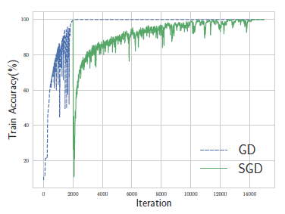
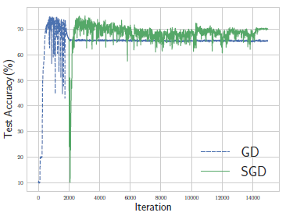
Background - Escape Phenomenon:
Though GD is close to a global minimum, switching to SGD causes the model to converge to a different global minimum which generalizes better than the GD minimum. However, SGD takes longer to converge.

Slide 4
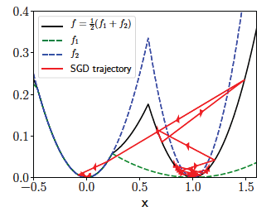
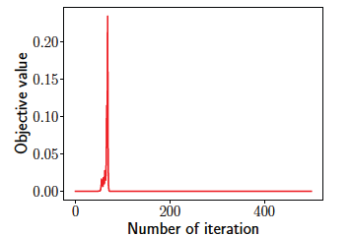


Background - Escape Phenomenon (contd.):
In this example, SGD will converge to x = 0 escaping from the right minima due to instability. Gradient descent behaved in a similar manner with the same learning rate.
Curvature is more stable at x = 0 which causes the escape phenomenon to occur.

Slide 5


Background - Escape Phenomenon (contd.):
The first equation is SGD with a batch size of 1.
SGD can only pick minima where
At x = 1, s = 1.8 > 1 / 0.7
At x = 0, s = 0 < 1 / 0.7
We see that at x = 0 the requirement is met, and x = 0 is the only valid minima.

Slide 6
Related Work:
Hu et al. [5] examined the escape phenomena and concluded that it is generally easier to escape from sharper minimizers
Jastrzebski et al. [6] found that the noise factor (learning rate / batch size) affects the sharpness of the solution that SGD will reach
Wilson et al. [12] showed that adaptive gradient methods will generally converge to solutions which do not generalize as well as those which will be reached by standard SGD

Slide 7


Background - Sharpness and Non-uniformity:
Sharpness (a): A measure of how quickly the slope of a loss function changes on average, represented mathematically by the second derivative of the loss function.
Non-uniformity (s) : A measure of smoothness across a loss function.

Slide 8
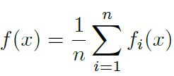





Background - Linear Stability Analysis:
For minimizing the following training error :
by a general optimizer :
Definition 1: x* is a fixed point in stochastic dynamics, if for any ℇ, G(x*;ℇ) = 0.
Definition 2: If x* is a fixed point in stochastic dynamics, and there is a linearized dynamical system
where, Then, x* is linearly stable if there exists a C such that, for all t > 0.
For SGD,

Slide 9


Proposed Solution:
Theorem 1: The global minimum x* is stable for SGD with learning rate , and batch size B if the following condition is satisfied:

Slide 10

Claim / Target Task:
Both sharpness and non-uniformity have an effect on the selection of global minima by GD and SGD
In general, SGD will prefer to select global minima with a lower degree of non-uniformity
Both sharpness(a) and non-uniformity(s) are bounded by the ranges in the following expressions where η is learning rate and B is batch size:
Notes:
Here, we make the claim of this project.

Slide 11
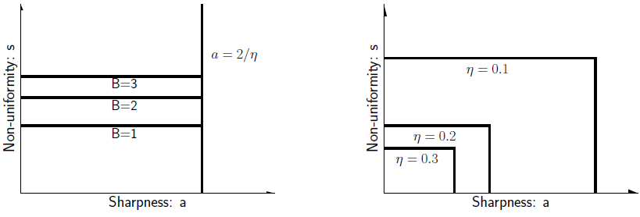
Sharpness-non-uniformity diagram of SGD:
If we increase learning rate, then SGD is forced to choose a global minima closer to the origin (i.e. smaller sharpness and smaller non-uniformity)
Decreasing the batch size only forces SGD to choose global minima with smaller non-uniformity, but does not affect sharpness

Slide 12
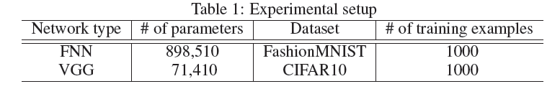
Experimental Setup:
Examine the relationship between sharpness and non-uniformity on the convergence of GD and SGD using two different datasets with various batch sizes
Two classification problems, FashionMNIST and CIFAR10, will be used to verify this relationship within the context of deep learning
Notes:
Here is our proposed solution.

Slide 13
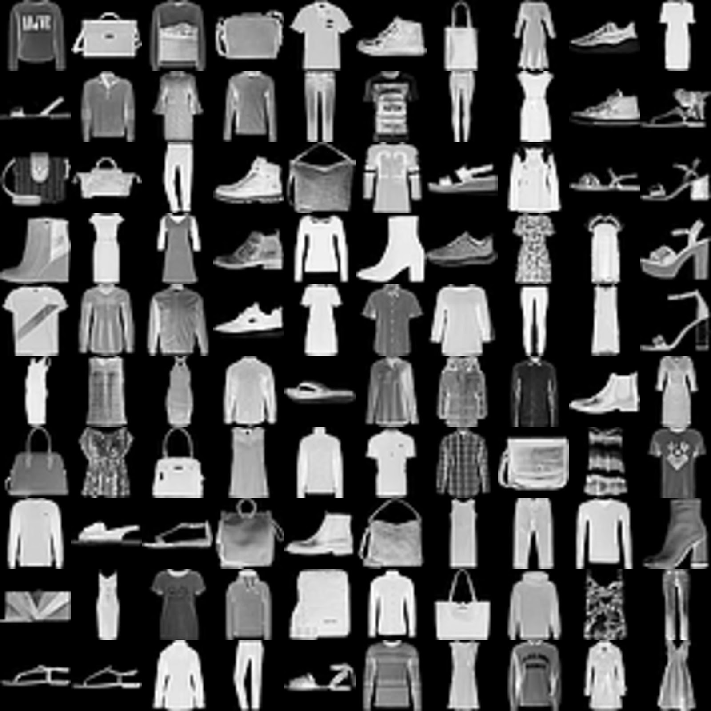
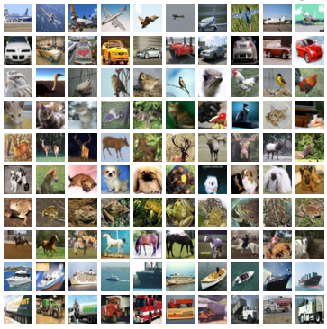
Data Summary:
FashionMNIST: A classification dataset consisting of 28x28 grayscale images of 10 different types of clothing
CIFAR10: A classification dataset consisting of 32x32 color images across 10 different categories; only images in the “airplane” and “automobile” categories were used
Notes:
In the rest of this presentation, I’m going to talk about following contents:

Slide 14
Our Results

Slide 15
Results
 | Train accuarcy | Test accuarcy | Sharpness | Non uniformity
Fashion MNIST | 99.9 | 80.4 | 19.9 | 40.4
CIFAR 10 | 100 | 88.9 | 19.2 | 53
Trained the simple FNN model on Fashion MNIST and VGG11 model on CIFAR10 dataset.

Slide 16
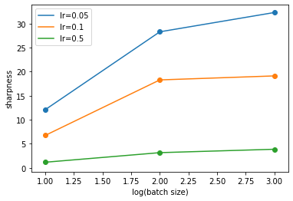
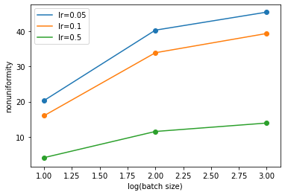
Non-uniformity and Sharpness vs Batch Size
Because we have 1000 samples, the rightmost points (batch size = 1000) corresponds to GD
As batch size increases, sharpness and non-uniformity tend to increase as well. Smaller batch sizes lead to flatter solutions.
Lower learning rates tend to result in higher sharpness and non-uniformity

Slide 17
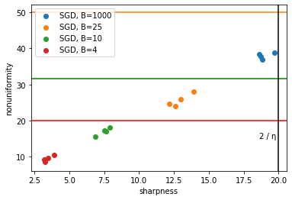
Non-uniformity vs Sharpness
There is a positive relationship between sharpness and nonuniformity
Models with higher sharpness will result in higher nonuniformity.
Larger batch sizes cause the non-uniformity to be close to the upper bounds.
Notes:
lr = 0.1 here, and 2/0.1 = 20, so sharpness is upperbounded by 20
horizontal lines repressent nonuniformity caps

Slide 18
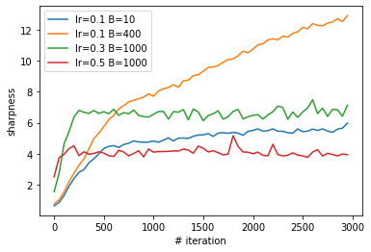
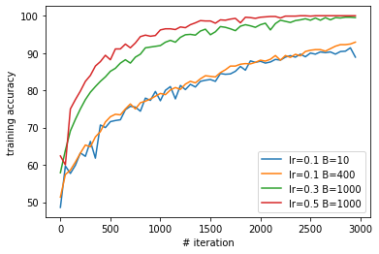
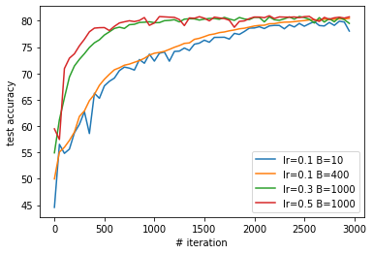
Sharpness, Training Accuracy and Test Accuracy vs Iterations
To better show the escape process, we only show the first 3000 iterations
Lower sharpness results on more stable global minima and higher test accuracy
The trials with higher sharpness take longer to escape an unstable minima.

Slide 19
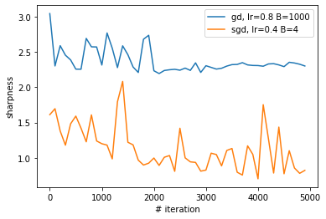
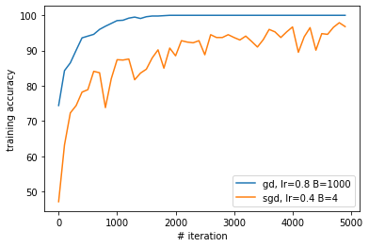
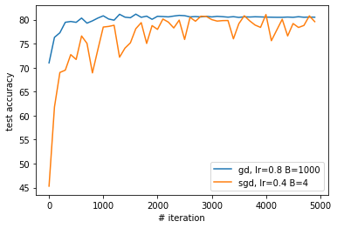
Comparing GD and SGD Performance
Compared to normal SGD, adaptive optimizers perform worse, because they chose sharper minimizers.
Higher sharpness causes less stability
We see GD perform much better in the training accuracy but is only marginally better on the test accuracy.

Slide 20
Experimental Analysis:
The positive correlation between sharpness and non-uniformity may explain why SGD tends to converge to flatter minima:
Flatter minima will have lower non-uniformity
It is easier to escape from areas that are non-uniform, particularly with SGD, making areas with low non-uniformity better candidates for convergence

Slide 21
Conclusion:
Both sharpness and non-uniformity have important impacts on the selection of global minima by GD and SGD
In neural networks, non-uniformity is approximately proportional to sharpness
In general, SGD can more easily converge to a more uniform global minima than GD, resulting in better generalization and higher test accuracy
However, this is a phenomena that still needs to be looked into further in future work

Slide 22
Paper References:
[1] Crispin Gardiner. Stochastic methods, volume 4. springer Berlin, 2009.
[2] Priya Goyal, Piotr Dollár, Ross Girshick, Pieter Noordhuis, Lukasz Wesolowski, Aapo Kyrola,
Andrew Tulloch, Yangqing Jia, and Kaiming He. Accurate, large minibatch sgd: training
imagenet in 1 hour. arXiv preprint arXiv:1706.02677, 2017.
[3] S. Hochreiter and J. Schmidhuber. Flat minima. Neural Computation, 9(1):1–42, 1997.
[4] Elad Hoffer, Itay Hubara, and Daniel Soudry. Train longer, generalize better: closing the
generalization gap in large batch training of neural networks. In Advances in Neural Information
Processing Systems, pages 1729–1739, 2017.
[5] Wenqing Hu, Chris Junchi Li, Lei Li, and Jian-Guo Liu. On the diffusion approximation of
nonconvex stochastic gradient descent. arXiv preprint arXiv:1705.07562, 2017.
[6] Stanisław Jastrz˛ebski, Zachary Kenton, Devansh Arpit, Nicolas Ballas, Asja Fischer, Yoshua
Bengio, and Amos Storkey. Three factors influencing minima in sgd. arXiv preprint
arXiv:1711.04623, 2017.
[7] N. S. Keskar, D. Mudigere, J. Nocedal, M. Smelyanskiy, and P. T. P. Tang. On large-batch
training for deep learning: Generalization gap and sharp minima. In In International Conference
on Learning Representations (ICLR), 2017.
[8] Qianxiao Li, Cheng Tai, and Weinan E. Stochastic modified equations and adaptive stochastic
gradient algorithms. In Proceedings of the 34th International Conference on Machine Learning,
volume 70, pages 2101–2110. PMLR, Aug 2017.

Slide 23
Team Member Contributions
Name | Contribution
Patrick Myers | I helped organize code in the .ipynb and wrote code to run some experiments and visualize them. I also helped display and discuss our results in the powerpoint.
Gaurav Jindal | Worked on data loader and data preprocessing part. I also helped in plotting the results and discuss them in the slide.
Rishab Bamrara | Worked on the linear algebra library and understood the functions which compute sharpness and nonuniformity. Also coded for visualization of results.
Phillip Seaton | I worked with 3 methods: compute_minibatch, training the model and accuracy. I also helped with commenting code, creating the powerpoint slides and discussing our results.

