Slide 1
CS595 DATA VISUALISATION
SUBMITTED BY – RISHAB TOMAR(224161007)
SUBMITTED TO – DR ASHISH ANAND

Slide 2
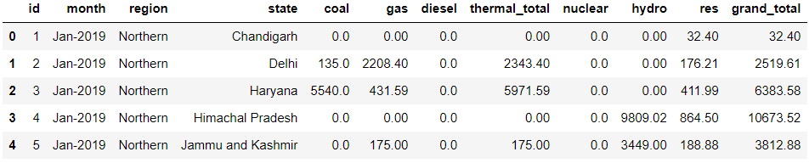
About Dataset
1. INSTALLED POWER CAPACITY STATEWISE(IN Megawatts)
Three Year data(2019,2020,2021) is been provided with each year, month wise installed capacity of each power generation method .

Slide 3
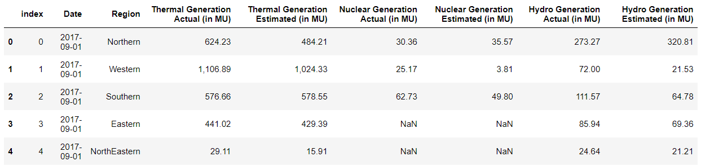
2 . POWER GENERATION
Three Year data(2017,2018,2019) of power generation region wise is been provided.
The data give the daily power generation by thermal, hydro and nuclear power generation methods
The data also give the Actual power generation and the Estimated power generation by different method on daily basis.

Slide 4
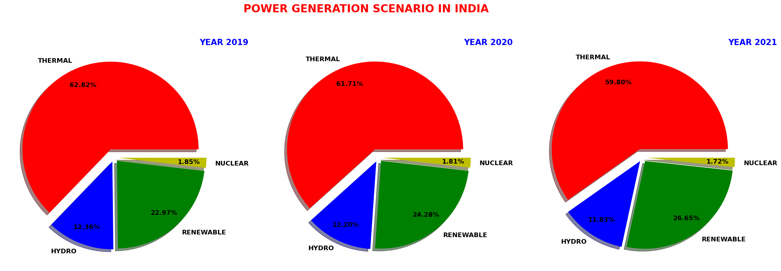
Understanding The Power Generation Scenario in India

Slide 5
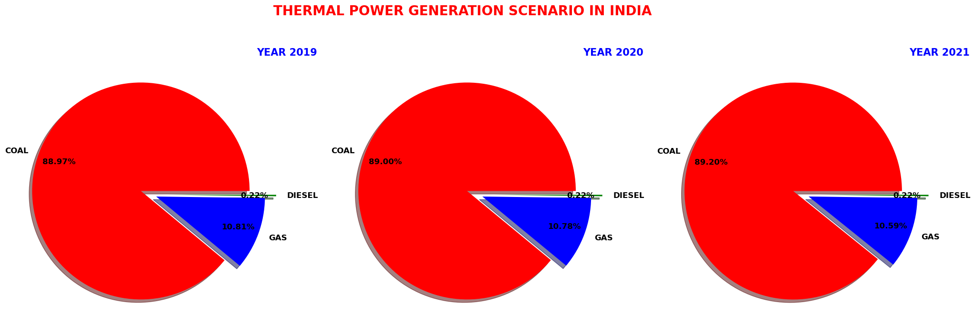
Understanding Thermal Power Generation Scenario in India

Slide 6
Some Questions
WHY THERMAL CONTRIBUTE MORE THAN HALF OF THE ENERGY SUPPLY?
India, being second-largest coal-producing country in the world , with the production of 767 million
tonnes in 2021 and is at 5th place in the countries in term of proven coal reserve.
Power plant are driven by fuel and coal in India is among the cheapest and abundantly available
energy source makes it the economic alternative to go with.
WHY NUCLEAR CONTRIBUTION IS SO SMALL?
Nuclear fuel is very expensive to procure, and the risk associated with the nuclear power plants is
also very high which makes it less attractive compared to other power sources.
Proven fuel reserve in India 129,000 tonnes.

Slide 7
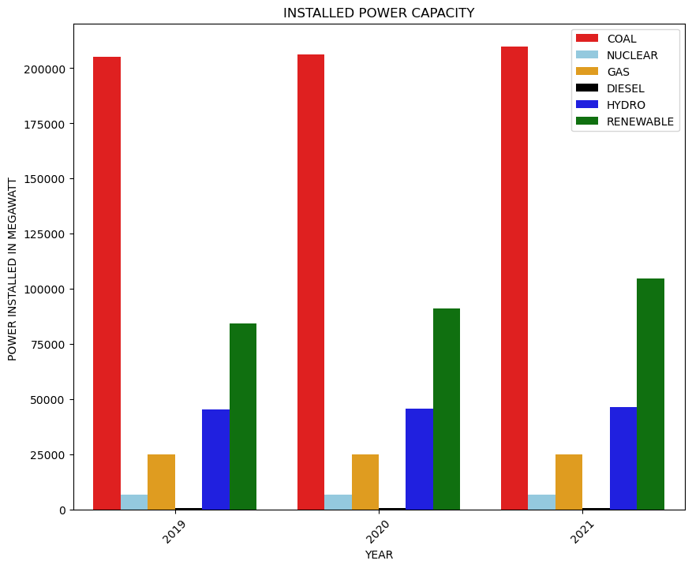
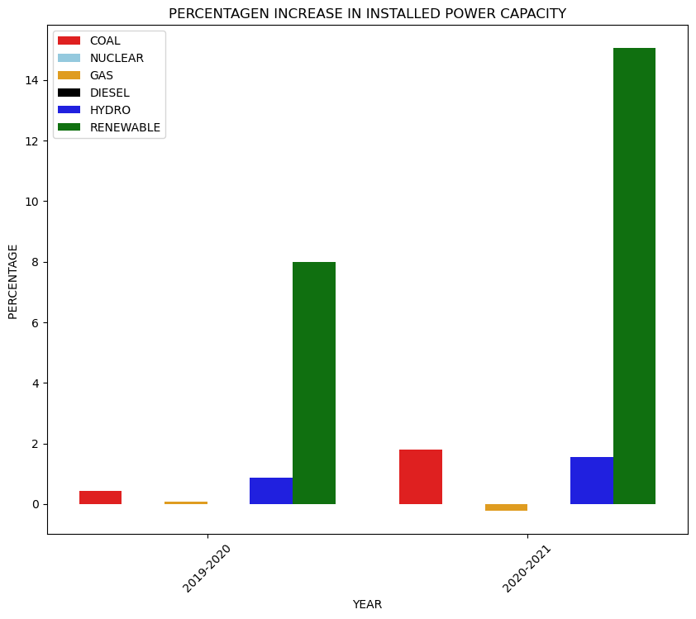
Installed Power Capacity

Slide 8
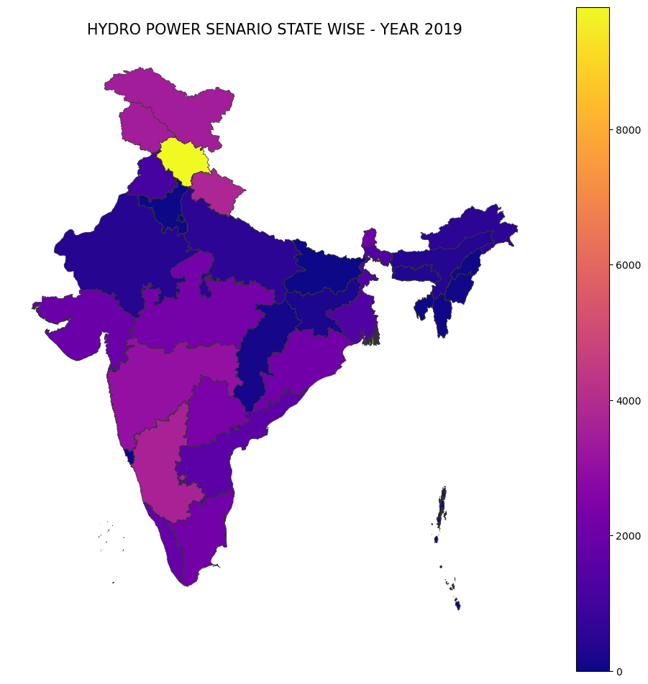
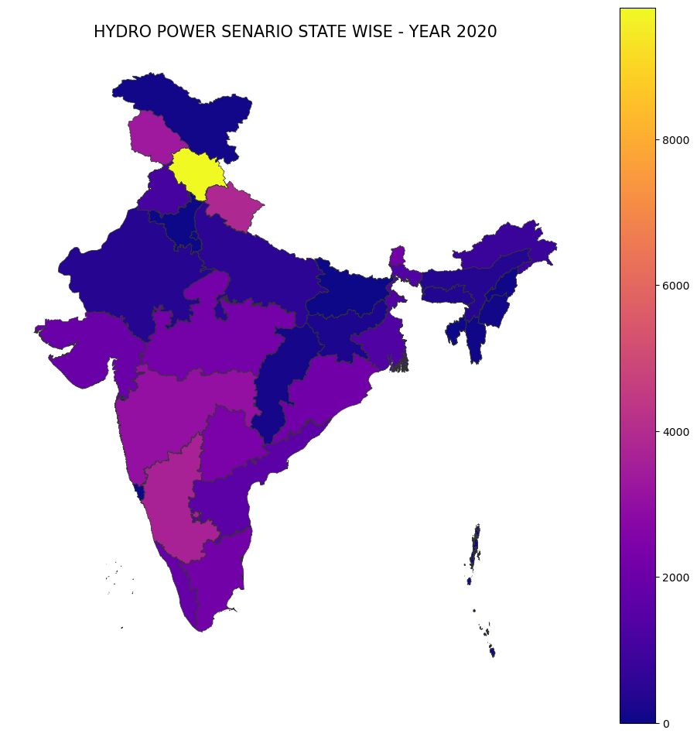
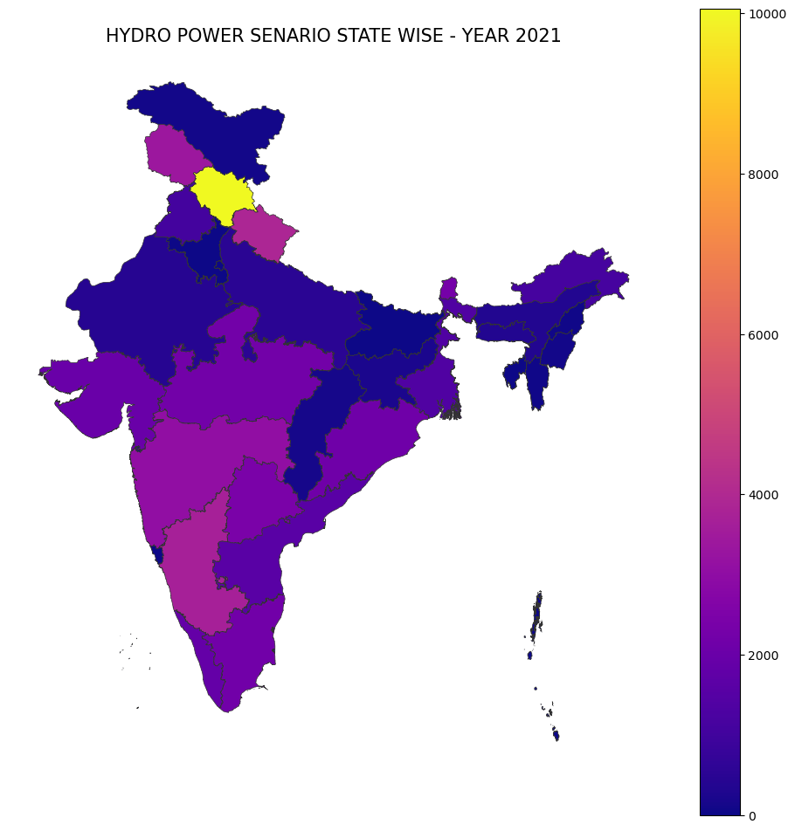
State-wise Distribution Of Hydro Power

Slide 9
Some Questions
WHY HIMACHAL PRADESH IS VERY DOMINATING IN HYDRO POWER PRODUCTIONS?
Himachal Pradesh has about twenty five percent of the national potential. About 27,436 MW of hydroelectric power
Hydro Power Plants requires year around water supply to maintain sufficient water level in the reservoirs to run Hydel Turbines and in the state some of the major glaciers and frozen lakes provides the year around water supply to such plants
Major Rivers like Chenab ,Ravi, Beas, Sutlej and Yamuna are some of the biggest glacial rivers in India

Slide 10
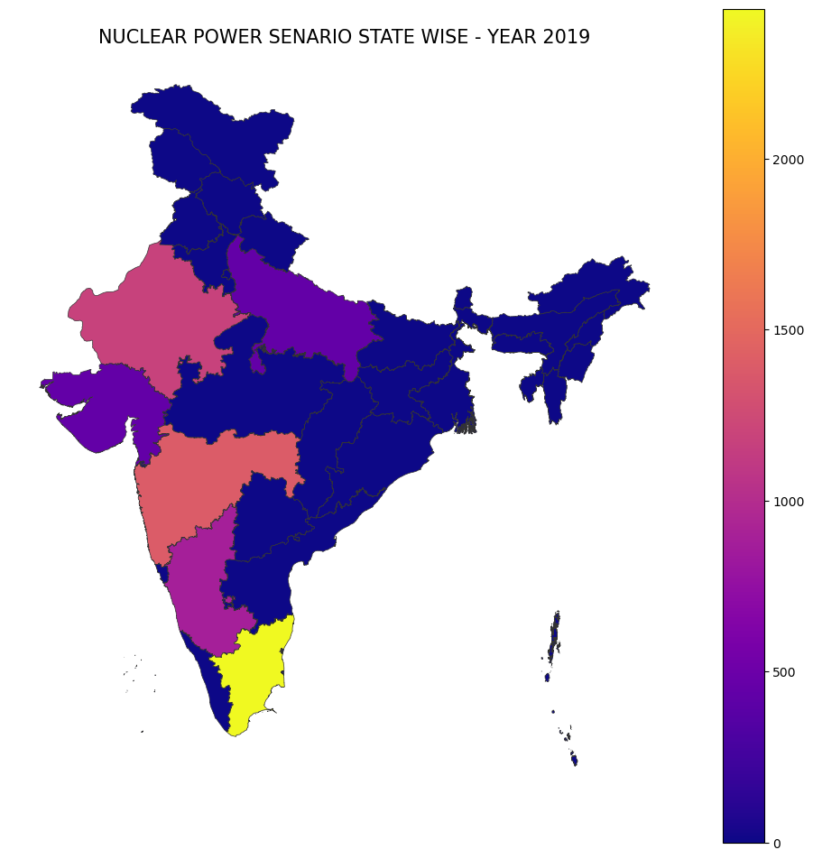


State-wise Distribution Of Nuclear Power

Slide 11
Some Questions
1. WHY TAMIL NADU CONTRIBUTS THE HIGHEST NUCLEAR POWER ?
India has a total nuclear power capacity of 6800MW and out of this, Tamil Nadu alone has 2440MW
Kudankulam Nuclear Power Plant (or Kudankulam NPP or KKNPP) is the largest nuclear power plant in India, situated in Tamil Nadu.
Other States Like Rajasthan and UP also Contribute but the Location of Such Plants are Mainly driven by state government policies and availability of water and

Slide 12
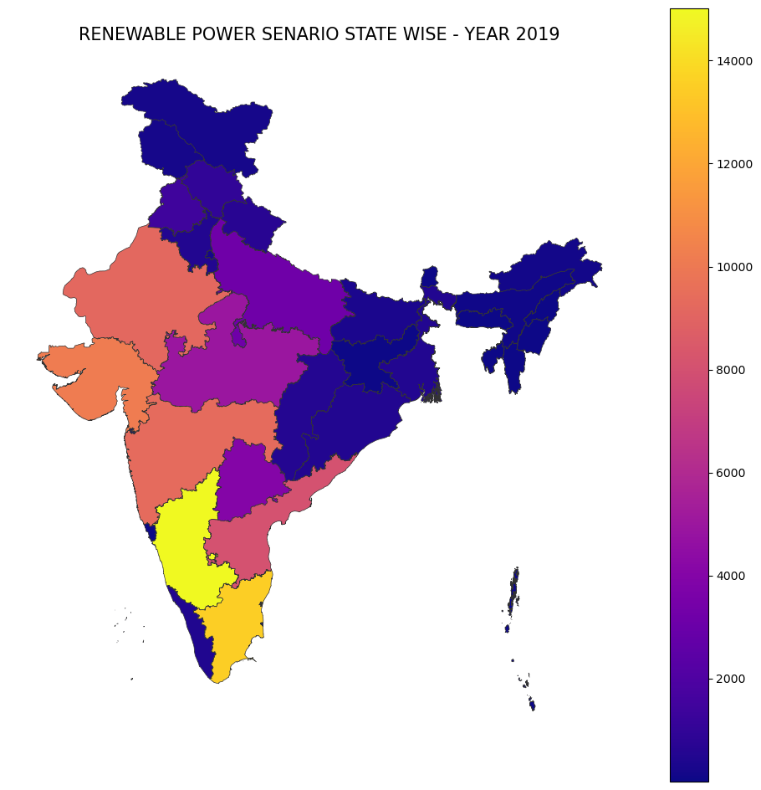
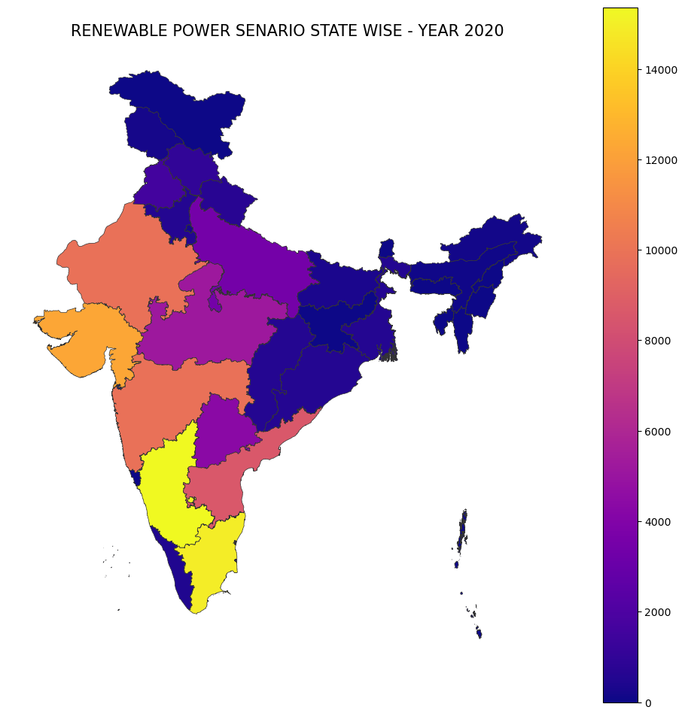

State-wise Distribution Of Renewable Power

Slide 13
Some Questions
1. WHY THE NORTHERN PART IS CONTRIBUTING VERY LESS AS COMPARED TO SOUTHERN PART IN RENEWABLE POWER?
Renewable Source are majorly contributed by Solar And Wind Power Plants
Solar Power plants require sunlight to generate electricity, and regions closer to the equator generally receive more sunlight throughout the year. Therefore, southern states and central India region can be suitable locations for installing solar power plants.

Slide 14
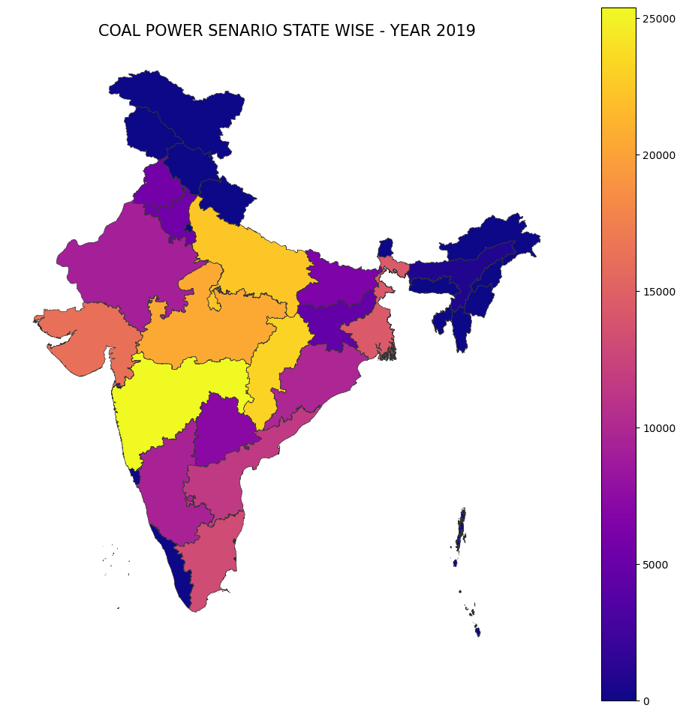
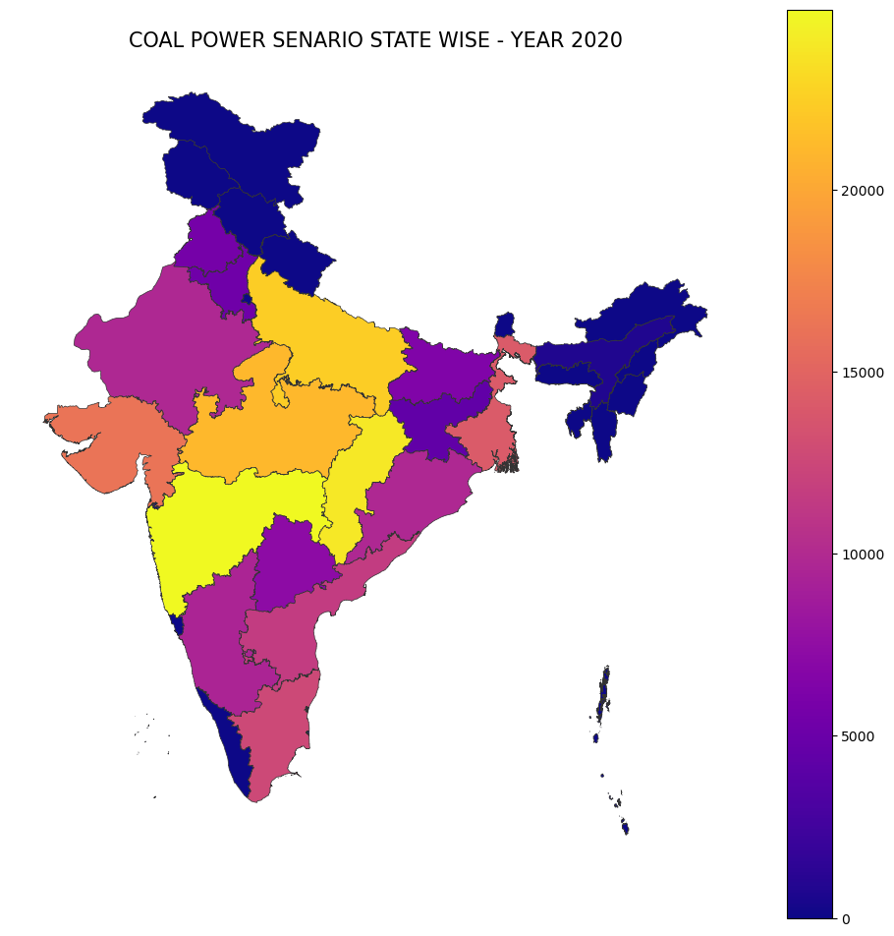
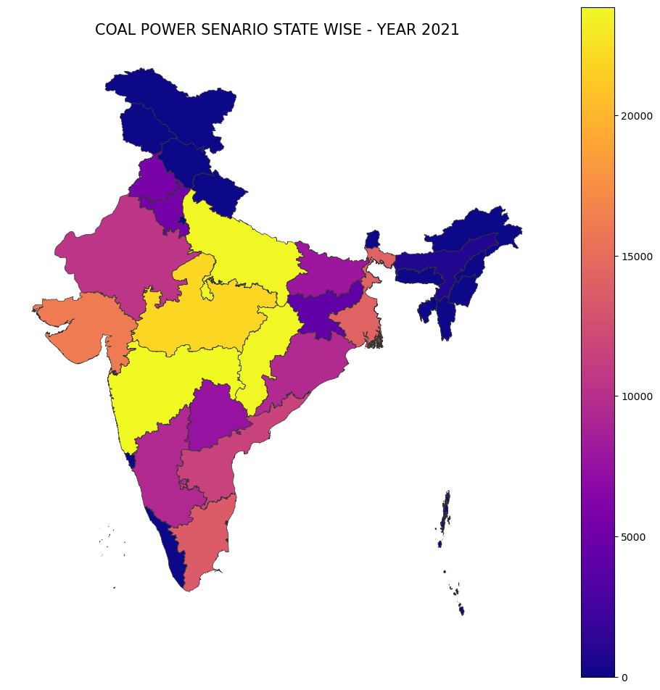
State-wise Distribution Of Thermal Power

Slide 15
Some Questions
1. WHY THE CENTRAL REGIONS CONTRIBUTES MORE COMPARED TO OTHER STATES?
Thermal Power Plants are mainly coal power plants.
Coal Power Plants are situated mainly near the regions closer to coal mines and availability of water resources
The five largest coal mines in India Gevra Mine(Chhattisgarh), Bhubaneswari Mine(Odisha), Dipka Project(Chhattisgarh), Kusmunda Mine(Chhattisgarh), and Urtan North(Madhya Pradesh)

Slide 16
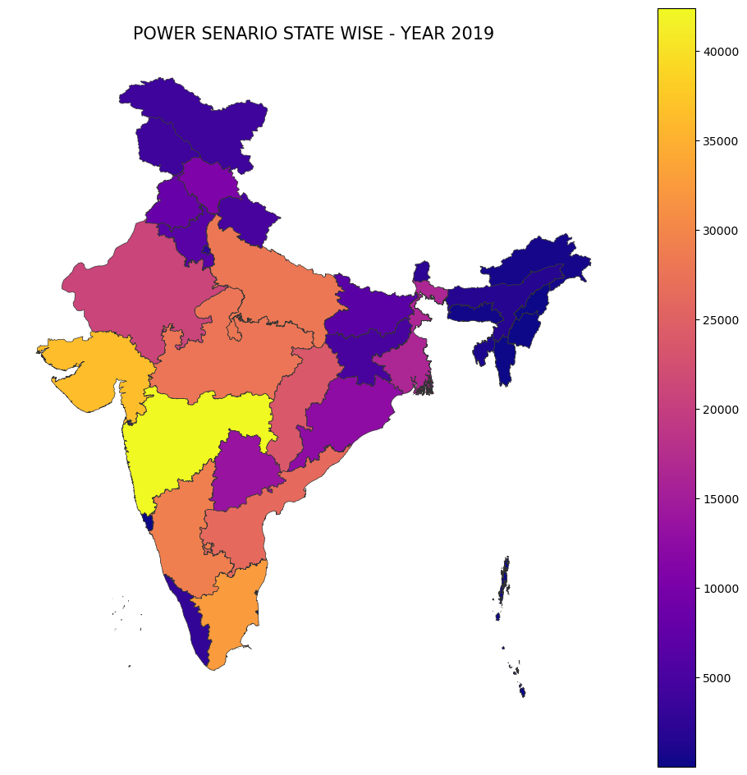
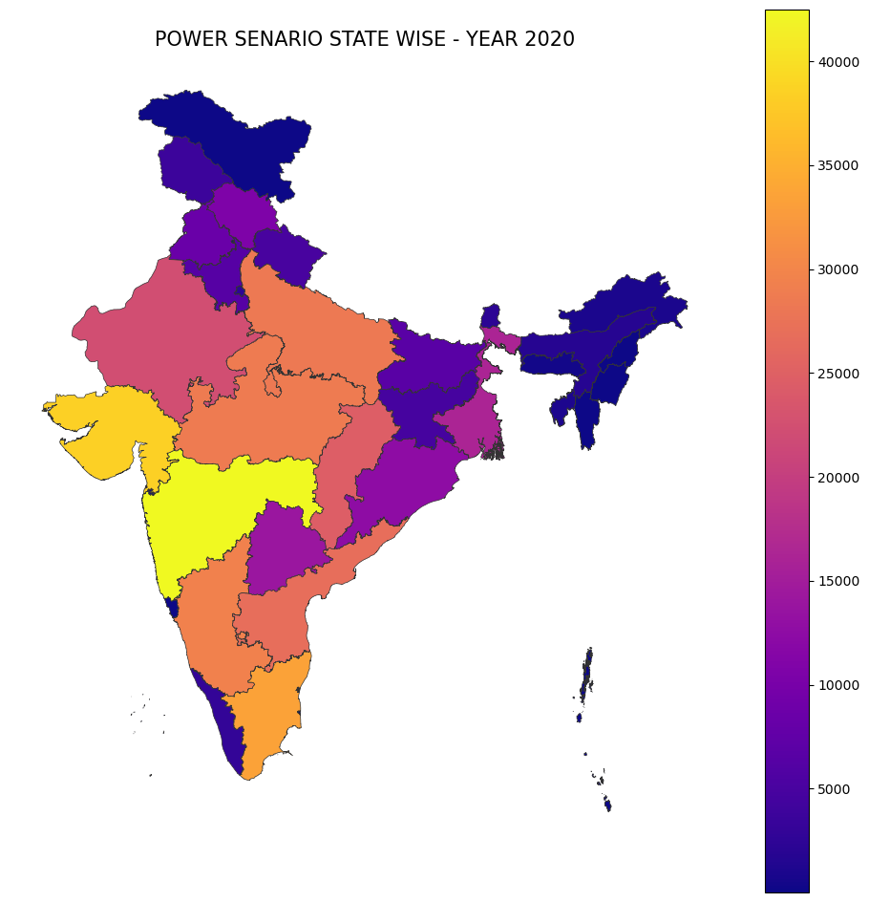

State-wise Distribution Of Total Power Installed

Slide 17
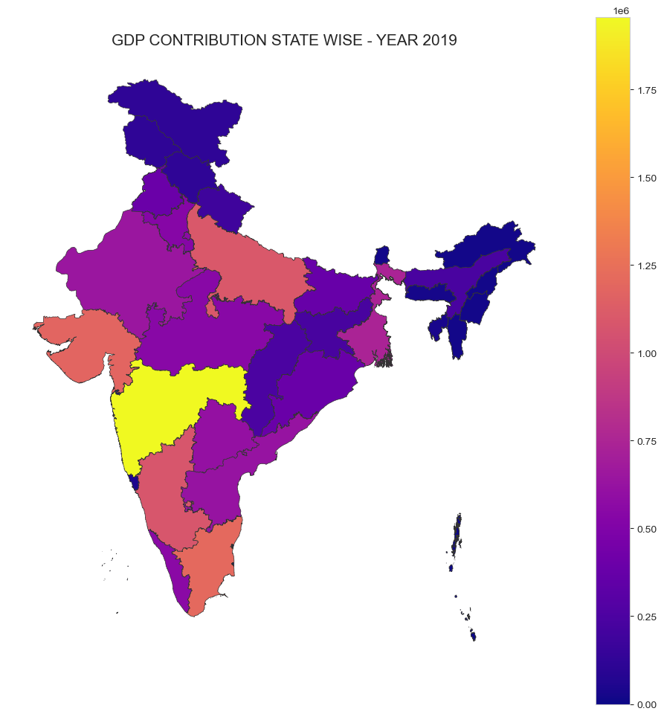


State-wise Distribution of GDP

Slide 18
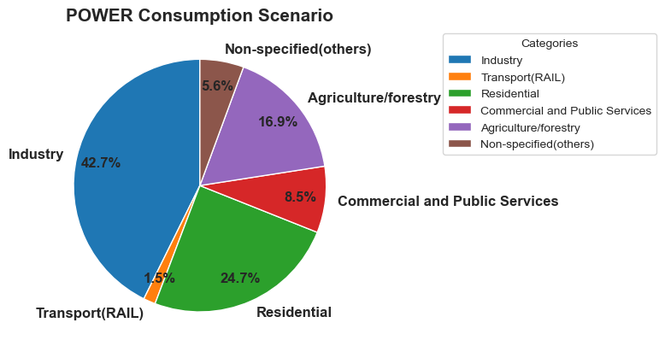
Power Consumption Scenario in India

Slide 19
Some Questions
WHY THE GDP AND POWER INSTALLED SHOW SIMILAR STATEWISE DISTRIUTIONS?
42.7% of Power is been consumed by Industries and 16.9% is consumed by Agriculture which are the two major economic contributor to the GDP.
So the More The Power Requirement more is the Installed Power Capacity to Meet the Demand and more is the Economic outcome of the State

Slide 20
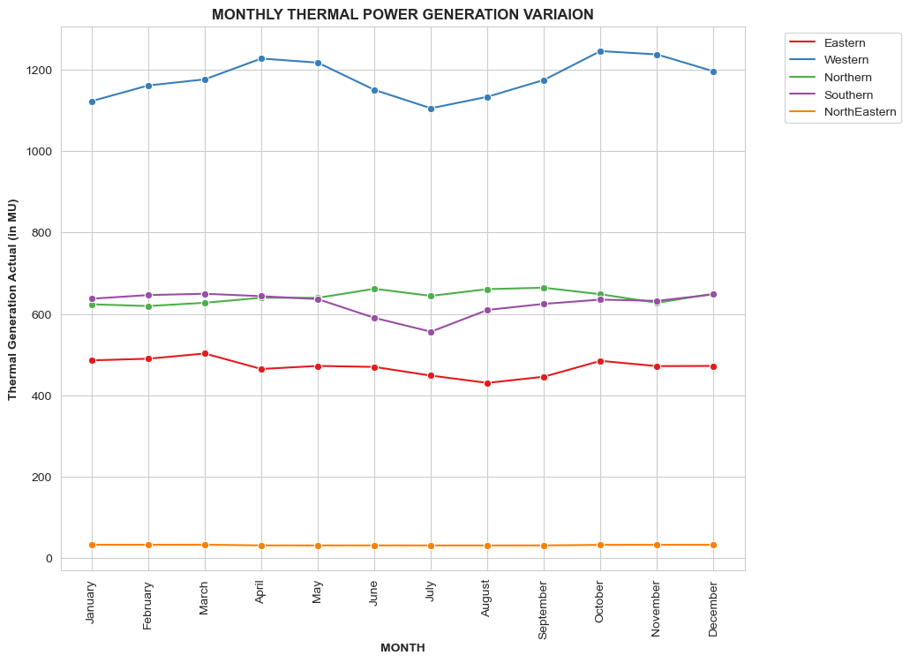
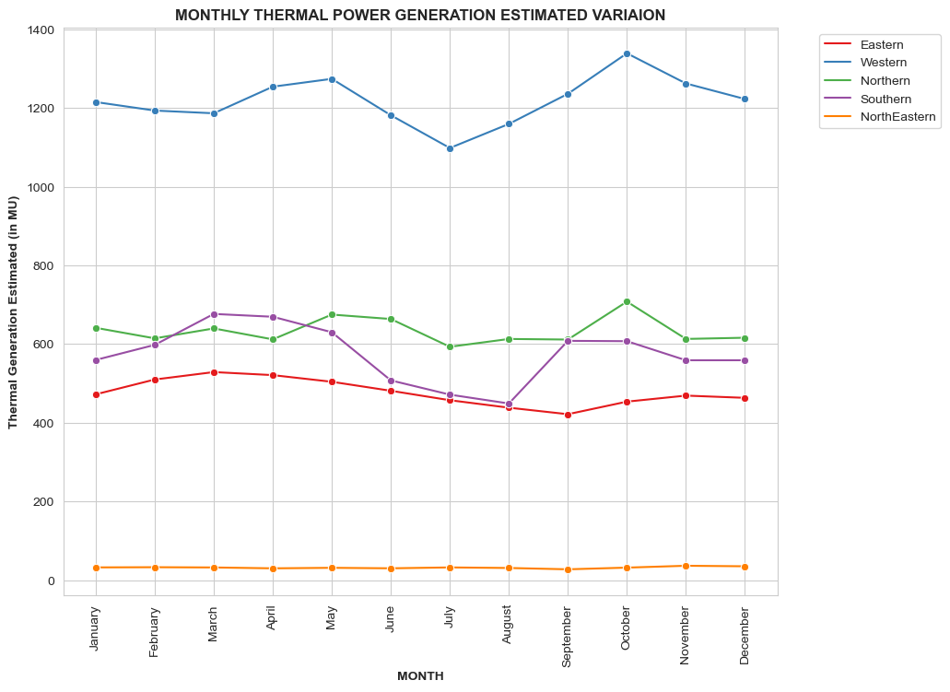
Monthly Trends of Thermal Power Generation Year-2018

Slide 21
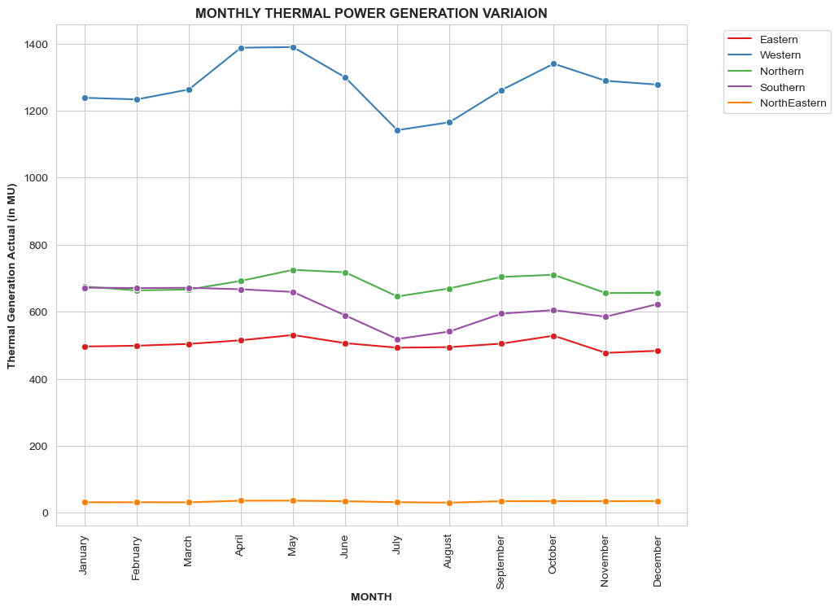
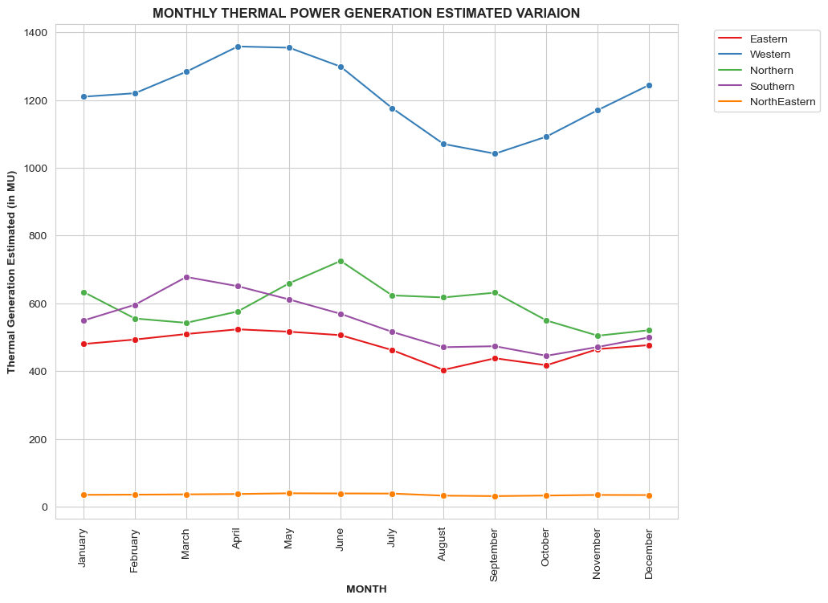
Monthly Trends of Thermal Power Generation Year-2019

Slide 22
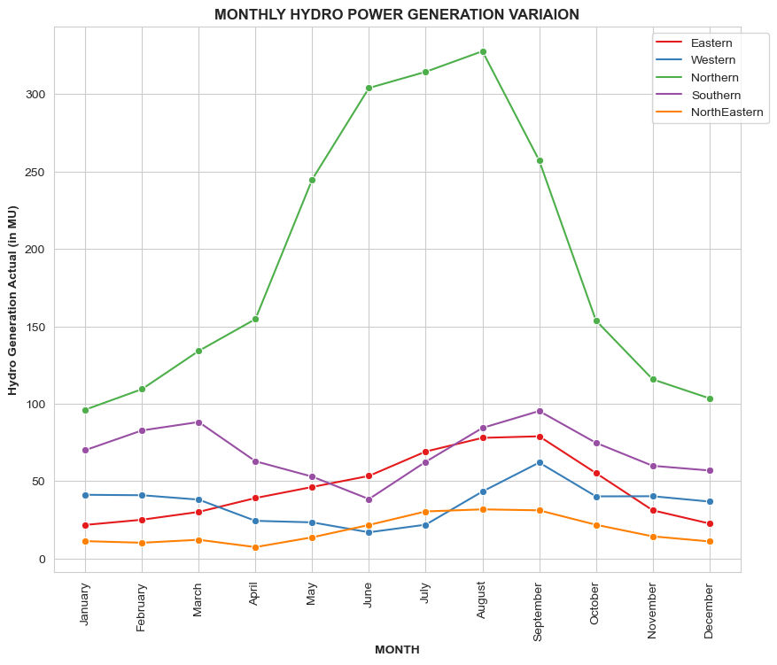
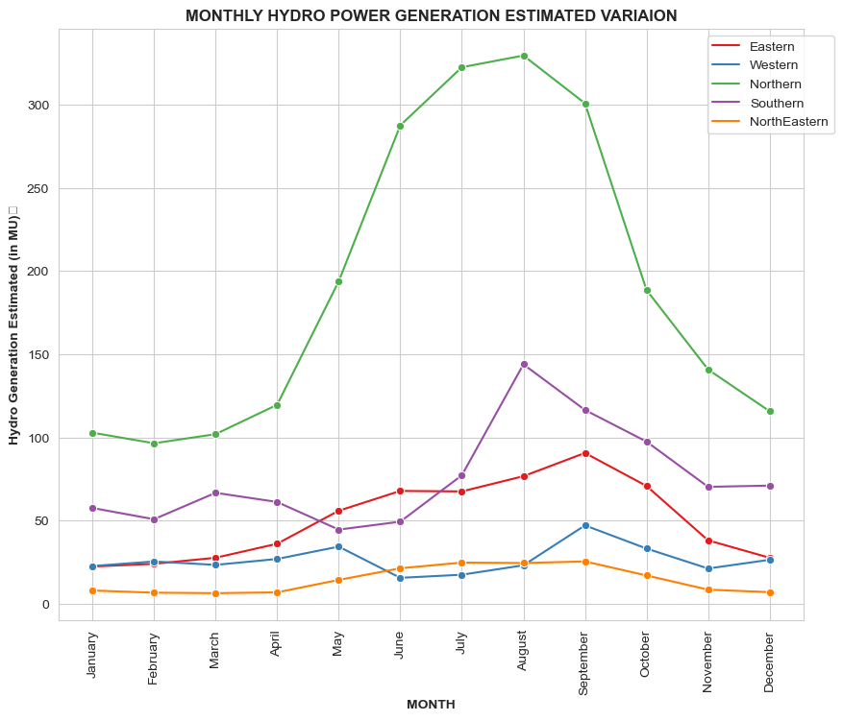
Monthly Trends of Hydro Power Generation Year-2018

Slide 23
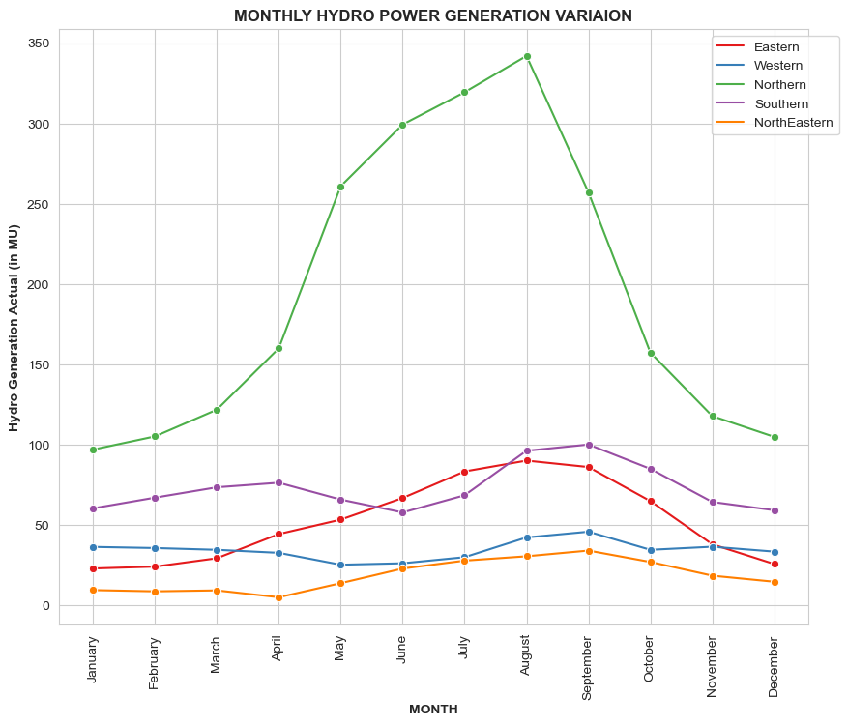
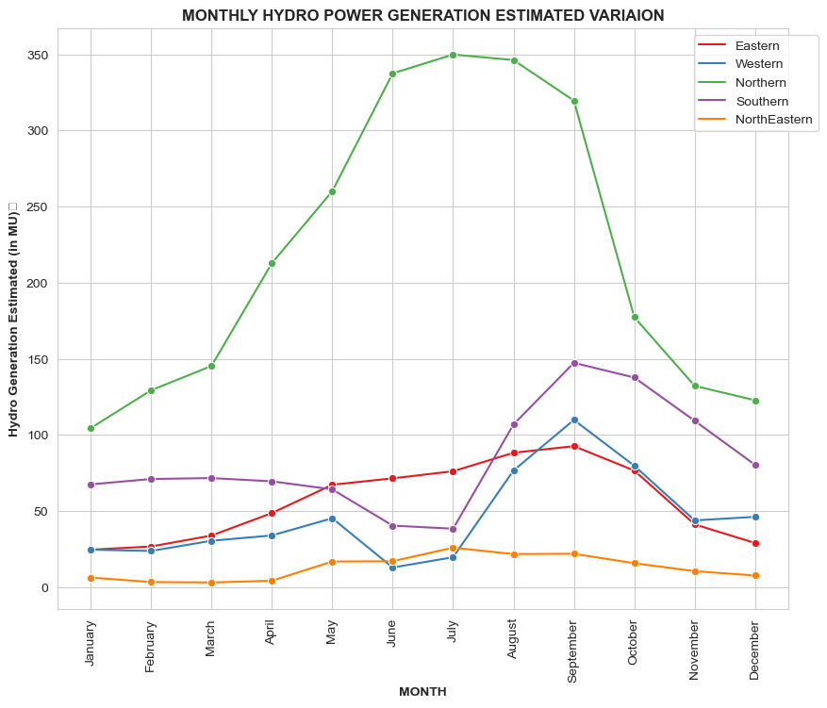
Monthly Trends of Hydro Power Generation Year-2019

Slide 24
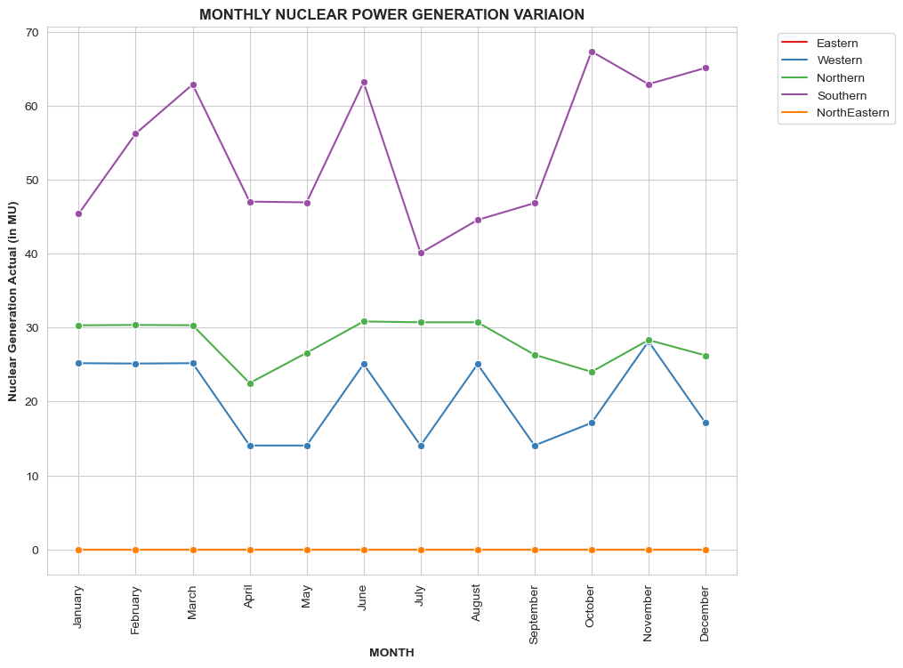
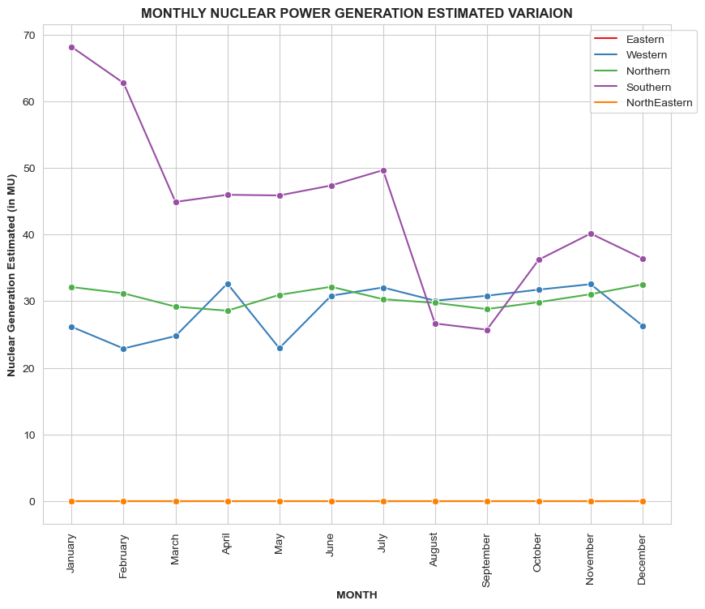
Monthly Trends of Nuclear Power Generation Year-2018

Slide 25
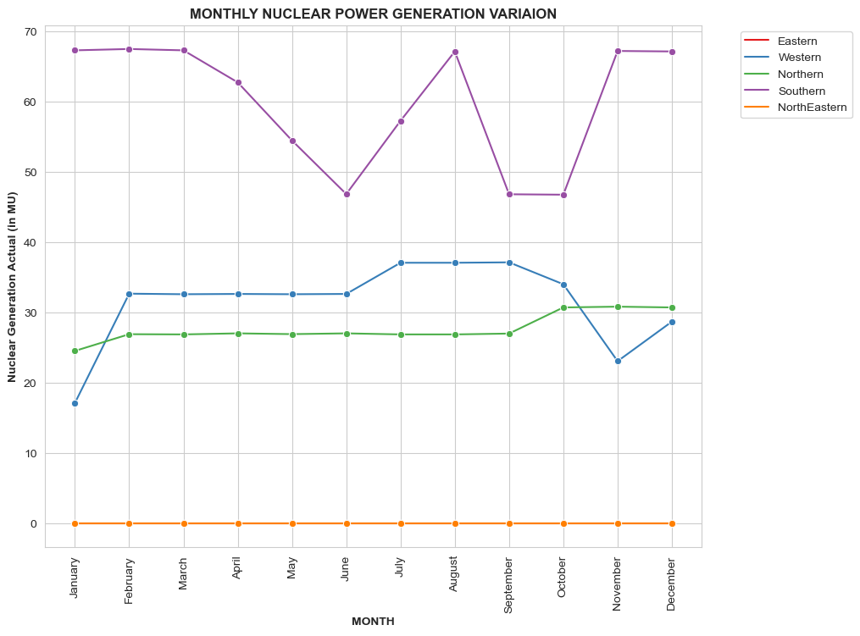
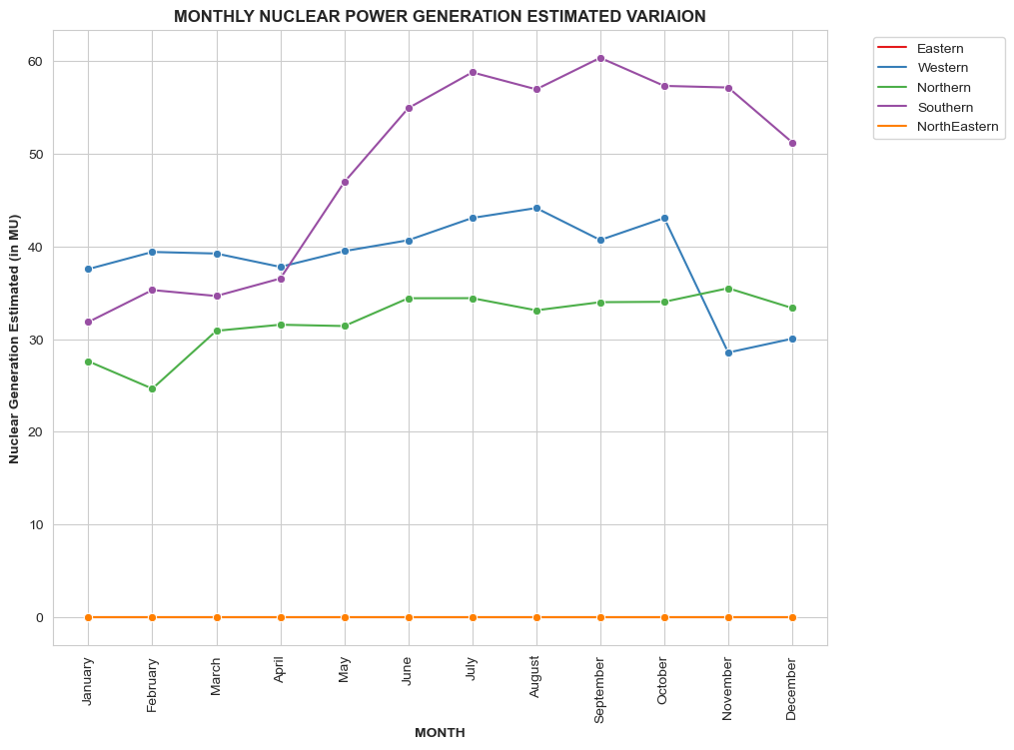
Monthly Trends of Nuclear Power Generation Year-2019

Slide 26
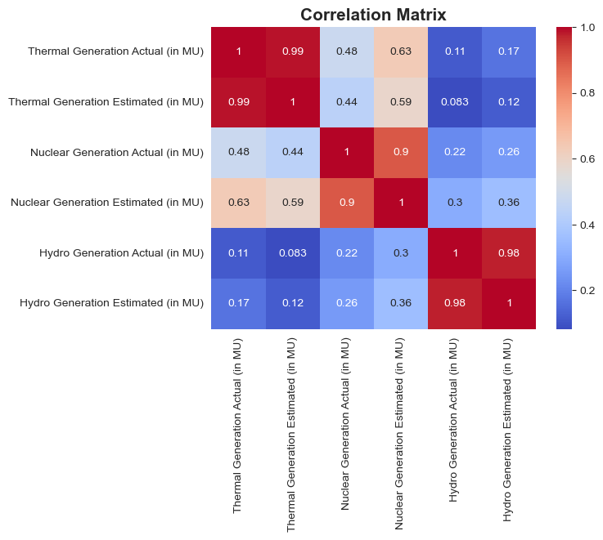
Correlation
Among
Different
Power
Sources

