Slide 1
Approaches Compared
One frozen-prompting baseline and three QLoRA configurations, same architecture and data
Approach | LLM | Adapted layers | Rank / α | LoRA params | Total trainable* | LR / eff. batch
Few-shot (0–10 shot) | Qwen2.5-VL-3B | None (frozen) | – | 0 | 0 | –
High-Capacity QLoRA | Llama-3.2-1B | Q K V O + gate/up/down | 16 / 32 | 11.3M | 17.0M | 1e-4 / 8
Balanced QLoRA | Llama-3.2-1B | Q K V O | 16 / 32 | 3.4M | 9.2M | 1.5e-4 / 16
Efficient QLoRA | Llama-3.2-1B | Q V | 8 / 16 | 0.85M | 6.6M | 2e-4 / 16
Shared setup
Frozen CLIP ViT-B/32 features for RGB and thermal, with separate projectors (768→2048) and modality type embeddings
4-bit base LLM, AdamW, cosine schedule, early stopping (patience 2)
Sycan subset: 738 image pairs × 34 questions = 25,092 QA pairs, split by image: 592 / 73 / 73 (train / val / test)
*Total trainable = LoRA adapters + the two projectors (5.8M in every configuration).

Slide 2
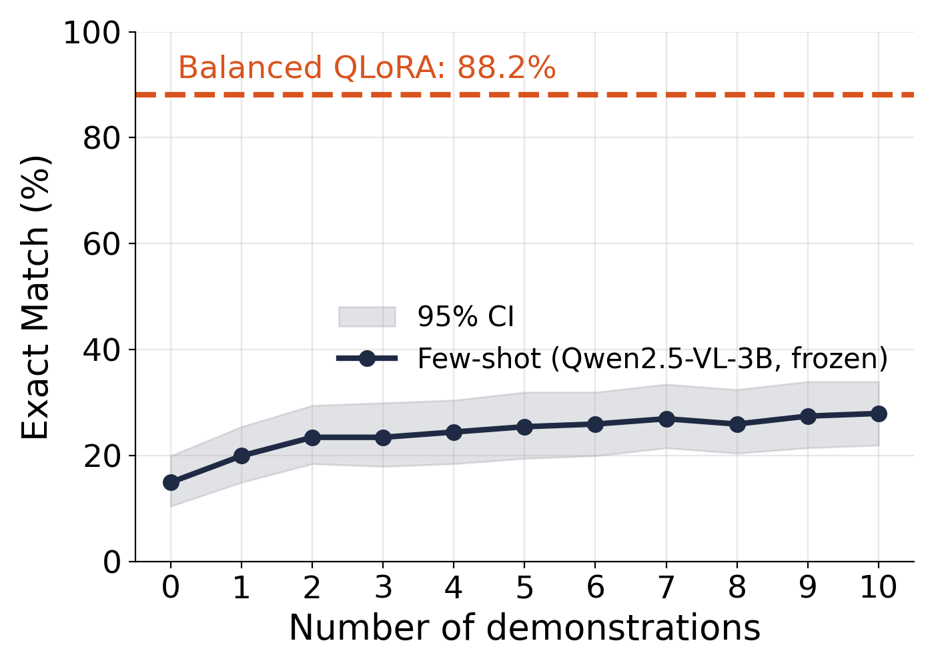
Results
Fine-tuning dramatically outperforms prompting; Balanced QLoRA is best
Approach | Exact Match | ROUGE-L | BLEU-4 | Best val loss
Few-shot, 0-shot† | 15.0% | 0.244 | 0.009 | –
Few-shot, 10-shot† | 28.0% | 0.376 | 0.019 | –
High-Capacity QLoRA | 85.46% | 0.888 | 0.145 | 0.133
Balanced QLoRA | 88.15% | 0.907 | 0.146 | 0.102
Efficient QLoRA | 86.38% | 0.891 | 0.145 | 0.123
+60 points: 10-shot prompting (28%) to Balanced QLoRA (88%)
Test set: 2,482 questions from 73 held-out image pairs
EM rises slowly with more shots (28% at 10), far below fine-tuning
†Baseline is a different model (frozen Qwen2.5-VL-3B) scored on a 200-question sample, so the comparison to Llama-1B QLoRA is indicative, not like-for-like.

Slide 3
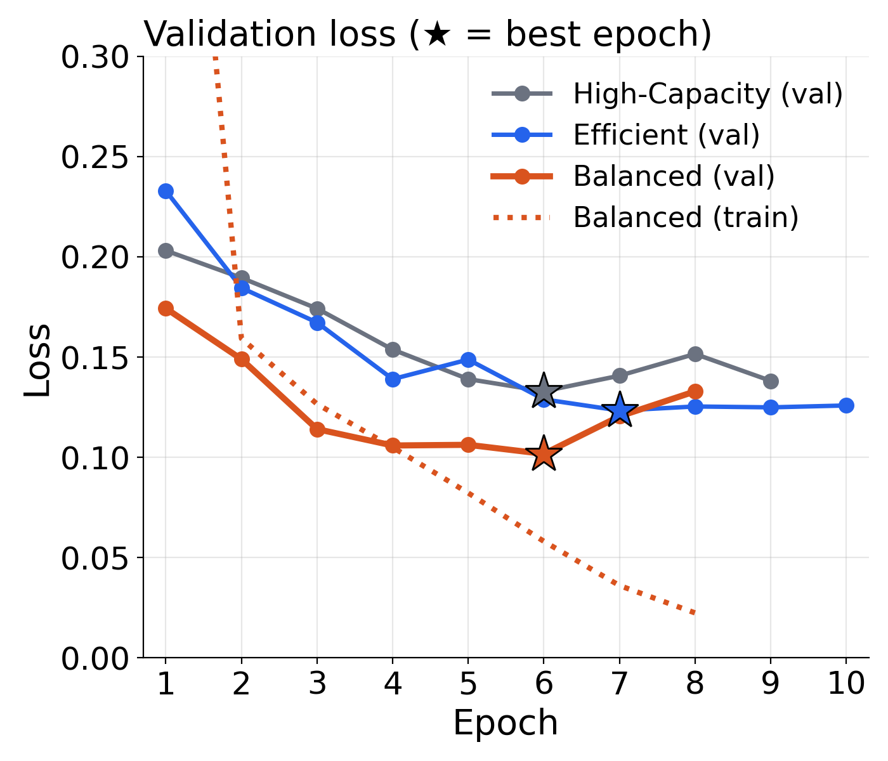
Efficiency vs Accuracy
Attention-only adapters matched or beat attention + MLP adapters at far lower cost
Config | LoRA | Total | EM | Best epoch | Train time
High-Capacity | 11.3M | 17.0M | 85.46% | 6 of 9 | ~8.4 h
Balanced | 3.4M | 9.2M | 88.15% | 6 of 8 | ~4.1 h
Efficient | 0.85M | 6.6M | 86.38% | 7 of 10 | ~5.0 h
Balanced beats High-Capacity by 2.7 EM points with ~70% fewer LoRA parameters
Adding MLP adapters did not help on this task
Balanced also has the lowest validation loss (0.102 vs 0.123 and 0.133)
Caveat: configs also differ in learning rate and batch size (High-Capacity: 1e-4, batch 2), so architecture and optimisation effects are not fully separated. Single run per config.

Slide 4
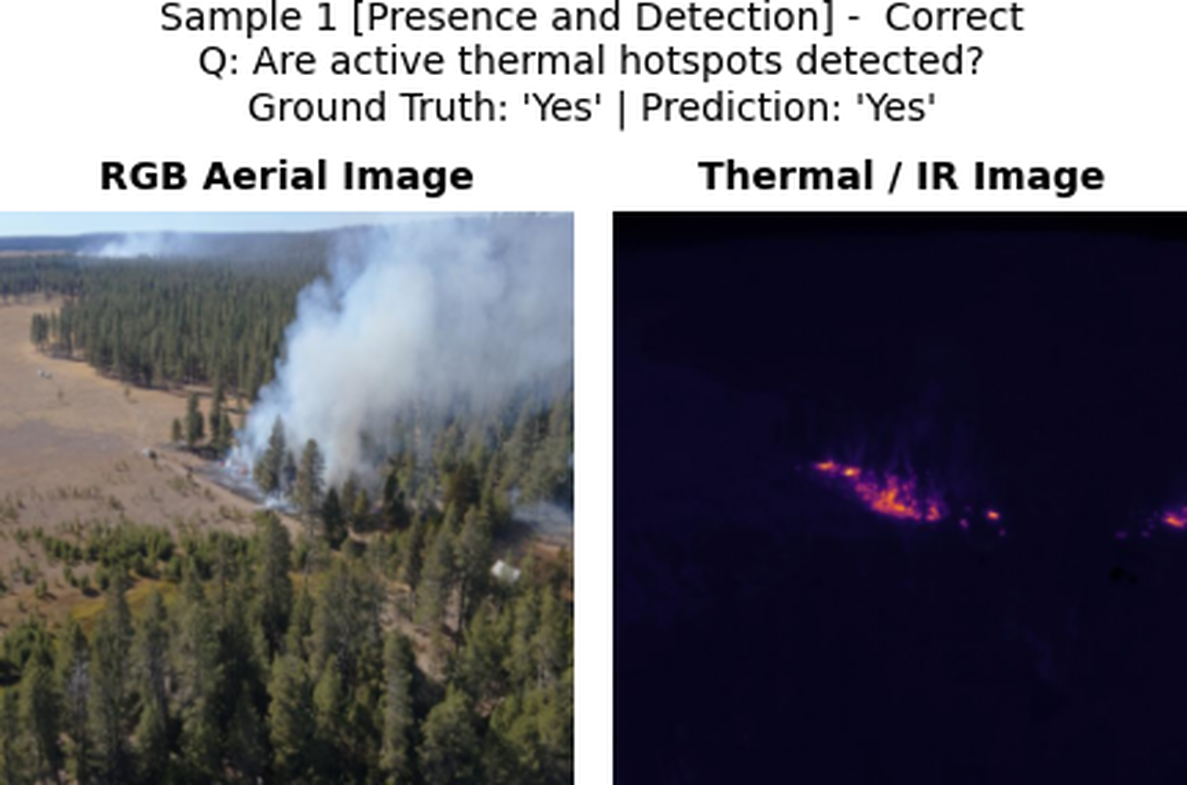
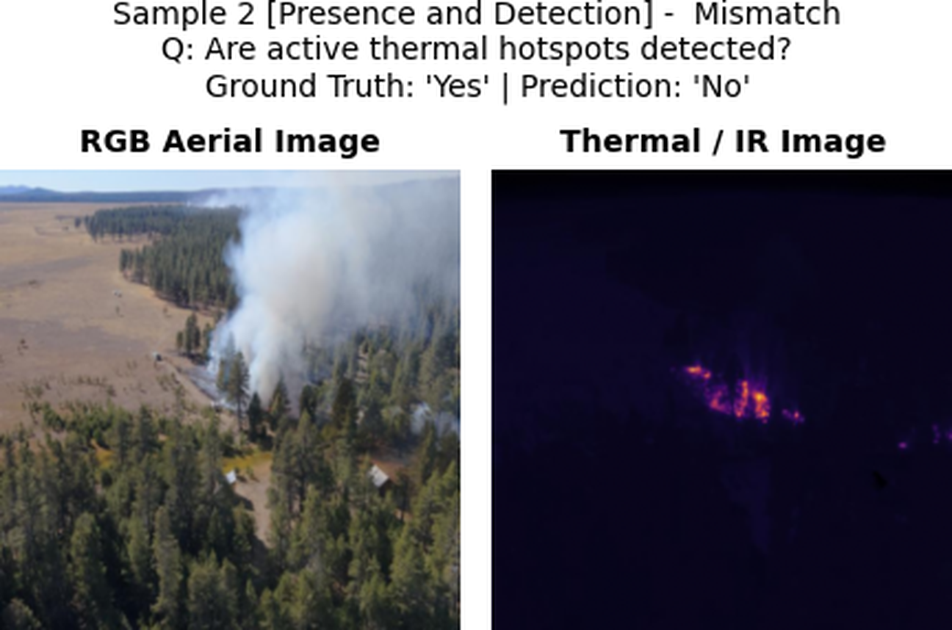
Per-Category Results and Sample Predictions
Exact Match (%) on the 73-image test set
Category | Balanced | High-Cap | Efficient
Presence & Detection | 93.8 | 93.0 | 94.3
Cross-Modal Reasoning | 91.1 | 84.2 | 81.8
Distribution & Segmentation | 88.4 | 83.6 | 90.4
Flight Planning | 86.6 | 88.7 | 85.3
Classification | 84.5 | 84.9 | 82.0
Localization & Direction | 80.5 | 72.9 | 74.7
Localization is the weakest category for every model. Gaps under ~3 points are within sampling noise (bootstrap over 73 test images, one training run per config); the Cross-Modal and Localization gaps for Balanced are larger than that.
Per-category numbers show where models differ; they do not isolate the contribution of thermal imagery (see next slide).

Slide 5
Takeaways, Limitations and Phase 3
Takeaways
Limitations
Phase 3
Balanced QLoRA reaches 88.15% EM with 3.4M LoRA + 5.8M projector parameters
Supervised fine-tuning far exceeds few-shot prompting (cross-model comparison)
Attention-only adapters were enough: no gain from MLP adapters, at about half the training time
Thermal contribution not yet isolated: no RGB-only or thermal-only run
Single site (Sycan), 73 test images, one run per config
Learning rate and batch size differ across configs
Localization questions remain weak (~73–80% EM)
1. Modality ablation: RGB-only and thermal-only
2. Cross-site test on Shoetank and Wilamette
3. Error analysis by category
4. Re-run High-Capacity with Balanced hyperparameters

