Slide 1
Word Mover’s Distance
Rishab Goel
RaRe Data Science Incubator Student
@RishabGoel
Notes:
Abstract: As a website owner you would want to show maximum content about your products to a new customer and show customized content to its old customers.
WMD is technique to find similarity between reviews even when the words are not the same. WMD is a new feature in the open-source Natural Language Processing package Gensim.

Slide 2
Same content. Different words.
“The Sicilian gelato was extremely rich”
“The Italian ice-cream was very velvety”
Credit: Sudeep Das @datamusing applied WMD to restaurant reviews. http://tech.opentable.com/2015/08/11/navigating-themes-in-restaurant-reviews-with-word-movers-distance/
Notes:
Here is the business problem we are going to solve. Imagine you run a restaurant review website. There is one Italian restaurant that has amazing ice-cream and 90% of reviews are just about the dessert. The users actually want to know about all the aspects of the place, not just the gelato. So how can we hide all the ice-cream reviews?

Slide 3
Ways to find similar documents
Count common words ( bag of words, TF-IDF)
#Dimensions = #Vocabulary (thousands)
Stuck if no words in common.
“Gelato” != “Ice-cream”
Credits : Lev Konstantinovskiy
https://speakerdeck.com/tmylk/same-content-different-words
Notes:
This problem is called “document similarity” in academic literature and there are some standard solutions. First of all we can just count how many common words are there between documents. If both reviews say “ice-cream” then they are similar. If one says “ice-cream” and another one says “gelato” then we are in trouble.

Slide 4
Ways to find similar documents
Low-dimensional latent features
Eigen-values (LSI)
Probability (LDA)
Good representation But …
There is something better now… WMD!
Credits : Lev Konstantinovskiy
https://speakerdeck.com/tmylk/same-content-different-words
Notes:
There are ways to work around the “no words in common” problem using some linear algebra or probability. This is what Gensim has been used for for the past 8 years. But there is a new kid on the block called WMD that I will talk about

Slide 5
New way to find similar documents
Word Mover’s Distance
Built on top of Google’s word2vec
Well-used concept in other fields known as Earth Mover’s Distance
Beats BOW, TF-IDF, LDA, LSI in Nearest Neigbours document classification tasks.
Credits : Lev Konstantinovskiy
https://speakerdeck.com/tmylk/same-content-different-words
Notes:
WMD stands for Word Mover’s Distance. As all the good new things it is created by combining two old well-trusted solutions together: the famous word2vec algorithm and Earth Mover’s Distance.

Slide 6
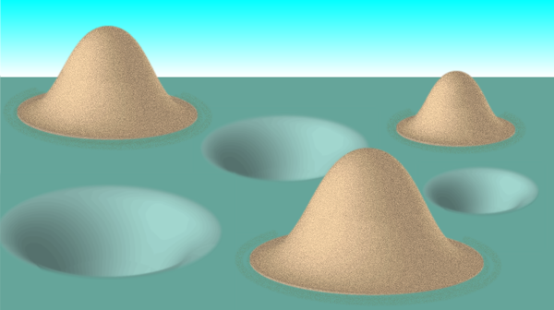
Earth Mover’s Distance
How do you best move piles of sand to fill up holes of the same total volume?
[Image: APS/Alan Stonebraker]
Stated by Monge in 1781. Solved by Kantorovich in 1942.

Slide 7
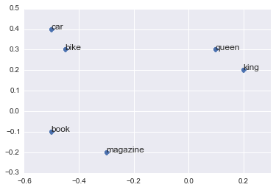
Google’s Word2vec algorithm
●
Word becomes a vector in 100-dimensional space.
● king - man + woman = queen
http://nbviewer.jupyter.org/github/fbkarsdorp/doc2vec/blob/master/doc2vec.ipynb
http://radimrehurek.com/2014/02/word2vec-tutorial

Slide 8
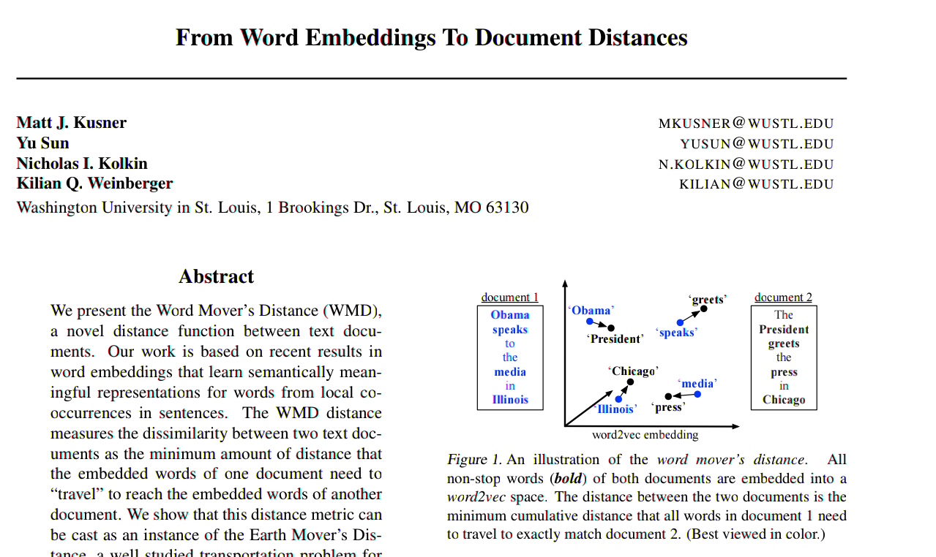
Word Mover’s distance
http://jmlr.org/proceedings/papers/v37/kusnerb15.pdf
https://github.com/mkusner/wmd
Notes:
You can read more details in this nice paper by Matt Kusner

Slide 9
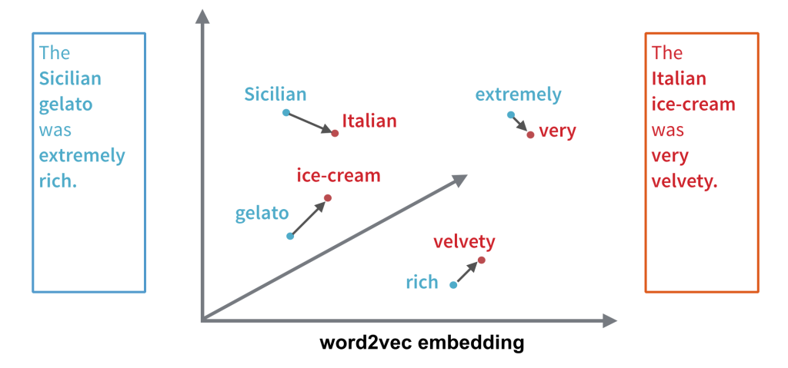
Word Mover’s distance
Optimization Expression
http://tech.opentable.com/2015/08/11/navigating-themes-in-restaurant-reviews-with-word-movers-distance/
Notes:
So how does the Word Movers Distance work? We measure the shortest way to move one sentence into another, word by word. These two sentences are actually very close because it only takes a short distance to move Sicilian to Italian, ‘gelato’ to ‘ice-cream’ and ‘rich’ into ‘velvety’.

Slide 10
Relaxed Word Mover’s Distance
Relaxed Word Centroid Distance

Slide 11
Word Centroid Distance is a lower bound Relaxed Word Mover’s Distance is a tighter bound
http://jmlr.org/proceedings/papers/v37/kusnerb15.pdf
Notes:
This is a plot of WMD(blue), WCD(Black), RWMD(red) distances of a query sentence with all the documents, arranged in ascending order. These lower bounds can be used to make reduce the computations of WMD. For more details you can refer to the paper.

Slide 12
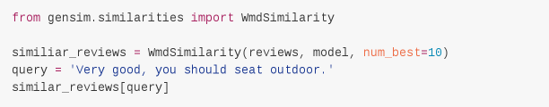
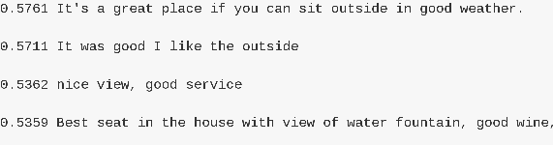
Finding similar reviews
from gensim.similarities import WmdSimilarity
similiar_reviews = WmdSimilarity(reviews, model, num_best=10)
similar_reviews['Very good, you should seat outdoor.']
Credits : Lev Konstantinovskiy
https://speakerdeck.com/tmylk/same-content-different-words
Notes:
Here is the gensim API for finding similar reviews. We trained it on Yelp reviews of a popular Las Vegas joint that doesn’t have ice cream unfortunately but has a great view.
The question is “What reviews are most similar to “Very good, you should seat outdoor’?”
You can see the answers here together with their similarity scores(higher values mean more similar).
The first match doesn’t contain a single word in common with our query!

Slide 13
Thanks!
Link to the Slides
https://github.com/RishabGoel/pycon_india_slides
Notes:
Thank you for listening. You can contact me on gitter or in the evening, if you would like to know more or have an idea for a pull request.

Slide 14
Extra slides

Slide 15
Ways to find similar documents
Google’s Doc2vec
Built on top of word2vec
Document tags are just extra words in the document
Hard to tune. Slow inference.

Slide 16
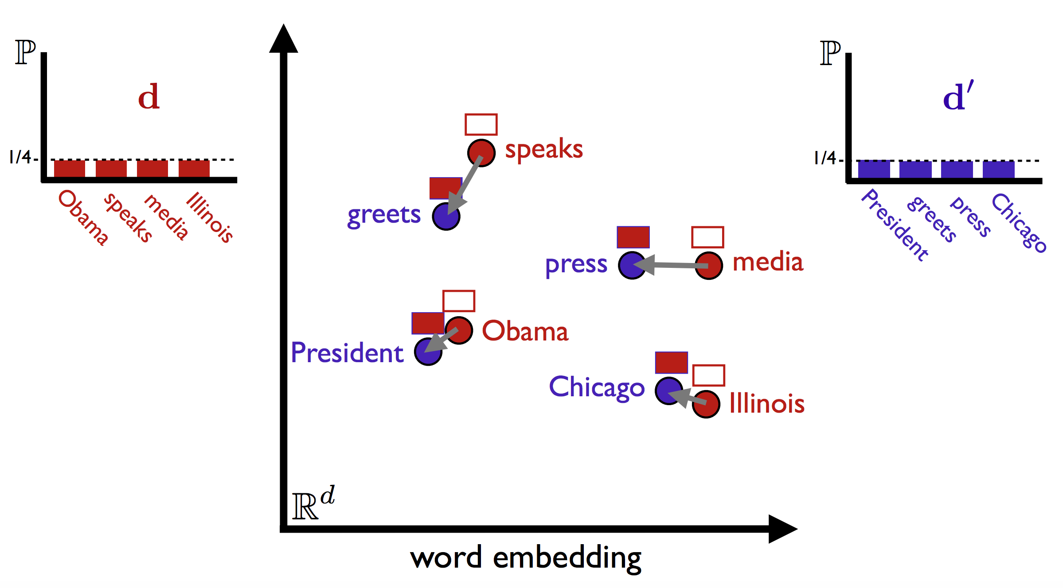
Word Mover’s distance
http://vene.ro/blog/word-movers-distance-in-python.html
Notes:
Example from Matt Kusner’s paper

