Slide 1


COLOSSUS 2.0
COLOSSUS 2.0
TEAM DETAILS
Vision Capture
Team Name: ELITEHUB
Team Leader Name: RISHABH PRAJAPATI
Track: IoT

Slide 2
PROBLEM STATEMENT
Identify the issue : Teachers in today's classrooms are struggling to manually track attendance, monitor student engagement, and measure their own teaching efficacy. This process is time-consuming, error-prone, and lacks insight into student behavior or teacher performance.
Explain its significance: Manual tracking of attendance and engagement is time-consuming, error-prone, and ineffective—especially in large or hybrid classrooms. Disengaged students often go unnoticed, and teachers lack feedback to improve their performance. These issues lead to poor academic outcomes and inefficient teaching. Without a smarter system in place, both students and teachers miss out on opportunities to grow and succeed in a rapidly evolving educational environment.

Slide 3
IDEA
Brief about the idea : We propose a smart classroom monitoring system that leverages AI, computer vision, and deep learning to identify and classify student behavior in real-time. This system addresses key issues such as poor engagement tracking, proxy attendance, and lack of actionable teaching insights.
Outline the solution : Our solution uses OpenCV and a 3D CNN model to analyze classroom video feeds, enabling real-time behavior recognition and attendance validation through facial recognition. Teachers receive instant feedback on both student engagement and their own performance, allowing them to adapt and improve teaching strategies effectively.

Slide 4
KEY FEATURES
List core functionalities :
Real-Time Engagement Detection: Analyzes live classroom video to detect student states such as Engaged, Distracted, Sleeping, or Using Phone.
Behavior Classification: Uses a 3D CNN model for accurate spatiotemporal recognition of student actions.
Teacher Dashboard: Displays dynamic engagement metrics and allows interactive visualization of student behavior.
Real-Time Feedback: Provides instant behavioral alerts and insights, empowering teachers to make timely interventions.
Explain benefits :
These features reduce manual monitoring, prevent proxy attendance, and provide continuous feedback on student and teacher performance—drastically improving classroom effectiveness.

Slide 5
TECH STACK
Tech Stack Overview :
Frontend:
React
Material-UI / Tailwind CSS
AI/ML:
Python (TensorFlow)
OpenCV
Mediapipe
Deployment:
Docker
Kubernetes (optional)
Backend:
FastAPI
Firebase (Firestore, Auth)
Storage:
Firebase Firestore
AWS S3
Hardware:
Raspberry Pi / Jetson Nano
PoE IP Cameras

Slide 6
TECH STACK
Purpose and Benefits :
React + Tailwind CSS: Builds a clean, responsive admin dashboard.
Node.js + Firebase: Handles fast backend logic and real-time data sync.
TensorFlow (Python): Trains and runs behavior analysis models.
OpenCV & Mediapipe: Enable face detection and head pose tracking at the edge.
Firestore + AWS S3: Store real-time data and video clips efficiently.
Docker + Kubernetes: Ensure consistent deployment and easy scaling.
Jetson Nano / Raspberry Pi: Perform local AI tasks to reduce cloud load.
IP Cameras: Provide high-quality classroom footage for analysis.

Slide 7
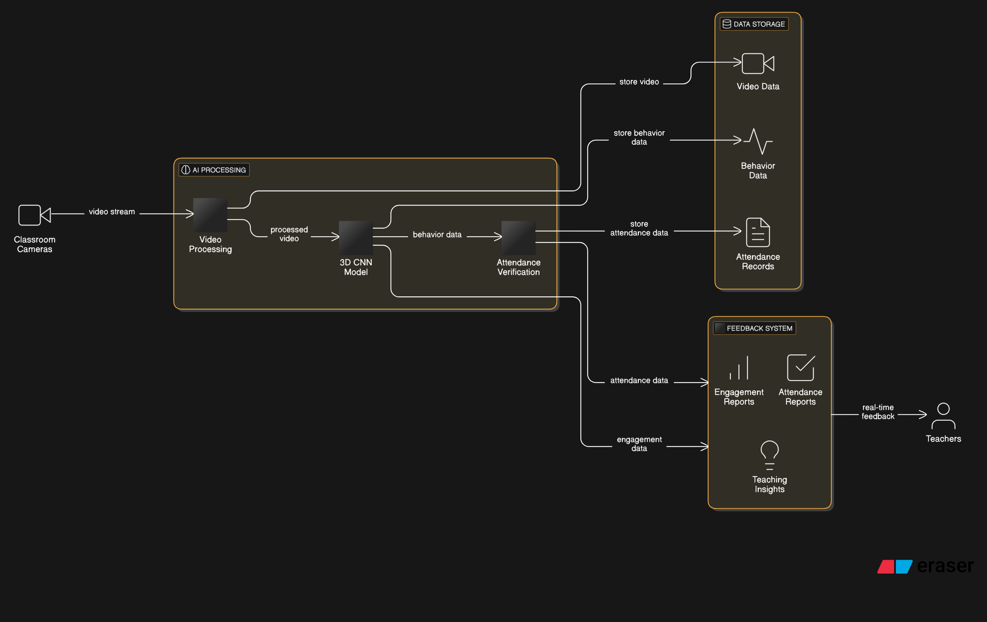
FLOW DIAGRAM
COLOSSUS 2.0
COLOSSUS 2.0
FLOW DIAGRAM

Slide 8
COLOSSUS 2.0
COLOSSUS 2.0
TEAM MEMBERS DETAILS
Team Lead
Team Member 2
Name : Rishabh Prajapati
College : NIE, Mysore
Email : rishabh4u07@gmail.com
Phone Number : 9257975211
Name : Aditya Pareek
College : NIE, Mysore
Email : adpaniitian@gmail.com
Phone Number : 8829099340
Team Member 3
Name : Pranav Thakur
College : NIE, Mysore
Email : thakur504.pranav@gmail.com
Phone Number : 7091522536

