Slide 1
Database Management System
Online Voting and Allocation System
Team Details:
Rishabh Aggarwal : 2410991813
Rhythm : 2410991812
Rishi : 2410991815
Chitkara University Institute of Engineering and Technology,
Chitkara University, Punjab

Slide 2
Table of Contents
Introduction
Problem Overview
Scope of Project
Objectives
Significance of project
Main Entities and Attributes
Relationships
ER Diagram
ER Modal
Relation Algebra Queries

Slide 3
Introduction
Voting stands as a fundamental pillar of democracy, requiring the collection and management of highly sensitive data that directly shapes governance. Traditionally, elections have relied on paper ballots and manual counting—methods that can be time-consuming, susceptible to errors, and inefficient for large-scale events.
In today’s digital era, the demand for a secure, transparent, and reliable Online Voting System is more pressing than ever. The proposed solution offers a unified platform for voter registration, secure vote casting, identity verification, and the real-time generation of accurate election results.
This system is designed not only to simplify the voting process but also to enhance security, transparency, and accessibility for both voters and administrators. By incorporating strong encryption techniques and database management principles, it ensures data integrity, confidentiality, and scalability, making it suitable for use in institutions, organizations, and even national elections

Slide 4
Problem Overview
Online voting involves multiple interconnected entities, including Voters, Candidates, Elections, Political Part, Results, and Administrators. Without a well-structured voting system, several challenges emerge:
Delays in processing due to manual verification of voter eligibility and vote counting.
Data inconsistency and redundancy resulting from scattered or poorly maintained records.
Difficulty in tracking voter participation and election results across regions.
Lack of centralized management, limiting transparency and coordination.
Security vulnerabilities, such as unauthorized access, duplicate voting, or vote tampering.

Slide 5
Scope of Project
The aim of this project is to design and implement a relational database framework capable of handling all essential elements of a secure and scalable voting environment. Specifically, the system will:
Data Storage & Organization: Maintain detailed information about voters, polling stations, candidates, election officials, parties, and cast ballots in a consistent format.
Entity Relationships: Model the real-world interactions between voters, elections, and results through a well-structured schema that minimizes redundancy and ensures data integrity.
Querying & Operations: Support efficient retrieval of voter lists, candidate details, polling results, and election summaries, while also allowing fast updates (e.g., vote counts, voter validations).
Scalability: Be designed to accommodate expansion, such as an increase in the number of registered voters, future elections, and additional constituencies without performance issues.

Slide 6
Objectives
The key objective for make this project is to provide a safe ,secure and reliable platform of online voting and election system for the user and ensure the data validity and safety
Centralized Election Data Repository Develop a unified database that eliminates duplication while keeping complete, accurate records of voters, candidates, and results.
Quick & Accurate Data Access Optimize the database for fast retrieval of voter lists, live results, candidate information, and real-time election summaries.
Data Integrity & Reliability Use primary keys, foreign keys, and constraints to prevent duplication, fake votes, or inconsistent election records.
High-Level Security Measures Apply encryption, secure login systems, and role-based permissions to protect voter identities and ensure anonymity of ballots.

Slide 7
Significance of the Project
The proposed Online Voting and Election System will significantly transform the election process by:
Ensuring Security and Privacy Protecting voter identities and election data through encryption, authentication, and strict access controls to prevent fraud, tampering, or unauthorized usage.
Enhancing Efficiency in Voting Replacing manual paperwork and ballot counting with a digital platform that enables quick voter registration, instant vote recording, and automated tallying of results.
Improving Accuracy and Transparency Eliminating human counting errors and ensuring that every vote is correctly recorded and reflected in real-time, thereby increasing public trust in the electoral process.

Slide 8
Main Entities and Attributes
Entity | Attributes
Voter | Voter_id (PK), Name, Date_of_Birth, Gender, Address, Adhaar_No / Govt_ID, Voter_Status
Candidate | Candidate_ID(PK), Name, Party_Name, Age, Gender, Symbol, Constituency_ID(FK)
Election | Election_ID(PK), Election_Name, Election_Type, Constituency_ID(FK)
Constituency | Constituency_ID(PK), Name, State/Region, Type(Rural /Urban/ Reserved), No. of Voters
Admin/ Election Commision | Admin_ID(PK), Role(System Admin/ Returning Officer), Username, Password, Email
Political Party | Party_Id(PK), Party_Name, Symbol(Party Logo), Leader

Slide 9
Relationships
Political Party-Election: One-to-Many (One political party can take part in many election)
Voter-Election: Many-to-Many (Many votes can vote in many elections which happen in a year)
Candidate-Election: One-to-Many (An election has many candidates at a time)
Candidate-Constituency: One-to-Many (A constituency can have many candidates at a time)
Candidate- Political Party: One-to-Many (A political party can have many candidates standing for them)

Slide 10
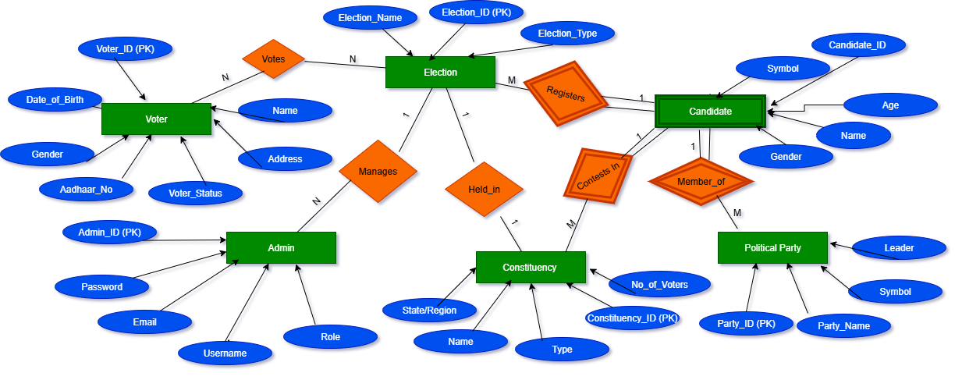
ER Diagram

Slide 11
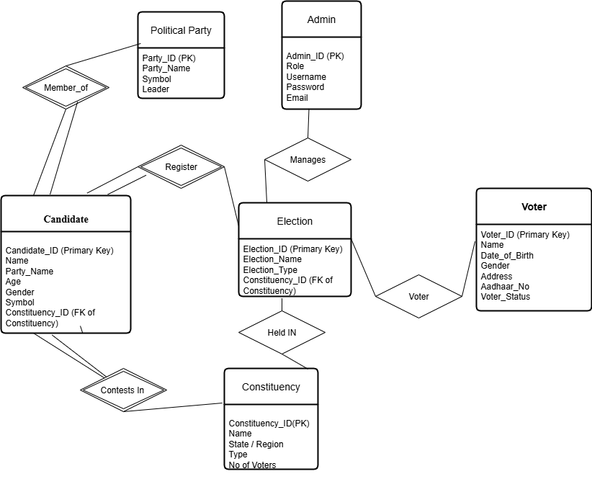
ER Modal

Slide 12
Relation Algebra Queries
Q1. Get all details of voters who are Active.
→ σ Voter_Status= ′Active′ ​(Voter)
Q2. Get names and Aadhaar numbers of all voters.
→ π Name, Aadhaar_No​ (Voter)
Q3. Find names of voters who have not voted.
→ π Name​(σ Voter_Status= ′NotVoted′​ (Voter))
Q4. Retrieve voter names who are either Inactive or Already Voted.
→ π Name​(σ Voter_Status= ′Inactive′​ (Voter)) ∪ π Name​(σ Voter_Status=′AlreadyVoted′​(Voter))
Q5. Find voters who are Active and Not Voted yet.
→ π Name​(σ Voter_Status= ′Active′​ (Voter)) ∩ π Name​(σ Voter_Status= ′NotVoted′ ​(Voter))
Q6. Get voters with their constituency name (assuming Address ~ Constituency.Name).
→ π Voter.Name,Constituency.Name (Voter ⋈Voter.Address=Constituency.Name Constituency)
Q7. Get names of all candidates
→ π Name​ (Candidate)

Slide 13
Relation Algebra Queries
Q8. Find details of female candidates.
→ σ Gender= ′Female′​ (Candidate)
Q9. List candidates above 40 years old.
→ σ Age > 40 ​(Candidate)
Q10. Get candidate names with their party names.
→ π Candidate.Name,Party.Party_Name​(Candidate ⋈Candidate.Party_Name=Party.Party_Name​Party)
Q11. Candidates contesting in constituency ID = 101.
→ π Candidate.Name​(σ Constituency_ID= 101​ (Candidate))
Q12. Find candidates who are from Party “ABC” or “XYZ”.
→ σ Party_Name= ′ABC′​ (Candidate)∪σ Party_Name= ′XYZ′ ​(Candidate)
Q13. Candidates belonging to Reserved constituencies.
→πCandidate.Name​(Candidate⋈Candidate.Constituency_ID=Constituency.Constituency_ID​ σ Type= ′Reserved′​ (Constituency))
Q14. Get all election names.
→ πElection_Name​(Election)

Slide 14
Relation Algebra Queries
Q15. Find all Parliamentary elections.
→ σ Election_Type= ′Parliamentary′​ (Election)
Q16. List election IDs and their constituency IDs.
→ π Election_ID, Constituency_ID​ (Election)
Q17. Elections of type Assembly or Local.
→ σ Election_Type=′Assembly′​(Election)∪σ Election_Type=′Local′​(Election)
Q18. Parliamentary elections in constituency ID = 101.
→ σ Election_Type=′Parliamentary′​(Election) ∩ σ Constituency_ID=101​(Election)
Q19. List elections with their constituency name.
→ π Election.Election_Name,Constituency.Name​(Election ⋈Election.Constituency_ID=Constituency.Constituency_ID​Constituency)
Q20. List candidates contesting in “General Elections 2025”.
→πCandidate.Name(Candidate⋈Candidate.Constituency_ID=Election.Constituency_ID σ Election_Name=′GeneralElections2025′(Election))

Slide 15
Relation Algebra Queries
Q21. Get all constituency names.
→ π Name​ (Constituency)
Q22. Find urban constituencies.
→ σ Type= ′Urban′​ (Constituency)
Q23. Find constituencies in Delhi.
→ σ State= ′Delhi′ ​(Constituency)
Q24. Constituencies that are Rural or Reserved.
→σType=′Rural′​(Constituency)∪σType=′Reserved′​(Constituency)
Q25. List constituencies with candidates contesting in them.
→πConstituency.Name,Candidate.Name​(Constituency⋈Constituency.Constituency_ID=Candidate.Constituency_ID​Candidate)

Slide 16
Thank You!

