Slide 1
Explain It Like
I’m 10

Slide 2
Problem
Many students find concepts difficult to understand
Explanations are often too technical
Beginners need simpler explanations

Slide 3
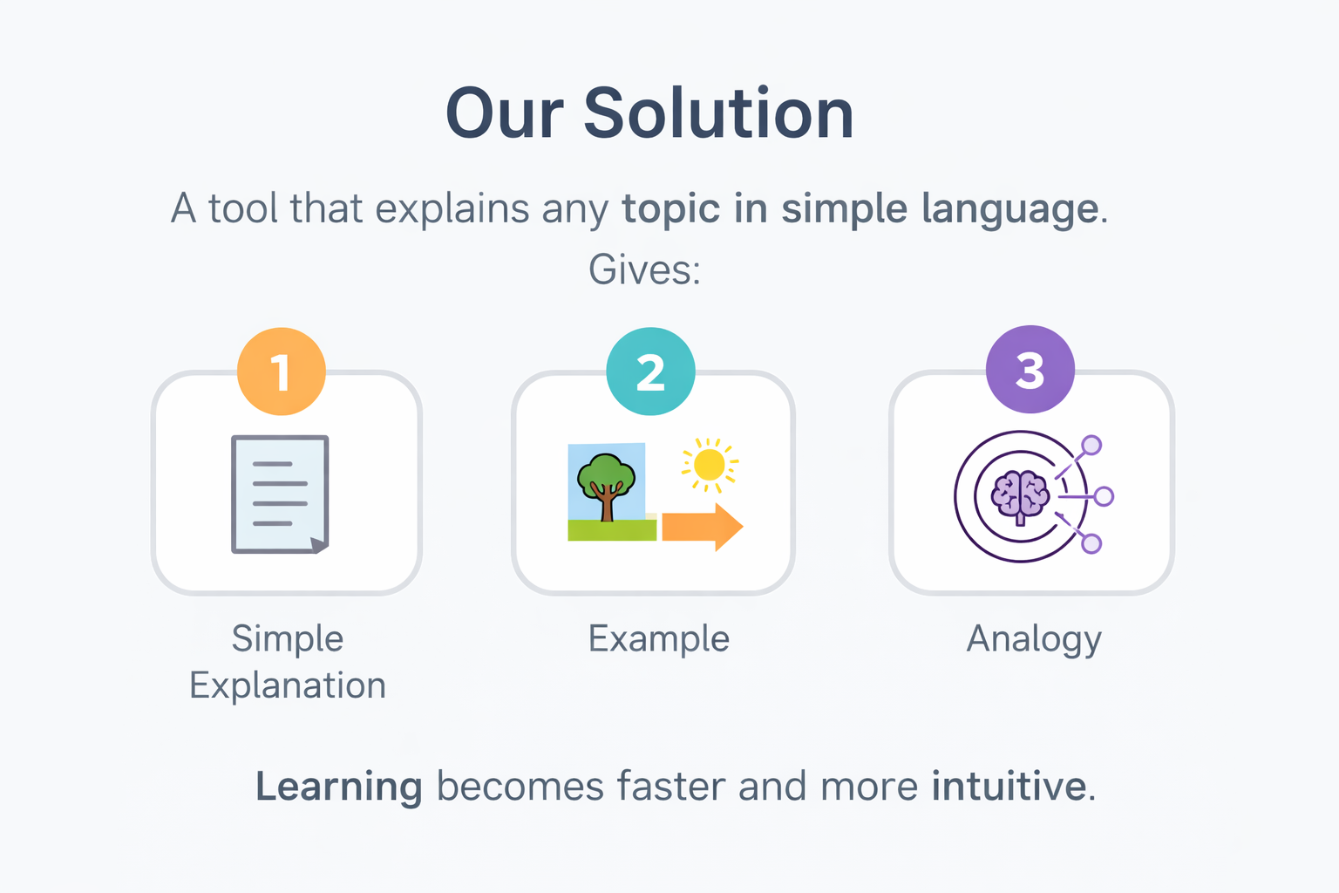

Slide 4
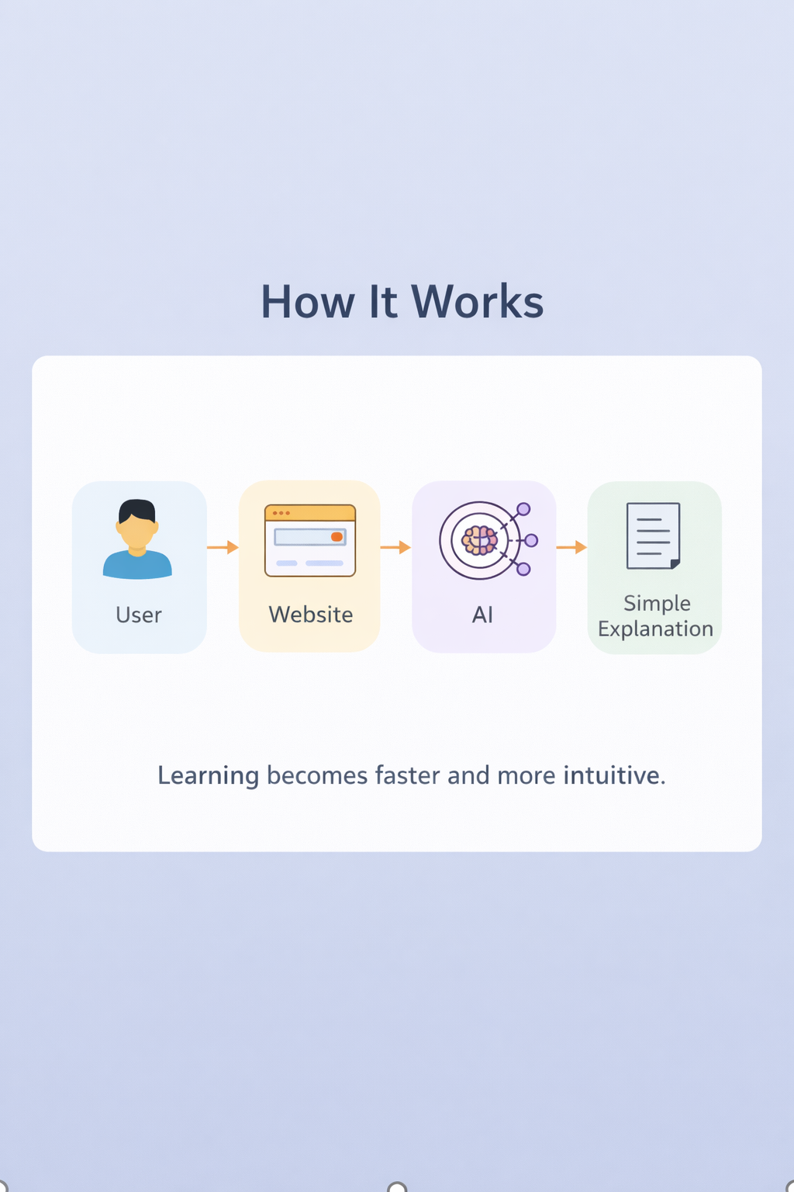
How it work ?
User enters topic
System processes input
Output generated in simple form

Slide 5
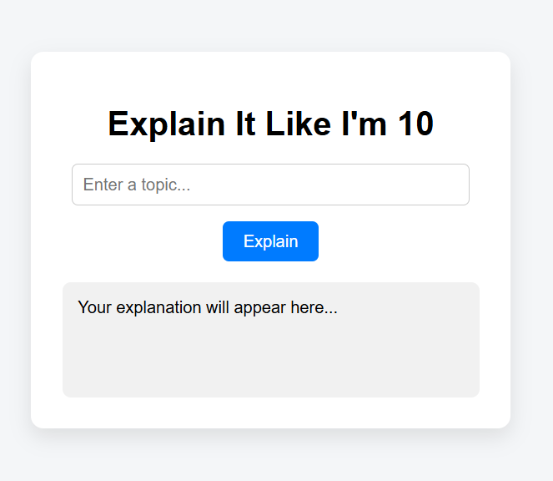
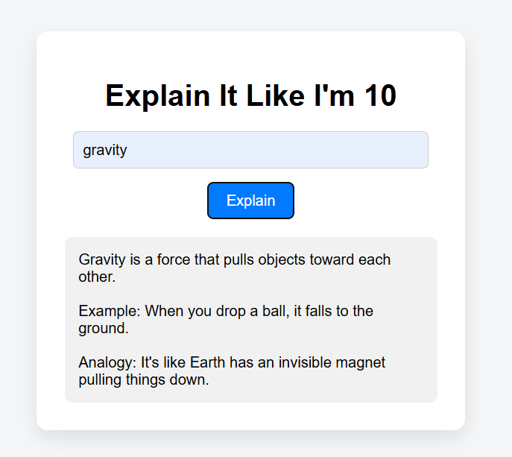

Slide 6
Future improvement
Age-based explanations (5, 10, 18)
Voice explanations
Multi-language support
Mobile app version

Slide 7
Thank you

