Slide 1

Task-Killer
Task Management To-do list
Developed By:
Rishabh Jain

Slide 2


Slide 3
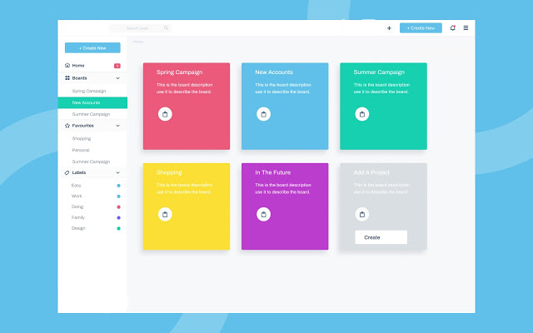

Slide 4
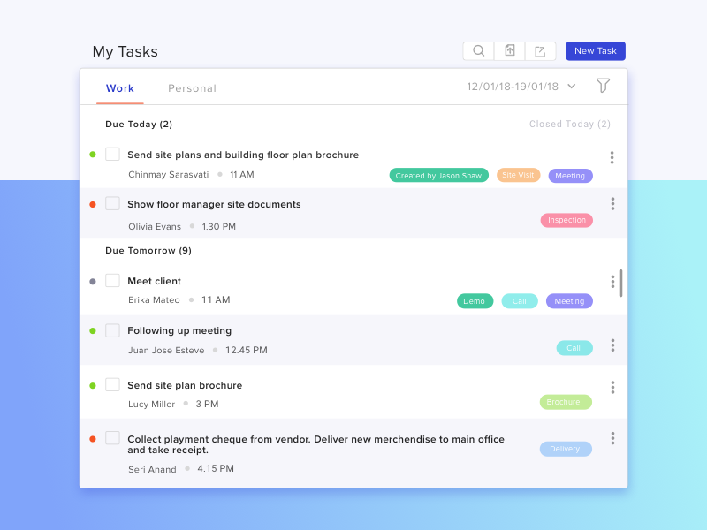

Slide 5
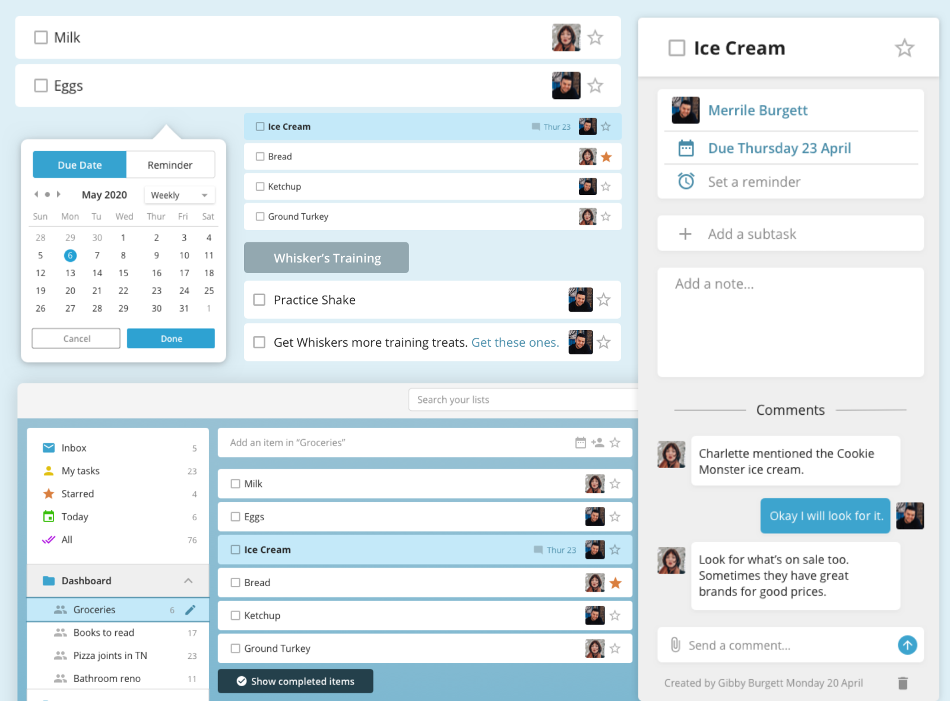

Slide 6


