Slide 1
JUKEBOX PROJECT
Submitted by
RISHABH KUMAR PATHAK
Under the Guidance of
VAIBHAV DIWAN
CHARUL BAPNA

Slide 2
INTRODUCTION
Jukebox is a music application for user to play songs. User can also search the song and make this playlist according to their interest which is being displayed in this application.

Slide 3
OBJECTIVE
The primary purpose of this musical application
is to play music available in the databases of the service, compose custom playlists and search similar songs by displaying various options.

Slide 4
MODULES:
Play songs
Display songs
Display playlist
Make playlist
Search song

Slide 5
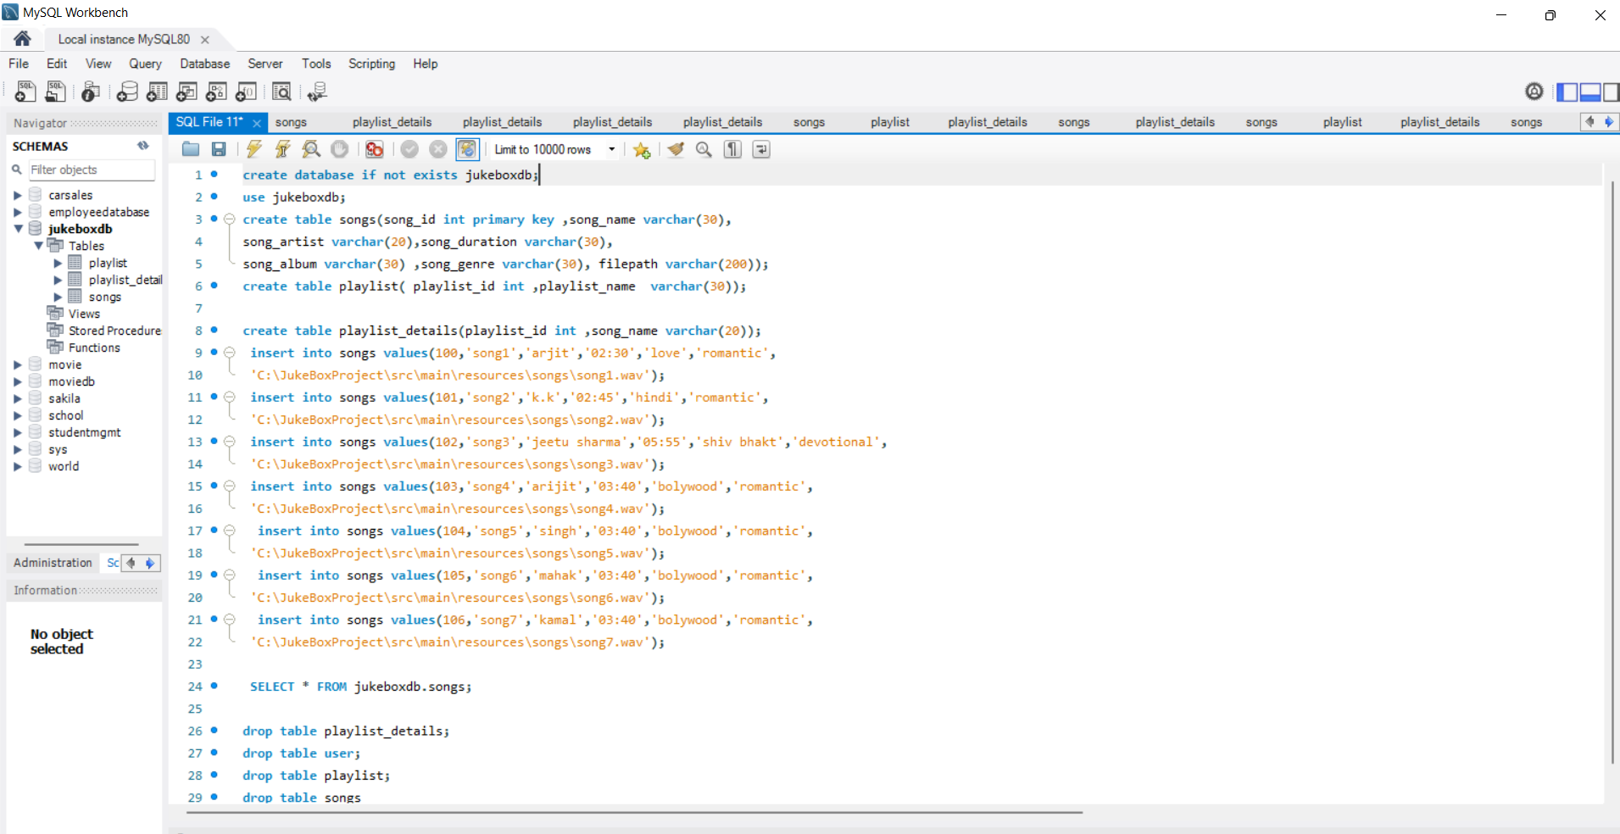
SQL QUERY

Slide 6
Software Required
Operating System
Intellij
MySQL Workbench

Slide 7
Hardware Required
Computer
RAM
Processor

Slide 8
FEATURES
User friendly interface
Easy and Fast response
Music categorization
Music collection
Flexible to access
Playlist feature

Slide 9
ADVANTAGES
Less time consumption
Offline listen to all music
User can create their playlist easily
Login authentiction
Proper data mainatining
Searching option by name

Slide 10
LIMITATIONS
* Limited collection of song

Slide 11
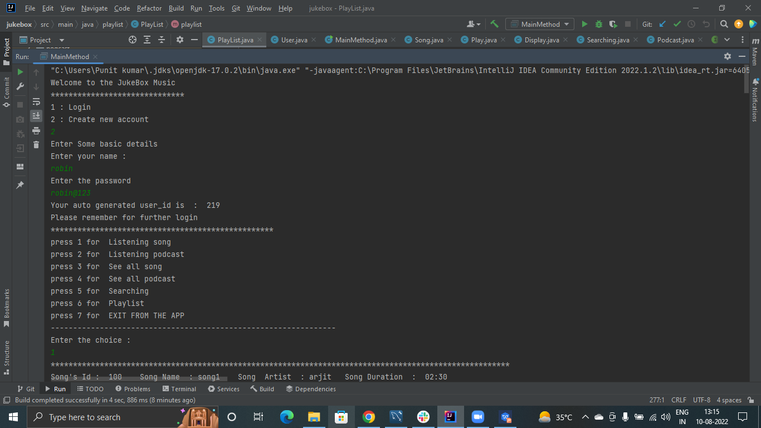
OUTPUT WINDOW

Slide 12
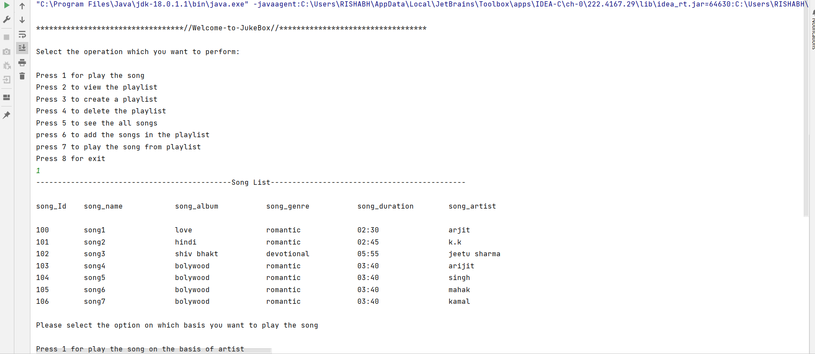
OUTPUT SCREEN DISPLAY

Slide 13
THANK YOU!

