Slide 1

Digital Healthcare Application
Mini Project

Slide 2
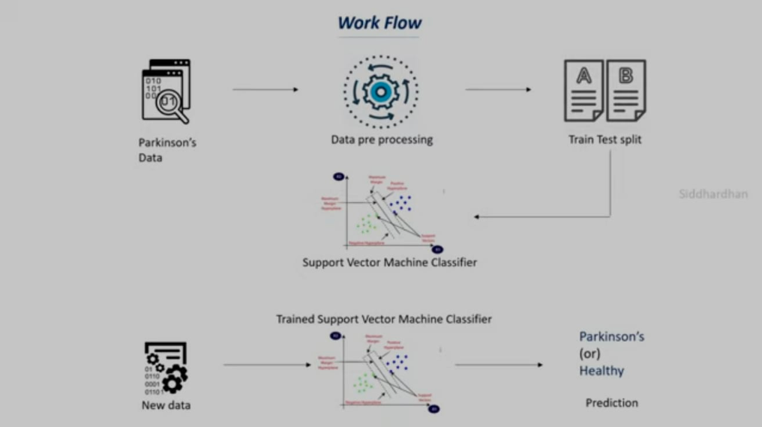
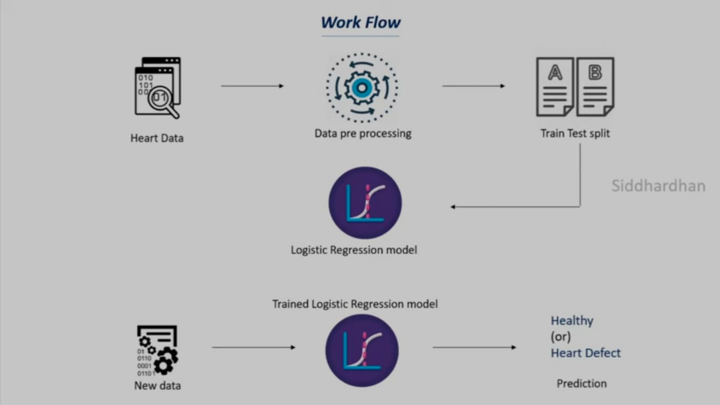
Work-Flow of machine learning model

Slide 3
OVERVIEW
Digital Healthcare app is an application used to detect
If a person suffering from a heart conditions
If a person is Parkinson's Positive i.e., suffering from a Parkinson's disease
The Application inputs the user details via a user-friendly interface and based on the details it predicts whether the persons is suffering from either of the above-mentioned diseases
Link :
https://drive.google.com/drive/folders/1Gz3eBnhGTx-njf0lTD2Elul4yr0lCkBy?usp=sharing

Slide 4
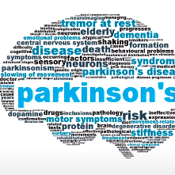
Parkinson’s Disease
Parkinson’s disease is a progressive nervous system disorder that affects movement leading to shaking, stiffness, and difficulty with walking, balance and coordination.
Parkinson’s symptoms usually begin gradually and worsen over time

Slide 5

Heart Disease
Heart disease is the broad term for conditions that affect the structure and function of the heart muscle. It includes:
Coronary heart disease (CHD)
Heart failure
Valve disease
Arrhythmias

Slide 6
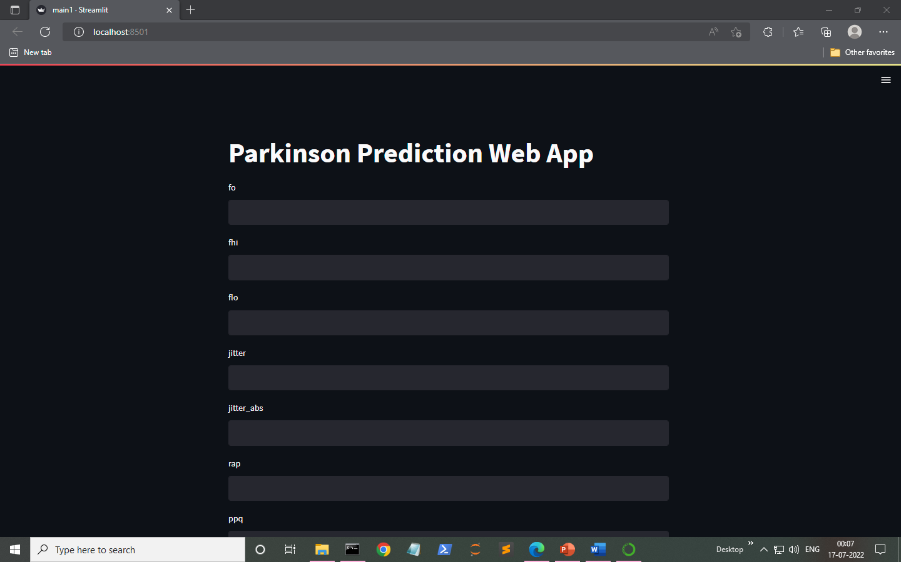
Graphical User interface

Slide 7
APPLICATIONS OF DIGITAL APPS IN HEALTHCARE INDUSTRY
Digital systems are a must in healthcare as well, like every field. Some of the applications and use cases of the system in healthcare are as following :
Online appointment bookings
Monitoring patient’s health
Efficiently handle emergency cases
Easy access of medical history of a patient
Growth of wearable medical devices to track your habits
(Oximeters, smartwatch, heart-rate sensor, sweat sensors etc )
Digital Medical consultation

Slide 8

THANK YOU

