Slide 1

C PROJECT BATCH

Slide 2


CHAPTER 1
CODE BLOCKS BASICS
Topics Covered
What Is Code Blocks ?
Why Not To Use Turbo C++ ?
Differences With Turbo C++
Configuring Code Blocks
Running A C Program In Code Blocks
Creating Our Own Header Files
Adding Support For “conio.h” In CodeBlocks

Slide 3
What Is Code Blocks ?
Code::Blocks is a free, open-source cross-platform IDE
(not a compiler) which was designed to support C
and C++ languages.
However now it also supports other languages like Fortran and D.

Slide 4
Which Compiler Code::Blocks Uses ?
Code::Blocks supports multiple compilers like:
GCC,
MinGW,
Digital Mars,
Microsoft Visual C++,
Borland C++,
LLVM Clang,
Watcom,
LCC and
the Intel C++ compiler.

Slide 5
What Are GCC And MinGW ?
GCC stands for GNU Compiler Collection, and is a collection of programming compilers including C, C++, Objective-C, Fortran, Java, and Ada.
It’s latest version is GCC 7.3 lauched on 25th –Jan-2018
MinGW stands for Minimalist GNU for Windows.
This is a project for providing native GCC compiler for Windows platform

Slide 6
About Turbo C++
Turbo C++ was released on somewhere between
1990-1992 (almost 25 years ago).
Back then it was a very good IDE and it was used
a lot to code C and C++.
But things have changed today in 2018

Slide 7
What Is Wrong With Turbo C++ ?
OutDated Compiler :
Turbo C++ uses a old 16-bit compiler which is outdated
and is not in compliance with the latest standards,
while the latest compilers are 32-bit or 64-bit and comply
to the standards.
Thus many applications built using Turbo C++ are not
compatible with our 64 bit OS.
No AutoComplete :
Another problem is that Turbo C++ does not support
autocomplete features which is really helpful on longer
projects and in minimizing errors related to syntax.
In Turbo C++ we will have to write every bit of code and
we will have to close every single function.

Slide 8
So What Are The Alternates ?
Today we have numerous IDE’s available
which can be used to migrate from Turbo C++ .
Some popular of them are:
Code Blocks
Dev C++
Code Lite
C-Free
Microsoft Visual Studio
Apple’s X-Code
We will be using Code Blocks in this project batch

Slide 9
Turbo C++ V/s Code Blocks
1. No “conio.h” Present
There's no header file named as 'conio.h' in
Code Blocks. Including such header file would
result in compilation error.
Since conio.h header file doesn't exist, the
latest standard does not support functions
like clrscr(), getch(), getche(), gotoxy() etc.

Slide 10
Turbo C++ V/s Code Blocks
So how do we clear the screen then?
We don't need to. Because whenever we will run the application , Code Blocks automatically launches a
fresh console window to display the output

Slide 11
Turbo C++ V/s Code Blocks
What if we want to clear the screen during execution of our application ?
If we want to clear the screen during runtime then we have to use the function system( ) available in the header file <stdlib.h>
The statement will be:
system(“cls”);

Slide 12
Turbo C++ V/s Code Blocks
What about getch( )?
As mentioned , getch( ) is not supported . However we have 2 alternates to it :
We can use system(“pause”)
We can use the function _getch( )

Slide 13
Turbo C++ V/s Code Blocks
2. No “dos.h” Present
There's no header file named as ‘dos.h' in Code Blocks.
And so we cannot call the functions like delay( )
But we have an alternate to this also, which the
function Sleep() available in the header file
“windows.h”
The statement will be:
Sleep(1000);

Slide 14
Turbo C++ V/s Code Blocks
3. The main( ) function has return type int
The main( ) function has the default return type of int
Just like C++ , here also we write return 0 as our last
statement in main( ) which indicates successful
termination
Although we can make it as void , but we will get a
warning during compilation :
warning: return type of 'main' is not 'int'

Slide 15
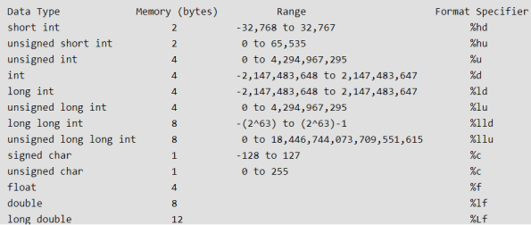
Data Types

Slide 16
Differences With TurboC++
In Turbo | In GCC
int | short int
unsigned int | unsigned short int
long int | int or long int
unsigned long int | unsigned int or unsigned long int
long double (10 B) | long double (12 B)
 | New Data Type: long long int (8B) and unsigned long long int(8B)
char , signed char , float and double are exactly same as Turbo C++

Slide 17
Differences With Turbo C++
What will be the output of the following code in Turbo ?
#include <stdio.h>
void main()
{
char ch=‘AB’;
printf(“%c”,ch);
}
Output:
A

Slide 18
Differences With Turbo C++
In CodeBlocks however this code will output B?
#include <stdio.h>
int main()
{
char ch=‘AB’;
printf(“%c”,ch);
return 0;
}
Output:
B

Slide 19
Differences With Turbo C++
What will be the output of the following code in Turbo ?
#include <stdio.h>
void main()
{
char ch=‘ABC’;
printf(“%c”,ch);
}
Output:
Syntax Error: character constants cannot be more than 2 characters long

Slide 20
Differences With Turbo C++
In CodeBlocks however this code will output C?
#include <stdio.h>
int main()
{
char ch=‘ABC’;
printf(“%c”,ch);
return 0;
}
Output:
C

Slide 21
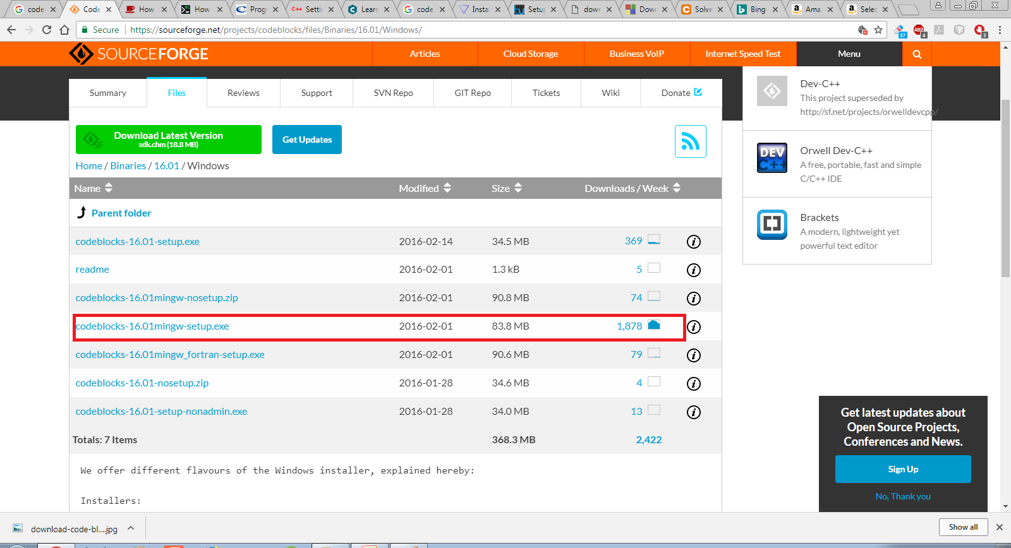
Downloading And Installing CodeBlocks
Open https://sourceforge.net/projects/codeblocks/files/Binaries/16.01/
Windows/
Click on CodeBlocks 16.01 mingw-setup.exe

Slide 22
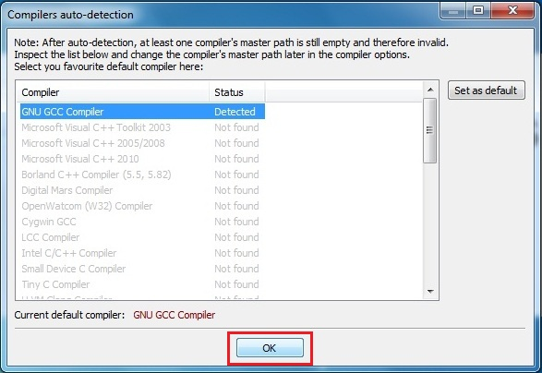
Downloading And Installing CodeBlocks
Now double click on downloaded installer.
The process is simple hit next couple of times.
Make sure installation path C:\Program Files\CodeBlocks (default location).
Now launch CodeBlocks

Slide 23
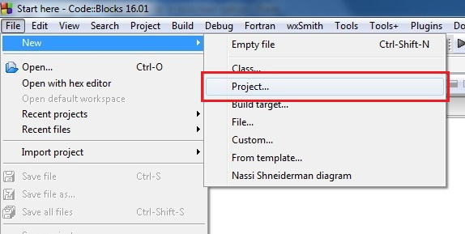
Developing First Application In CodeBlocks
Open CodeBlocks
Go to File –> New –> Project..

Slide 24
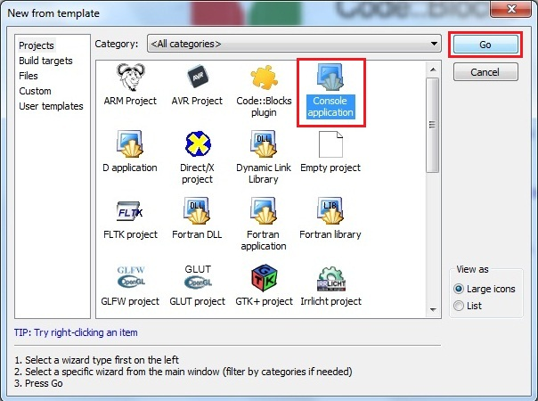
Developing First Application In CodeBlocks
Select Console application and hit on Go.

Slide 25
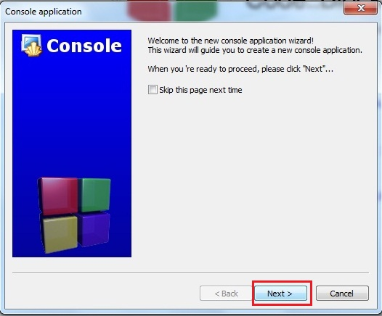
Developing First Application In CodeBlocks
Hit on Next

Slide 26
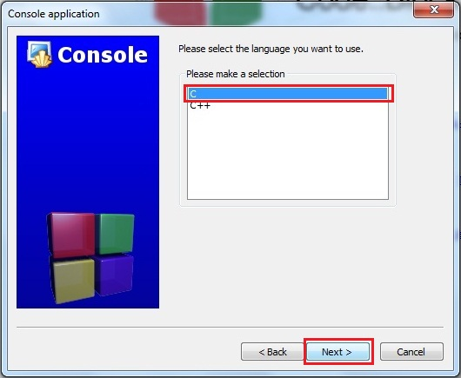
Developing First Application In CodeBlocks
Select C and click on Next

Slide 27
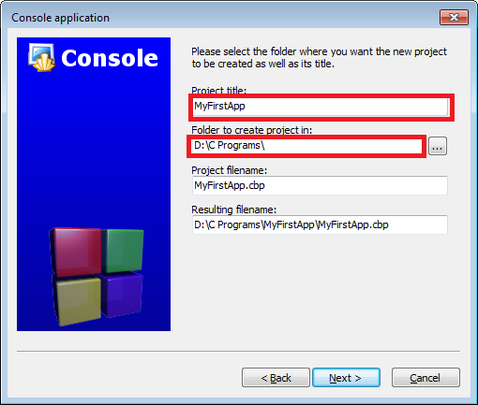
Developing First Application In CodeBlocks
Fill in the name of your Project( In CodeBlocks ,
every program is called a Project)
Also set the folder where you want to save
all your projects. In my case it is D:\C programs

Slide 28
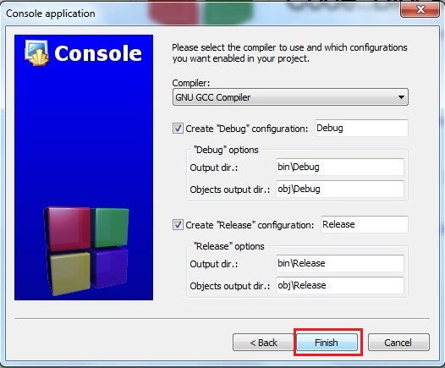
Developing First Application In CodeBlocks
Hit on Finish

Slide 29
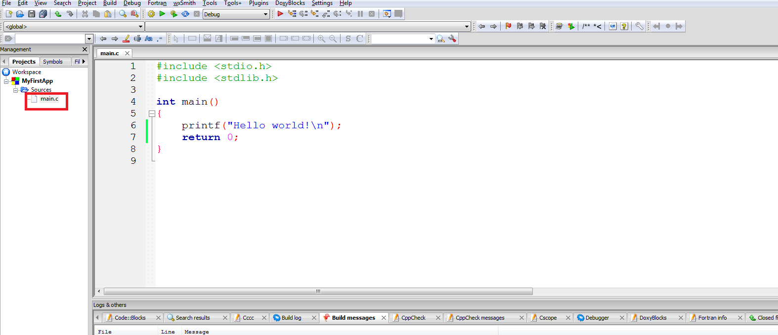
Developing First Application In CodeBlocks
CodeBlocks will automatically generate a file
called main.c shown in left pane under the
project name
You can now open the main.c file.
This entire code is automatically generated by CodeBlocks

Slide 30
Compiling And Running The Program
To compile the program, click Build → Build
To run the program, click Build→Run
Alternatively we can also select Build and Run
icon located in the toolbar on the top.
The icon has a yellow gear and a green play logo.

Slide 31
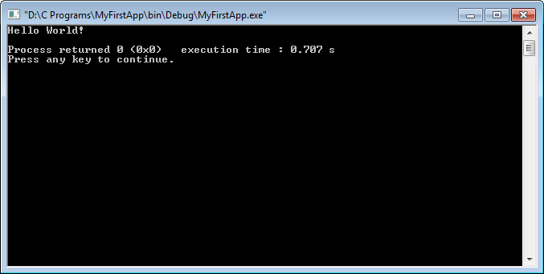
Compiling And Running The Program
Finally we will get the following output ,
as shown below.

