Slide 1

C PROJECT BATCH

Slide 2


Adding A New File
A project contains related files such as
source codes, header files, and relevant resources.
Although a project may contain many source files,
there can only be one main() function
among all the source files.

Slide 3
Adding A New File
That is, we cannot keep two programs (each having a main() function) in one project (we will get
the error "multiple definition of 'main'" when
we try to build the project).
We need to create one project for each program.
However , there is a solution to this , but first we
will learn how to add a new file/program to our
project

Slide 4
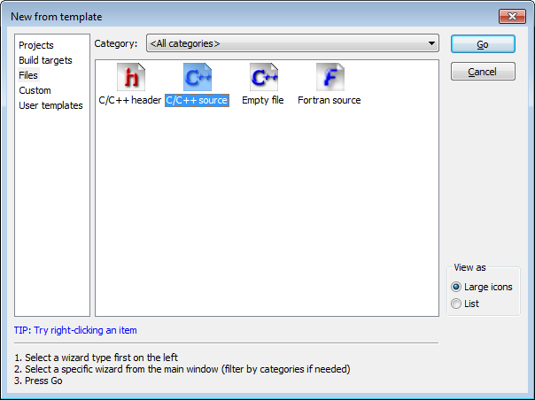
Adding A New File
Select C/C++ Source from the window that appears

Slide 5
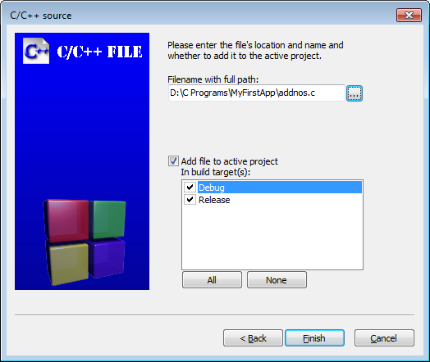
Adding A New File
Continue through the following dialogs very
much like the original project creation and
select C when prompted for a language.
On the final page, we will have to mention the
new filename and location. We have given
the name addnos.c

Slide 6
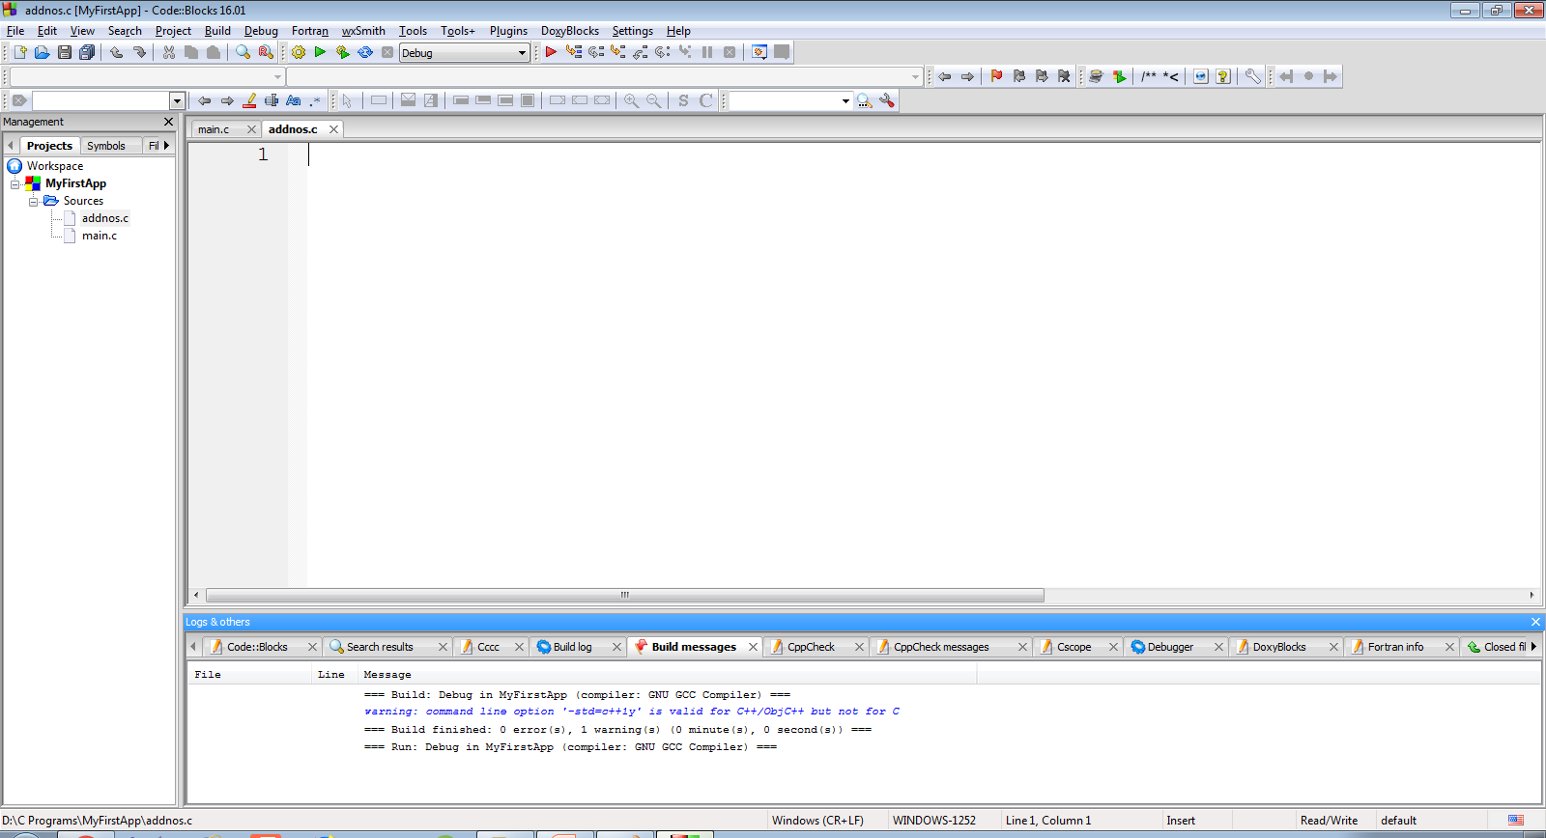
Adding A New File
Doing this will add a blank file called addnos.c
to the project MyFirstApp

Slide 7
Writing The Code
Let’s add the code to find sum of 2 integers
inputted by the user:
#include <stdio.h>
int main()
{
int a,b,c;
printf("Enter 2 int:");
scanf("%d %d",&a,&b);
c=a+b;
printf("Nos are %d and %d",a,b);
printf("\nTheir sum is %d",c);
return 0;
}

Slide 8
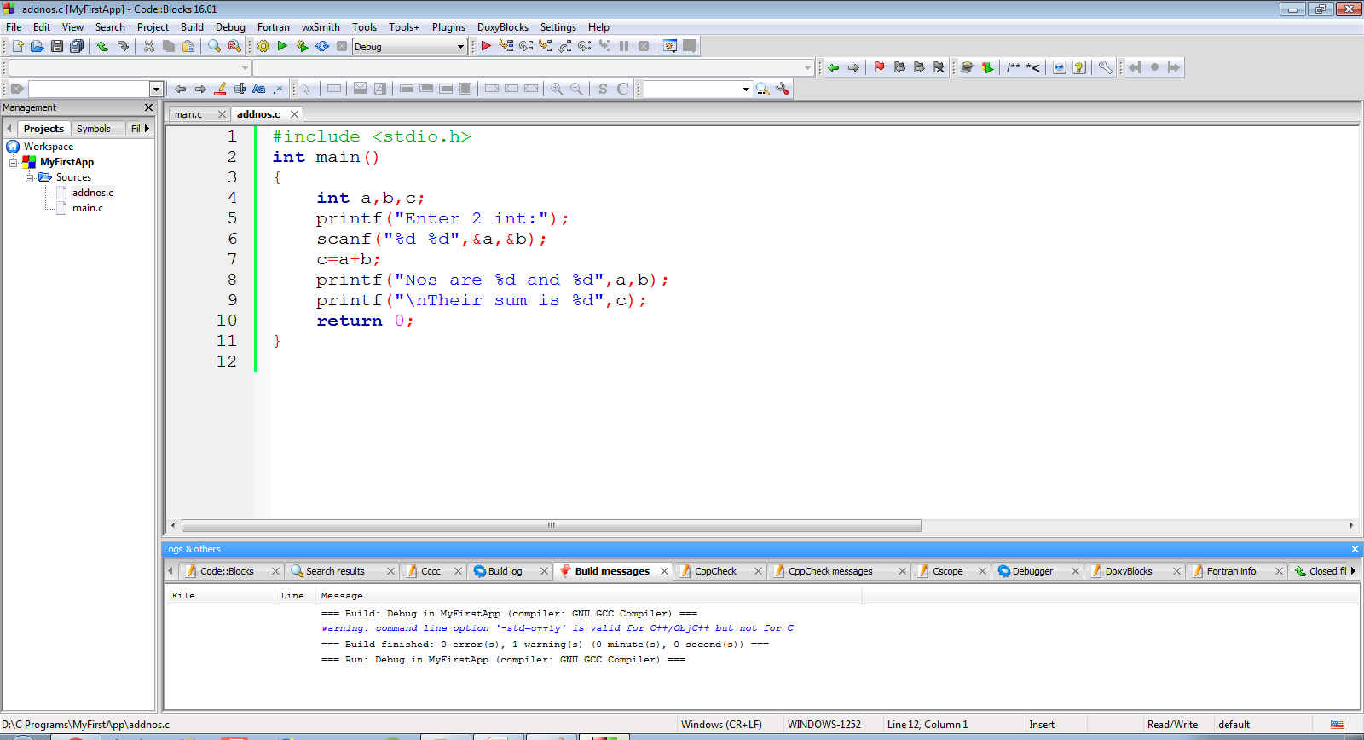
Writing The Code
The screenshot of the code is as below

Slide 9
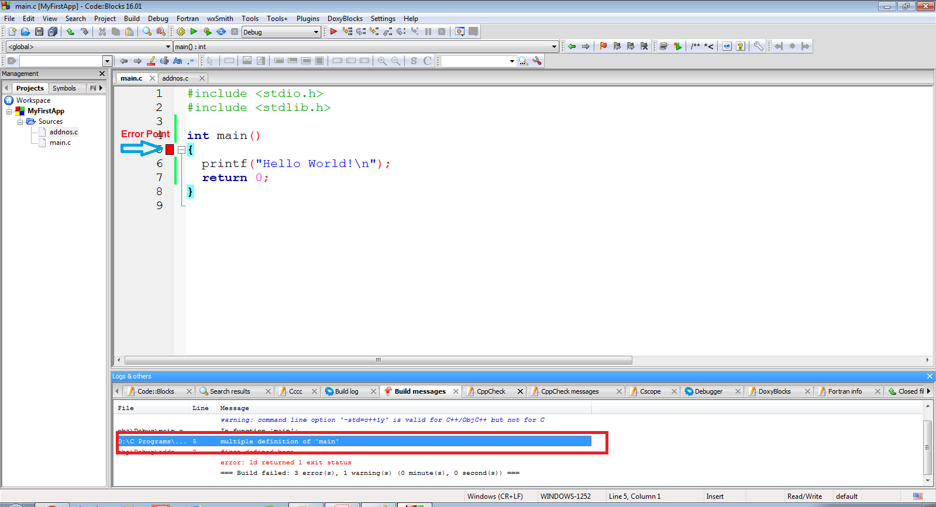
Multiple main( ) Error !
Now , when we will compile the code , we will
get the error “multiple definition of `main’ ”

Slide 10
Reason And Solution !
This is because our project contains 2 files
(main.c and addnos.c) and both have the
main( ) function
To solve this problem , we can remove main.c
from the project .
The removed files are not deleted and remain
in the folder

Slide 11
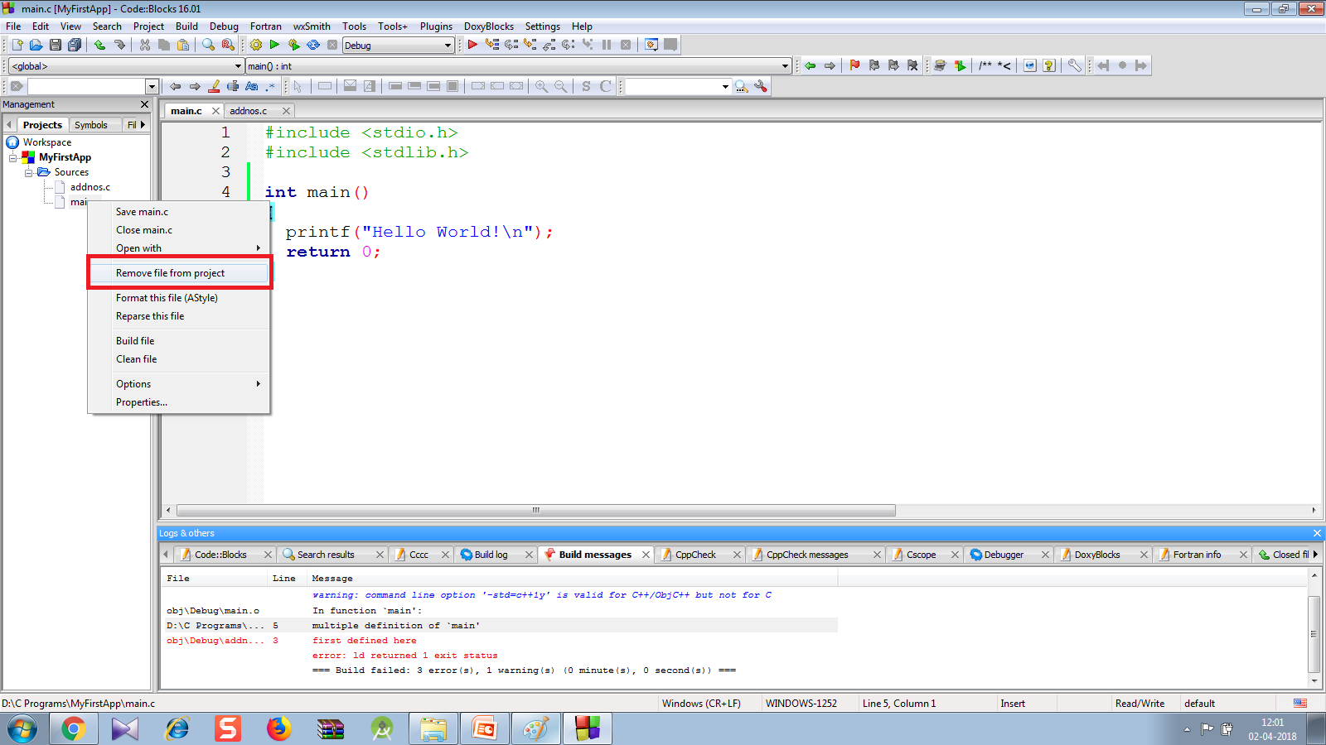
Solution
To remove main.c , right-click on “main.c" ⇒ "remove file from project".

Slide 12
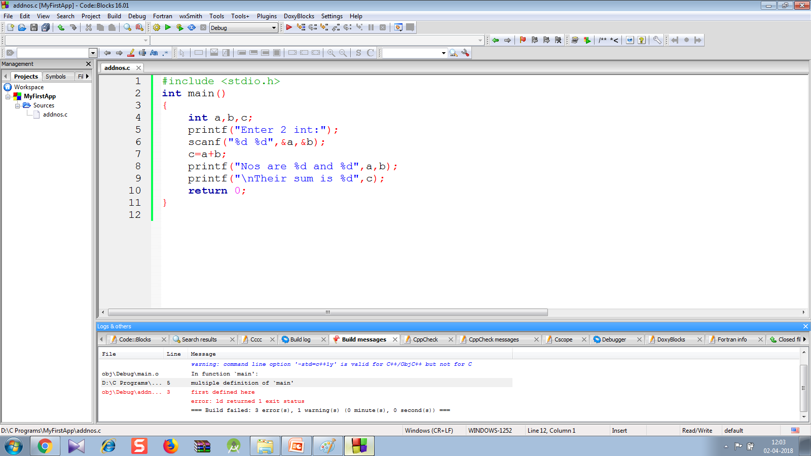
Error Removed !
Now we will only have 1 file with main( ) function i.e. addnos.c so the code will compile and run

Slide 13
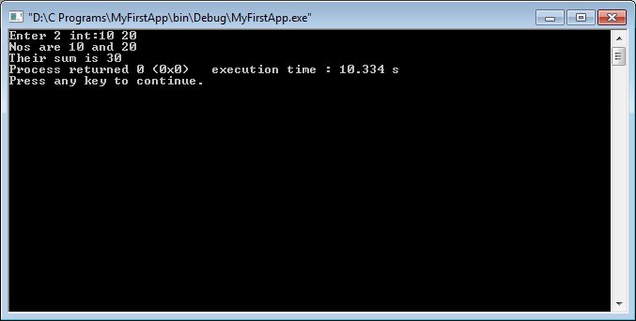
Output
Following is the output shown by the code

Slide 14
Creating Programmer Defined Header File
CodeBlocks , makes it very simple to create our own header files containing declaration of our own functions.
It is a 3 step process:
First we create our own header file containing function prototypes
Then we define these functions in a separate .c file
Finally we call these functions from our main( ) function

Slide 15
Creating Programmer Defined Header File
To do this follow the below mentioned steps:
Create a new project called MySecondApp
Follow the previous steps which will add a file called main.c in our project containing the main( ) function

Slide 16
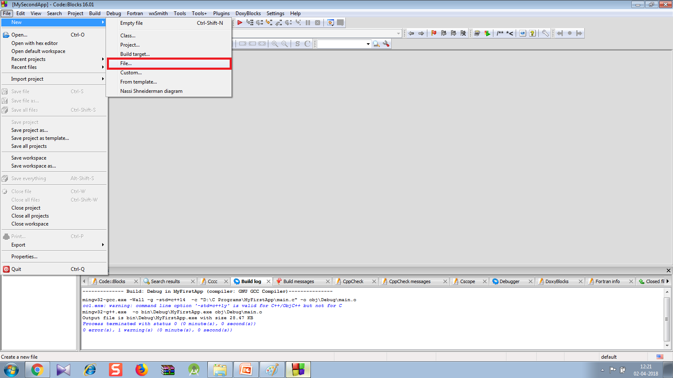
Creating Programmer Defined Header File
Now select File menu →New→File

Slide 17
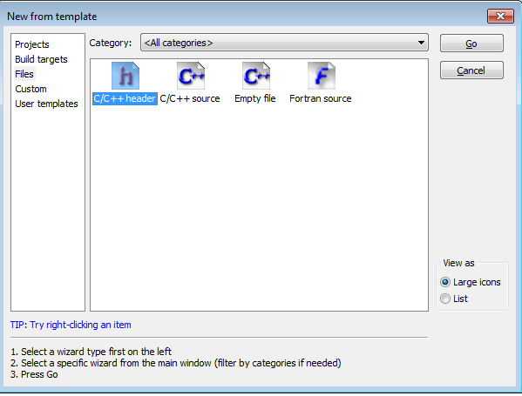
Creating Programmer Defined Header File
From the window that appears , select C/C++ Header and select Go

Slide 18
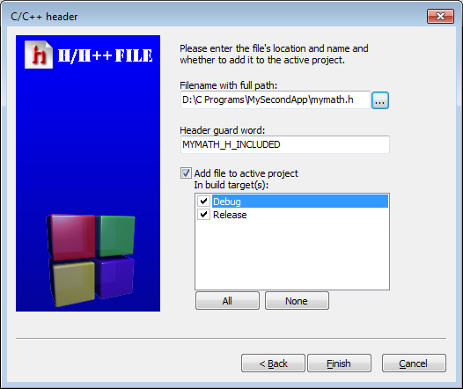
Creating Programmer Defined Header File
In the next window type the header file name as mymath.h after selecting the location and click on Finish
Also select debug and release options

Slide 19
Creating Programmer Defined Header File
After this we will get the header file by the name mymath.h with a default header guard code
We will also get a new element called Headers added to our project containing the header file mymath.h
The screenshot is on next page

Slide 20
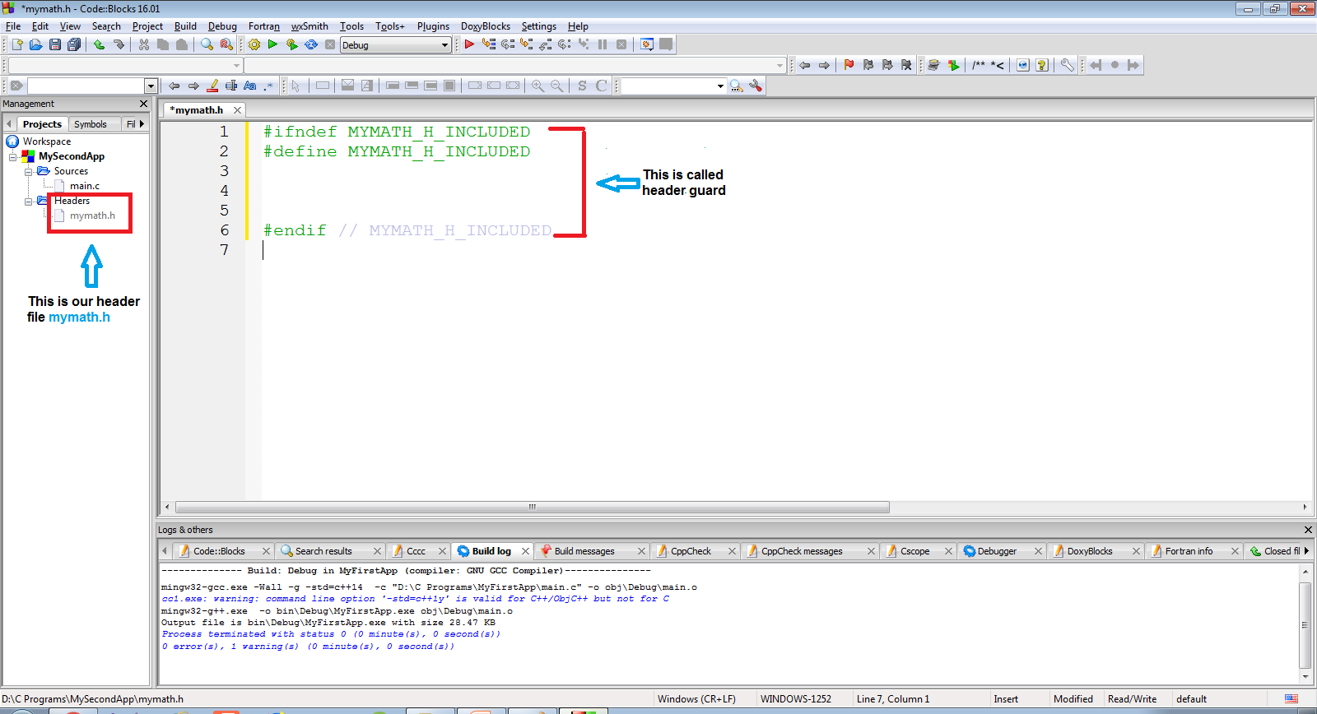
Creating Programmer Defined Header File

Slide 21
Creating Programmer Defined Header File
Now we will have to declare the prototype of the functions we want to keep in this header file.
Let’s create a function called add( ) in this header file
#ifndef MYMATH_H_INCLUDED
#define MYMATH_H_INCLUDED
void add(int,int);
#endif

Slide 22
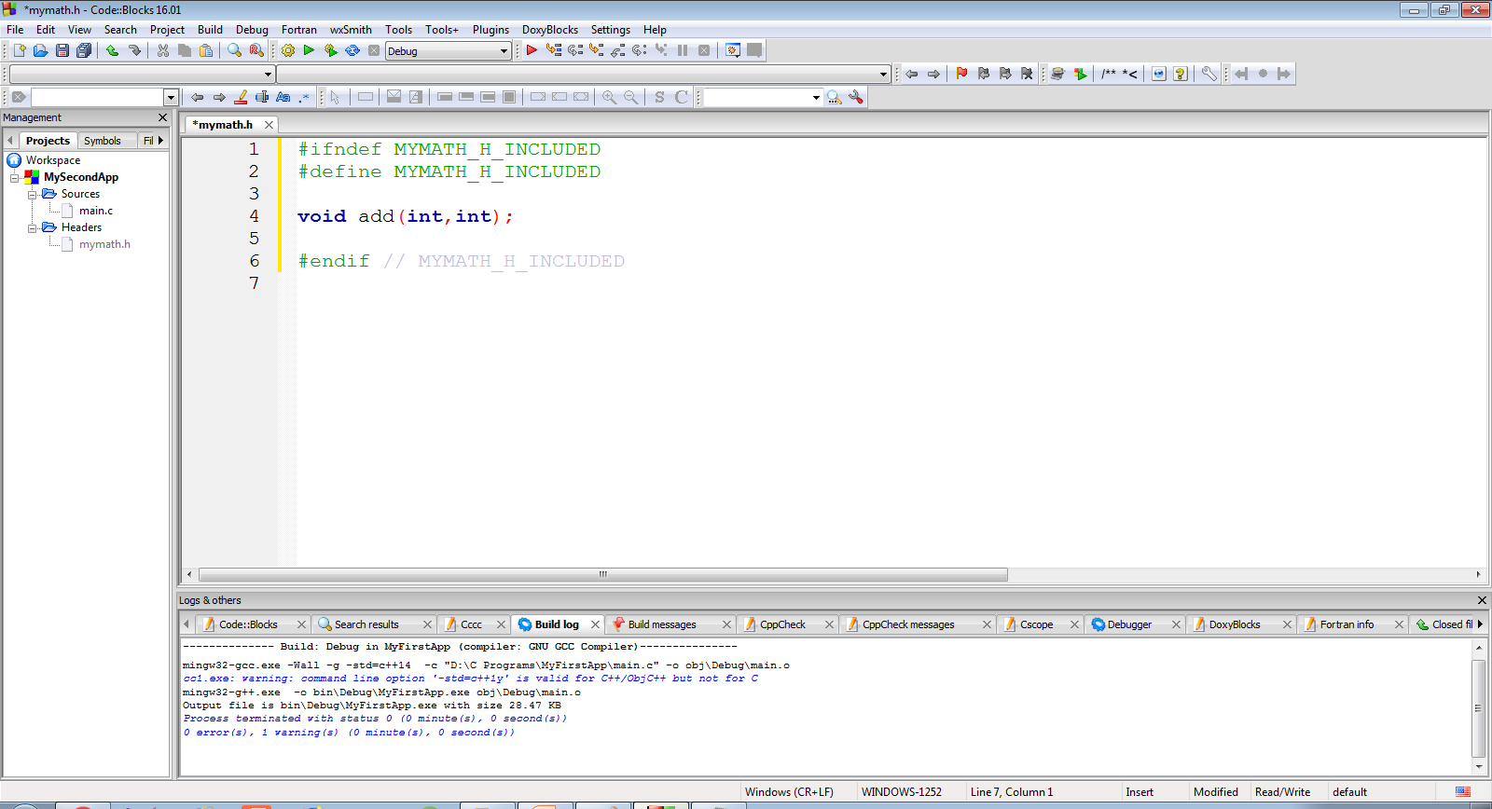
Creating Programmer Defined Header File

Slide 23
Creating Programmer Defined Header File
Now after declaring the function prototype , our next job is to define the function in a separate .c file
For this , as before select File menu →New→File

Slide 24
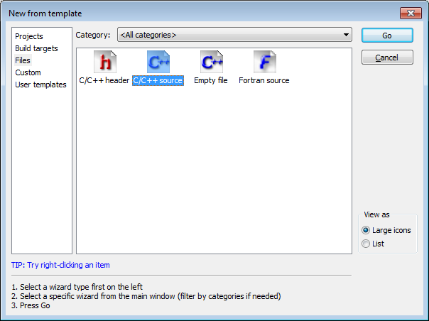
Creating Programmer Defined Header File
From the window that appears , select C/C++ Source and select Go

Slide 25
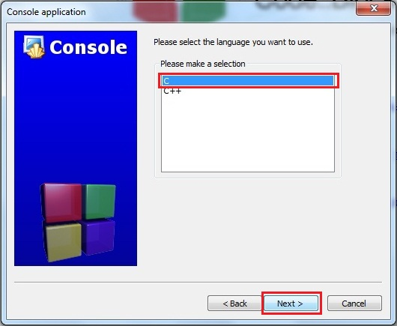
Creating Programmer Defined Header File
Select C and click on Next

Slide 26
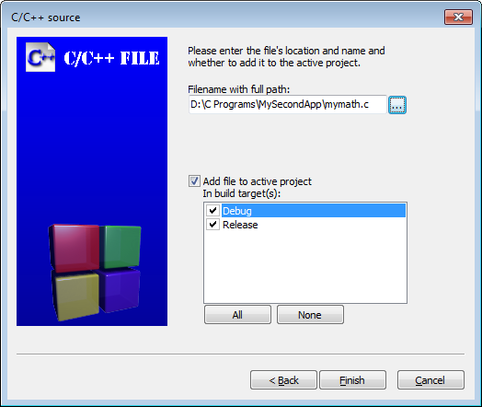
Creating Programmer Defined Header File
In the next window , as before provide the name and location of the file and hit Finish
For example ,in this app we have named it mymath.c

Slide 27
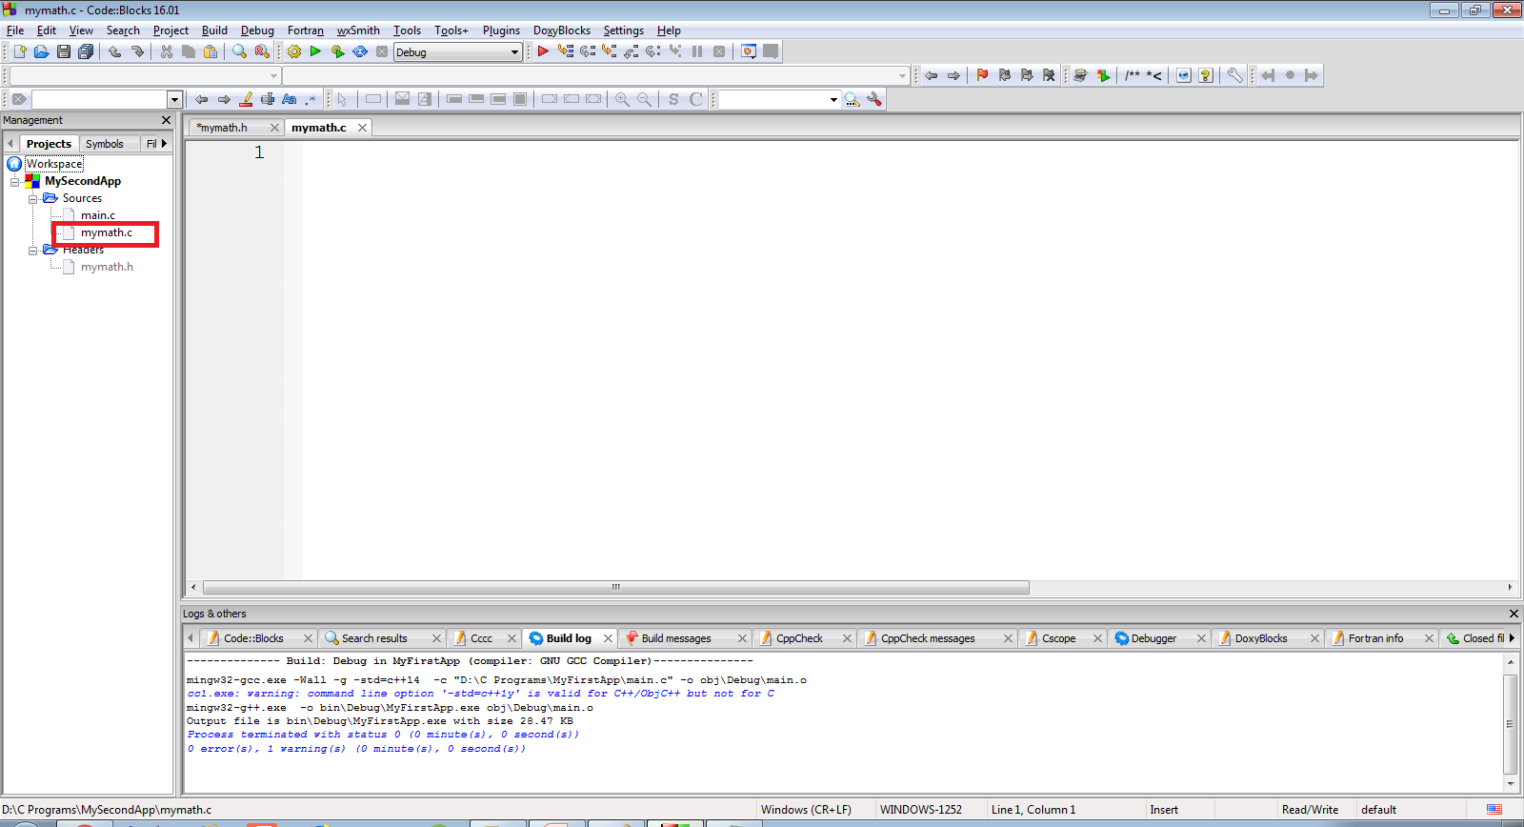
Creating Programmer Defined Header File
Doing this will add a blank file called mymath.c to the project MySecondApp

Slide 28
Code Of mymath.c
Let’s add the definition of the function add( ) in the file mymath.c
#include <stdio.h>
void add(int a,int b)
{
int c;
c=a+b;
printf("Nos are %d and %d",a,b);
printf("Their sum is %d",c);
}
We have to attach the header file <stdio.h> because we are calling the function printf( ) here in this code

Slide 29
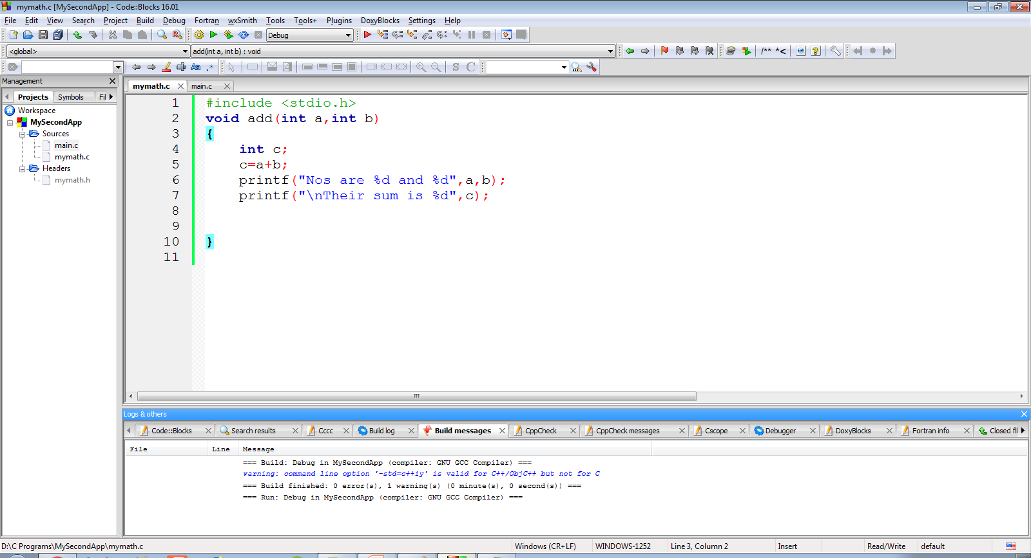
Creating Programmer Defined Header File

Slide 30
Creating Programmer Defined Header File
Finally we will have to update the file main.c by doing the following changes in it:
Include the header file “mymath.h” along with <stdio.h>
In function main( ) accept input from the user and call the function add( ) appropriately

Slide 31
Code Of main.c
#include <stdio.h>
#include "mymath.h"
int main()
{
int a,b;
printf("Enter 2 int");
scanf("%d %d",&a,&b);
add(a,b);
return 0;
}

Slide 32
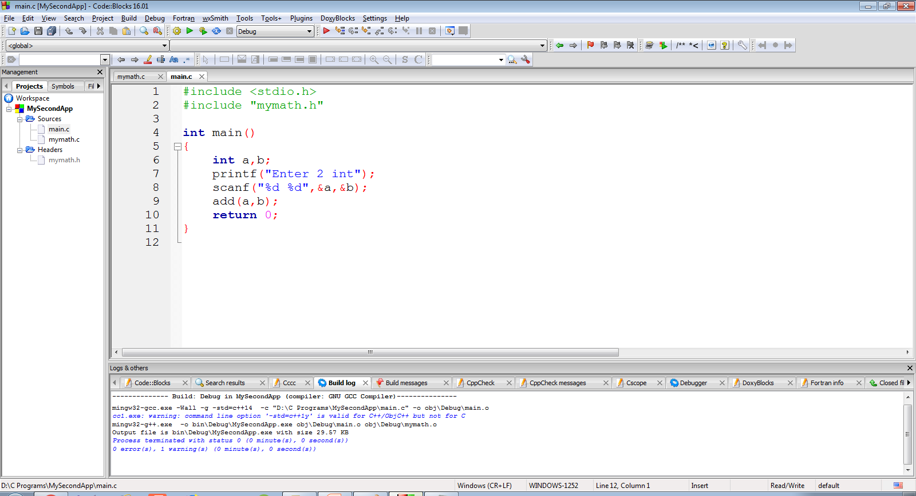
Code Of main.c
The screenshot of the code is as below

Slide 33

Output
Following is the output shown by the code

Slide 34
Adding conio.h To CodeBlocks
CodeBlocks/gcc don’t natively support conio.h.
However , there is an implementation of conio.h for gcc as a third party library.
This implementation can be downloaded from
https://sourceforge.net/projects/conio/
This link will give us a file called conio21.zip

Slide 35
Adding conio.h To CodeBlocks
After extracting conio21.zip , we will get 2 files called
conio2.h and conio.c
Copy and paste conio2.h and conio.c in our Project Folder
Now open the project in CodeBlocks by selecting File→Open and selecting the Project File from the Workspace Folder

Slide 36
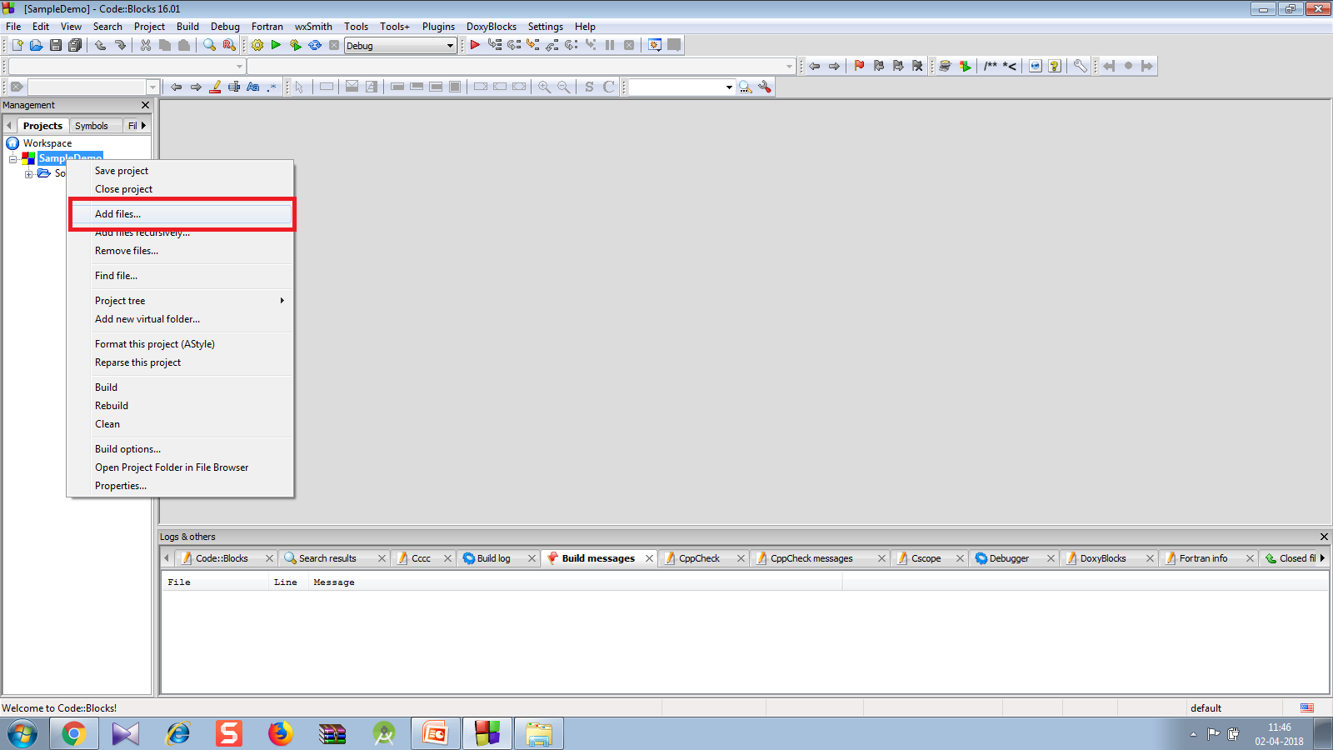
Adding conio.h To CodeBlocks
Now right click the Project in Workspace in the left pane and select Add Files

Slide 37
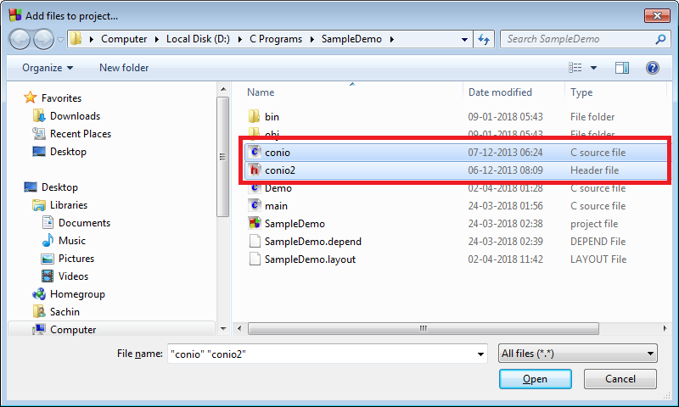
Adding conio.h To CodeBlocks
In the window that opens , select the files conio2.h and conio.c

Slide 38
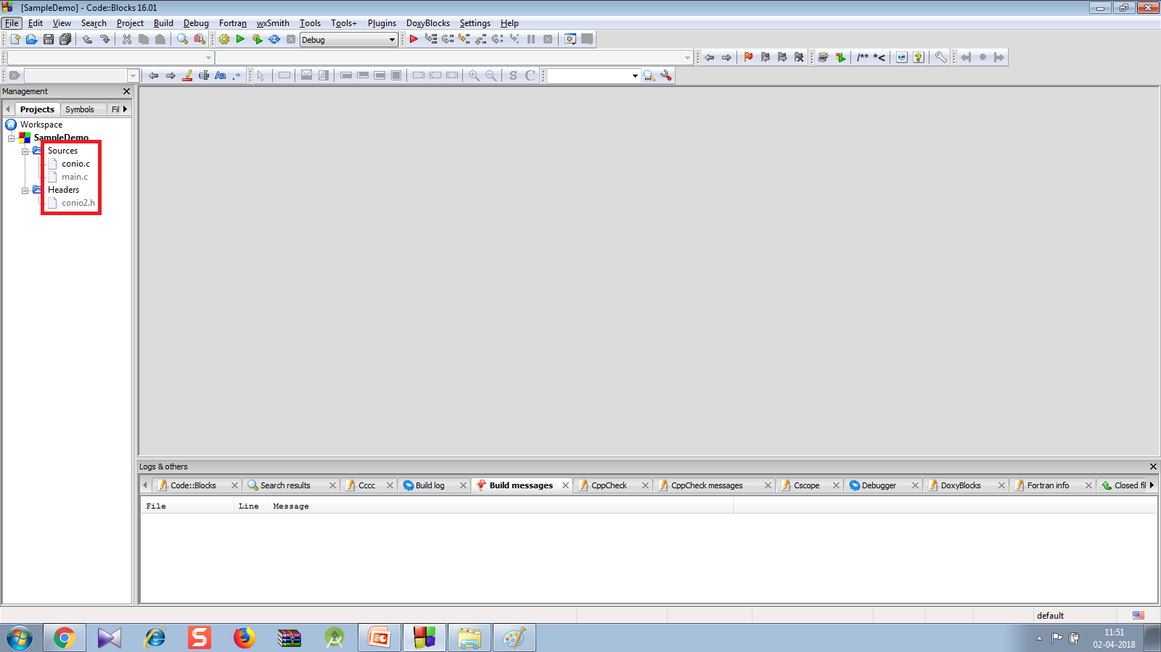
Adding conio.h To CodeBlocks
Doing this will automatically place conio2.h in Headers and conio.c in Sources

Slide 39
Adding conio.h To CodeBlocks
Now open the source file “main.c” and add the statement #include “conio2.h”.
Now we can use all the functions which are present in conio.h in Turbo C++ like clrscr( ), textcolor( ), gotoxy( ) etc
#include <stdio.h>
#include "conio2.h"
int main(){
gotoxy(40,12);
printf("Hello");
textcolor(GREEN);
gotoxy(40,13);
printf("Bye");
getch();
return 0;
}

Slide 40
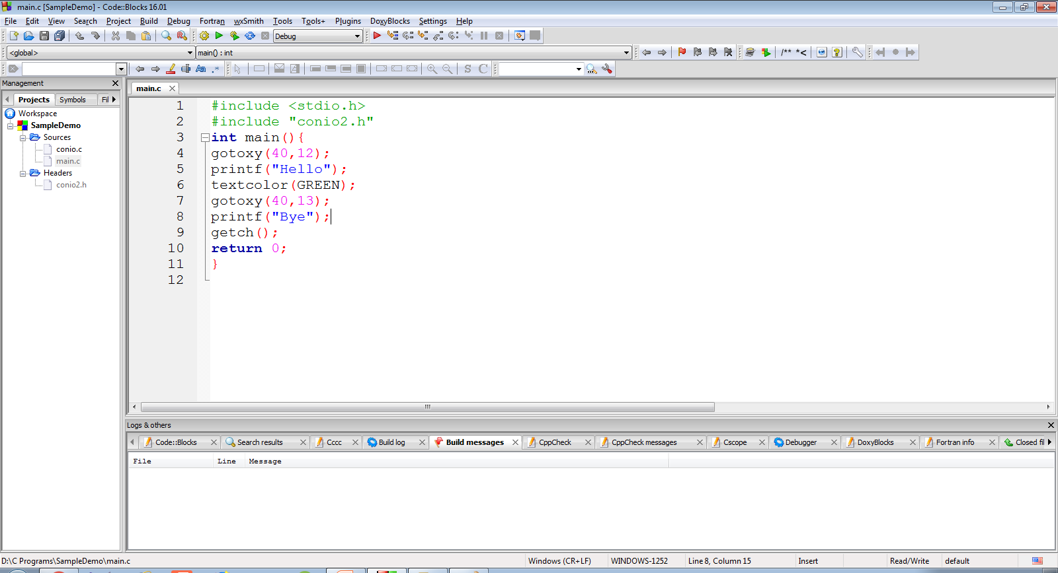
Adding conio.h To CodeBlocks

Slide 41
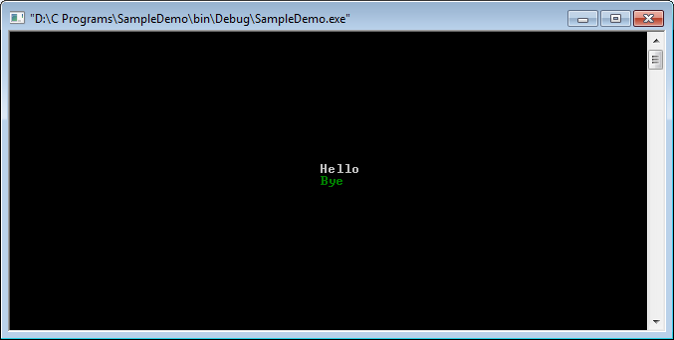
The Output

