Slide 1
Resume Shortlister
By :
Karanpal Singh (2017UCO1643)
Shubham (2017UCO1649)
Rishabh Gupta (2017UCO1682)

Slide 2
Introduction
Resume Shortlister is an AI application used for fastly and automatically shortlisting resumes saving a lot of time and manpower. The application, used for screening and shortlisting Resumes and candidatures of individuals is built around (NLP)Natural Language Processing along with heuristic calculations to evaluate the final score of each candidate. The candidates with the highest scores can then be called for further interview rounds.

Slide 3
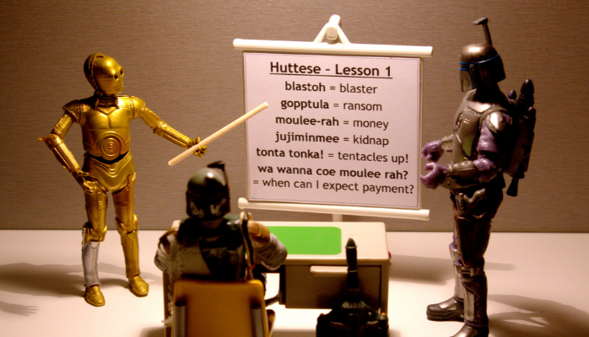
So what exactly is NLP ?
Natural language processing (NLP) is
a field of computer science, artificial
intelligence,and computational linguistics
concerned with the interactions between computers and human (natural) languages.

Slide 4
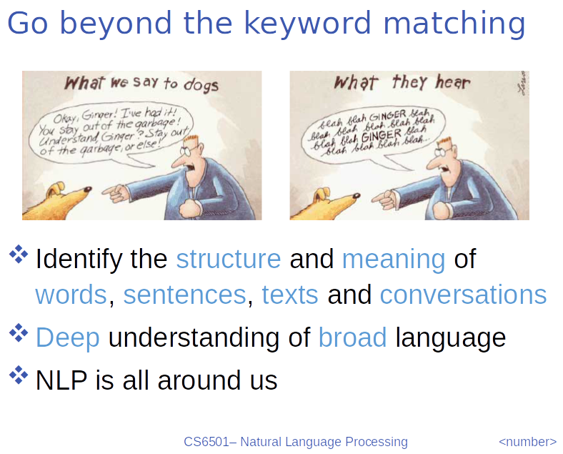

Slide 5
Key Component of NLP Pipeline
• Morphological analyzer - Word Segmentation
• Parser (syntactic analysis) - Structure,Grammar
• Semantic analysis (transform into a logical form, semantic network, etc.)
• Discourse analysis - Meaning of a text, Relationship between Sentences
• Pragmatic analysis

Slide 6
Morphological Analysis
• Study of word formation - how words are built up from smaller pieces.
Identification, analysis and description of the structure of a given language’s MORPHEMES and other linguistic units, such as root words, affixes, parts of speech.
Eg : washing = wash + ing

Slide 7
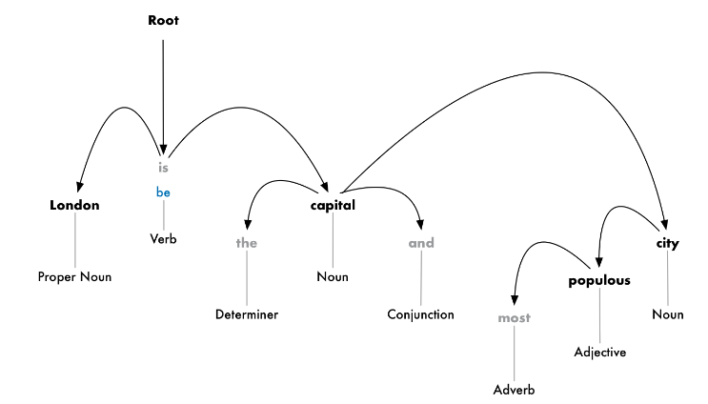
Parsing (Syntactic Analysis)
In this step, a tree is built that assigns a single parent word to each word in a sentence. The root of the tree will be the main verb in the sentence. For example for the sentence, London is the capital and most populous city.. Our tree looks like this

Slide 8
Semantic Analysis
In this step, true meaning of the sentence is understood using
Named Entity Resolution: Detection and labelling of nouns with the real world concepts that they represent. Eg. London-Geographical Entity.
Coreference Resolution: In this step, pronouns are assigned various nouns to which they represent.
For example: It was founded by Romans, who named it’ londinium’. Here ‘it’ represents London and ‘who’ represent Romans.

Slide 9
Discourse Analysis
• Anaphora
He hits the car with a stone. It bounces back.
• Understanding a text
– Who/when/where/what … are involved in an event?
– How to connect the semantic representations of different sentences?
– What is the cause of an event and what is the consequence of an action?
– …

Slide 10
Pragmatic Analysis
Pragmatic Analysis is part of the process of extracting information from text. Specifically, it’s the portion that focuses on taking a structures set of text and figuring out what the actual meaning was. It actually comes from the field of linguistics (as a lot of NLP does), where the context is considered from the text.
Why is this important? Because a lot of text’s meaning does have to do with the context in which it was said/written. Ambiguity, and limiting ambiguity, are at the core of natural language processing, so needless to say, pragmatic analysis is actually quite crucial with respect to extracting meaning or information.

Slide 11
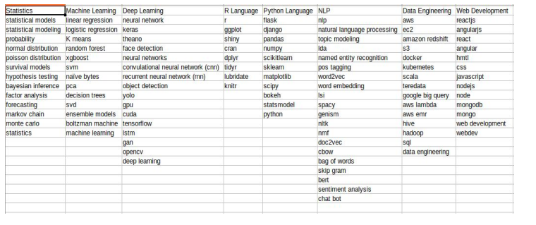
Skill Categories / Keyword Dictionary

Slide 12
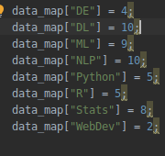
Heuristics :
● Scoring Based Heuristics
● Different points corresponding to the different categories of skills (in accordance with Hiring Category)
● Top 10% of Resumes with Highest scores are shortlisted for further process.

Slide 13
Heuristic Calculation :
Consider a person’s no. of skills in various categories as A₁, A₂, …, A_{n} , where A_{i} represent number of skills a person have in i^{th} category.
Let X₁, X_{2,} …, X_{N} as multiplier or points for corresponding categories.
Score is calculated as :
Score = ∑ A_{i} * X_{i} ∀ 0 ≤ i ≤ N
The Resumes are then sorted in Descending order and the top 10% of the Resumes are selected for further Interview/Test process.

Slide 14
Benefits:
1. Automatically reading the Resume - If we were to manually open each and every resume, it would take a lot of time. The code saves us from this scenario by automatically opening each and every resume and parsing the content.
# Function to read resumes from the folder one by one
mypath = '/home/karanpal/NLP_Resume/candidateResume' onlyfiles = [os.path.join(mypath, f) for f in os.listdir(mypath) if os.path.isfile(os.path.join(mypath, f))]
def pdfextract(file):
fileReader = PyPDF2.PdfFileReader(open(file, 'rb')) countpage = fileReader.getNumPages() count = 0 text = [] while count < countpage:
pageObj = fileReader.getPage(count) count += 1 t = pageObj.extractText() print(t) text.append(t) return text

Slide 15
2. Phrase Matching - Instead of manually searching for whether a candidate has
the desired skills or not, the code hunts for the keywords, keeps a count of their occurrence and categorizes them.
matcher = PhraseMatcher(nlp.vocab) matcher.add('Stats', None, *stats_words)
3. Data Visualization - It is the most important aspect as it helps us to speed up
the process . The graph plotted by the algorithm helps us to decide which candidate has more keywords under each category, thus implying that they may be good in that domain and thus helps to make the selection procedure much faster.

Slide 16
plt.rcParams.update({'font.size': 10}) ax = new_data.plot.barh(title="Resume keywords by category", legend=False, figsize=(25, 7), stacked=True) labels = [] for j in new_data.columns:
for i in new_data.index:
label = str(j) + ": " + str(new_data.loc[i][j]) labels.append(label) patches = ax.patches for label, rect in zip(labels, patches):
width = rect.get_width() if width > 0:
x = rect.get_x() y = rect.get_y() height = rect.get_height() ax.text(x + width / 2., y + height / 2., label, ha='center', va='center') plt.show()

Slide 17
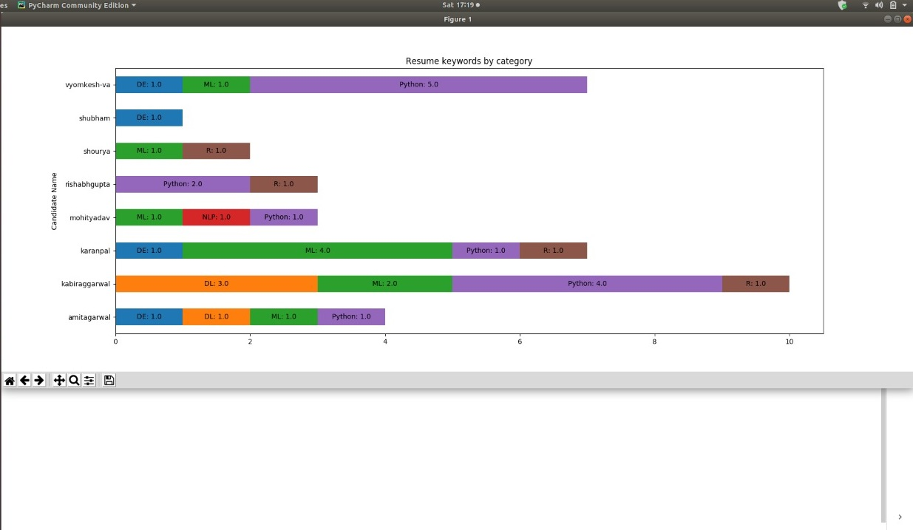
Project Results :

Slide 18
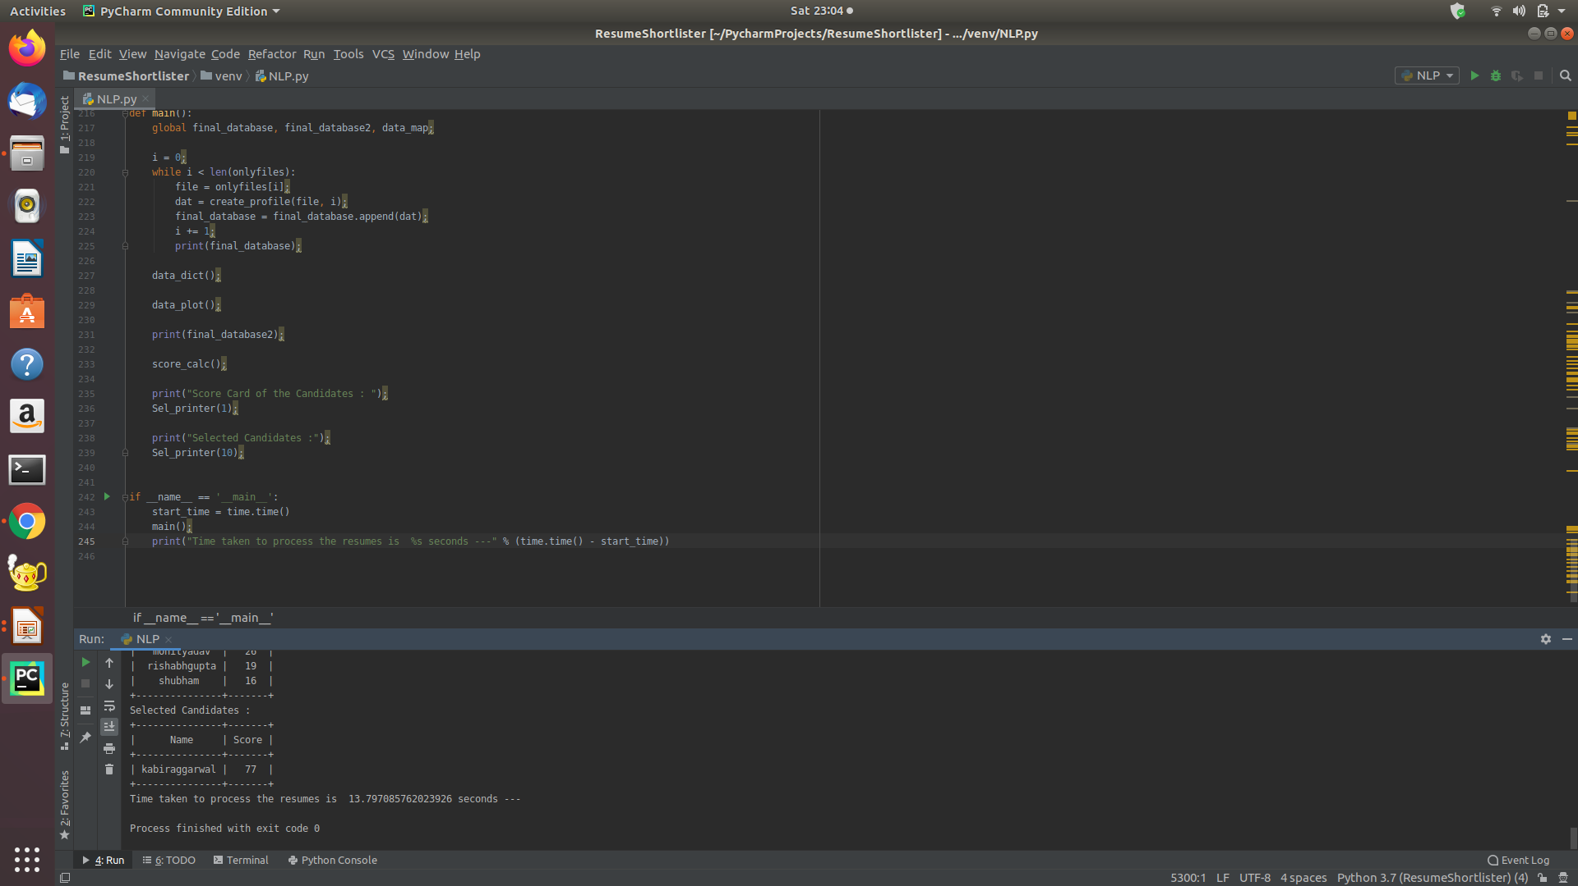
Performance
As we can see, the program took roughly 13.7 seconds to screen a total of 10 resumes and filtered out the desired candidates eligible for the job. So for a total of 100 resumes, the program wouldn’t take more than 138 seconds which is a significant improvement over manual processing of the resumes. Thus, we can see that automated parsing helped to increase the recruitment productivity and eliminated human biases.

Slide 19
Future Improvements :
The Application can screen in a candidate as a false positive based on keyword stuffing or screen out a candidate as a false negative because he or she doesn’t meet the keyword filters but has strong qualifications otherwise.
The software isn’t designed to measure quality of hire. Currently,the system doesn’t support a way to learn which candidates went on to become successful and unsuccessful employees, so, there is no way we can improve its heuristic function.

