Slide 1
R2C Automation

Slide 2
Use Case :Automated Pipeline for Aha Feature Board Integration with Jira
To create an automated pipeline that seamlessly connects the Aha Feature Board with the Jira Board, ensuring efficient translation of business requirements into actionable development tasks.

Slide 3
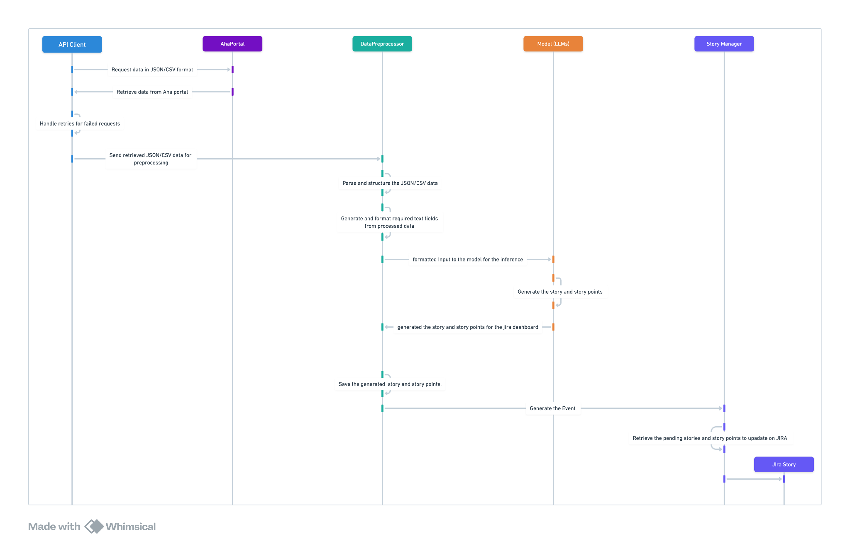
Sequence diagram

Slide 4
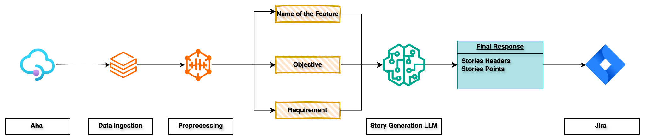
Flow diagram

Slide 5
Data Preprocessing steps
Load Data: Imported the dataset (Initial rows: 6023).
Filter Epic Names: Removed rows with empty Epic Names (Remaining rows: 2123).
Combine Feature and Requirement Names:
Created Combined Name by merging Feature Name and Requirement Name.
Filtered rows where Combined Name is empty or NaN.
Combine Feature and Requirement Descriptions:
Created Combined Description by merging Feature Description and Requirement Description.
Filtered rows where Combined Description is empty or NaN.
Sample Data: Selected 20 records per workspace name for a balanced dataset (Rows left: 195).
Create Final DataFrame: data frame has 195 records with no missing data from each workspace name, and the columns names are as follows: workspace name, objective (feature + requirement name), the final requirement( feature +requirement description), Epic Name

Slide 6
Progress Overview
Model Utilized: Gemini-1.5-Flash-001
Key Features Implemented:
Implementation of zero-shot and few-shot prompting techniques for optimized output generation.
Structured JSON output format implemented within the model.
Integration of guard settings within the model for output validation.
Development of a user-friendly Gradio Graphical User Interface (GUI) to facilitate interaction.
Story Generation Capabilities:
Generation of story titles.
Acceptance criteria.
Context
story summary
Estimation of story points for each user story.
Subtask Generation Capabilities:
Generation of subtask titles.
Creation of detailed subtask descriptions.
JSON Output Functionality:
Capability to process multiple requirements simultaneously via CSV file input.
Generation of JSON file responses, wherein each input requirement corresponds to a distinct JSON object suitable for direct API integration.

Slide 7
Future Enhancements
Enhanced subtask generation for granular task planning.(Done)
Fine-tuning for domain-specific use.

