Slide 1
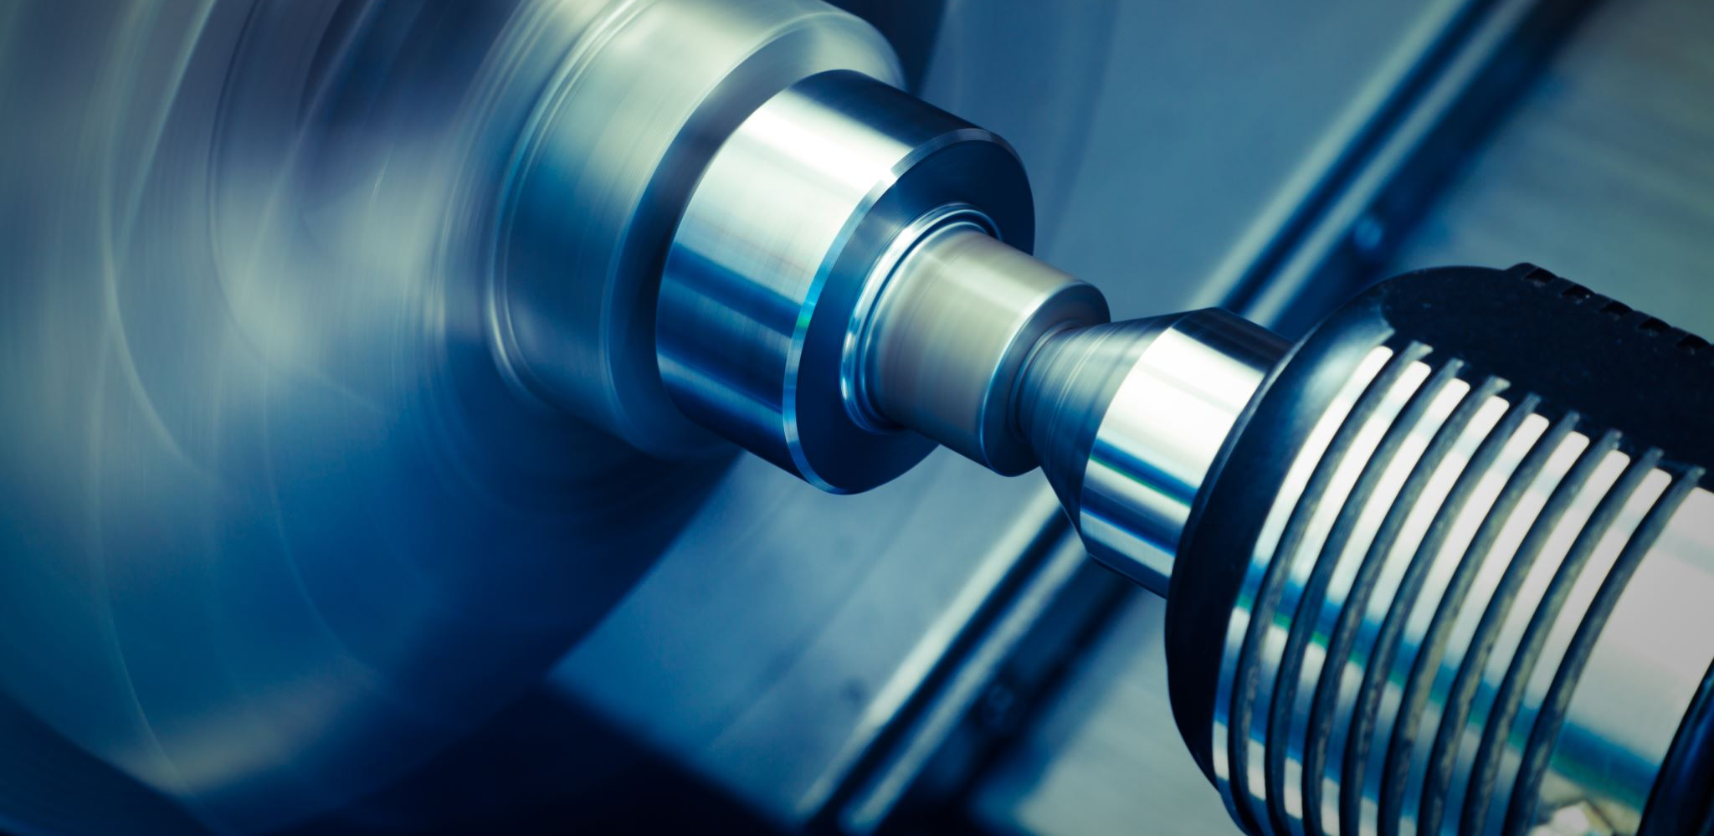
Predicting Steel Quality using Machine Learning
Subject: Applied Machine Learning & Deep Learning (190.015)
Semester: Winter Semester 2025/26
Student: Rishabh Kothari
Institution: Montanuniversität Leoben

Slide 2
Motivation and Problem Statement
Steel quality is critical for safety, durability, and cost.
Production depends on many interacting process parameters such as temperature, pressure, material composition, cooling rate.
Traditional rule-based models struggle with complexity
With Industry 4.0, large volumes of sensor data are available.
Goal of this project: Use machine learning to predict a continuous steel quality factor.

Slide 3
Dataset Overview
Steel production sensor dataset:
  7,642 training samples and 3,337 test samples
  21 normalized input features, 1 continuous output
  No missing values or duplicates
  Task type: Supervised regression.

Slide 4
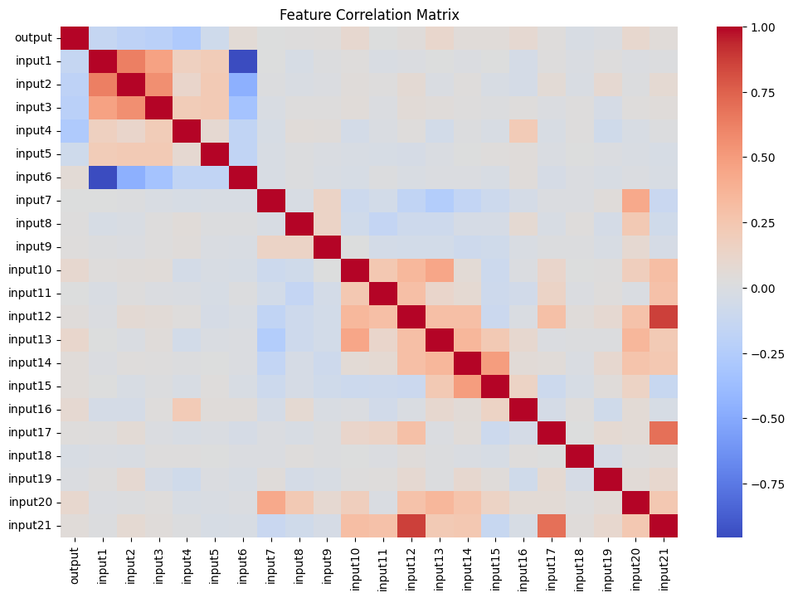
Exploratory Data Analysis
Feature distributions are mostly unimodal
  No extreme outliers observed
  Output variable is continuous
  Dataset is well-suited for regression
  Correlation heatmap shows moderate correlation between features, no single dominant feature.
  Steel quality depends on combination of multiple parameters.

Slide 5
Methodology
Problem formulated as supervised regression
Models used
i) Random Forest Regressor
ii) Support Vector Regression
iii) Multi-Layer Perceptron
iv) Gaussian Process Regressor
All models trained on normalized training data.
Evaluation done on independent test dataset.

Slide 6
Evaluation Metrics
1. Models evaluated using:
i) Mean Absolute Error
ii) Root Mean Squared Error
iii) R squared score
iv) Training Time
v) Inference time
2. These metrics measure:
i) prediction accuracy
ii) error magnitude
iii) model goodness of fit

Slide 7
Experimental Results
Best performing model-
Random Forest Regressor
R square score – 0.4167
Second best performance – Gaussian process Regressor
Visuals used - model comparison bar plot
- actual vs predicted scatter plot

Slide 8
Discussion and Limitations
Key observations:
1. Random Forest Regressor achieved the best R² score of 0.4167, explaining ~41.67% of variance in steel production output.
2. RMSE of 0.059094 and MAE of 0.045271 indicate reasonable prediction accuracy.
3. Gaussian Process Regressor improved from negative R² (-0.222) to positive (0.219) after hyperparameter tuning.
Limitations
1. Limited to 21 engineered features; additional domain-specific features could improve R².
2. Moderate R² score indicates room for improvement through ensemble methods or deep learning.
3. Temporal dependencies not captured (time-series analysis could enhance predictions).
4. Cross-validation not extensively performed; k-fold CV recommended for robustness.

Slide 9
Conclusion & Future Work
Conclusion:
1. Successfully cleaned 7,642 training and 3,337 test samples with zero missing values and duplicates post-processing.
2. 21 features standardized using StandardScaler for fair model comparison.
3. Balanced train-validation-test split (67%-10%-23%) ensures reliable performance evaluation.
Future work:
1. Time-series forecasting (ARIMA, Prophet) for temporal patterns.
2. Deep learning models (LSTM, Transformer) for sequence data.
3. Hyperparameter optimization using Bayesian search or AutoML.
4. Explainability analysis (SHAP values) for model interpretability.
5. Anomaly detection for unusual production conditions.

Slide 10


Thank You

