Slide 1
DATA ANALYTICS PRESENTATION
UFO SIGHTINGS
A Data Analytics Deep Dive
Exploratory analysis of 80,332 witness-reported sightings from the National UFO Reporting Center (NUFORC), spanning 1949–2014
Prepared from ufo_sightings_scrubbed.csv

Slide 2
THE DATASET
A raw incoming-tip log, not a vetted sightings list
80,332
1949–2014
11
6
Total sighting records
Date range covered (65 yrs)
Fields per record
Countries represented
Geographic composition
Reading note
United States
65,114
81.1%
The US accounts for ~81% of all records, so this deck focuses there for the state-level analysis — but remember: this is a global, self-reported log with no verification step behind any entry.
Unlisted / blank
9,670
12.0%
Canada
3,000
3.7%
United Kingdom
1,905
2.4%
Australia
538
0.7%
Germany
105
0.1%
UFO Sightings Analysis | NUFORC Dataset, 1949–2014
2

Slide 3
OUR OBJECTIVE
Six questions, six evidence-backed answers
1
Identify which UFO shapes are reported most often
2
Examine how annual sightings have trended since 2000
3
Determine which US states report the most sightings — and why
4
Clean the duration field and analyze its distribution as a histogram
5
Mine witness comments for additional, non-obvious insights
6
Package everything into a clear, presentable analytics narrative
UFO Sightings Analysis | NUFORC Dataset, 1949–2014
3

Slide 4
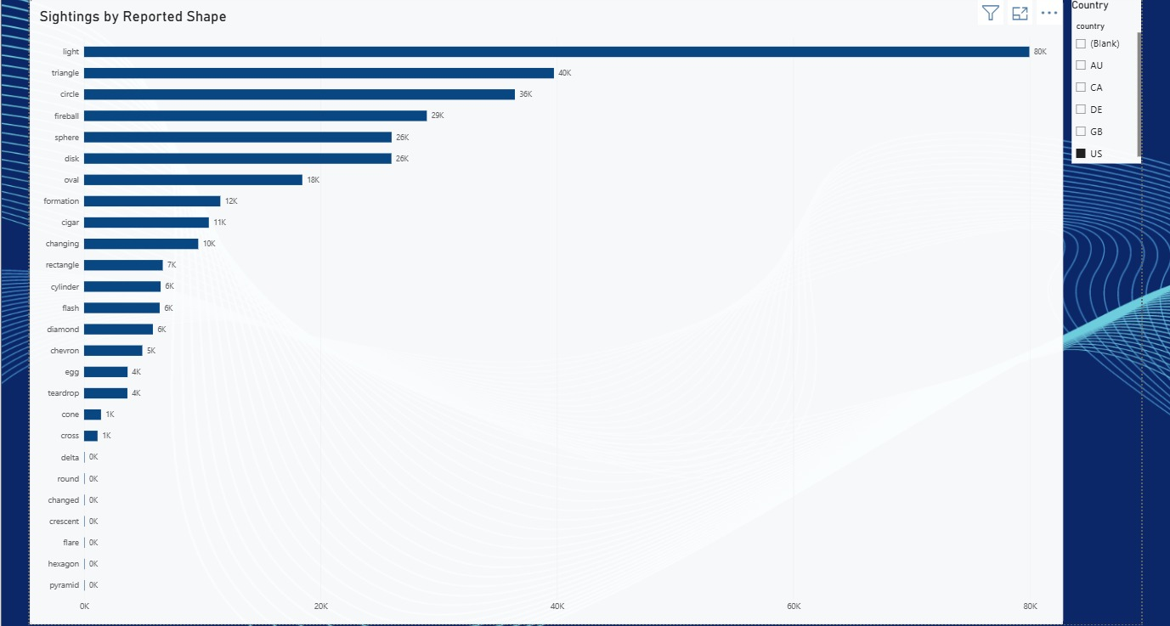
QUESTION 1
“Light” dominates reported UFO shapes
Why this makes sense
Light leads with 16,565 reports (~21% of all sightings) — nearly double the runner-up
Triangle (7,865) and Circle (7,608) follow, each under half of Light's total
“Light” needs the least detail to report — any unresolved point of brightness qualifies, making it a catch-all for ambiguous sightings
Distinctive shapes (disk, cigar, triangle) require a longer or closer look to identify confidently — naturally rarer
Source: Power BI dashboard — Sightings by Reported Shape
UFO Sightings Analysis | NUFORC Dataset, 1949–2014
4

Slide 5
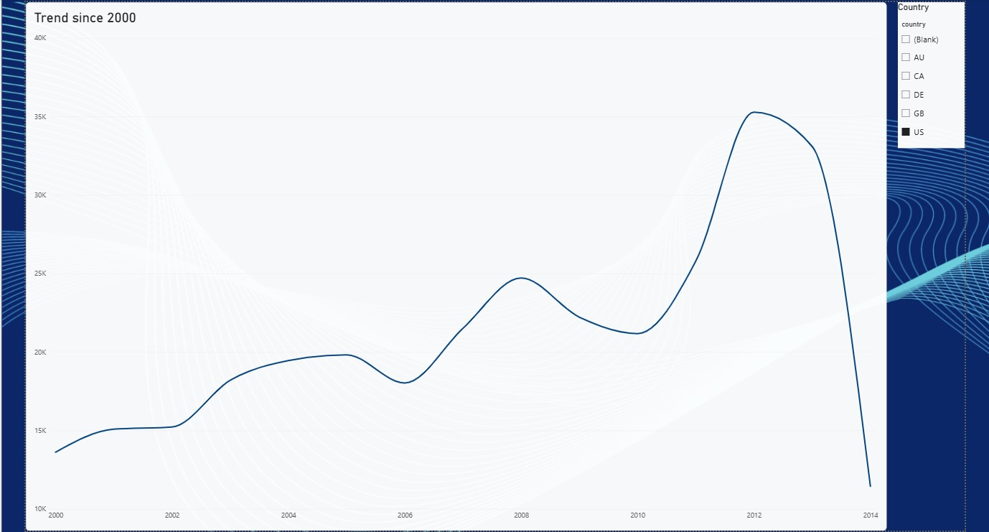
QUESTION 2
Reported sightings rose 2.7x from 2000 to 2012
Why this makes sense
US reports climb from 2,772 (2000) to a peak of 7,356 (2012) — 2.7x growth, then decline
Growth isn't linear — it accelerates sharply after 2008, and 2014 drops off because the export only covers part of that year
This almost certainly reflects a rising reporting rate, not a rising sighting rate
Smartphone cameras crossed ~50% US penetration around 2012, and NUFORC's online form removed the friction of mailing in a report
Read this as a reporting-behavior trend, not evidence of more UFO activity
Source: Power BI dashboard — Trend since 2000 (US)
UFO Sightings Analysis | NUFORC Dataset, 1949–2014
5

Slide 6
QUESTION 3
California leads, but Washington is the real outlier
Raw sighting counts by state (top 10)
Sightings per 100k residents (2010 pop.)
CA (8,912), TX (3,447), NY (2,980) and FL (3,835) are also 4 of the 5 most populous US states — raw counts largely track population.
Washington breaks the pattern: only the 13th most populous state, yet #2 in raw sightings and #1 by a wide margin once normalized (~59 per 100k — 2.5x California's rate). Likely explanation: WA has a strong regional UFO culture dating to Kenneth Arnold's 1947 sighting near Mt. Rainier, which coined the term “flying saucer.”
UFO Sightings Analysis | NUFORC Dataset, 1949–2014
6

Slide 7
DATA CLEANING
Getting “duration” ready to analyze
1
2
3
4
Fix 3 corrupted rows
→
Convert to numeric
→
Cap extreme outliers
→
Bin into minute buckets
Values like "2`", "8`" and "0.5`" had a stray backtick — stripped and re-parsed as numbers
"duration (seconds)" was stored as text; cast the full column to numeric (float)
Raw max was ~97.8M seconds (~3 years!) vs. a median of just 180 seconds — capped at 3,600s (60 min) for analysis
Capped values converted to minutes and grouped into 10 bins from 0 to 60 minutes for the histogram
180 sec
97.8M sec
3
3,600 sec
Median raw duration
Max raw duration (~3 yrs)
Corrupted rows fixed
Cap applied (60 min)
UFO Sightings Analysis | NUFORC Dataset, 1949–2014
7

Slide 8
QUESTION 4
Most sightings are brief — a third last under 2 minutes
Why this makes sense
After capping at 60 minutes, ~46% of sightings last 5 minutes or less, and the single largest bucket is under 1 minute (29,453 reports)
A secondary bump appears at 45-60 minutes (5,544) — largely an artifact of capping every longer outlier at exactly 60
Sightings cluster at round numbers people would say out loud (1, 2, 5, 10, 15, 30, 60 min) — a sign witnesses are estimating from memory, not timing the event
This is a memory-reporting artifact, not evidence that sightings genuinely cluster at those exact lengths
UFO Sightings Analysis | NUFORC Dataset, 1949–2014
8

Slide 9
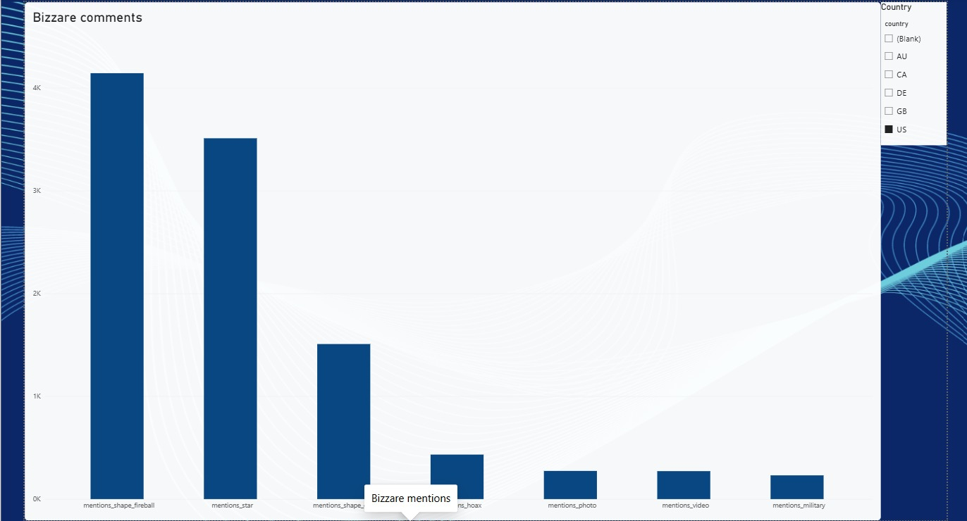
QUESTION 5
Witness comments reveal a self-correcting dataset
Additional keyword counts (80,332 comments)
"star"
4,944
"fireball"
2,986
"NUFORC" (editor notes)
2,593
"plane"
1,912
"meteor"
707
"hoax"
660
"satellite"
520
"video"
437
"photo"
421
"military"
348
Source: Power BI dashboard — mentions of shape/self-debunk terms in comments
Mundane explanations show up constantly in witnesses' own words: “star” and “fireball” each appear in thousands of comments, often as the witness's own guess at what they actually saw.
Only ~1% of comments mention photo or video evidence, and ~3.2% directly reference “NUFORC” — meaning editorial notes are embedded in the witness-text field itself. Treat this as a raw, self-annotating tip log, not a vetted “confirmed UFO” list.
UFO Sightings Analysis | NUFORC Dataset, 1949–2014
9

Slide 10
Summary of Findings
1
Light, triangle, and circle are the most-reported shapes — ambiguity drives “light” to the top (~21% of records)
2
Reported sightings rose 2.7x from 2000-2012, most likely from easier reporting (smartphones, online forms), not more UFOs
3
California and Washington lead US reports — mostly population, but WA over-indexes ~2.5x on local UFO culture
4
Duration data needed real cleaning (3 corrupted rows, 60-min outlier cap) before use; once capped, ~46% of sightings last 5 minutes or less
5
Comments show the dataset self-debunks often ("star", "fireball", "plane") and rarely includes photo/video evidence
Next step: normalize all state comparisons per-capita by default, and apply NLP topic modeling to comments for deeper theme extraction.
UFO Sightings Analysis | NUFORC Dataset, 1949–2014
10

