Slide 1


IBM Project
AI-Powered Movie Recommender
Presented by:
R2142220147 - Rishabh Sharma
R2142221209 - Sunny Jain
R2142221014 - Hardik Raj Kapoor
R2142221369 - Girish.
R2142220628 - Samridh
Mentored By:
Dr. Suvojit Dhara

Slide 2
Content
Introduction
Objectives
Relevant Diagrams
SWOT Analysis
Result
Conclusion

Slide 3
Introduction
Problem Statement: Imagine a movie discovery companion that truly understands you — your moods, your tastes, and those little quirks that make you love certain films. This next-generation recommendation system goes beyond generic lists, offering suggestions that feel handpicked just for you, no matter what kind of story you’re in the mood for.
Motivation: With countless films at our fingertips, choosing the right one can be overwhelming. Hours get lost scrolling through titles, only to settle for something “good enough.” By understanding each person’s unique preferences and emotional state, a smarter recommendation approach can cut through the noise, helping you find the right movie faster — the one that truly fits the moment.
How It Works:
A Brain That Understands Context: Large language models interpret your input — whether it’s a genre you like, a vibe you’re chasing, or how you’re feeling — and match it to films that fit.
Specialized Behind-the-Scenes Processes: Different components handle the heavy lifting, from gathering movie data to building your profile and fine-tuning the suggestion list.
Backend Orchestration: A Python-powered core manages all the moving parts and delivers recommendations smoothly.
Interactive Frontend: A clean, intuitive Streamlit interface lets you explore suggestions effortlessly, dive into details, and discover films you might have never considered.

Slide 4
Introduction
Area of Application:
Entertainment & Streaming – Personalized movie/TV suggestions, mood-based playlists.
Content Discovery – Similar movie suggestions, niche cinema exploration.
Social & Community – Group watch matching, friend-based recommendations, shareable film lists.
Retail & E-commerce – Movie bundles for sale, purchase-based suggestions.
Cinemas & Events – Showtimes matching your taste, festival/event alerts.
Cross-Media – Related books, games, or soundtracks suggestions.

Slide 5
Objective
The AI Movie Recommendation System aims to revolutionize the way users discover and enjoy films by leveraging advanced AI agents and LLM integration. The primary goal is to create a personalized, intuitive, and engaging platform that delivers human-like movie suggestions tailored to individual tastes and moods.
The Key Objectives are:
User-Friendly Interface: Build an interactive Streamlit-based frontend that allows users to easily set preferences, explore recommendations, and receive real-time results.
Highly Personalized Recommendations: Use LLMs as the core “brain” to understand user behavior, context, and mood for precise movie suggestions.
AI Orchestration: Implement specialized LLM to handle data gathering, profile management, and recommendation generation.
Scalable & Reliable Backend: Develop a Python-based workflows and support real-time interaction.
Enhanced Discovery Experience: Help users find hidden gems and new genres while reducing search time through intelligent, dynamic recommendations.

Slide 6
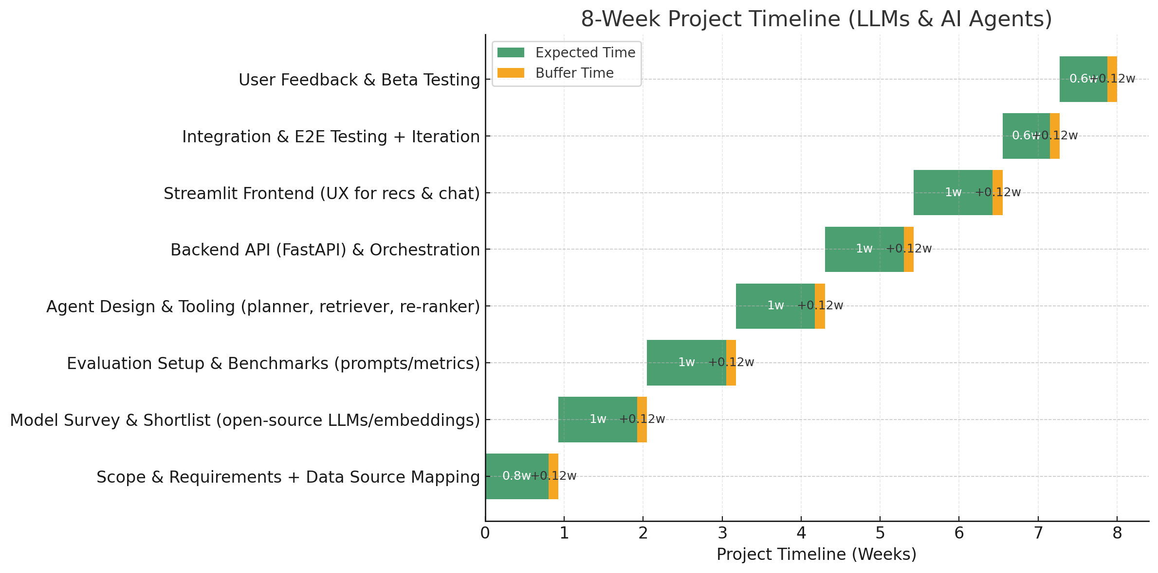
Relevant Diagrams
PERT Chart

Slide 7





SWOT Analysis
STRENGTHS
WEAKNESSES
Personalization: Models adapt to nuanced preferences, moods, and contexts for precise recommendations.
Fast Development: Open-source tools cut training time and costs.
Scalable Design: Backend and smart components integrate easily with new features.
Engagement: Interactive Streamlit interface encourages exploration.
Model Dependency: Reliance on external open-source model updates and performance.
Cost: Running large models in production can be resource-intensive.
Cold Start: New users may get less accurate results without history.
Connectivity: Cloud models need constant internet access.
Data Gaps: Limited access to real-time data and missing API integrations.
S
W
OPPORTUNITIES
THREATS
Partnerships: Work with streaming platforms for direct integration.
Expansion: Extend into TV, music, and books.
Insights: Use anonymized data for trends and targeted suggestions.
Localization: Support multiple languages and cultural contexts.
Competition: Existing services already offer recommendations.
Privacy: Secure data handling is essential to maintain trust.
Bias: Models may inherit unfair patterns from training data.
Tech Shifts: Rapid advances could outdate the current stack quickly.
O
T

Slide 8
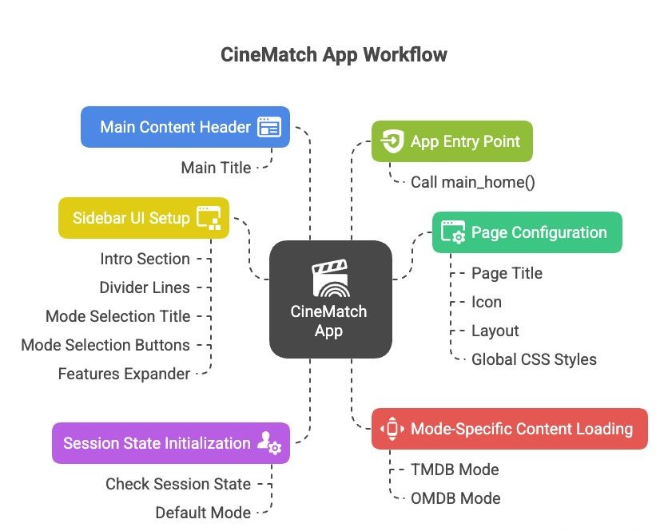
Results

Slide 9
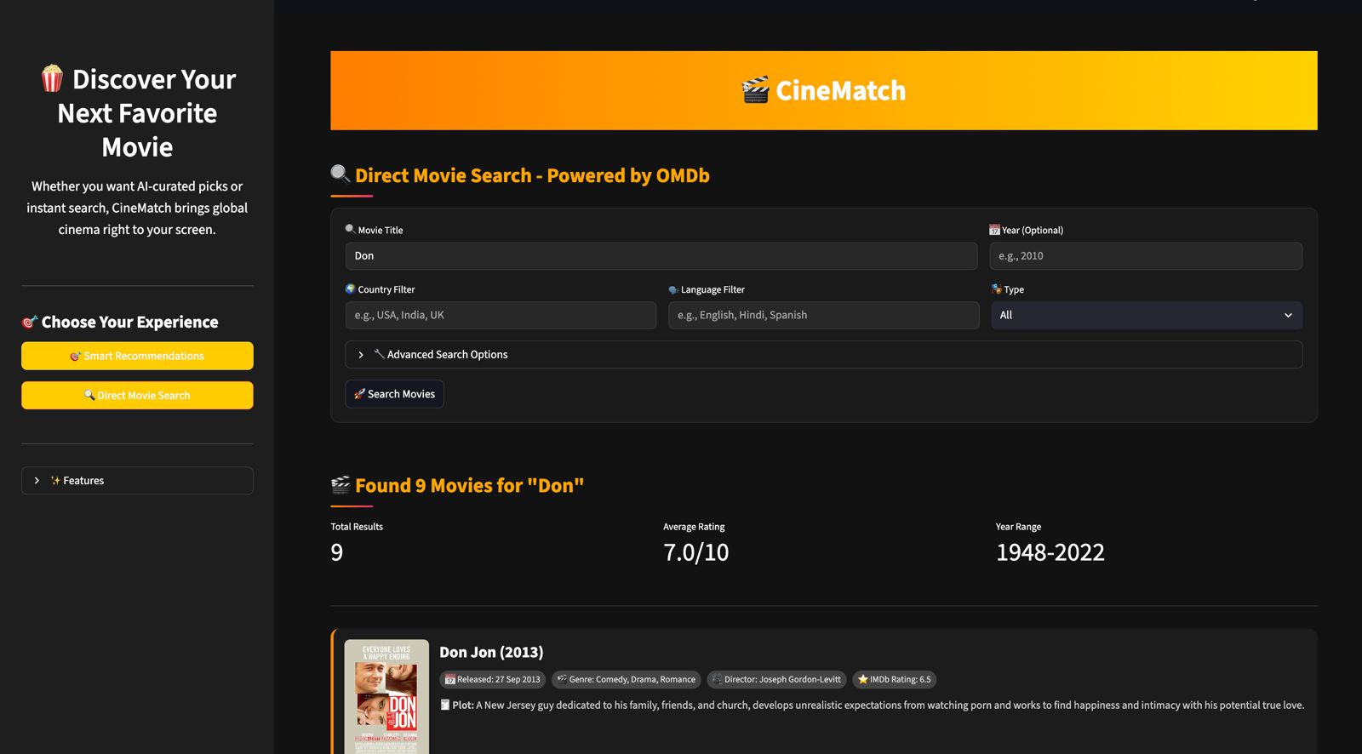
Results

Slide 10
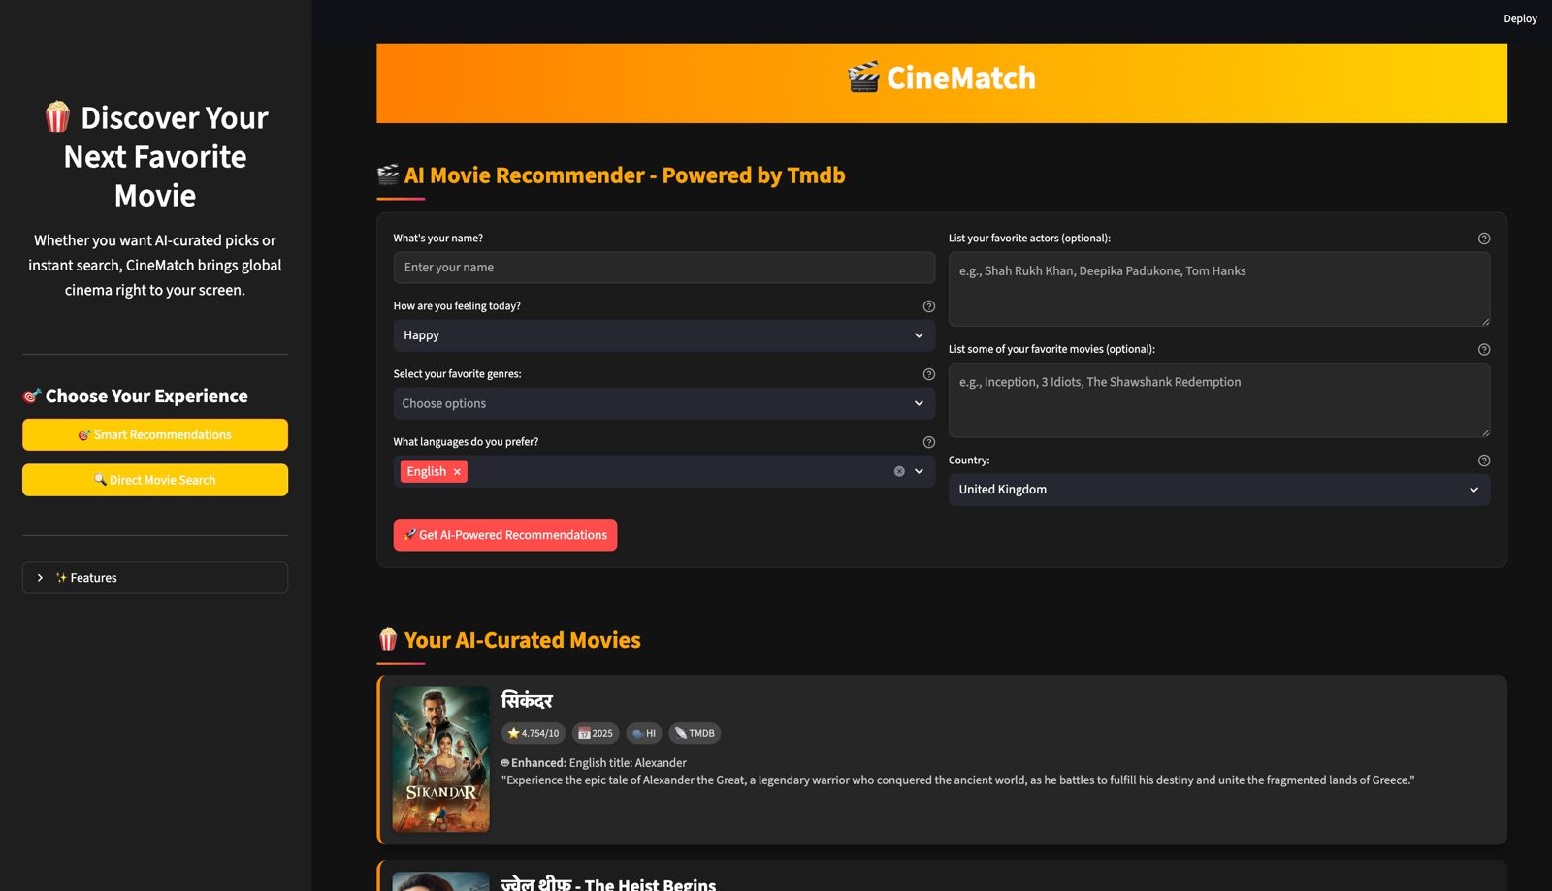
Results

Slide 11
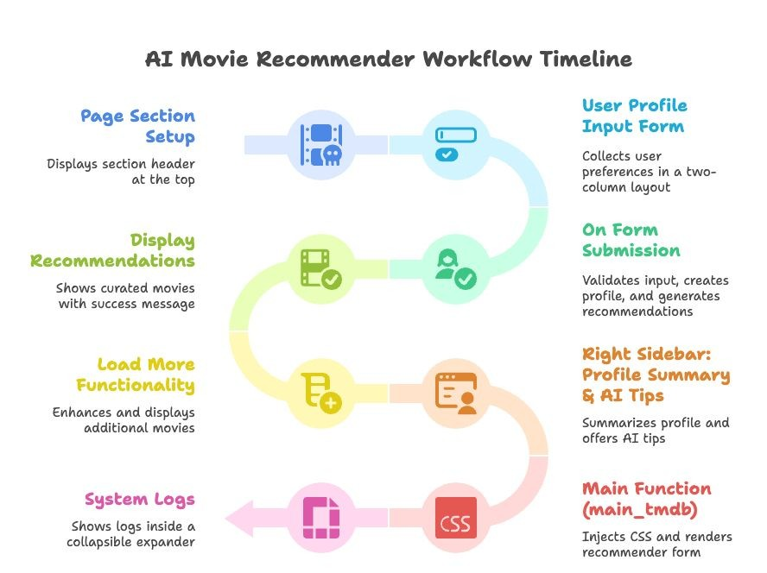
Methodology

Slide 12
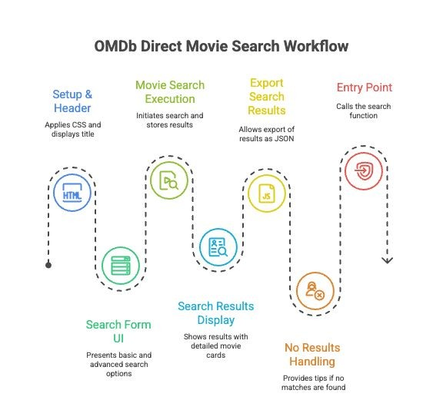
Methodology

Slide 13
Conclusion
The Movie Recommendation System shows how modern technology and large language models can make discovering films more personal, engaging, and efficient. By using open-source models, managing them through a scalable Python backend, and delivering results via an interactive Streamlit interface, the system helps reduce search time and improve user satisfaction. With room for expansion, partnerships, and ongoing improvements, it sets a strong foundation for the future of smart content discovery.
Future Scope:
Multi-Domain Expansion: Extend recommendations to TV shows, music, podcasts, and books.
Voice Interaction: Add voice-based search and recommendations using speech recognition and conversational tools.
Real-Time Context Awareness: Adjust suggestions based on factors like time of day, location, or user activity.
Cross-Platform Integration: Work with streaming services and OTT platforms for seamless in-app suggestions.
Improved Personalization: Use emotion detection and detailed preference tracking for highly tailored results.
Explainable Recommendations: Give users clear reasons for each suggestion to build trust.

Slide 14
Thank You

