Slide 1

MMIC Problem Statement
May 20th, 2021

Slide 2
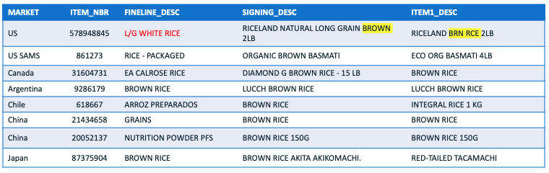
Problem Formulation
Problem Statement
  Walmart is a global company and have millions of items across the markets.
  Within each market have its own item hierarchy.
  For Walmart to operate as a truly International Retailer, there is a need for a homogenous item hierarchy.
  This can help the sourcing partners to understand the economies of scale that have in their global sourcing of products for sale in stores.
  The business objective here is to aggregate each market's sourcing data into a Global Sourcing Perspective.
Sample Data

Slide 3
Item Hierarchy
Column Name | Level
SBU | 0
SP_CLASS | 1
DEPT_DESC | 2
CATG_DESC | 3
SUBCATG_DESC | 4
FINELINE_DESC | 5
SIGNING_DESC ITEM1_DESC ITEM2_DESC UPC_DESC | 6

Slide 4
Data Science Objective & Data
Data Science Objective
  The main objective of this project is to identify the Category/ Subcategory for a given item based on the set of item attributes for the particular item.
Data
  Train and test item data for 'FOOD’ - 'PRODUCE & FLOWERS' is provided in a single consolidated file in the element environment.
  Train Data: If target variable is defined
  Test Data: If target variable is not defined
  Feature Variable(s): FEAT1, which is the combination of Signing, Item1, Item2, UPC, Category, Sub-Category and Fineline descriptions.
  Basic text cleaning of the features such as removal of punctuations, stopwords has already been done.
  Target Variables: REVISED CATEGORY & REVISED VARIETY
Evaluation
  The solution will be evaluated on the basis of the trust factor calculated for predicted varieties.

