Slide 1
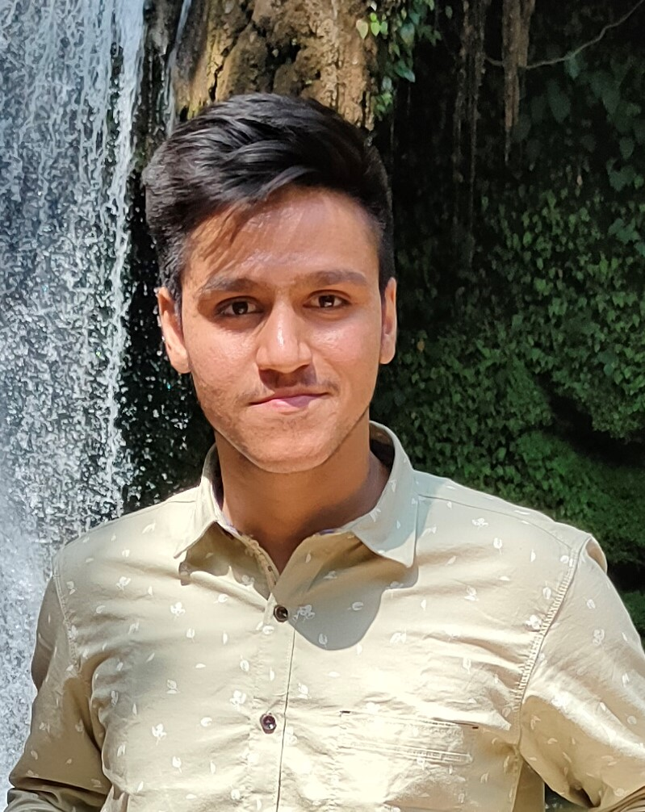
introducing
Rishabh Thapliyal
Summer intern’21
Walmart Global Tech
Rishabh is pursing his B.Tech in Chemical Engineering with a minor in Centre for Machine Intelligence and Data Science from IIT Bombay and is currently in his 3rd year.
Rishabh enjoys working in a team and interacting with people. He was a part of IIT-B Placement Team and is currently a Department Academic Mentor.
He’s very passionate about sports and is currently the captain of IIT-B cricket team. He spend most of his spare time watching series, talking with friends and working out.

