Slide 1

MMIC Problem Statement
Name: Rishabh Thapliyal
Mentor: Syed Faraz Ali & Mallikharjuna MV
Manager: Subhasish Misra
July 21st, 2021

Slide 2
Agenda
Problem Statement
EDA
Text cleaning
Models
Data augmentation
Evaluation metric
Fuzzy matching of feature
Final result

Slide 3
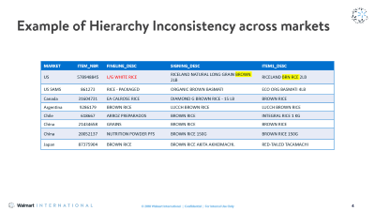
Problem Statement
The business objective here is to aggregate each market's sourcing data into a Global Sourcing Perspective.​
  Walmart is a global company and have millions of items across the markets.​
  Within each market have its own item hierarchy.​
  For Walmart to operate as a truly International Retailer, there is a need for a homogenous item hierarchy.
  This can help the sourcing partners to understand the economies of scale that have in their global sourcing of products for sale in stores. ​
Business Objective
The main objective of this project is to identify the Category/ Subcategory (Variety) for a given item based on the set of item attributes for the particular item.​
Data science Objective
Data snapshot

Slide 4
Example of Hierarchy Inconsistency across markets
MARKET | ITEM_NBR | FINELINE_DESC | SIGNING_DESC | ITEM1_DESC
US | 578948845 | L/G WHITE RICE | RICELAND NATURAL LONG GRAIN BROWN 2LB | RICELAND BRN RCE 2LB
US SAMS | 861273 | RICE - PACKAGED | ORGANIC BROWN BASMATI | ECO ORG BASMATI 4LB
Canada | 31604731 | EA CALROSE RICE | DIAMOND G BROWN RICE - 15 LB | BROWN RICE
Argentina | 9286179 | BROWN RICE | LUCCH BROWN RICE | LUCCH BROWN RICE
Chile | 618667 | ARROZ PREPARADOS | BROWN RICE | INTEGRAL RICE 1 KG
China | 21434658 | GRAINS | BROWN RICE | BROWN RICE
China | 20052137 | NUTRITION POWDER PFS | BROWN RICE 150G | BROWN RICE 150G
Japan | 87375904 | BROWN RICE | BROWN RICE AKITA AKIKOMACHI. | RED-TAILED TACAMACHI

Slide 5













Project Overview
Data Acquisition
Text Cleaning
Data augmentation
EDA
Analytical solution
Evaluation Metric & Final Results
END

Slide 6
Data Acquisition
SBU: Food
SP_CLASS: Produce and Flowers
About Data
Concatenating all the below columns :-
  CATG_DESC, SUBCATG_DESC, FINELINE_DESC, SIGNING_DESC, ITEM1_DESC, ITEM2_DESC, UPC_DESC
Feature column
Target column
Cross category + Cross subcategory (Variety)
FEAT1 | TARGET
UPON FARM GREEN KALE APPLE 3 2PCH OUAF KALE APPL PCH OUAF KALE APPL PCH KALE APPLE YOGURT CHILLED SNACK SNACKING DRINK | SNACKS_SNACKS
AQUA CARROT CELERY STICK 14OZ CARROT CELERY 14OZ DM VEGGIE SNACK CUT FRUIT PACKAGED VA VEG VALUE ADDED CARROT | CUT FRUIT PACKAGED_VA VEG
Example

Slide 7
EDA results
FEAT1 | TARGET
APPLE CHEESE PRETZEL SNACK 4 75 OZ APPLE CHEESE PRETZEL ACP SNACKR 4 75OZ CP APPLE SNACK CUT FRUIT PACKAGED SNACK MEDIUM SNACK | SNACKS_SNACKS
TAIWAN PINE CUT LARGE TIE ONE CUT PINE DIE TAIWAN PINE CUT L CUT FRUIT 712 CUTFUL TSU 712 CUTFUL TSU CUT FRUIT | NaN
TRAIN DATA
Train-Test split
TEST DATA
Parameter | Train data | Test data
Country wise | 99.8% from US | 65% from CN
Mean Word count | 16.7 | 17.3
Mean Char count | 80.6 | 90.8
Mean word length | 4.92 | 5.26
Jaccard similarity: 11.57%
Cosine similarity: 33.73%
Comparison
There are 32 classes with <= 5 training samples.
AVOCADOES_AVOCADOES 1176
BLUEBERRIES_BLUEBERRIES 975
CITRUS_ORANGES - OTHER 938
FEAT1 is almost of same length.
Train and test data are highly dissimilar.
There is class imbalance in our train data.
Insights from EDA

Slide 8
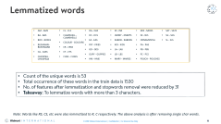
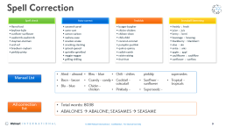
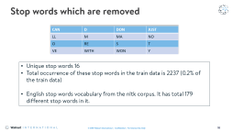
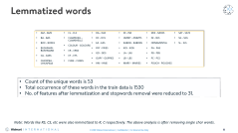
Pre-processing of feature
Removing numbers and special characters
Removing stopwords
Lemmatization
Spell correction
Remove < 3 char words
Remove noise words
Examples
SNACK 4 75OZ → SNACK OZ
#2 BANANAS → BANANAS
Examples
CA
BR
ES
IN
Total words in the list: 56
Examples
Dot com
Null
Discount

Slide 9
Spell Correction
Spell check
flavrd-lord
Auto-correct
caramel-cartel
Textblob
burger-burgher
Snowball Stemming
keylime-kylie
sunflwer-sunflower
caulicrmb-caulicrmb
stayman-starman
xref-ref
braeburn-rayburn
pinkldy-pinky
freshly : fresh
juice : juic
berry : berri
beverage : beverag
blackberry : blackberri
aloe : alo
anise : anis
apple : appl
cauliflower : cauliflow
sunflower : sunflow
cartn-cart
carton-carbon
cashew-case
snacker-snake
snacking-stacking
spiced-spaced
sprinkle-sprinkled
veggie-reggae
grilling-drilling
chickn-chicken
chilean-clean
chili-child
coconut-coronet
pumpkin-pushkin
quince-quincy
radish-ravish
raisin-raising
thai-that
Almd – almond
Bacn – bacon
Blu – blue
Bleu – blue
Ccandy – candy
Chickn – chicken
Chili – chilies
Cocktail – cokcatail
Pinklady – pinkldy
Sunflwer – sunflower
Superseedz – supersedes
Tropical – tropicals
Manual List
All correction list
Total words: 8038
ABALONES → ABALONE; SEASAMES → SEASAME

Slide 10
Stop words which are removed
CAN | D | DON | JUST
LL | M | MA | NO
O | RE | S | T
VE | WITH | WON | Y
Unique stop words 16
Total occurrence of these stop words in the train data is 2237 (0.2% of the train data)
English stop words vocabulary from the nltk corpus. It has total 179 different stop words in it.

Slide 11
Lemmatized words
AM - AMS
BA - BAS
BOX - BOXES
BUSHMAN - BUSHMANS
CA - CASS
CHICKPEA - CHICKPEAS
CL - CLS
CLAMSHELL - CLAMSHELLS
COLOUR - COLOURS
CR - CRSS
CT - CTS
CUKE - CUKES
DA - DAS
DC - DCS
EA - EAS
FRY - FRIES
GD - GDS
GUPY - GUPPIES
HM - HMS
IN - INS
JIMMY - JIMMYS
KABOB - KABOBS
KID - KIDS
LA - LAS
LB - LBS
MARY - MARIES
MIX - MIXES
NJ - NJS
ORNAMENTAL
PA - PAS
PB - PBS
PC - PCS
POUCH - POUCHES
SAT - SATS
SG - SGS
SL - SLS
Count of the unique words is 53
Total occurrence of these words in the train data is 1530
No. of features after lemmatization and stopwords removal were reduced by 31
Takeaway: To lemmatize words with more than 3 characters.
Note: Words like RS, CS, etc were also lemmatized to R, C respectively. The above analysis is after removing single char words.

Slide 12
Modelling using multiple metrics
Feature engineering
Using TF-IDF vectorizer with min document frequency (min_df) equal to 1 initially and later it is changed to optimal value of 10. Default L2 normalization is used.
S.No | Model | Accuracy | Precision (Micro) | Recall (Micro) | Accuracy after hyperparameter tuning
1. | Random Forest | 0.98900 | 0.98900 | 0.98900 | 98.917
2. | SVM | 0.98100 | 0.98100 | 0.98100 | 98.489
3. | Logistic Regression | 0.97743 | 0.97743 | 0.97743 | 98.908
4. | KNN | 0.96050 | 0.96050 | 0.96050 | X
5. | Multinomial Naïve Bayes | 0.79816 | 0.79816 | 0.79816 | X
Traditional ML models
CONDITIONS
RESULTS
5-fold cross validation performed
There are total 533 classes
I will go ahead with Random Forest and Logistic Regression and will leave SVM as it’s computation time is high.

Slide 13
Voting Classifier
ML model based on ensemble learning.
Hard voting: The predicted output class is a class with the highest majority of votes.
  Classifier 1 = class B
  Classifier 2 = class A
  Classifier 3 = class B
Soft voting: In soft voting, the output class is the prediction based on the average of probability given to that class.
  Class A = (0.30, 0.47, 0.53) and Class B = (0.20, 0.32, 0.40)
I’m using an ensemble of Random Forest and Logistic regression.
Predicted class: Class B
Predicted class: Class A
Model | CV score
RF+LR (hard) | 98.46
RF+LR (soft) | 98.39

Slide 14


FastText
It is an open-source, free, lightweight library created by the Facebook for efficient learning of word representations and sentence classification.
Has few advantages over Word2Vec and GloVe.
  It can give the vector representations for the words not present in the dictionary. Eg- “stupedofanctabulouslyfantasti”
  It is extremely fast.
Cons:-
  Predictions are not consistent.
Model | Validation score
Model 1 | 93.75
Model 2* | 98.92
*after hyperparameter tuning
To know more

Slide 15
Data Augmentation
Method
Snorkel models the data augmentation process by applying user-defined transformation functions (TFs) in sequence
Randomly choose a word in the sentence and look for its synonym in “Wordnet”/Walmart synonyms list. If found, then replace it otherwise return nothing.
Example:
Original: ENERGY ACAI BERRY JUICE SAM ENERGY JUICE PREMIUM BEVERAGE SUPER PREMIUM BEVERAGE NAKED BOLTHOUSE
Augmented: ENERGY ACAI BERRY JUICE SAM ENERGY JUICE PREMIUM POTABLE SUPER PREMIUM BEVERAGE NAKED BOLTHOUSE
Few errors with Wordnet- SAM: surface-to-air missile, Premium: Insurance Premium
Simple Wordnet/
Simple Walmart
Set the ratio of verb, noun and adjectives.
If transformation function for verb is applied, then it will find all the verbs in the sentence, and randomly select any of them to look for synonym.
If the chosen verb is present in our Walmart list, then it is replaced with anyone of its synonyms, else if the verb is not present then return nothing.
Example: Washing → Cleaning, Scrubbing, Laundry
Complex Walmart

Slide 16
Augmented Train data
Data | Length | Jaccard similarity | Cossine similarity
Train_df original | 50248 | 9.77 | 34.31
Augmented(n_per_original=2) | 69842 | 10.26 | 35.24
Augmented(n_per_original=3) | 79972 | 10.33 | 35.39
Augmented(n_per_original=5) | 99056 | 10.41 | 35.55
Augmented(n_per_original=10) | 148432 | 10.53 | 35.3
Augmented(n_per_original=2) | 69937 | 10.32 | 35.28
I will choose to add 2 new entries per observation because there is a trade off between similarity and computation time.

Slide 17
Fuzzy score & Trust factor
Target Column
Note: I’ll use Partial token set ratio to calculate the fuzzy score.
Example:
str1 = "CHOCOLATE CHOCOLATE BRANDS MID TIER"
str2 = "brands; chocolate"
Fuzz.partial_token_set_ratio = 100
Category
Variety
If Fuzzy score > =80
Else
If Fuzzy score >= 80
Else
Trust factor = 1
Trust factor = 0
Trust factor = 1
Trust factor = 0
Trust factor Category
Trust factor Variety

Slide 18
Fuzzy TF-IDF matching of FEAT1
Example :-
Data | FEAT1 | Ratio | Category | Variety
Test | CUSTOMER ORDERED PROGRAM COP LEATHER LEAF CUSTOMER ORDER PROGRAM FLORAL MISC FLORAL CUSTOMER ORDER PROGRAM | 72 | CONSUMER BUNCHES | CONSUMER BUNCHES
Train | CUSTOMER ORDERED PROGRAM COP HYDRG BLUE CUSTOMER ORDER PROGRAM FLORAL CONSUMER BUNCH SHOPPER BUNCH EVERYDAY CUSTOMER ORDER
Deciding on the ratio-
Ratio | Observations matched | TF category | TF variety
>=90 | 699 | 96.85 | 95.85
>=80 | 8453 | 97.27 | 98.37
>=70 | 32521 | 94.75 | 96.54
>=60 | 109061 | 89.68 | 91.24
>=50 | 223808 | 81.69 | 82.99
For fuzzy Tfidf match-
  Partial = False
  Ratio = sort
For Trust factor-
  Partial token set ratio
I’ll take my ratio as greater than and equal to 70 as I want more & more no. of observations to match and at the same time want to ensure high trust factors for category and variety.

Slide 19
Final Results
w/o Data augmentation
after Data augmentation
Data augmentation & Fuzzy
Model | TF category | TF variety | TF category | TF variety | TF category | TF variety
FastText | 68.95 | 70.13 | 63.05 | 71.86 | 63.58 | 72.31
RF+LR (hard) | 64.02 | 79.61 | 69.29 | 79.88 | 69.82 | 80.08
LR | 66.12 | 76.57 | 68.96 | 82.20 | 69.92 | 82.46
Data augmentation gives a good boost to TF category and TF variety.
There is just (0.4-0.8)% increase in trust factor after using fuzzy tfidf match of FEAT1. Also, it affects TF category more as compared to TF variety.
Final score: 86% Trust factor using current MMIC trust factor calculation method. The present model which is in use gives 85% Trust factor. Hence, I’m able to improve the performance by 1%.

Slide 20
THANK YOU!

Slide 21
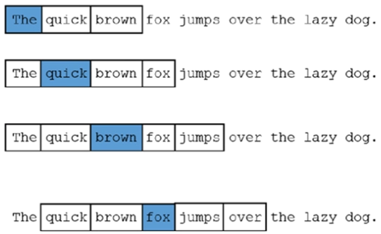
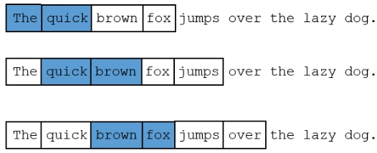
FastText - I
WordNGrams and ws
wordNgrams = 1
ws = 2
wordNgrams = 2
ws = 1

Slide 22
FastText - II
Minn and Maxn
Sentence
I love ML
Parameters
Minn = 2 and Maxn = 3
Transformed to
[<I, <I>, l>], [<l, <lo, lo, lov, ov, ove, ve, ve>, e>],[<M, ML, L>]
For the word love, its fasttext embedding = (emb(love) (as a complete word) + emb(<l)+emb(<lo)+....) / n
The embedding of the sentence will be the average of the embeddings of individual tokens.
FastText word vectors are built from vectors of substrings of characters contained in it. This allows to build vectors even for misspelled words or concatenation of words.
Example: ‘stupedofanctabulouslyfantastic’

