Slide 1

Review meet- 2
June 4th, 2021
Name: Rishabh Thapliyal
Mentor: Syed Faraz Ali & Mallikharjuna MV
Manager: Subhasish Misra

Slide 2
Review Meet – 2
June 4th,2021
Agenda
Brief of previous meet
This week’s progress
Way forward

Slide 3
Recap
Initial EDA
Train/Test ratio
Max FEAT1 length
Data pre-processing
Creating Target column
Train/Test split
Removed classes with count < 5
Fitting ML models
Multinomial NB
Random forest
Logistic Regression
KNN
Hyperparameter tuning for RF
N_estimators= 150
Class_weight = balanced
Vectorizer = CountVectorizer
Min_df = 10
Accuracy = 0.9899
SVM

Slide 4
This week’s progress
Tried to perform an exhaustive EDA
Comparison of Text and Train data
Data cleaning
Modelling using multiple metrics
Feature importance for Random forest
Coefficients for Logistic Regression
Hyperparameter tuning

Slide 5
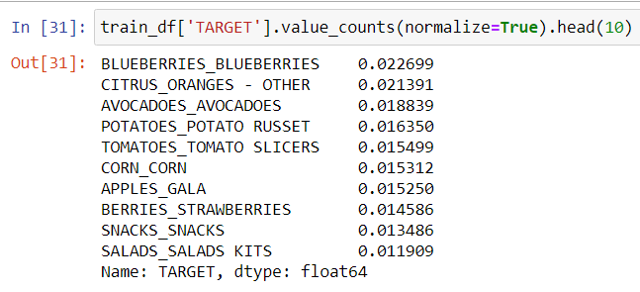
EDA results
Country
FEAT1
Target
Train data
Train data
Mean word count is 16.7
Mean character count is 80.6
Mean avg word length is 4.92
Correlation b/w word count and char count is 0.54
Test data
Mean word count is 17.3
Mean character count is 90.8
Mean avg word length is 5.26
Correlation b/w word count and char count is 0.84
Test data
65% of the test data is from CN, 10% from CA, 6% from JP.
99.8% of the training data is from US.

Slide 6
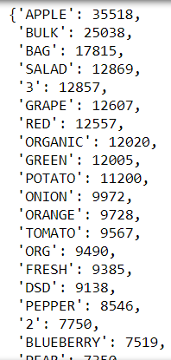
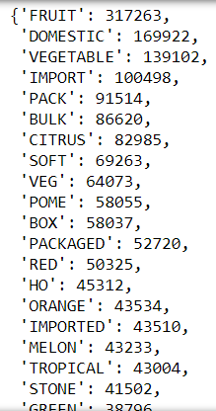
Comparison of test and train data
Jaccard similarity: 11.57%
Cosine similarity: 33.73%
No. of common words: 3221
No. of words in the union: 27834
No. of words NOT in TRAIN set but in TEST set: 2659
No. of words NOT in TEST set but in TRAIN set: 21954
Frequency of top 20 words in TRAIN set
Frequency of top 20 words in TEST set

Slide 7
Data cleaning
Stop words
Lemmatization
Single character words
Total occurrence of stop words is around 2000, which accounts to 0.2% of the total words in the train data.
Total occurrence of words which are lemmatized is 1530. The unique count of words is 53.
Around 3000 single character words (like C, N, K, etc) were removed.

Slide 8
Modelling using multiple metrics
S.No | Model | Accuracy | Precision (Micro) | Recall (Micro) | Time taken (secs)
1. | Random Forest | 0.98900 | 0.98900 | 0.98900 | 275.87
2. | SVM | 0.98
3. | Logistic Regression | 0.97743 | 0.97743 | 0.97743 | 629.61
4. | KNN | 0.96050 | 0.96050 | 0.96050 | 41.69
5. | Multinomial Naïve Bayes | 0.79816 | 0.79816 | 0.79816 | 9.65
CONDITIONS
RESULTS
Total classes = 533
5-fold cross validation performed
Class_weight = balanced used for RF and LR
Tfidf vectorizer used for all with min_df = 1 (default)
Same accuracy, precision and recall score
RF score increased from 0.98 to 0.99

Slide 9
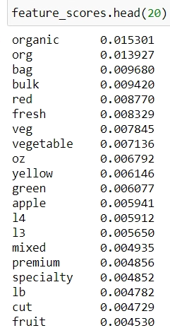
Random forest
FEATURE IMPORTANCE
Tfidf vectorizer (min_df= 1)
Random forest with class weight as balanced
HYPERPARAMETER TUNING
N_estimators = 120
Class_weight = balanced
Tfidf vectorizer (mind_df = 10)
Accuracy = 0.98917
With n_estimators = 150, memory out of space error

Slide 10
Logistic regression
Top 5 features
Hyperparameter tuning
Feature | Coeff Value | Absolute value
aloe | 6.024688 | 6.024688
vera | 5.687455 | 5.687455
tropicals | 1.569965 | 1.569965
juice | -1.503277 | 1.503277
12ct | 1.154497 | 1.154497
C= 215.4464
Penalty = l1
class_weight= None
solver= ‘saga’
Tfidf vectorizer (min_df= 10)
Accuracy = 0.98908
Default LR parameters with balanced class weights.
Default Tfidf vectorizer.
Where as L2 performed best with ‘newton-cg’ solver and C=46415.888.
Accuracy was 0.98722

Slide 11
SVM
Hyperparameter tuning
Class_weight = balanced
Kernel = linear
Count vectorizer (min_df = 10)
Accuracy = 0.98489

Slide 12
Tasks for the next week (3rd week)
Modularize the jupyter notebook.
Clean the test data as well.
Find the list of all the stop words and lemmatized words
Formulate the function for Trust factor.
Test the performance on the test data.
Fuzzy score
Find the difference in two distributions
KL divergence

